Slide 1
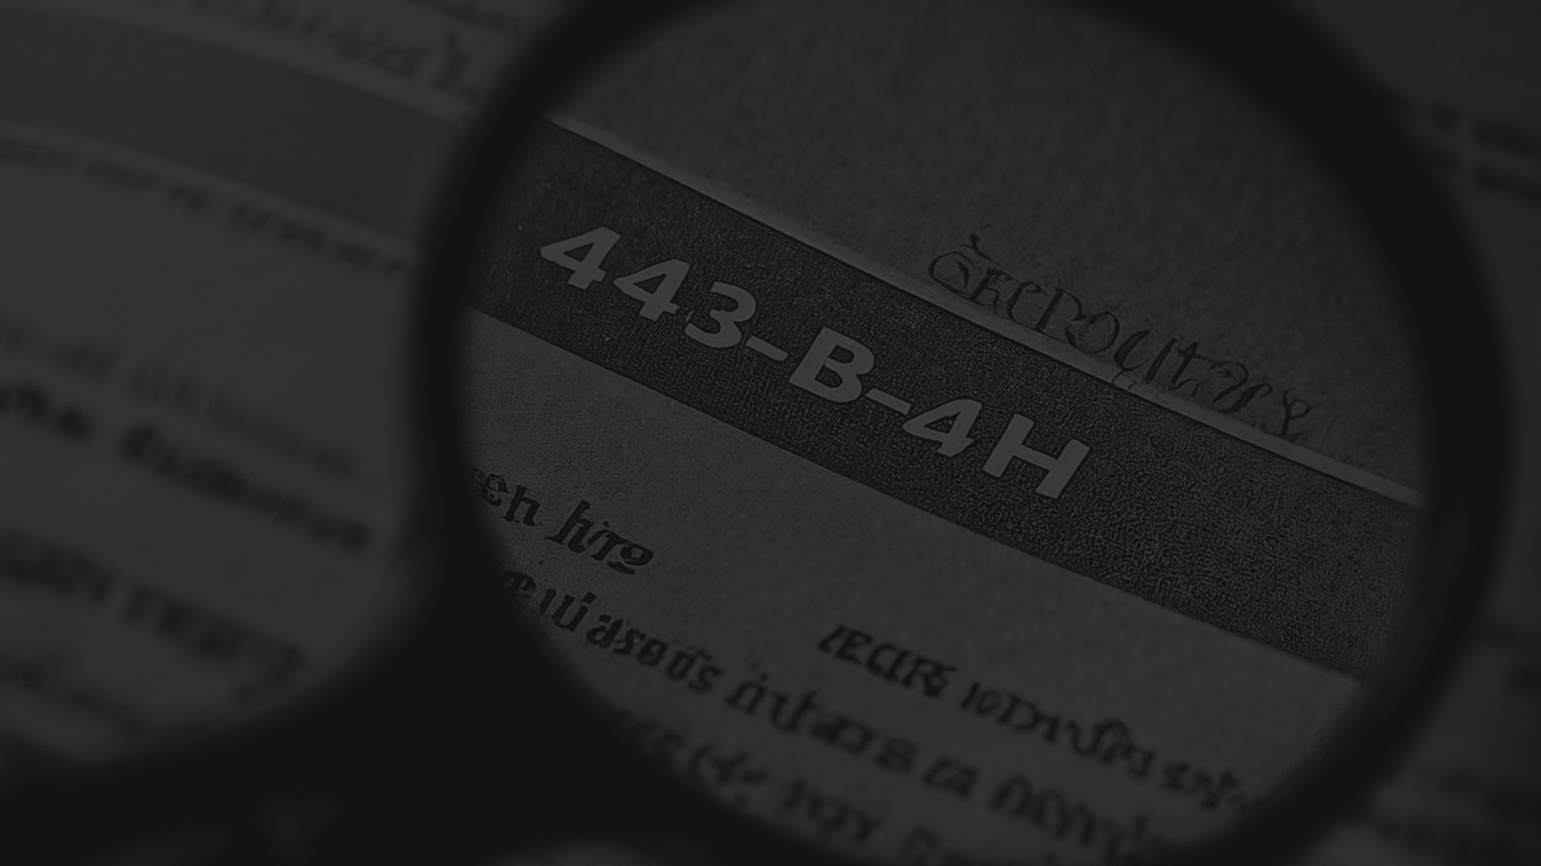

Amendments to Section 43B(h) of the Indian Income Tax Act, 1961
The Indian government has introduced amendments to Section 43B(h) of the Income Tax Act, 1961 to promote timely payments to micro and small enterprises (MSEs). This document provides a detailed analysis of the new provisions, including the applicable timelines, the impact on businesses, and relevant examples to illustrate the changes.
by PHANINDHRA KOTHA

Slide 2

Background
Micro, Small and Medium Enterprises (MSMEs) play a significant role in the growth of the Indian economy. To support the MSME sector, the Indian government has introduced amendments through the Finance Act 2023 to promote timely payments to micro and small enterprises (MSEs).
The amendments to Section 43B of the Income Tax Act, 1961 aim to ensure that businesses make payments to MSEs within the timelines specified in the Micro, Small and Medium Enterprises Development Act, 2006 (MSMED Act).

Slide 3
Key Provisions of Section 43B(h)
1
Applicability
2
Covered Entities
The provisions of Section 43B(h) are applicable from Assessment Year 2024-25, i.e., Financial Year 2023-24 onwards.
Section 43B(h) applies to payments made by businesses to registered micro and small enterprises (MSEs) under the MSMED Act. Medium enterprises and unregistered micro and small enterprises are not covered under this provision.
3
Payment Timelines
4
Deduction Allowance
Businesses are required to pay MSEs within 45 days of the delivery of goods or rendering of services, as per the MSMED Act. In the absence of a written agreement, the payment should be made within 15 days.
If the payment is made within the timelines specified in the MSMED Act, the deduction is allowed in the year the expenditure is booked. If the payment is delayed, the deduction is allowed only in the year the actual payment is made.

Slide 4

Illustrative Examples
1
No Written Agreement
If there is no written agreement, and the payment is made within 15 days, the deduction is allowed in the financial year the expenses are accounted for. If the payment is made after 15 days, the deduction is allowed in the financial year the actual payment is made.
2
Written Agreement
If there is a written agreement stipulating payment within 45 days or less, and the payment is made beyond the agreed date, the deduction is allowed in the financial year the actual payment is made.
3
Payment Before Due Date
If the payment is made on or before the due date as per the MSMED Act, the deduction is allowed in the financial year the expenses are accounted for.

Slide 5
Disallowance under Section 43B(h)
Payable Sum
Timing of Deduction
Any sum payable by the assessee (buyer) to a micro or small enterprise (MSE) registered under the MSMED Act, beyond the time limit specified in Section 15 of the MSMED Act, shall be disallowed as a deduction.
The deduction for the payable sum will be allowed only in the financial year in which the actual payment is made, and not in the year the expenditure is booked.
Exceptions
Disputes and Advance Payments
The provisions of Section 43B(h) do not apply to medium enterprises, MSMEs engaged in trading activities, and unregistered micro and small enterprises.
Disputed payments cannot be considered as "payable" until the dispute is resolved. Advance payments to MSEs will be allowed as a deduction in the year of payment, even if they do not fall due in that year.

Slide 6
Definitions and Thresholds
MSE Definitions
Exclusions
Turnover Threshold
Micro Enterprise: Net investment in plant and machinery or equipment ≤ Rs. 1 crore and net turnover ≤ Rs. 5 crores.
Medium Enterprises, even if registered under the MSMED Act, are not covered by Section 43B(h).
Purchases from manufacturers with a turnover above Rs. 50 crores are not subject to the provisions of Section 43B(h).
MSMEs engaged in trading activities are also excluded from the purview of Section 43B(h).
Small Enterprise: Net investment in plant and machinery or equipment ≤ Rs. 10 crore and net turnover ≤ Rs. 50 crores.

Slide 7



Payment Timelines under the MSMED Act
Written Agreement
No Written Agreement
Day of Acceptance
The "day of acceptance" is the actual delivery of goods or rendering of services, unless the buyer raises a written objection within 15 days, in which case it is the day the supplier removes the objection.
If there is a written agreement between the buyer and the supplier, the payment must be made on or before the agreed date, not exceeding 45 days from the date of supply of goods or rendering of services.
In the absence of a written agreement, the payment must be made within 15 days of the supply of goods or rendering of services.

Slide 8



Disallowance under Section 43B(h)
Disallowance Calculation
Timing of Disallowance and Deduction
Exceptions
Medium enterprises, MSMEs engaged in trading activities, and unregistered micro and small enterprises are not subject to the provisions of Section 43B(h).
If the payment to an MSE is made beyond the timelines specified in the MSMED Act, the unpaid amount will be disallowed as a deduction under Section 43B(h) in the year of booking. The deduction will be allowed only in the year the actual payment is made.
The disallowance under Section 43B(h) applies from Assessment Year 2024-25 (Financial Year 2023-24) onwards. Any outstanding amount as of March 31, 2023, if paid after the due date, will not be subject to this disallowance.

Slide 9




Reporting Requirements
ITR Forms
Audit Forms
Tax Implications
Potential Disputes
The disallowance under Section 43B(h) needs to be reported in ITR 3, ITR 5, and ITR 6 under the "Other Information" section.
The new Forms 3CB and 3CE, as well as clause 26 of Form 3CD, are yet to be notified to incorporate the changes related to Section 43B(h).
The disallowance under Section 43B(h) may lead to increased tax liability for businesses that do not make timely payments to MSEs.
The Revenue may argue that the provisions of Section 43B(h) should be interpreted literally, leading to potential disputes with businesses.

Slide 10
Conclusion
Key Takeaways
Exceptions and Clarifications
The amendments to Section 43B(h) aim to promote timely payments to MSEs, with deductions allowed only when payments are made within the timelines specified in the MSMED Act. Businesses need to be aware of the new requirements and plan their payment processes accordingly.
Medium enterprises, MSMEs engaged in trading activities, and unregistered micro and small enterprises are not covered by Section 43B(h). Further clarifications from the CBDT may be needed to address potential disputes regarding the interpretation of the new provisions.
Compliance Considerations
Impact on Businesses
Businesses should review their payment processes and ensure compliance with the MSMED Act to avoid disallowance of deductions under Section 43B(h). Proper reporting in the relevant tax forms is also crucial.
The amendments to Section 43B(h) may have a significant impact on businesses, particularly those with a large number of MSE suppliers. Timely payments and proper documentation will be essential to minimize the tax implications.

Slide 11
About Sri Gayathri taxes & Accounting solutions
Our Firm
Our Expertise
Our Offices
Sri Gayathri Taxes & Accounting solutions is a Professional Services Firm that provides a range of services, including Tax consulting, GST Registration and return rlated, Firm and company Incorporation and other MCA related and direct and indirect taxation services.
Each of our partners is specialized in different service areas, allowing us to provide comprehensive solutions to our clients. Our vast experience and exposure to various industries have made us adaptable to the changing needs of the time and technology.
Sri Gayathri Taxes and Accounting solutions office in Hyderabad, allowing us to serve clients across India.
Our firm was started in 2020 in Hyderabad with the ambition to provide high-quality services in the field of accountancy and audit. Over the years, we have expanded our services and presence across India to become a "One Stop Solutions" provider for our clients.
We continuously strive to improve our services to meet the growing expectations of our esteemed customers.

Slide 12


Contact Us
Email
Ramnagar
Sri.vas405@ gmail. com
Hyderabad, Ramnagar gundu, bised cost to cost
Phone
+91 7207585181, 9666478323

Slide 13

Disclaimer
The information in this publication is intended to provide only a general outline of the subjects covered. It should neither be regarded as comprehensive nor sufficient for making decisions, nor should it be used in place of professional advice. Sri Gayathri Taxes & Accounting solutions accepts no responsibility for any loss arising from any action taken or not taken by anyone using this material.

