Slide 1
Complications caused by cash transactions in income tax

Slide 2
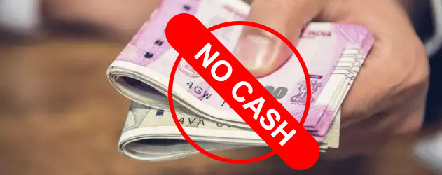
Government wants that people use banking system and in the same direction some new provisions added in the Finance Act, 2017 to prevent black money.
We will discuss all the provisions related to cash transactions, exceptions of the same and consequences of them as well.
Taking or Accepting Certain Loans & Deposits
Repayment of Certain Loans & Deposits
Transactions in Cash
Expenditure Incurred in Cash
Capital Expenditure in Cash
Donation in Cash
Premium on Health Insurance
TDS in case of Cash withdrawal

Slide 3
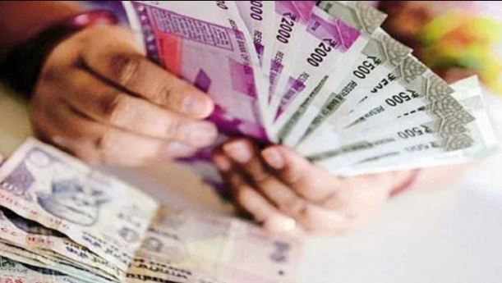
1. Taking or Accepting Certain Loans & Deposits
Section 269SS of the Act provides that no person shall take or accept Rs. 20,000 or more in cash
For any loan or deposit, or
Any amount in relation to transfer of any immovable property (even if transfer does not take place)
If any cash received from a person for any such purpose is still outstanding to be repaid, then the overall limit of Rs. 20,000/- will apply to the outstanding amount plus any subsequent receipt in cash.

Slide 4
Exceptions to this provision include the following:
Sum of this nature accepted or taken from
Government ;
any banking company, post office savings bank or co-operative bank ;
any corporation established by a central, state or provincial Act ;
any Government company as defined in clause (45) of section 2 of the Companies Act,2013 ;
(e) such other institution, association or body or class of institutions, associations or bodies which the Central Government may, by notification in the Official Gazette, specify.
(f) from a person having agriculture income, and the recipient is also having agriculture income and neither of them is chargeable to income tax.
Consequences of violation :
As per section 271D, a penalty of an amount equal to the amount taken or accepted in cash will be levied.

Slide 5
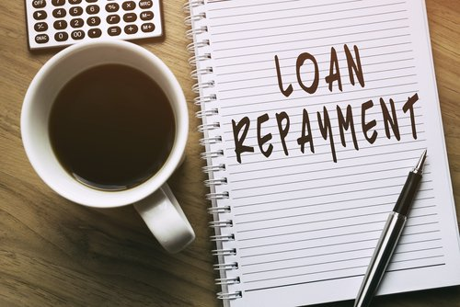
2. Repayment of Certain Loans & Deposits
Section 269T : Any branch of a banking company or a co-operative bank, co-operative society, firm, other company or other person is not allowed to repay any loan or deposit in cash if
the amount of the loan or deposit, or
any amount in relation to transfer of immovable property (even if transfer does not take place) together with the interest, if any, is Rs.20,000/- or more, or
The aggregate amount of loans or deposits or specified advance held by such person, either in his own name or jointly with other person on the date of such repayment together with the interest, if any, is Rs.20,000/- or more.
to any person who has made
the loan or deposit
b) paid the amount in relation to transfer of immovable property

Slide 6
Exceptions to this provision include the following:
Repayment of any loan or deposit taken or accepted from
Government ;
any banking company, post office savings bank or co-operative bank ;
any corporation established by a central, state or provincial Act ;
any Government company as defined in clause (45) of section 2 of the Companies Act,2013 ;
(e) such other institution, association or body or class of institutions, associations or bodies which the Central Government may, by notification in the Official Gazette, specify.
Consequences of violation :
As per section 271E, a penalty of an amount equal to the amount of loan or deposit repaid in cash will be levied.

Slide 7
3. Transactions in Cash
Section 269ST: No person is allowed to receive in cash an amount of Rs. 2,00,000 or more
in aggregate from a person in a day; or
in respect of a single transaction; or
(c) in respect of transactions relating to one event or occasion from a person,
Exceptions to this provision include the following:
any receipt by –
Government
any banking company, post office savings bank or co-operative bank;
transactions of the nature referred to in section 269SS;
such other persons or class of persons or receipts, which the Central Government may, by notification in the Official Gazette, specify.

Slide 8
Consequences of violation of Section 269ST:
As per section 271DA, a penalty of an amount equal to the amount of such receipt will be levied.
Example: X sells goods on credit to Y on 14.08.2021(vide invoice no. 2021-22/104), amount of Rs. 10,42,000. Payment is made by Y as follows:
Payment of Rs. 1,45,000 in cash on 16.08.2021.
Payment of Rs. 8,00,000 by RTGS on 20.08.2021
Payment of Rs. 97,000 in cash on 22.08.2021
What are the tax consequences of aforesaid payments?
Answer: Payment received in cash Rs. 2,42,000. it is covered by section 269ST.
The assessing officer can impose 100% of Rs. 2,42,000 as penalty under section 271DA

Slide 9
4. Expenditure in Cash
Section 40A(3) : Any expenditure in respect of which payment or aggregate of payments in excess of Rs. 10,000 is made in cash, 100% of such expenditure will be disallowed.
However, where the payment is made to the transporters for plying, hiring or leasing goods carriages, the limit of amount is Rs. 35,000.
Rule 6DD prescribes the following circumstances under which no disallowances will be made of the expenditure even if payment exceeding Rs. 10,000 in cash.
Payment is made to -
Reserve bank of India or any banking company
State Bank of India or any subsidiary bank
Co-operative bank or land mortgage bank
Any primary agricultural credit society or any primary credit society.
LIC of India

Slide 10
2. Payment made to government or to legal tender as per the rules framed by government.
3. Payment is made by –
any letter of credit arrangement through bank
a mail or telegraphic transfer through bank
a book adjustment from one bank account to another account whether in same bank or different bank
Bill of exchange made payable only to bank
4. Payment is made for adjustment against liability incurred by the payee for goods supplied or services rendered by the assessee.
5. Payment is made for purchase of –
(i) agricultural or forest produce; or.
(ii) the produce of animal husbandry or dairy or poultry farming; or
(iii) fish or fish products; or
(iv) the products of horticulture or apiculture,
to the cultivator, grower or producer of such articles produce or products.

Slide 11
6. Where the payment is made for the purchase of the products manufactured or processed without the aid of power in a cottage industry, to the producer of such products
7. Where the payment is made in a village or town, which on the date of such payment is not served by any bank, to any person who ordinarily resides, or is carrying on any business, profession or vocation, in any such village or town
8. where any payment is made to an employee of the assessee or the heir of any such employee on or connection with the retirement retrenchment resignation, discharge or death of such employee, on account of gratuity, retrenchment compensation or similar terminal benefit and the aggregate of such sums payable to the employee or his heir does not exceed fifty Thousand rupees
9. where the payment is made by an assessee by way of salary to his employee after deducting the income-tax from salary in accordance with the provisions of section 192 of the Act, and when such employee—
is temporarily posted for a continuous period of fifteen days or more in a place other than his normal place of duty or on a ship; and
(ii) does not maintain any account in any bank at such place or ship;

Slide 12
10. Where the payment is made by any person to his agent who is required to make payment in cash for goods or services on behalf of such person
11. Where the payment is made by an authorised dealer or a money changer against purchase of foreign currency or travelers cheques in the normal course of his business.
Scope of Section 40A(3)
If the aggregate payment to the same person during a day exceeds Rs. 10,000 in cash, the provision of section 40A(3) will apply and the entire amount of such payment will be disallowed.
If an assessee makes payment of two different bills (none of them exceeds Rs. 10,000) at the same time in cash, section 40A(3) is not applicable even if the aggregate payment is more than Rs. 10,000. This is because of the fact that section 40A(3) is applicable only in respect of an expenditure which is excess of Rs. 10,000.

Slide 13
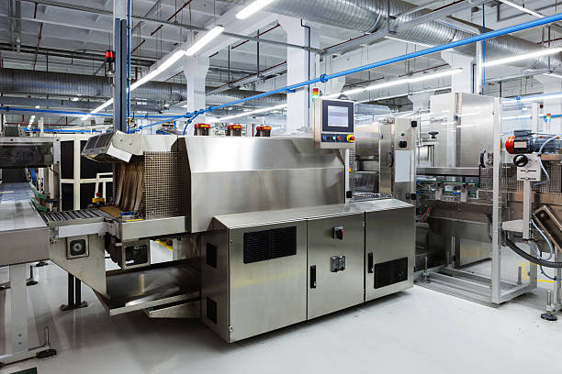
3. Where the assessee makes payment over Rs. 10,000 at a time, partly by an account payee cheque and partly in cash to some parties but the payment in cash alone at one time does not exceed Rs. 10,000, section 40A(3) is not attracted.
4. Provision of section 40A(3) does not apply in respect of an expenditure which is not to be claimed as deduction under section 30 to 37.
5. Capital expenditure in Cash
Section 43(1) : section 43(1) speaks about “actual cost” of a fixed asset. Any payment made for acquisition of assets in respect of which payment or aggregate of payments in excess of Rs. 10,000 is made in cash, 100% of such expenditure will be disallowed.

Slide 14

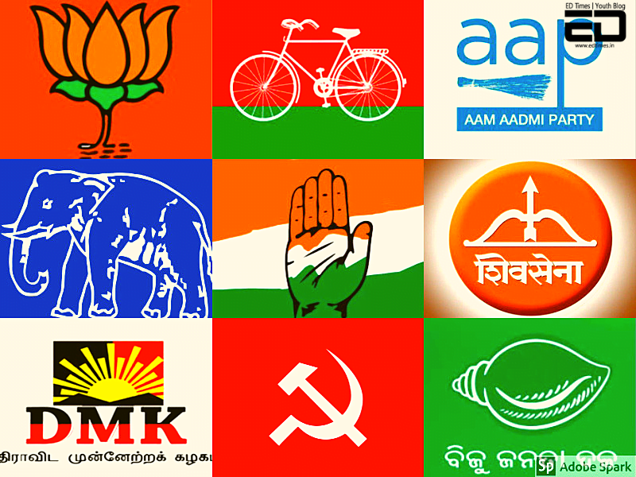
6. Donation In Cash
Section: 80G
The Income Tax Act allows deduction while calculating the total taxable income to every assessee. One such deduction is allowed under section 80G of Income Tax Act, 1961 for donations made to a charitable organization or a trust.
Under this section, no deduction is allowed for cash donation exceeding Rs.2000 under Income Tax provisions.
Section: 80 GGB
Any Indian company are allowed to make donation to political party or electoral trust.
Cash contributions are not allowed under Section 80 GGB.
Therefore, the respective contributions to political parties must be made through other modes of payments such as Cheque, Demand Draft or Electronic Transfer.

Slide 15

Section: 80GGC Donation to Political parties
Under this section any person (except local authority and Artificial Judicial person funded by Government) is allowed to make donation to political party.
Only condition to be met is that donation to be made in any mode other than cash.
7. Premium on Health Insurance
Section: 80D Deduction in respect of Medical Insurance Premium
Any Individual or HUF is eligible for deduction of medical insurance premium paid.
Any Payment made in cash on account of premium on health insurance facilities is not allowable as deduction.
But for preventive health checkup, payment can be made by any mode upto Rs.5000.

Slide 16
8. TDS in case of Cash withdrawal
Section 194N : Deductor: Bank, Co-operative bank or a post office
Threshold limit: If aggregate payment in cash from one or more accounts during a previous year to an account holder exceeds the threshold limit given below:
Time of Payment | Threshold limit for payment in cash | TDS Rate
On or after 01.07.2020 | Customer who have not filed their tax returns for the previous 3 years and for which the due date for filing tax return has expired:
 | exceeding Rs. 20 lakh but not exceeding Rs. 1 crore | 2%
 | exceeding Rs. 1 crore | 5%

Slide 17
Time of Payment | Threshold limit for payment in cash | TDS Rate
On or after 01.07.2020 | Customers other than mentioned above:
 | Upto Rs. 1 crore | 0%
 | exceeding Rs. 1 crore | 2%
Exemption:
Exemption is available, when payment is made to certain recipients, such as the government, banking company, co-operative society engaged in carrying on the business of banking, post office, banking correspondents and white label ATM operators, who are involved in the handling of substantial amounts of cash as a part of their business operations.

Slide 18

Disclaimer: This is meant purely for general educational purposes. While the information is believed to be accurate to the best of my knowledge, I do not make any representations or warranties, express or implied, as to the accuracy or completeness of this information. The reader should conduct and rely upon their own examination and analysis and are advised to seek their own professional advice. This note is not an offer, invitation, advice, or solicitation of any kind. I accept no responsibility for any errors it may contain, whether caused by negligence or otherwise or for any loss, howsoever caused or sustained, by the person who relies upon it.
CA RAHUL MITTAL
B.Com, FCA, FAFD, DISA
M:+91-99917-25373

