Slide 1
Taxation of Gifts
Section 56(2) of Income Tax Act, 1961

Slide 2
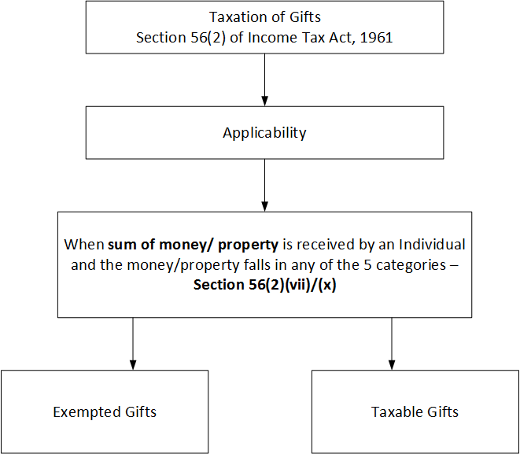
Applicability

Slide 3
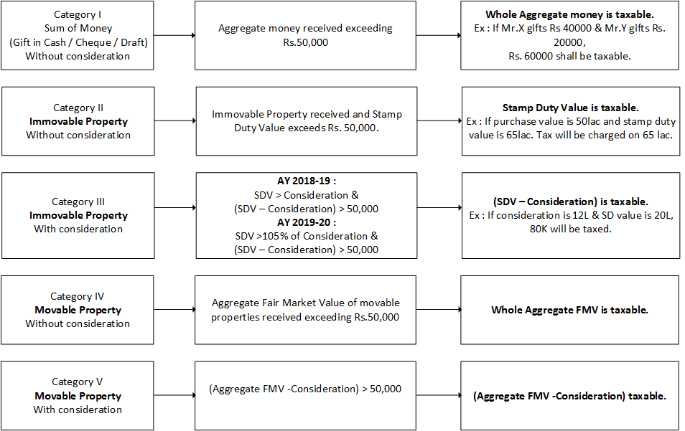

Slide 4
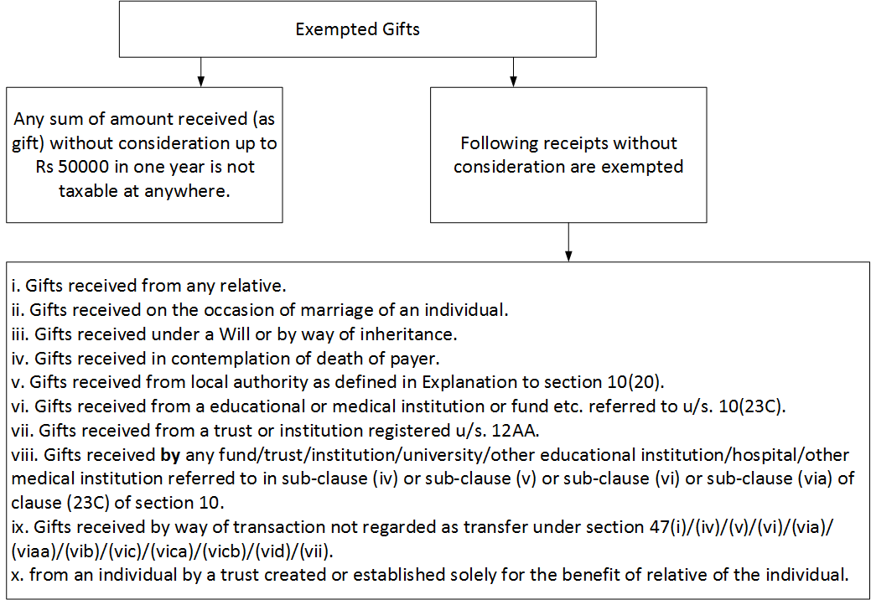

Slide 5
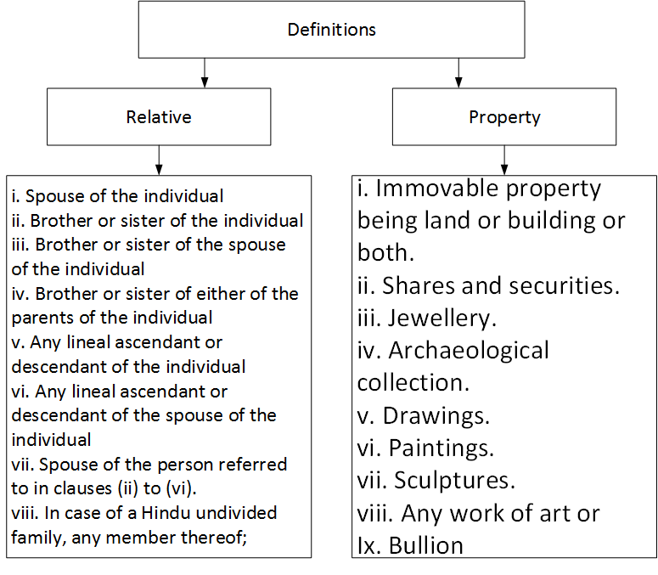

Slide 6
Other Points
Only single transaction is considered for calculating threshold limit of Rs.50000/- in the case of immovable property received as a gift. Where as in other cases (cash or movable property) all transactions in financial year are taken into consideration for calculating threshold limit of Rs.50000/-.
Stamp Duty Value means the value adopted or assessed or assessable by any authority of the Central Government or a State Government for the purpose of payment of stamp duty in respect of an immovable property.

Slide 7
Thanks for watching
Please LIKE & SUBSCRIBE for more

