Slide 1


E-Return :2008-09
PROCEDURE OF FILING
Presented by:
CA.Pramod Kumar Panda
ABP & Associates
Chartered Accountants

Slide 2

Topics to be Covered
Who is required to file a return.
When is it required to be filed.
Which form is required to be used.
How is the return to be submitted.
Details required in the New Return Forms.
Who is required to sign & verify the return.
Miscellaneous.

Slide 3
Feature of ITR for Asst.Yr. 2008-09
Annexure less – No TDS Certificates, but can use extra sheets if space not enough
Designed for electronic capturing of data & Filing Specific to AY 08-09
Special Transactions to be stated - AIR
Several errors from ITRs of AY 07-08 removed and additions made.

Slide 4
Who is required to File a Return:-
MANDATORY FILING:-
For individuals whose income exceeds the prescribed limits
For the A.Y 08-09, the limits are:
a. Rs 110,000 – Individuals except women, NR & Senior Citizens
b. Rs 145,000 in case of women
c. Rs 195,000 in case of senior citizens (above 65 years of age)
NOTE: Threshold of Basic exemption limit is to be determined on the basis of total income calculated before giving effect to 10A/10B/10BA or Chapter VIA deductions.

Slide 5
Who is required to File a Return
(Contd)###
MANDATORY FILING:
Every Company & Partnership Firm.
Association of Persons or Body of Individuals.
Every University / College / Other Institution referred to in section 35(1)(ii) / (iii).

Slide 6
Who is required to File a Return (Contd)###
IF INCOME EXCEEDS MAXIMUM AMOUNT NOT CHARGEABLE TO TAX:*
PERSON *Before considering provisions of
Individual / HUF / AOP / BOI S. 10A / 10B / 10BA & Chapter VI-A
Charitable or other trust or institution
claiming exemption u/s. 11 and 12 S. 11 and 12
Political parties S. 13A & S.10
Scientific research association - S. 10(21)
News agency - S.10(22B)
Association or institutions - S.10(23A)/(23B)
Fund, trust, institution, hospital, university - S.10(23C)(iii ad) to (via)
Trade Union - S.10(24)

Slide 7
Who is required to File a Return (Contd)##
TO CLAIM BENEFIT OF:
1.Carry forward of loss:
- U/s 72(1) - Business or profession (non-speculative)
- U/s 73(2) - Speculation Business
- U/s 74(1) - Capital loss
- U/s 74A(3) - Running and maintaining Race Horses
2.Deductions:
- U/s 10A/ 10B
- U/s 80-IA, 80-IAB, 80-IB, 80-IC/ID/IE (As per80AC)
3.Refund of Taxes Paid

Slide 8
When the Return to be Filed
In case of :- Due Date
1.Company 30th. Sept.
2.Person whose accounts are required 30th. Sept.
to be audited under the Income-tax
Act or any other law.
3.Working partner of a firm whose 30th. Sept
accounts are required to be audited
4.Any other assessee 31st July

Slide 9
Belated Return: Section 139(4)
Any person who has not furnished a return within the time allowed under section 139(1) /142(1)
May furnish his return within one year from the
end of the relevant assessment year or before the
completion of assessment, whichever is earlier.

Slide 10
Revised Return- Section 139(5)
Any person who has furnished a return under Section 139(1) / 142(1), and Discovers any omission or wrong statement there in, can file a revised return
A Revised return can be furnished within one year from the end of the relevant assessment year or before the completion of assessment, whichever is earlier.
A belated return cannot be revised.

Slide 11
Which Form is to be Used:-
NEW RETURN FORMS:
Rule 12 substituted with effect from 28th March, 2008
Eight new forms viz. ITR-1 to ITR-8 prescribed
New forms valid only for A.Y.2008-09
Each Return has 2 or 3 Parts having separate modules
and schedules - no page numbering
No attachments to be enclosed with returns except for
ITR 7 (TDS Certificate to be attached)
Detailed Instructions given for each

Slide 12
Guidelines for Filling out Parts & Schedules of the ITR:-
All items must be filled in the manner indicated therein in the form.
If any schedule is not applicable score across as “----NA----”
Write NIL to denote nil figures.
All figures should be rounded off to the nearest one rupee.
However the figures for total income/loss and tax payable be
finally rounded off to the nearest multiple of ten rupees.
Figures in computation of income should match from their
respective schedules.

Slide 13
Procedure for Submitting return:-
OPTIONS FOR FILING RETURN:
MANUAL
Paper Return
Bar Coded Return in Paper Format
ELECTRONIC
Electronically under Digital Signature (DSC)
Transmitting without DSC electronically and then submitting ITR – V.
(Incase, the assessee has not digitally signed the ITR, the
assessee must print 2 copies of the same after transmitting it
electronically and submit 2 copies manually within 15 days and
receive an acknowledgement on one of them. If paper copy
filed late then that date will be the date of filing and not actual
electronic submission date)

Slide 14
FORM No: ITR-1
APPLICABLE TO: | FILING OPTION :
Individuals having | (a) Paper return
Income from | (b) Electronically under digital signature
Salary, Family Pensions | (c) Transmitting electronically and then ITR – V
And Interest Income | (d) Bar coded return in paper form
From FDR, NSC, Etc.,
Note 1: Salaried Person having | Any Other income other than Interest cannot use this ITR
NOTE 2: Instructions given in the form place additional restrictions: | A person having exempt income other than agricultural income and interest cannot use this form (DIV LTCG) - A person who has to include income of other persons as per clubbing provisions not entitled to use this form - The above effectively reduce the scope for use (Section10(13A) - HRA, Section 10(10) - Gratuity)

Slide 15
FORM No: ITR-2
APPLICABLE TO: | FILING OPTION :
Individual [other than covered in ITR-1] and HUF not having business income NOTE: (1) Instructions given in the Form states that person who is a partner in a firm shall use ITR-3 even if he gets no interest / remuneration from the firm and has only exempt share of profit. This is in excess of the language of the Rule 12(1)(b) and 12(1)(c) where if HUF earns profits it should beable to use ITR 2. | Same Four Filing Option as Prescribed discussed under ITR-1 NOTE: (2) It is further specifically provided that a person entitled to use ITR-1 shall not use this form.

Slide 16
FORM No: ITR-3
APPLICABLE TO: | FILING OPTION :
Individual / HUF who is partner in a firm where ‘Profits and Gains from Business or Profession’ does not include any income except for interest and/or remuneration from firm. | (a) Paper return. (b) Electronically under digital signature. (c) Transmitting electronically and then filing ITR– V. (d) Bar coded return in Paper Form.

Slide 17
FORM No: ITR-4
APPLICABLE TO: | FILING OPTION :
Individual or HUF not covered for Filing Return using ITR–1 / 2 / 3 and deriving income from a Proprietary Business / Profession. | (a) Paper return (b) Electronically under digital signature (c) Transmitting electronically and then filing ITR – V (d) Bar coded return in paper Form.

Slide 18
FORM No: ITR-5
APPLICABLE TO: | FILING OPTION :
A person not being an Individual / HUF /Company. i.e. ITR-5 is Applicable to All Partnership Firms, AOPs and BOIs | (a) Paper return * (b) Electronically under digital signature (c) Transmitting electronically and then ITR – V (d) Bar coded return in paper form * * A firm to whom the provisions of S.44AB (tax audit) are applicable can furnish the return only in the manner specified in (b) or (c) above, i.e. Only E-Filing of ITR-5.

Slide 19
FORM No: ITR-6
APPLICABLE TO: | FILING OPTION :
All Companies other than those Companies claiming exemption u/s 11 | a)Electronically under digital signature. b)Transmitting Electronically and then Manual Submission of ITR-V within 15 days * *One should note that from 1.4.08 every company has to pay their taxes electronically.

Slide 20
FORM No: ITR-7
APPLICABLE TO: | FILING OPTION :
Persons including Companies required to file a return under the following sub-sections of Section 139: (4A) Charitable or other trust or institution claiming exemption under section 11 and 12 (4B) Political party (4C) Scientific research association - section 10(21) News agency - section 10(22B) Professional association or institution – section 10(23A) Institution - section 10(23B) Fund or institution - specified clauses of section 10(23C) (4D) University, College or Other Institution U/S 35(1)(ii) / (iii) | Only Paper Return to be filed and ITR-V to be obtained from the Department as proof of filing Return.

Slide 21
FORM No: ITR-8
APPLICABLE TO: | FILING OPTION :
Persons not required to file return of income but required to file return of fringe benefits. | Paper return (b) Electronically under digital signature (c) Transmitting electronically and then online generating ITR– V for submission to Department. (d) Bar coded return in paper

Slide 22
FORM No: ITR-V
APPLICABLE TO: | FILING PROCEDURE :
All Assessee (If filed Digitally) | After uploading the XML file to the Income Tax Department Site the Acknowledgement shall be generated named ITR-V . The same should be printed in Duplicate and after due signature to be submitted to I.T Department with in 15 days from the date of filing. (www.incometaxindiaefiling.gov.in)

Slide 23
Details Required to be Filled in ITR:
SALARY INCOME:
Employer category: Govt. /PSU /Others
Name and address of last employer, incase there are more then one employers during last previous year.
Fill the details of salary as given in the TDS certificates (Form 16) issued by the employer.
HOUSE PROPERTY:
Name of Tenant.
PAN of Tenant (Optional)
Other information like GAV, municipal taxes paid, unrealized rent, interest accrued etc.

Slide 24
Details Required to be Filled in ITR:
CAPITAL GAINS:
Information about Short Term Capital Gain
• From Slump Sale
• From assets in case of non- residents under special provisions
• From other assets – items except above 2 items
• Exemption u/s 54B/54D
• Deemed short-term capital gain i.e. non compliance of Sec. 54B/54D/54EC/54G/54GA + on Depreciable assets
• Short term capital gain u/s 111A i.e. On shares on which STT has been paid. – Show separately and reduce from total
• Arrive at final figure of ST Capital Gain
Information about Long Term Capital Gain
• From Slump Sale, From assets in case of non- residents
• From other assets disclosing separately when option u/s 112 exercised and not exercised i.e. 10 % or 20% tax on the basis of Indexation/ no indexation on specified security.
• Exemption and Deemed Capital gain
• Quarterly Break- up of LTCG and STCG separately

Slide 25
Details Required to be Filled in ITR:
INFORMATION IN RESPECT OF PARTNERS TO WHOM ITR-3 IS APPICALBLE:
- Name, PAN, Percentage & amount of Share of Profit
- Capital balance in the firm as at year end.
- Remuneration, salary, bonus, commission and interest on the capital employed.
- The expenses, if any relating to earning of such income shall be deducted.

Slide 26
Details Required to be Filled in ITR:
INFORMATION REQUIRED IN CASE OF PARTNERSHIP FIRM, AOP OR BOI – ITR 5
Name and Address of partners/members, percentage of share and PAN. In case of clubs where members are numerous details of Managing Committee members will suffice. Change in Partners/Managing Committee during the previous year.
BUSINESS / PROFESSION(ITR-4, 5 & 6):
• General Information - Audit Information:
Name and Membership No. of Auditor,
Name and PAN of firm / proprietorship
• Balance Sheet:
Detailed Break-up in line with Schedule VI format

Slide 27
Details Required to be Filled in ITR:
BUSINESS / PROFESSION (Cont’d):
Profit & Loss Account:
Detailed Break-up of Income & Expenses into various heads.
Sales and Purchases to be shown net and then to be grossed up separately with excise, service tax, VAT, Cess, etc.
Depreciation:
In Schedule DPM and DOA give details of depreciation on Plant and Machinery and on Other Assets, the sale proceeds have to be furnished separately for sales out of :
Opening WDV and current years additions > 180 days,
Current years additions < 180 days
Details of additional Depreciation to be claimed ,if any.

Slide 28
Details Required to be Filled in ITR:
BUSINESS / PROFESSION (Cont’d):
The summary of depreciation as per the schedules will be shown in schedule DEP
Expenditure on scientific research under section 35
The details of the deduction allowable and the amount which is debited to P&L should be mentioned in schedule ESR.

Slide 29
Details Required to be Filled in ITR:
OTHER INFORMATION (required only in case of audit
under sec 44AB)
Same information is required as given in Form 3CD i.e. Method of Accounting, Change in method and its impact, Method of valuation of Stock, any change in method and its impact, amounts disallowable u/s 36, 37, 40, 40A, 43B etc.
QUANTITATIVE DETAILS (required only in case of
audit under sec 44AB)
Details of principal items as given in Form 3CD
Separate information for Traders and Manufactures
If more than 1 item then use separate sheet

Slide 30
Details Required to be Filled in ITR:
SET-OFF AND CARRY FORWARD OF LOSSES:
Schedule CYLA: Show CY Income from different heads and show what losses are adjusted against each of them.
Schedule BFLA: Net CY income after intra head set off if positive should be shown and adjusted against B/f losses under each head, + B/f depn, and remaining positive or negative income is to be given.
Schedule CFL: Summary of losses carried from earlier years, set off during the year (as per Sch BFLA) and to be carried forward for set off against income of future years is to be entered. Date of filing return of previous assessments are to be mentioned. Losses can be adjusted and C/f only if returns were filled on or before due date.
DONATIONS:
Name and address of the donee together with PAN, where donee is required to be approved u/s. 80G(5)(vi)

Slide 31
Details Required to be Filled in ITR:
DETAILS OF TDS ON OTHER INCOME:
If Tax has been deducted but income has not been shown then claim only proportionate TDS. Specific column for the portion of TDS claimed this year due to accrual – cash basis mismatch between payer and payee.
If required separate sheets can be used.
Even if certificate has not been received but if information required is available then can TDS be claimed?
Words are changed this year in TDS1 – from tax ‘deposited’ to total tax ‘deducted’. All the same the words in TDS2 ‘date of payment’ continues.
For each deductor (TAN) write total amount under date of credit/payment and date can be put as 31.3.08 for multiple payments. (as per instructions issued by the department). This may result in mismatch and query from the department have come.

Slide 32
AIR Information
Sr. No | Particulars of information to be Given in ITR
1 | Cash deposits made by you aggregating to Rs.10 lakhs or more in any savings account during the year.
2 | Payment made by you against bills raised in respect of a credit card aggregating to Rs.2 lakhs or more in a year.
3 | Payment made by you of an amount of Rs.2 lakhs or more for purchase of units of Mutual Fund.
4 | Payment made of an amount of Rs.5 lakhs or more for acquiring bonds or debentures issued by a company or institutions.
5 | Payment made of an amount of Rs.1 lakh or more for acquiring shares issued by a company.
6 | Purchase of an immovable property valued at Rs.30 lakhs or more
7 | Sale of any immovable property valued at Rs.30 lakhs or more
8 | Payment made of an amount of Rs.5 lakhs or more in a year for investment in bonds issued by Reserve Bank of India.

Slide 33
Sec-140 who is to Sign the Return
INDIDIDUAL | By the individual himself . If he is mentally incapacitated - by his guardian or other person competent to act on his behalf. If he is absent from India – or for any other reason – by any person duly authorised by him
HUF | By the Karta Or in any of the above circumstances by any other adult member
COMPANY | By the Managing Director Or where there is no Managing Director or for any unavoidable reason - by any other director
COMPANY NOT RESIDENT IN INDIA | By a person who holds a valid power of attorney from such Company
FIRM | By the Managing Partner or for any unavoidable reason - by any other partner not being a minor
POLITICAL PARTIES | By the Chief Executive Officer
LOCAL AUTHORITY | By the Principal Officer
OTHER ASSOCIATION | By any member of the association or the Principal Officer thereof
OTHER PERSON | By that person or some person competent to act on his behalf

Slide 34
Permanent Account Number
Govt. is determined to track down those trying to evade taxes.
It proposes to issue a Permanent Account Number (PAN), suo moto, if any authority discovers that it has not been mentioned for specific transaction where it is mandatory to do so.
The person will be issued a PAN by the assessing officers.
The provision would be effective from June 1,2006.
Already a penalty of Rs.10,000 is required to be paid if the PAN is missing.

Slide 35
Power of the Board U/s 139C/139D
The Board may make rules for a class or classes of persons who may not be required to furnish documents which are otherwise required to be furnished along with the return.
The said documents are to be produced before the Assessing Officer on demand.
The Board may make rules for :
• The class or classes of persons to furnish the return in electronic form.
• The form and manner of E-Return.
• The documents which are not required to be furnished along with the E-Return but to be produced before AO on demand.
• The computer resource or the electronic record to which the E-Return form may be transmitted.

Slide 36
RULE :12(2) of the I.T.Rule
Under the said power, Rule 12(2) inserted which reads as under:
The return of income and return of fringe benefits required to be furnished in Form No. ITR-1, 2, 3, 4, 5, 6 or 8 shall not be accompanied by a statement showing the computation of the tax payable on the basis of the return, or proof of the tax, if any, claimed to have been deducted or collected at source or the
advance tax or tax on self-assessment, if any, claimed to have been paid or any document or copy of any account or form or report of audit required to be attached with the return of income or the return of fringe benefits under any of the provisions of the Act.

Slide 37
E-Return At a Glance
Sl. No. | For ⇒ | Indivudual | Individual , HUF
 | Source of Income ⇓ | ITR-1 | ITR-2 | ITR-3 | ITR-4
1 | Income from Salary/Pension
2 | Income from Other Sources (only Interest Income or Family Pension)
3 | Income/Loss from Other Sources
4 | Income/Loss from House Property
5 | Capital Gains/Loss on sale of investments/property
6 | Partner in a Partnership Firm
7 | Income from Proprietary Business/Profession

Slide 38
E-Return At a Glance
Sl. No. | For ⇒ | Firms, AOP, BOI, & Local Authority | Companies | Trusts | Only FBT
 | Source of Income ⇓ | ITR-5 | ITR-6 | ITR-7 | ITR-8
1 | Income / Loss from Other Sources
2 | Income / Loss from House Property
3 | Capital Gains / Loss on sale of Investments / Property
4 | Income / Loss from Business
5 | Fringe Benefit Tax
38
CA.Pramod K.Panda, ABP & Associates

Slide 39
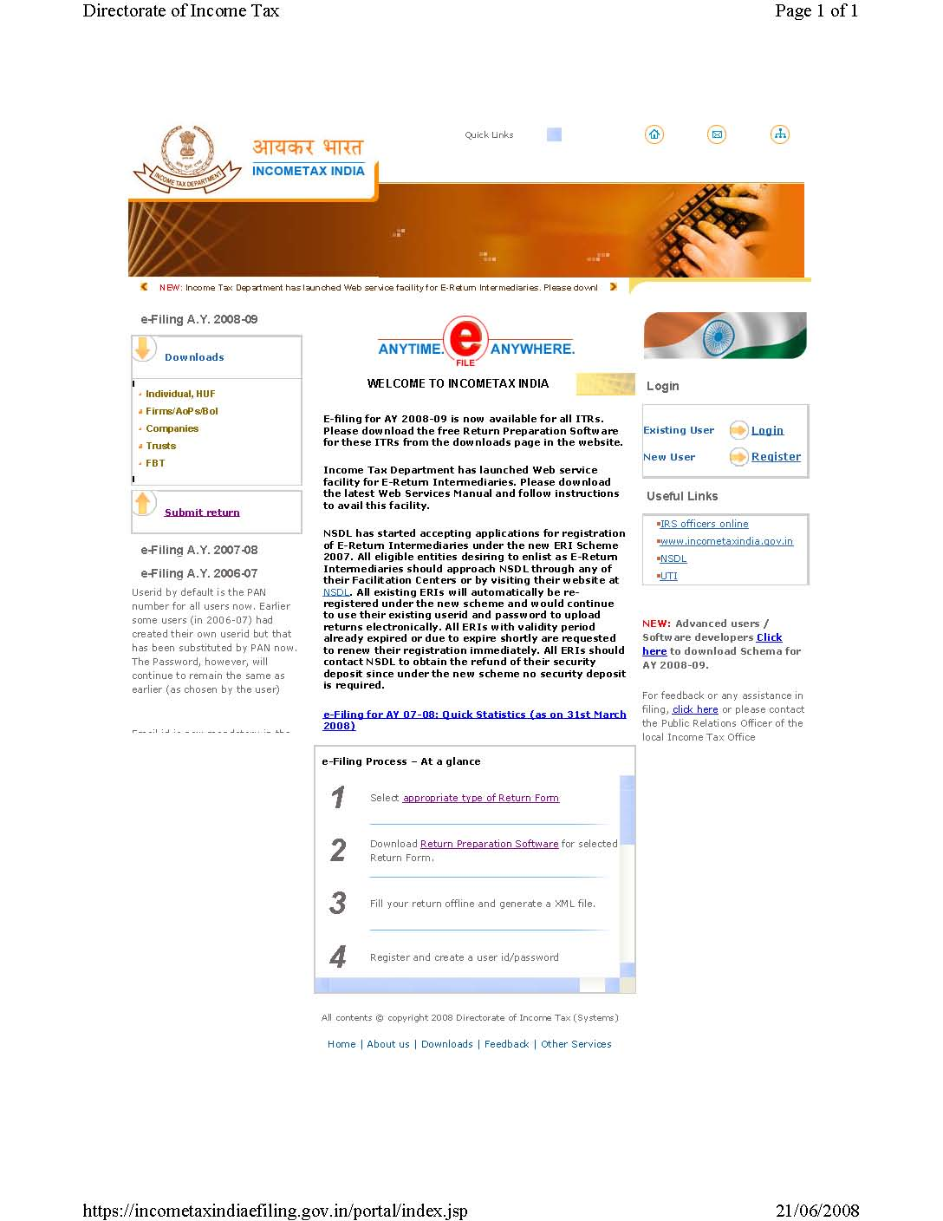
www.incometaxindiaefiling.gov.in
LOGIN WINDOW:
Click the Register Button to enter the Registration Details of the Assessee.
If already registered, click the Login Button to upload the XML. File.

Slide 40
System Requirement
Window XP or Window Vista Operating System.
Adobe PDF-Version 8 or above.
Java Run Time Environment (JRE 6 Beta) or above.(Can be downloaded from the Income tax website) (www.incometaxindiaefiling.gov.in)

Slide 41
E-Filing Process- At a Glance
1. | Select Appropriate Type of Return Form Required for the Assessee.
2. | Download Return Preparation Software for Selected Return Form.
3. | Fill All the Data in the Return Preparation Software and Generate XML File
4. | Register & Create User ID/Password.
5. | Login and Click on relevant form on left panel and select “Submit Return”

Slide 42
E-Filing Process- At a Glance
6. | Browse the select XML File and click on “Upload” Button.
7. | On successful upload acknowledgement details would be displayed. Click on “Print” to generate printout of the Acknowledgement/ITR-V.
8. | Incase the return is digitally signed, on generation of “Acknowledgement” the Return Filing process gets completed.
9. | For non-digitally filed return, the Return Filing Process is completed after delivering a duly verified copy of the ITR-V with the Income Tax Department with in 15 days from the date of E-Filing.
10. | For any enquiry on account of PAN Validation: You can contact the Help Line No: 0124-2438000

Slide 43
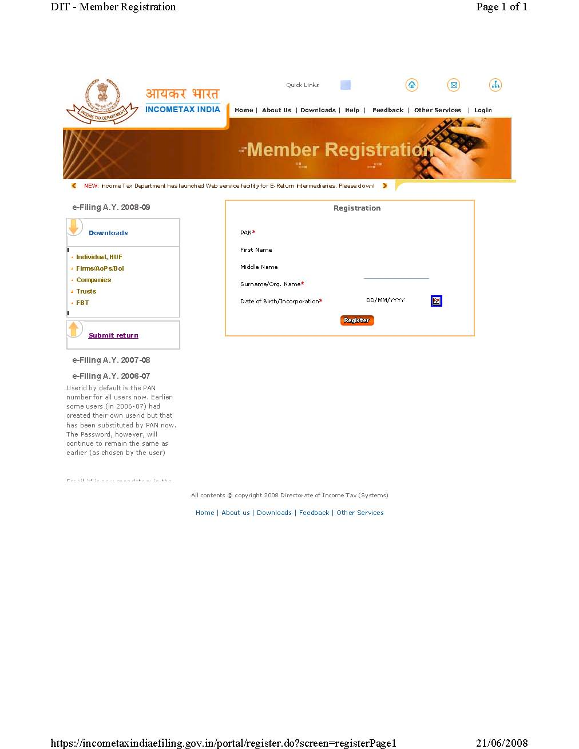
www.incometaxindiaefiling.gov.in
Enter In the Registration Window Your:
PAN No.
First Name
Middle Name
Surname/ Organisation Name
DateofBirth/Incorporation

Slide 44
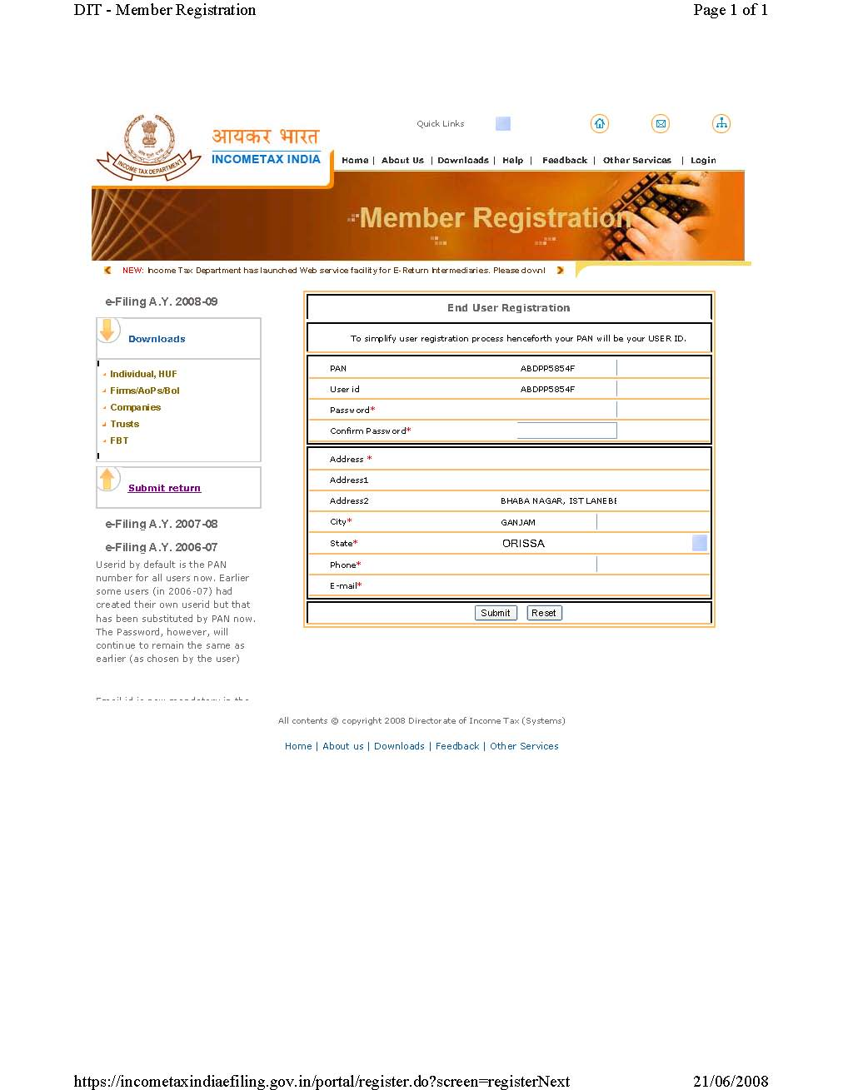
www.incometaxindiaefiling.gov.in
Enter in this Window Your:
Password
Reconfirm Password
Enter Phone No.
Enter E-Mail ID
Click SUBMIT

Slide 45
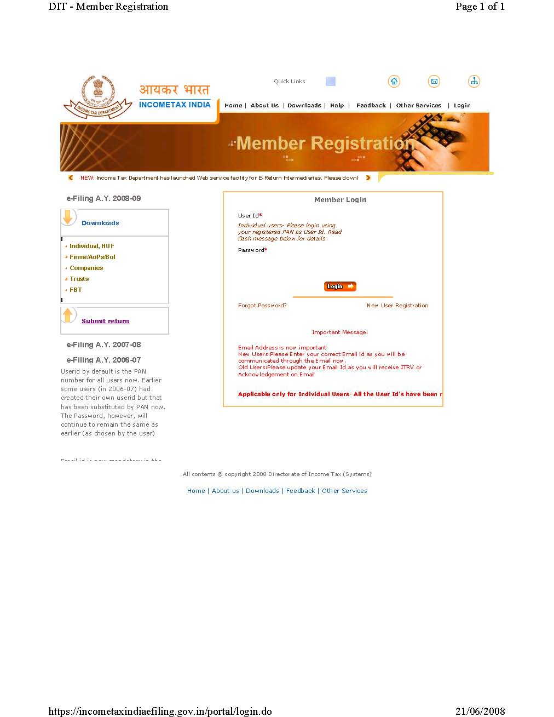
www.incometaxindiaefiling.gov.in
Enter:
User ID
Password
User ID is by default is the PAN No. for all assessee.

Slide 46
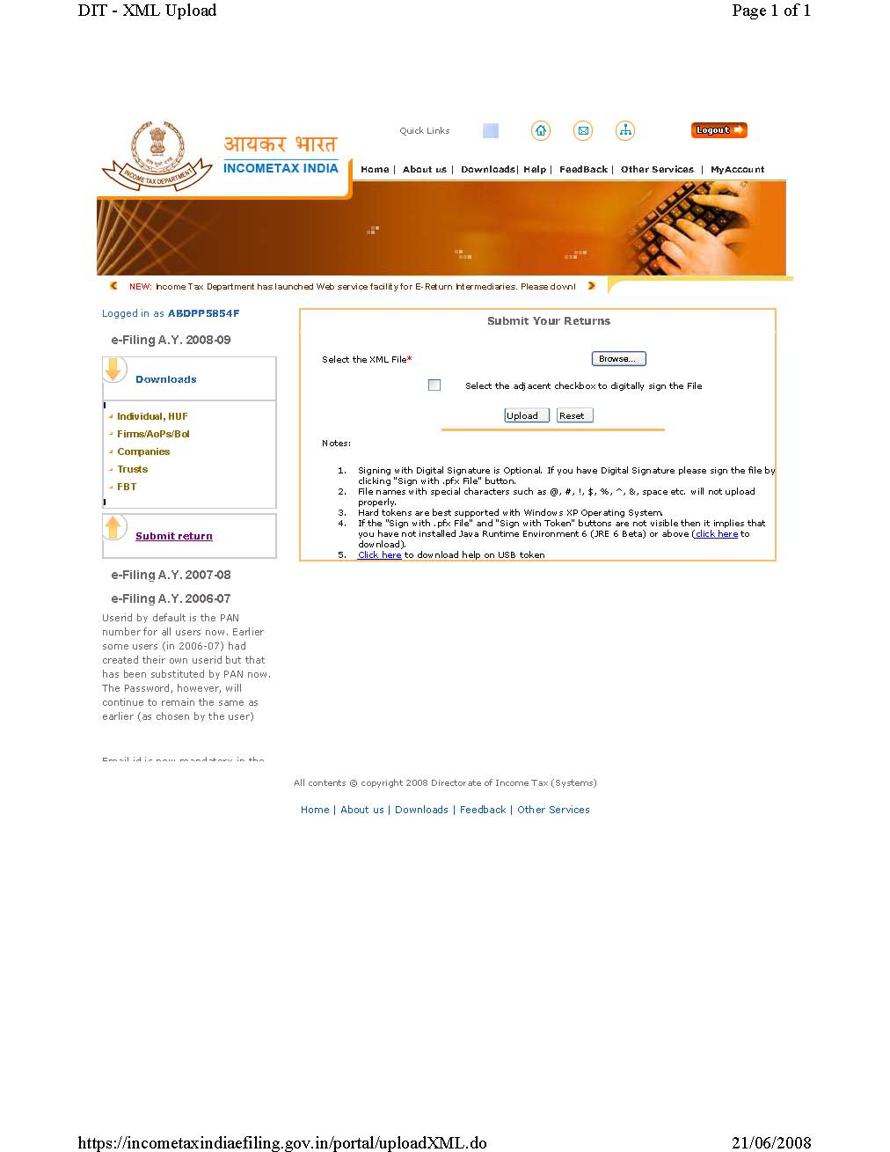
www.incometaxindiaefiling.gov.in
E-return Upload Window:
Browse the XML file from your System and then Click the Upload Button.
ITR-V shall be generated and can be downloaded from My Account/My Return Button.

Slide 47
Conclusion
Make proper enquiries from your clients to ensure completeness of the information.
Make Proper verification of data provided.
Ensure that changes in law have been taken care of by you.
Importance of preparing balance sheet & receipts and payments account for proper tracking and monitoring of assets, liabilities & incomes be briefed to the clients.

Slide 48
Come File Well In Advance
An Income tax form is like a laundry list
either ways you loose your shirt.

Slide 49


THANK YOU
FOR YOUR PRECIOUS TIME

