Slide 1

AMENDMENTS w.e.f JUNE 2016
1. tax deduction at source
2. service tax

Slide 2
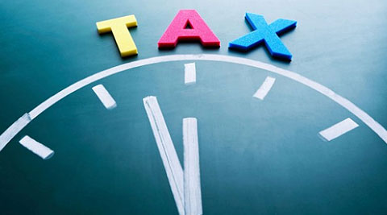
Overview – Significant Additions and Modifications
Tax Deduction at Source :
Changes in TDS Rates
Changes in threshold limit
Changes in due date
Omissions/Insertions
Service Tax :
Krishi Kalyan Cess
Changes in Negative List of Services
IDT DRS Scheme

Slide 3
1. TDS – CHANGE IN RATES
Section | Particulars of Payment | Old rate | New Rate
194D | Commission on Insurance | 10% | 5%
194DA | In respect of Life Insurance Policy | 2% | 1%
194EE | NSS Deposits | 20% | 10%
194G | Commission on Sale of lottery tickets | 10% | 5%
194H | Payment of Commission or Brokerage | 10% | 5%
194LBB | Units of Investment Fund | 10% | 10%, if payee is resident. Rates in force in case of non-resident (not being a company) or foreign company.

Slide 4
2. TDS – CHANGE IN THRESHOLD LIMITS
Section | Particulars of Payment | Old Limit | New Limit
192A | Payment of accumulated PF balance due to an employee | 30,000 | 50,000
194BB | Winnings from race horses | 5,000 | 10,000
194C | Payment to Contractors | 75,000 p.a | 1,00,000 p.a
194D | Commission on Insurance | 20,000 | 15,000
194G | Commission on Sale of lottery tickets | 1,000 | 15,000
194H | Payment of Commission or Brokerage | 5,000 | 15,000
194LA | Compensation on acquisition of immovable property | 2,00,000 | 2,50,000

Slide 5
3. TDS – CHANGE IN DUE DATE FOR FILING
Quarter | Date of ending of quarter of financial year | Due date for Government and Non-Government Deductors
Q1 | 30th June | 31st July of the financial year
Q2 | 30th September | 31st Oct of the financial year
Q3 | 31st December | 31st Jan of the financial year
Q4 | 31st March | 31st May of the financial year immediately following the financial year in which the deduction is made

Slide 6
4. TDS – INSERTION
Income
Securitization Trust
Investment
in respect of an investment in a securitization trust, the person responsible for making shall---
deduct income-tax thereon, at the rate of—
(i) 25% - payee is an individual or a HuF;
(ii) 30% - payee is any other person.
(iii) Rates in force- payee is non-resident.

Slide 7
4. TDS – OMISSIONS
194K: Income in respect of Units of Mutual Fund
Person responsible for payment of such income (>10,000) shall deduct income- tax thereon@
194L : Payment of compensation on acquisition of Capital Asset
Person responsible for payment of such income (>100,000) shall deduct income tax thereon@10%.
(b) 15% in the case of other payees.
(a) 20%, if the payee is a company, and

Slide 8


Slide 9

New Levy- Krishi Kalyan Cess :
Purpose-Applicability of levy
Determination of Point of Taxation
Availing Cenvat Credit
Other points to be considered

Slide 10
Purpose & Applicability:
To finance and promote initiatives to improve agriculture and farmer welfare
To be levied at 0.5% on the value of all taxable services w.e.f June 1, 2016.
Effective rate of Service tax- 15% (14% + 0.5%+ 0.5%)

Slide 11
Determination of POT for KKC:
For Service Provider
POT shall be determined as per Rule 5- New levy or tax
Rule 5 – no tax liability if :
a) DOI is before and DOP is before
b) DOP is before and DOI within 14 days
For Service Recipient
POT shall be determined as per Rule 7 – Specified services or persons
POT- Other than AE outside India:
1. If DOP <3m DOI, then DOP
2. If DOP >3m DOI, then Immediate date after end of 3rd month
Ultravires to Charging section
New Proviso inserted in Rule 7 :
1. DOCS-before
2. DOI- before
3. DOP- after(eventhough <3m)
Then, POT= DOI

Slide 12
Cenvat Credit w.r.t KKC :
Allowed only to output service provider, but not to manufacturers
To be utilized for payment of KKC only
Any other duty/tax shall not be utilized for payment of KKC
Other points to be noted :
Shall not be levied on services exempted from service tax
To be levied on abated value of services
Valuation Rules shall also be applicable for KYC
Rebate of KKC paid on input service used in export of services is allowed
Right to claim refund to KKC paid on services procured by SEZ unit and Developers of SEZ is allowed
Composition tax scheme ( Air travel agents etc) is now extended for KKC as well

Slide 13

Changes in Negative List of Services :
Service of transportation of passengers, with or without accompanied belongings, by a stage carriage
Services by way of transportation of goods by an aircraft or a vessel from a place outside India up to the customs station of clearance

Slide 14

Changes in Negative List of Services :
To be deleted from Negative List of Services
New Entry has been inserted in the Mega Exemption Notification to exempt (other than air-conditioned stage carriage)
For AC stage carriage @ 40% after abatement of 60% without input tax credit

Slide 15
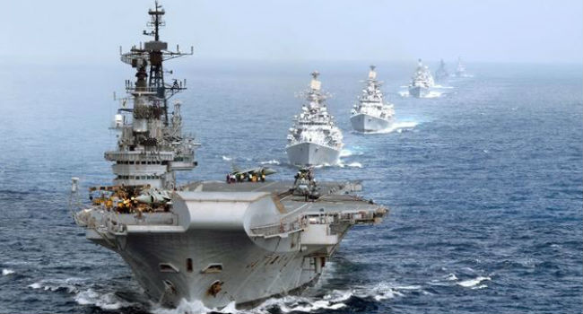
Changes in Negative List of Services :
To be deleted from Negative List of Services
New Entry has been inserted in the Mega Exemption Notification to exempt such services by aircraft
Services provided by vessels would be taxable

Slide 16

The IDT DRS Scheme, 2016
Pending appeal before Commissioner as on 31st Mar 2016
Make a Declaration on or before 31st Dec 2016
Designated Authority will acknowledge in prescribed form
Make payment of tax due alongwith the interest thereon and 25% of penalty within 15 days from receipt of acknowledgement
Intimate the designated authority within seven days of making such payment giving the details of payment made along with the proof thereof

Slide 17
The IDT DRS Scheme, 2016
Designated authority shall, within fifteen days of the receipt of such proof, pass an order of discharge of dues

Slide 18

Thank You
Mokka
Thank God

