Slide 1

How to File TDS Return
&Other TDS Issues

Slide 2
Agenda:-
1.Due Date For TDS Payment.
2.Due Date For Filing TDS Return &Issuance Of Tds Certificates
3.Applicable TDS Rates.
4.How To File TDS Returns.
5.Type Of Forms And it’s Requirement.
6.Consequines For Not-Filing Of Return And Payment of Tds.

Slide 3
Due Date For TDS Payments
On Are Before 7th of Next Month in Which Tds Was Deducted.
Note:-Except of Provision Made on 31st March ,
For Which Due Date Of Payment Will be 30th April.

Slide 4

Due Date Of Filing Of TDS Returns &
Issuance Of TDs Certificates
Quarter Ending | Last Date Of Filing Return | Last Date Issuance of Certificate of Form 16 | Last Date Issuance of Certificate of Form 16 A
30th June | 15th July | 30th July | 30th July
30th September | 15th October | 30th October | 30th October
31st December | 15th January | 30th January | 30th January
31st March | 15th May | 30th May | 30th May

Slide 5
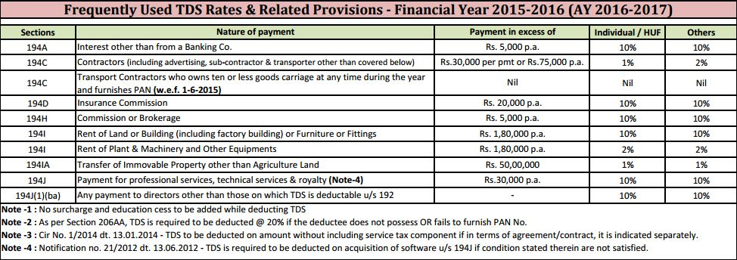
Applicable Tds Rates

Slide 6
Type of Forms And It’s Requirements
24Q :- In Case Of Salary Return
Ex:- Sec 192B
26Q :- In Case Of Other Then Salary
Ex:- Sec 194 c,194 j,194 i,194 a.

Slide 7
Consequences For Not-Filing And Payment of Return.
1.Not Filling Of Tds Return With In Due Date:-
1. 200/- Per Day From Due Date Date Of Filing.
2. Actual Tds Amount.
(Lower Of The Above Two)
2.Delay In Payment Of Tds Amount.
Case (1):- Deducted But Not Paid.
1.5%P.m From The Date Deduction to till the date of Payment.
Case(2) :- Not Deducted And Not Paid.
1 % P.m From The Date Of Deductible to Actual Date Of Deduction.
1.5% P.m From The Date Of Deduction To Till The Date Of Payment.

Slide 8
Q/A

Slide 9


