Slide 1

E-Filing of Income Tax Returns

Slide 2
Index
Contents
Introduction
What is E-Filing
Benefits of Filing Tax Returns Online
Difference Between E-Filing & Paper Filing
Common E-Filing Process
Mandatory E-Filing of ITR for AY 2015-16
Income Tax E-Filing
  ITR Forms for Individual/HUFs
  ITR Forms for other than Individual/HUFs
List of Income Tax Returns
  ITR 1 To ITR 4
  ITR 4S To ITR 7
Overview of E-Filing
Services offered by E-Filing Website

Slide 3
Index
Contents
What is Digital Signature Certificate ?
Steps & Types for filing ITR
Steps for Uploading Income Tax Return
E-Filing with DSC
E-Filing without DSC
Registration of DSC
Preparation & Submission of ITR-1 Online
Common mistakes in Filing of ITR
Impact of errors made while filing returns
Rules to be followed to ensure trouble free processing
Some Important Changes / New Introduction in ITR
  Introduction of ITR 2A & Aadhar Card Number
  Details of Bank A/c & mandatory e-filing for Income Tax refunds
  EVC & Other changes

Slide 4

Introduction
E-filing of tax returns and other documents is a major change in Indian tax administration scenario. In this era of information technology, everything is changing to “electronic” format. Change in tax administration was much awaited and expected. Today, all major tax administration matters are converted to electronic format. This has proved to be a big step towards increasing transparency and efficiency in tax administration.

Slide 5


What is E-Filing ?
Electronic tax filing, or e-filing, is a system for submitting tax documents to a revenue service electronically, often without the need to submit any paper documents.
In simple words, it is giving information to tax authorities in electronic format.
Giving information in electronic format is much easier for assesse as well as tax authorities.
E-filing saves the tax agency time & money.

Slide 6


Benefits of Filing Tax Return Online
While you file your returns online, the calculations are done automatically thus you are relieved from the hassle of calculations and confusions.
It is easier, convenient and time saving.
Another benefit of filing tax return online is that you do not have to wait in long queues nor have to pay an agent.
As it becomes more easily accessible, filing returns online also gives you an advantage of checking the status of your refund.

Slide 7


Difference between E-filing and Paper Filing
Sr. No. | Particulars | E-filing | Paper Filing
1 | Convenience | Can be filed during any time of day. | To be filed during office working hours only.
2 | Place of filing | Can be filed from anywhere in the world. | To be filed at a particular office only.
3 | Possibility of errors | Very less as all possible electronic checks and controls are there. | Very high as there can not be any control or check before filing of return.
4 | Processing of returns | Very fast | Very slow

Slide 8

Common E-Filing Process
Obtaining e-format file
Filling information in e-format file
Validating e-format file
Uploading e-format file

Slide 9


Mandatory E-Filing of ITR For AY 2015-16
Any assessee having total income of ₹ 5 Lakhs and above from AY 2013-14 and subsequent Assessment Years.
Individual/ HUF, being resident, having assets located outside India from AY 2012-13 and subsequent Assessment Years.
An assessee required to furnish a Audit Report u/s 44AB as Income Tax Act, 1961.
All companies.
A resident who has signing authority in any account located outside India.

Slide 10
Income Tax E-Filing
ITR Forms for Individual, HUF (Hindu Undivided Family)
S.No. | Source of Income | Individual | Individual, HUF
 |  | ITR-1 | ITR-2 | ITR-3 | ITR-4 | ITR-4S
1 | Income from Salary/Pension | • | • | • | • | •
2 | Income from Other Sources (only Interest Income or Family Pension) | • | • | • | • | •
3 | Income/Loss from Other Sources |  | • | • | • | •
4 | Income/Loss from House Property |  | • | • | • | •
5 | Capital Gains/Loss on sale of investments/property |  | • | • | •
6 | Partner in a Partnership Firm |  |  | • | •
7 | Income from Proprietary Business/Profession |  |  |  | •
8 | Income from presumptive Business

Slide 11
Income Tax E-Filing
ITR Forms for Firms, Associations of Persons (AOP), Body of Individuals (BOI), Local Authority, Companies, Trusts, Fringe Benefit Tax (FBT) Return:
S.No | Source of Income | Firms,AOP,BOI Local Authority | Companies | Trusts
 |  | ITR-5 | ITR-6 | ITR-7
1 | Income / Loss from Other Sources | • | • | •
2 | Income / Loss from House Property | • | • | •
3 | Capital Gains / Loss on sale of Investments / Property | • | • | •
4 | Income / Loss from Business | • | • | •
5 | Fringe Benefit Tax | • | • | •

Slide 12
List of Income Tax Returns
Form No. | Who Can File | Source of Income
ITR-1 | Only Individual | 1.Salary 2. Only one House Property – No B/F losses 3. Other Sources – No B/F losses.
ITR-2 | Individual/HUF | 1. Salary 2. More than one House Property or B/F Losses under the head 3. Capital Gains 4. Other Sources-B/F Losses Exception:- No PGBP Income.
ITR-3 | Individual/HUF (who is partner in firm) | 1. PGBP income from partnership firm in which the Individual or HUF is a partner. 2. Salary 3. More than one house property – B/F Losses 4. Capital Gain
ITR-4 | Individual/HUF | 1. Proprietary PGBP 2. Salary 3. More than one HP- B/F Losses 4. Other Sources – B/F Losses 5. Capital Gains

Slide 13
List of Income Tax Returns
Form No. | Who Can File | Source of Income
ITR-4S | Individual/HUF | 1. PGBP:-Presumptive income u/s 44AD or 44AE 2. Salary 3. More than one House Property –B/F Losses 4. Other Sources – B/F Losses 5. Capital Gains
ITR-5 | Firm/AOP/BOI/Local Authority/ Artificial Juridical Person | Any Income
ITR-6 | Company ( Private Ltd. & Public Ltd.) | Any Income
ITR-7 | Trust/Political Party/Institutions/college | Any Income

Slide 14

Overview of E-Filing
E-filing website has become much more user friendly now. So many new features are added for increasing transparency. The first step for using income tax e-filing website is to register with it. Registration process is simple process just like creating an email account.
To register for the first time,
Click on the “Register Yourself” button located on top right part of the website home screen.
Select the user type, e.g. Individual, HUF, Company, etc.
Fill in the required information like PAN, Name, Email ID, Mobile No, etc.
Save the information.

Slide 15
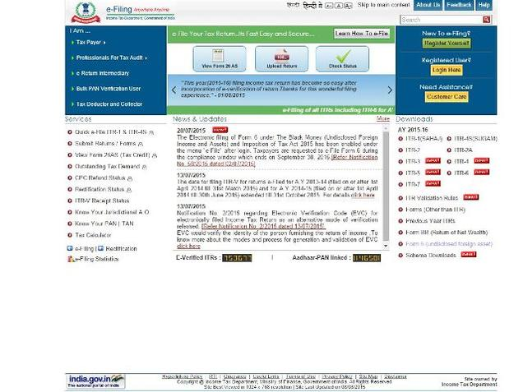
Services offered by E-Filing Website
Submit returns/ forms
View Form 26AS (Tax Credit)
Check the details of outstanding tax
demand
Check ITR-V receipt status
Check CPC Refund Status
Check rectification status
Know your jurisdictional A.O.
Know your PAN
Know your TAN
Apply online for PAN / TAN
E-pay taxes

Slide 16

What is Digital Signature Certificate ?
Digital Signature Certificates (DSC) are the digital equivalent (that is electronic format) of physical or paper certificates.
a digital certificate can be presented electronically to prove your identity, to access information or services on the Internet or to sign certain documents digitally.
A licensed Certifying Authority (CA) issues Digital Signature.
The different types of DSC
are : Class 2 & Class 3.
Digital Signatures are legally
admissible in a court of law.

Slide 17
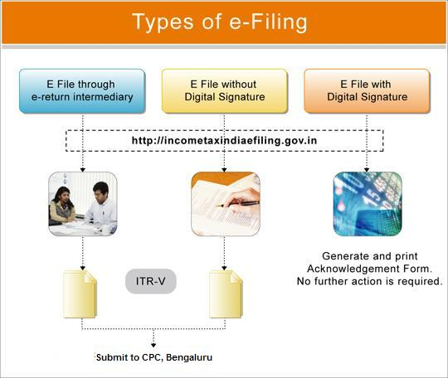
Steps & Types for Filing ITR

Slide 18

Steps for Uploading Income Tax Return
On homepage, GO TO 'Downloads' section and select applicable Income Tax Return Form of the relevant Assessment Year
Download the excel or Java utility of the Income Tax Return (ITR).
Fill the excel or Java utility and Validate.
Generate an XML file and save.
LOGIN to e-Filing application and GO TO --> e-File --> Upload Return.
Select the Income Tax Return Form and the Assessment Year.
Browse and Select the XML file.
Upload Digital Signature Certificate, if available and applicable.
Click 'SUBMIT'.
On successful upload, Acknowledgement details would be displayed. Click on the link to view or generate a printout of Acknowledgement/ITR-V Form.

Slide 19

E-Filing With DSC
Here, there is no need of sending ITR-V acknowledgement to CPC, Bengaluru as the return is signed by the assessee digitally. While uploading income tax return, a question is asked as “Do you want to digitally sign ? ”. Answer to this question must be set to “YES” to upload the return with digital signature certificate.

Slide 20

E-Filing Without DSC
The process of e-filing remains the same in both the case, with digital signature and without digital signature, except one additional step.
E-filing without Digital Signature Certificate requires one more step of sending the acknowledgement to CPC at Bengaluru.
After successful upload of income tax return, assesse has to take a printout of ITR-V, acknowledgement of income tax return, sign it and send it to Central Processing Centre at Bengaluru to complete the return filing process.
This signed acknowledgement must reach Central Processing Centre within 120 days of uploading the return.

Slide 21
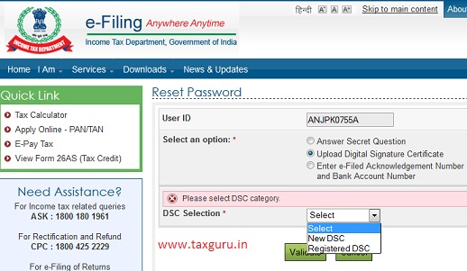

Registration of DSC
This is an activity to be performed before uploading the income tax return with digital signature certificate.
Path : Profile Settings > Register Digital Signature Certificate.
Select appropriate option and submit.

Slide 22
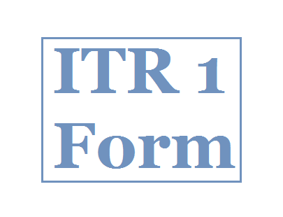
Preparation & Submission of ITR-1 Online
The taxpayer has the option of submitting ITR 1 by way of Uploading XML OR by Online submission
Step 1: Login to e-Filing application
Step 2: GO TO 'e-File' --> 'Prepare and Submit Online'
Step 3: Select the Income Tax Return Form ITR 1 and the Assessment Year.
Step 4: Fill in the details and click the SUBMIT button
Step 5: On successful submission, Acknowledgement detail is displayed. Click on the link to view or
generate a printout of Acknowledgement/ITR-V Form.

Slide 23

Common mistakes in Filing of ITR
Salary from all employees should be entered in item 1 of ITR-1 or details in Schedule Salary in ITR2.
Interest income from fixed deposits, saving bank account etc. should be entered in item 3 viz. Income from Other sources of ITR 1.
House property Income. Schedule HP should be filled carefully including the address details.
Income from Short Term Capital Gains should be entered in Item A of Schedule CG-Capital Gains.
Income from Long Term Capital Gains should be
entered in Item B of Schedule CG-Capital Gains.
Deductions from income under Chapter VI A

Slide 24

Impact of errors made while filing returns
Returns can be classified as defective u/s 139 (9) and in some scenarios the return can be declared in valid / Non Est. ITD is not introducing this concept to cover certain types of errors in order to prevent future grievances.
Computation Errors - In electronic filing, it has been noticed that most of the errors are due to data errors as filed by the assessee This includes non filling of key schedules, wrong details etc. resulting in rectification requests etc. which delay closure of processing.
Inability to pay refunds
to the assessee.

Slide 25

Rules to be followed to ensure trouble free processing
Once E filing is done (without digital signature), ITR V needs to be sent within 120 days of e-filing your Income Tax return to CPC, Banglore. Nearly 10% of assessees fail to send the ITR V to CPC after E filing.
Assessee needs to fill his email address, mobile number correctly to ensure appropriate communication from the Income Tax Department.
The assessee should make sure the correct (latest) address, bank account number, MICR number is filled.
The assessee should verify tax credits available in Form 26AS/NSDL websites. Mismatches are the single largest cause of incorrect tax computation.

Slide 26
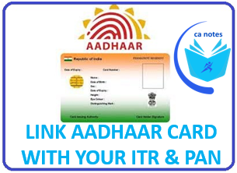
Some Important Changes / New Introduction in ITR
Introduction of ITR 2A
At present individuals/HUFs having income from more than 1 house property or capital gains are required to file form ITR-2. It is, however, noticed that majority of individuals/HUFs who file return in Form ITR-2 do not have Capital Gains.
With a view to provide a simplified Form for these individuals/HUFs, a new Form ITR 2A has been introduced.
  Aadhar Card Number
  The new Income Tax Return also has field for optional information about Aadhar Card number. You have to select whether you have Aadhar Card or not. If you select yes then you have to mention your Aadhar Card No.

Slide 27

Some Important Changes / New Introduction in ITR
  Giving Details of Multiple Bank Account No.
New Income Tax Return forms require Tax Payers to report the number of Bank Accounts they are operating along with related details such as name of Bank, Account number, & IFSC code. Irrespective of a Payer operates a Savings or a Current Account, reporting the details is mandatory.
  Mandatory E-Filing for Income Tax Refunds
To speed up and prompt issue of Tax Refunds, e-filing of Income Tax return has been made mandatory for those who desire any Income Tax Refund. This step will definitely ensure quick refunds to tax Payers. Secondly, it is proposed that from now onwards all the refunds will be done electronically and cheques will not be issued.

Slide 28

Some Important Changes / New Introduction in ITR
  Introduction of Aadhar Card No. based Electronic Verification Code (EVC)
    A new system of verification has been rolled out which is called as Electronic verification. In this system, the Tax Payer will receive a verification code on Payer’s Mobile number which is associated with Payer’s Aadhar card. Once the Payer enters the verification code, the e-filing will be verified. Therefore posting ITR-V to CPC, Bangalore is not required
  File ITR-1 even if the exempt income is more than Rs.5000
  Introduction of e-filing of Return u/s 119(2)(b)

Slide 29
THANK YOU

