Slide 1


INCOME COMPUTATION AND DISCLOSURE STANDARDS [ICDS]
Deepika Mevadi
CA Final

Slide 2

What is ICDS
Framework for computation of taxable income
Independent of the financial reporting method
followed by the taxpayer

Slide 3

Why ICDS
The Central Board of Direct Taxes (CBDT) set up a committee in 2010 to look at the taxation related aspects of Indian Accounting Standards (Ind-AS) implementation.
It recognised that certain accounting issues were a subject matter of tax litigation due to either diversity in accounting practices or divergence in views between tax payers and authorities, which needed to be addressed.

Slide 4
Background of Introduction of ICDS
Accounting Standards (AS)
Sec. 145(2) of Income Tax Act, 1961 (‘the Act’) empowers the Central Government to notify
AS – 1 ‘Disclosure of Accounting Policies’ and
In 2010
CBDT constituted a Committee
Tax Accounting Standards
AS - 5 ‘Disclosure of Prior Period items & Extraordinary items and Changes in Accounting Policies’
to suggest standards for the purposes of notification u/s 145(2) of the Act.
instead of notifying AS issued by the ICAI
In 2011, the Committee submitted its Report

Slide 5
Background of Introduction of ICDS (cont.)
Draft TAS
placed in public domain for comments & suggestions.
In 2012
Committee submitted its final report to CBDT with 14 draft TAS.
Jan 2015
CBDT placed revised draft of 12 ICDS
in public domain for comments & suggestions.
Notification No. 33/2015 dated 31-03-2015
CBDT, has notified 10 ICDS effective from 01-04-2015 (ICDS on Leases and Intangible asset not notified)

Slide 6

Applicability of ICDS
Applicable from
1-04-2015 &
advance tax for current financial year & thereafter needs to be computed based on ICDS.
The effective dates of these ICDSs are
1st April, 2015 and shall accordingly apply to the Assessment Year 2016-17 and subsequent assessment years.

Slide 7

Applicable for
Computation of Income chargeable under the head
Profit and Gains from Business and Profession or
Income from Other Sources
To all assesses following mercantile method of accounting

Slide 8

Applicable to
All Taxpayers
Companies, Individuals, Association of persons,
Body of individuals or Hindu Undivided Families
Whether resident in India or not
Except assesses who are covered by Presumptive basis, since they are not require to maintain any accounts

Slide 9


Features
No criteria prescribed for
Net Worth or Turnover or any other
Not applicable for
Minimum Alternate Tax (MAT) Calculation
Not for
Maintenance of Books of Account

Slide 10
Features (Cont.)
Taxable profits would now be determined after making appropriate adjustments to the financial statements (whether prepared under Ind-AS or existing AS) to bring them in conformity with ICDS.
Considering that these standards are already effective, it could have an immediate impact on large companies as they need to take these into account while paying the advance tax as well as accounting of tax expense in the upcoming quarterly results.

Slide 11

If there is Conflict between
Provisions of the Income tax Act, 1961 &
Income Computation and Disclosure Standard
provisions of the Act shall prevail to that extent

Slide 12

Transitional Provisions
Have been inserted in all ICDS except ICDS on Securities
Income, expense, loss or provision existing or entered into on or after 1-04-2015 are to be recognized as per ICDS.
However Income, expense, loss or provision, if any, recognized before 31-03-2015 shall be taken into account for recognizing the same for the period commencing on 1-04-2015 to avoid double taxation/non-taxation in pre and post ICDS period.

Slide 13

Entity need not to maintain separate Books of accounts for ICDS.
But the difference between the accounting standards and ICDS may give rise to additional computations and reconciliations which in essence could result in the need for maintaining additional set of records.
ICDS is not an extension of the Act rather it is a part of the Act which accords the treatment in respect of issues covered therein viz. foreign exchange fluctuations, construction contract, tangible fixed assets etc.
Hence, ICDS only meant to supplement the present Income Tax Act

Slide 14

Delinking taxable income from accounting income and, thereby, increasing the compliance burden and tax exposure of taxpayers, ICDS has certainly moved them from their comfort zone.
ICDS has revamped the tax computation structure for all taxpayers.
If you thought ICDS doesn’t impact you, it is not true, as almost all taxpayers have income taxable under the head income from other sources, such as bank interest, interest on company deposits, etc.

Slide 15

ICDS, in respect of revenue recognition, provides that interest shall accrue on time basis determined by the amount outstanding and the rate applicable.
Hence, interest on debentures and bonds, which was accounted by most taxpayers considering the due dates falling within the financial year, shall now be required to be recognised even for the intermittent period till the end of the year. You would be required to prepare separate computations for each type of interest bearing fund, meaning more work for you.

Slide 16

Gives power to the Tax Authority to assess income on “Best Judgment” basis and also levy penalty on additions to returned income.
It is possible that the current tax audit requirements will be enhanced to require auditors to report on the correctness of tax computation under ICDS

Slide 17
List of the ICDS Notified with their
IND AS & AS
ICDS No. | NAME | Equivalent New IND AS No | Equivalent AS No
I | Accounting Policies | 1 & 8 | 1
II | Valuation of Inventories | 2 | 2
III | Construction Contract | 11 | 7
IV | Revenue Recognition | 18 | 9
V | Tangible Fixed Asset | 16 | 10
VI | Effects of changes in foreign exchange rates | 21 | 11
VII | Government Grants | 20 | 12
VIII | Securities | 32 | 13
IX | Borrowing Costs | 23 | 16
X | Provisions, contingent liabilities and contingent assets | 37 | 29
Notes:
The standards on leases and intangible assets have, however, not been notified.

Slide 18

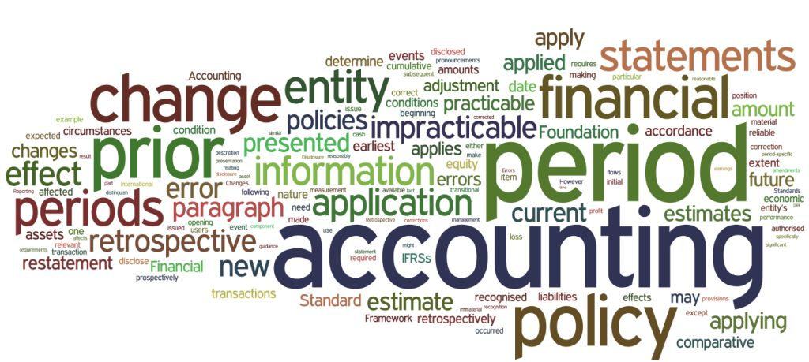
ICDS - I - Accounting Policies
Corresponding to AS-1
ICDS recognizes three accounting concepts – going concern, consistency and accrual.
But ICDS does not recognize the concept of MATERIALITY and PRUDENCE
Expected losses or mark-to-market losses shall not be recognized unless permitted by any other ICDS.
Accounting policies shall not be changed without a reasonable cause.
Whereas AS permits change if it is required by statute or for compliance of AS or if the change would result in a more appropriate presentation

Slide 19

ICDS - II - valuation of
Corresponding to AS-2
Use of standard cost method, as a technique for measurement of cost, is not permitted
Method of valuation of inventory once adopted by a taxpayer in any tax year shall not be changed without a reasonable cause
Recording of inventory is now required for SERVICE PROVIDERS
In case of dissolution of a partnership firm or Association of Persons (AOP) or Body of Individuals (BOI)
Opening Inventory, if business commenced during the year, it shall be cost of inventory available on the day of commencement of business
value of inventories shall be the net realizable value on the date of dissolution

Slide 20

ICDS – III
Construction Contracts
Corresponding to AS-7
Retention money shall be recognized for computing revenue based on percentage of completion method
Pre-construction income in the nature of interest, dividend and capital gains shall not be reduced from the cost of construction.
As per Committee, they shall be taxed as income in accordance with the applicable provisions of the ITL
ICAI AS requires that contract costs relating to future activity shall be recognized as an asset when it is probable that such costs are recoverable.
ICDS provides for recognizing such costs as an asset. As per Committee, if such costs are not realizable then the same may be allowed under the provisions of ITL
No specific permission for downward revision in Revenue due to downward variation in contract

Slide 21

ICDS – III
Corresponding to AS-7
Condition of non-recognition of contract revenues, if it is not possible to reliably measure the outcome of a contract, is not incorporated in
ICDS based on Committee’s recommendation that it is subjective in nature and has resulted in litigation and postponement of tax liability.
Losses incurred on a contract shall be allowed only in proportion to the stage of completion.
As per Committee, future or anticipated losses shall not be allowed, unless such losses are actually incurred.
Once a contract crosses 25% of the completion stage, the revenue in respect of such contract shall be required to be recognized - No Specific Condition to consider outcome of contract

Slide 22

ICDS - IV
Corresponding to AS-9
Interest will be recognised on time basis, dividend as per provisions of the Act and royalty as per terms of the relevant agreement.
Revenue from service transactions shall be recognized by following “percentage completion method alone.
AS permits adoption of either ‘completed service contract method’ or ‘percentage completion method’. Relevant for shipping division majorly.
Sale of goods shall be recognised when all significant risks and rewards of ownership are transferred.
Claims for escalation of price and export incentives can be postponed to the extent of uncertainty involved.

Slide 23

ICDS – V tangible fixed assets
Corresponding to AS-10
Acquisition of an asset in exchange for another asset, shares or other securities, fair value of tangible fixed asset acquired
Fixed asset is acquired in exchange for another asset, shares or other securities issued, cost of asset acquired
Recorded either at fair market value of asset given up/shares or securities issued or fair market value of asset acquired, whichever is more clearly evident.
Recorded as actual cost of the asset

Slide 24

ICDS – V tangible fixed assets
Revaluation Banned
Corresponding to AS-10
Existing AS permits capitalization of foreign exchange difference along with the underlying asset under certain circumstances
ICDS reiterates the fact that capitalization of exchange difference relating to fixed asset shall be in accordance with the Section 43A and other provisions of the Income Tax Act
No concept of Revaluation of asset in the ICDS
Income arising on transfer of a tangible fixed asset and depreciation shall be computed in accordance with the provisions of the Income Tax Laws

Slide 25

ICDS-VI the effects of changes in foreign exchange rates
Corresponding to AS-11
ICDS provides that the exchange differences on translation of non-integral foreign operations to be recognized as an income or expense as against accumulation in foreign currency translation reserve in Balance Sheet as prescribed under AS
All gains or losses on forward exchange or similar contracts entered into for trading or speculation contracts shall be recognized only on settlement.
This is difference frrom the practice under existing AS of whether recognition of gains and losses on mark to market basis or recognition of only losses in line with principle of prudence

Slide 26
ICDS-VI - the effects of changes in foreign exchange rates
Recognition of Exchange Difference
Monetary Items
(Such as Trade Receivables, Trade Payable)
Non-Monetary Items
(Such as Inventory)
Converted into reporting currency by applying the closing rate
Converted into reporting currency using the exchange rate at the
date of the transaction.
All are Subject to Provisions of Section 43A of the Act or Rule 115 of Income Tax Rules, 1962

Slide 27
Illustration for Revenue Recognition for Non-Monetary Items
The impact of deviation by ICDS from the provisions of AS may be understood with the help of following illustration
Particulars | Amount in Forex | Exchange Rate | Value
Cost | 1000 $ | 55 as on date of acquisition | ` 55000
NRV | 500 $ | 60 closing rate i.e. B/S date | ` 30000
Valuation as per lower of Cost or NRV i.e. [1000$ or 500$]
As per AS 11 500 $ * 60 |  |  | ` 30000
As per ICDS 500 $ * 55 |  |  | ` 27500

Slide 28
Applicability of AS 22
This will result into creation of Deferred Tax Liability (DTL) as per AS 22 “Accounting for Taxes on Income”
DTL will be created on difference of valuation of Inventory as per Taxation and as per Books of accounts
When stock will be sold, in that year it will result into reversal of DTL
= ` 30000 – ` 27500 = ` 2500 * Applicable Tax Rate

Slide 29

ICDS – VII government grants
Corresponding to AS-12
ICDS does not permit the capital approach for recording of government grants
Therefore, Government grants should either be treated as revenue receipt or should be reduced from the cost of fixed assets based on the purpose for which such grant or subsidy is given
Recognition of Government grants shall not be postponed beyond the date of actual receipt even though all the recognition conditions in accordance with the AS are not met

Slide 30

ICDS - VIII securities
Corresponding to AS-13
Securities should be valued at lower of cost or net realizable value (NRV)
Comparison of cost and NRV shall be done category-wise (and not for each individual security) for which securities shall be classified into the following categories
(d) Any other securities not covered above
(c) Convertible securities
(b) Debt securities
(a) Shares

Slide 31
ICDS - VIII securities
Since ICDS deals with computation of income under Business or Other Sources heads, ICDS only deals with securities held as stock-in-trade
Corresponding to AS-13
Unlisted traded securities shall be valued
At actual cost as initially recognized
In case of acquisition of securities in exchange for issue of shares or other securities, fair value of shares or securities acquired shall be recorded
Cost which cannot be ascertained by specific identification shall be determined on the basis
of First In- First Out (FIFO) method
In case of acquisition of securities in exchange for another asset, fair value of securities acquired shall be recorded
Actual cost of the securities
As actual cost of the securities

Slide 32
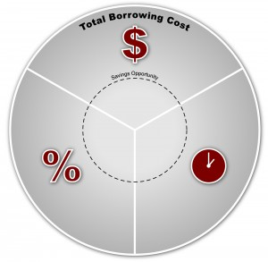
ICDS - IX borrowing costs
Corresponding to AS-16
Borrowing cost will not include exchange differences arising from foreign currency borrowings
ICDS states that in case of specific borrowings capitalization of borrowing cost should commence from the date of borrowing
In case, asset is not put to use, capitalization under ICDS will be higher than that
whereas AS includes such differences to the extent that they are regarded as an adjustment to interest costs
whereas AS requires cumulative fulfillment of three conditions viz. incurrence of capital expenditure, incurrence of borrowing costs and preparatory activities being in progress.
under AS-16 which stops capitalization when all activities to prepare asset for its use are complete

Slide 33

ICDS - IX borrowing costs
Corresponding to AS-16
It does not deal with the actual or imputed cost of owners’ equity and preference share capital
Borrowing Cost may need to be capitalized even if an asset does not take substantial period of time to construct

Slide 34
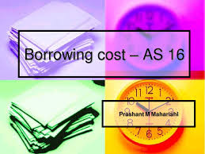
ICDS - IX borrowing costs
Corresponding to AS-16
Unlike AS 16
ICDS does not define any minimum period for classification of an asset as a qualifying asset (with the exception of inventories)
Income on temporary investments of borrowed funds cannot be reduced from borrowing costs eligible for capitalization in ICDS
Condition of suspension of capitalization during interruption of active development is removed in ICDS

Slide 35

ICDS - IX borrowing costs
Corresponding to AS-16
(A)* (B)/(C)
(C) Average cost of asset at the first day and last day of the previous year.
(B) Average cost of qualifying asset at the first day and last day of the previous year and
(A) Borrowing cost except directly relatable to specific purpose
Borrowing Cost in respect of borrowings partly used for acquisition of the qualifying asset to be capitalized in accordance with the following formula

Slide 36

ICDS – X provisions, contingent liabilities & contingent assets
Corresponding to AS- 29
A provision can be recognized when it is “Reasonably Certain” that an outflow of economic resources will be required to settle an obligation As against condition of “Probable” under AS
A contingent asset can be recognized when the realization of related income is “Reasonably Certain” As against condition of “Virtual Certainty” under AS

Slide 37



