Slide 1

How to pay TDS

Slide 2

Go to Google.co.in
Enter www.tin-nsdl.com
Select e payment to taxes on right hand side
Then you see this

Slide 3
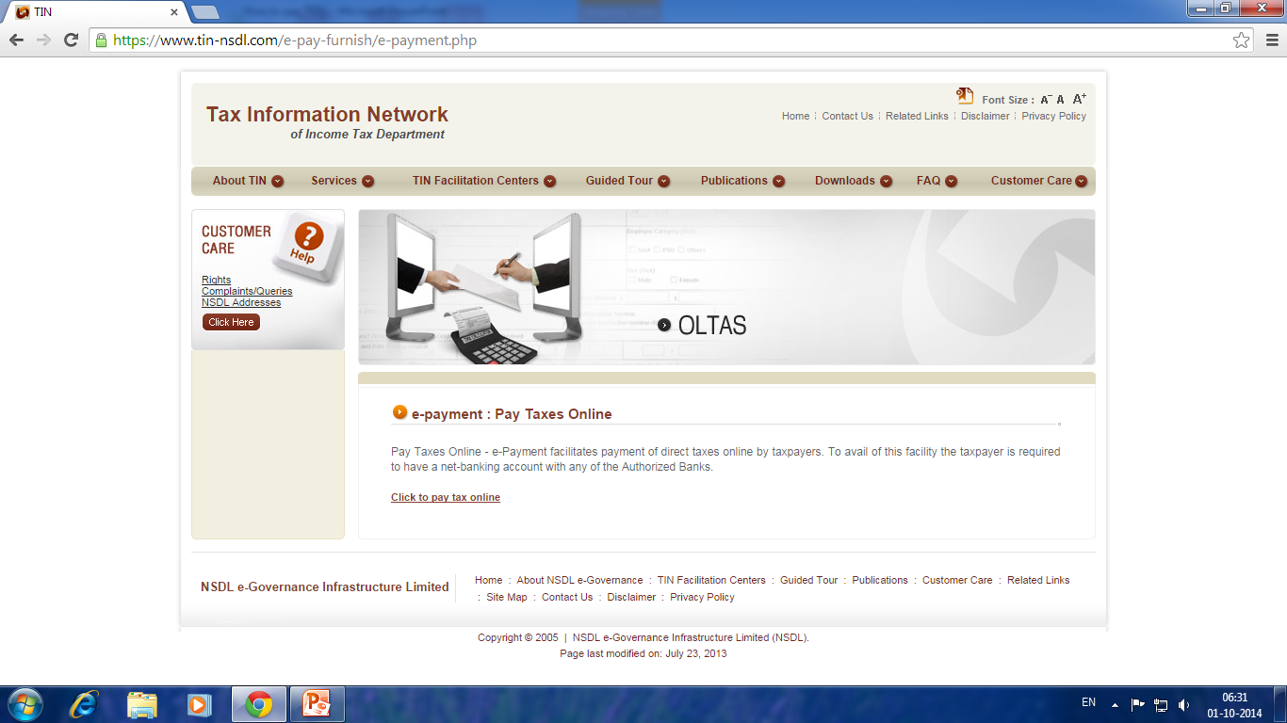
Go to Google.co.in
Enter tin-nsdl.com

Slide 4

Click on click to pay tax online
Then Select Challan No./ITNS 281
Enter TAN Number
Select correct Assessment Year
(for Financial Year 2014-15, Assessment Year is 2015-16)

Slide 5

Enter Address and State must.
Select Type of payment as (200)
Select correct nature of payment
ie., Rent, Contract, Professional Expenses etc.,

Slide 6

Select Bank from which you are making payment
Enter the case sensitive characters in the box given

Slide 7

In the next screen confirm the name displayed and financial year.
After you confirm all the details click proceed for online payment and preserve the challan for E TDS Filing.

Slide 8

Prepared by
Srinath K R - Income Tax Practitioner
Bangalore
# 900 800 2273

