Slide 1
Practical Workshop on
Online Filing of Tax Audit Report
By:-
CA MANOJ LAMBA
B.COM, FCA, LL.B., ICSI Licentiate
Mobile:- 09355371639
E-Mail:- mlc_ca@rediffmail.com

Slide 2
DISCLAIMER
The views expressed & discussed in this presentation are personal views of presenter.
All the viewers are requested to please consult the law before taking final decision.

Slide 3
Accountability: Movie Clip
Take Charge!!!

Slide 4
HISTORY OF TAX AUDIT IN INDIA
The tax audit was introduced by section 11 of the Finance act, 1984 by insertion of a new section 44AB to the Income Tax Act, 1961 w.e.f 1st April, 1985.
This section creates an obligation on a person carrying on business to get his accounts audited by a chartered accountant and to furnish by the specified date, the report in prescribed form of such audit.

Slide 5
HISTORY OF TAX AUDIT IN INDIA
If the total sales, turnover or gross receipts in business in the relevant previous year exceed or exceeds Rs. 40 lakhs (increased to Rs. 60 lakhs from financial year 2010-11)(RS.100Lakhs from FY 2012-13). For the professionals, tax audit is mandatory if the gross receipts in profession exceeds Rs. 10 lakhs (increased to Rs. 15 lakhs from the financial year 2010-11)(RS.25Lakh from FY 2012-13)in the relevant previous year.

Slide 6
Purpose of tax audit had been stated by CBDT Circular No. 387 dated July 6, 1984
“Compulsory audit of accounts of certain persons carrying on business or profession
17.1 Accounts maintained by companies are required to be audited under the Companies Act, 1956. Accounts maintained by co-operative societies are also required to be audited under the Co-operative Societies Act, 1912. There is, however, no obligation on other categories of taxpayers to get their accounts audited.
17.2 A proper audit for tax purposes would ensure that the books of account and other records are properly maintained, that they faithfully reflect the income of the taxpayer and claims for deduction are correctly made by him. Such audit would also help in checking fraudulent practices. It can also facilitate the administration of tax laws by a proper presentation of the accounts before the tax authorities and considerably saving the time of Assessing Officers in carrying out routine verifications, like checking correctness of totals and verifying whether purchases and sales are properly vouched or not. The time of the Assessing Officers thus saved could be utilised for attending to more important investigational aspects of a case.”

Slide 7
Why online filing on Tax Audit?
In the year 2011-12, ICAI along with CBDT did a thorough check of tax audit reports and observed that a number of tax audits reports were filed by the assessee by quoting Fake Membership details of the Chartered Accountants. Some of the points observed were:

Slide 8
Why online filing on Tax Audit?
a) 696 membership numbers (1385 tax audits conducted) quoted by the assessees in e-returns do not subsist at all.
b) 420 membership numbers belong to deceased members.
Further it was pointed out that
1. Approx. 9,500 Members conducted tax audits in excess of specified limit of 45
2.Approx. 2,700 Members with NO COP as on 21.01.2012 conducted Tax Audits.
3. Approx. 736 Members holding Part time COP conducted Tax Audits.

Slide 9
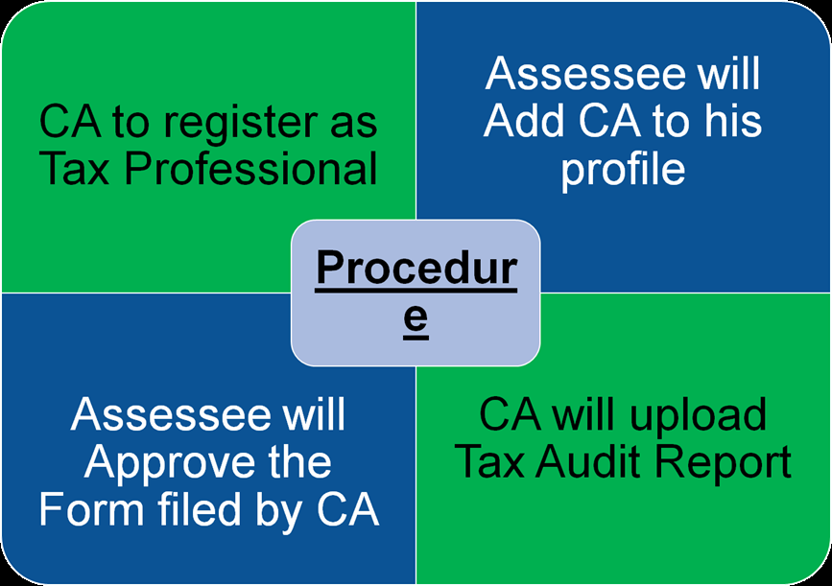
Procedure

Slide 10
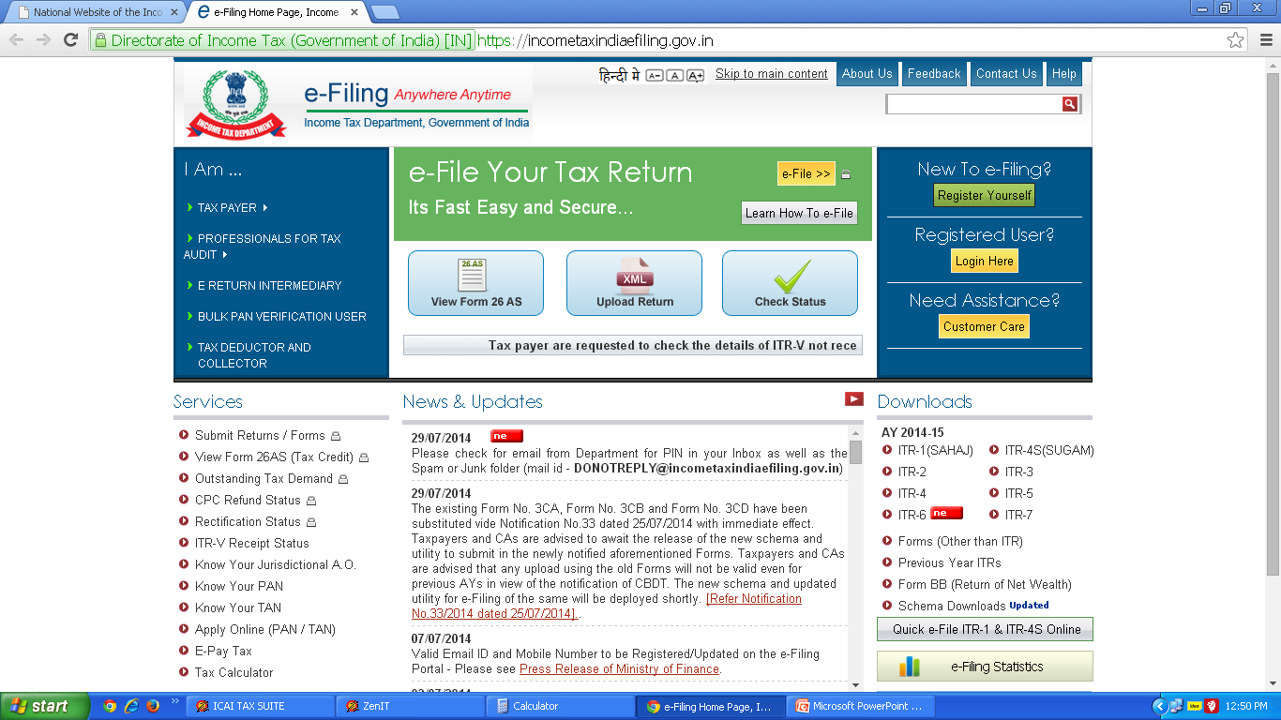

Slide 11
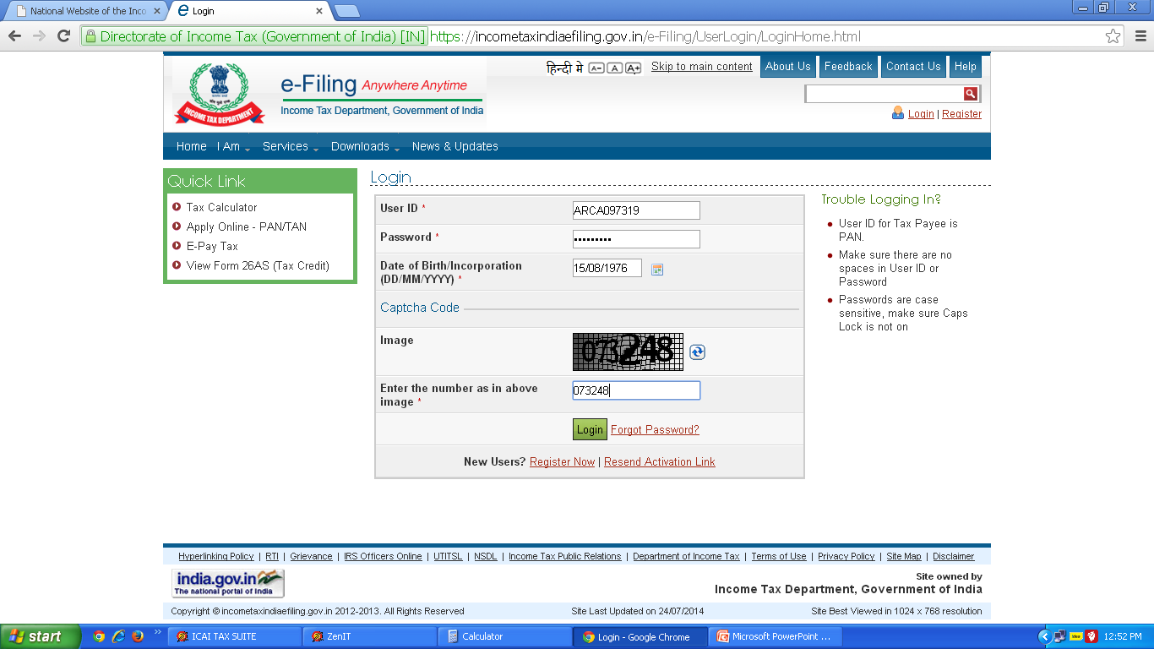

Slide 12
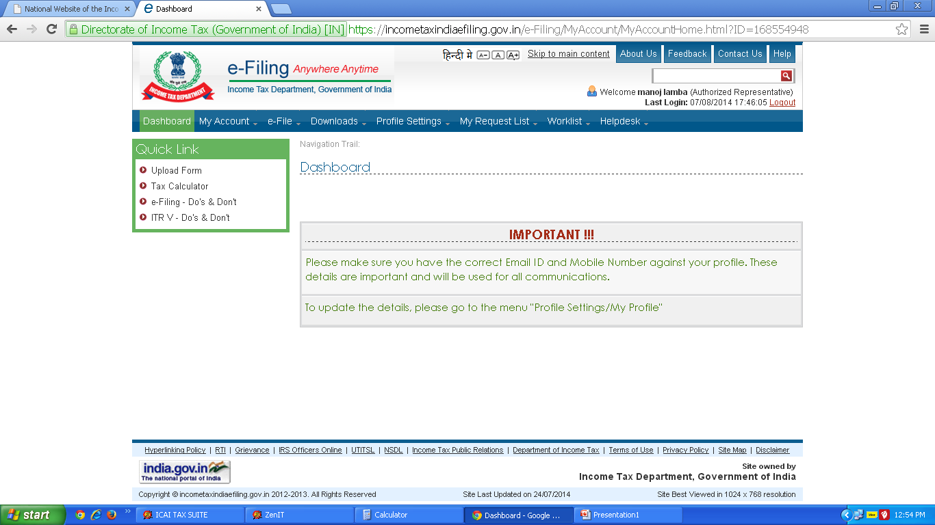

Slide 13
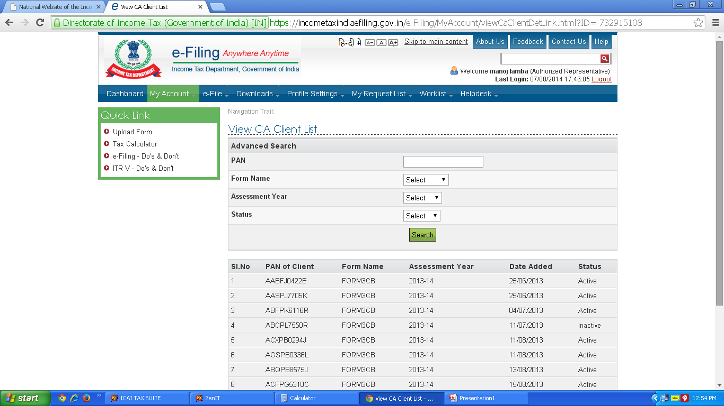

Slide 14
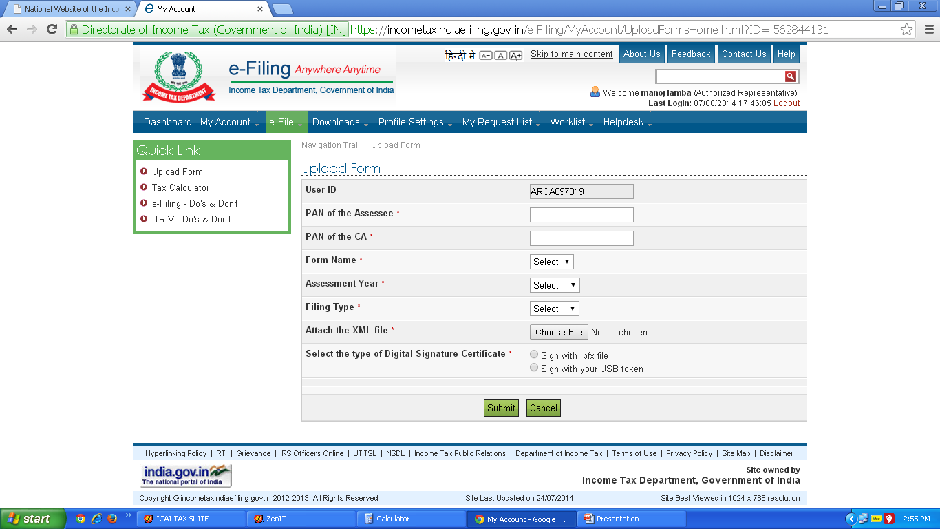

Slide 15
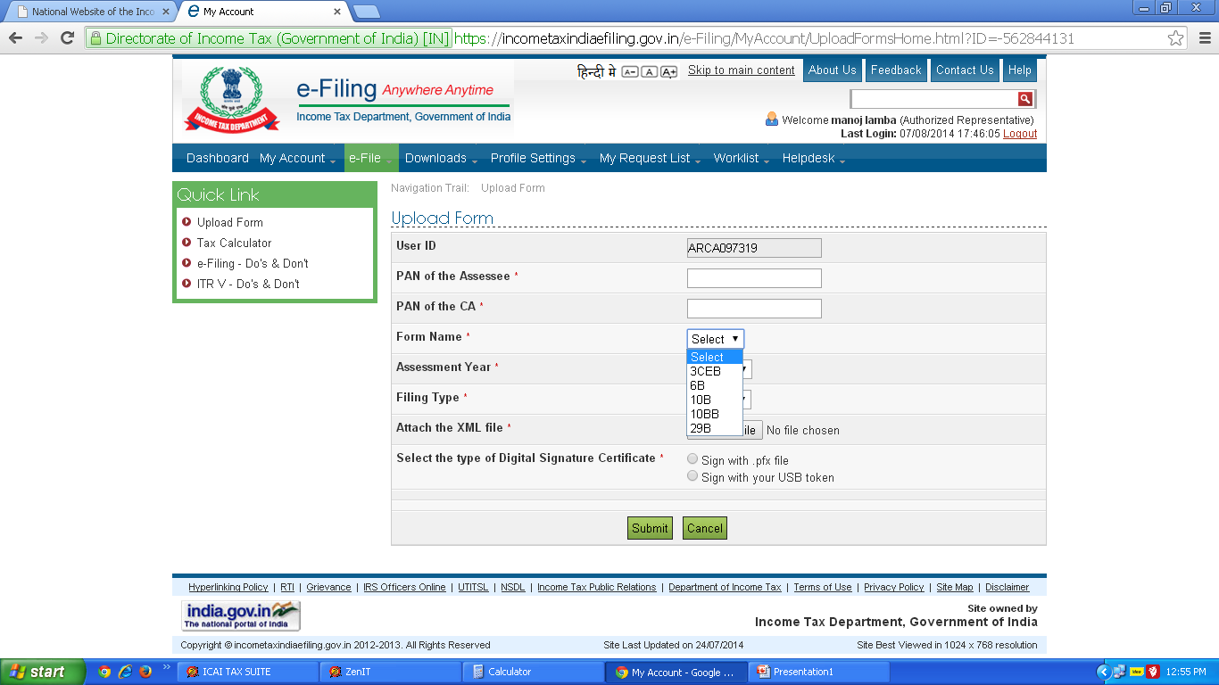

Slide 16
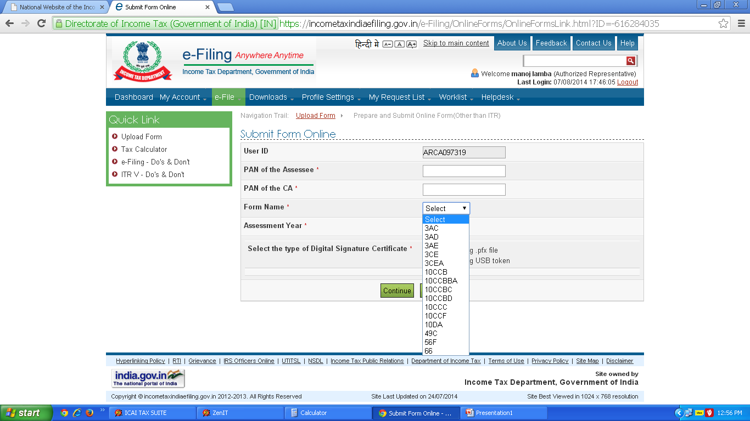

Slide 17
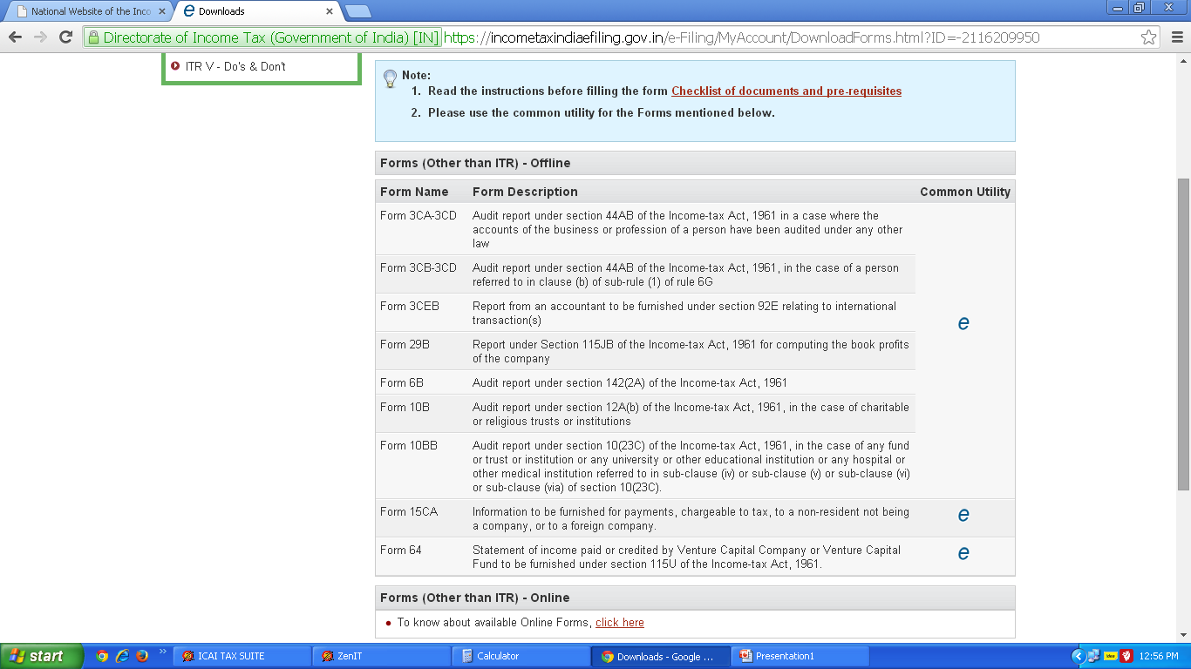

Slide 18
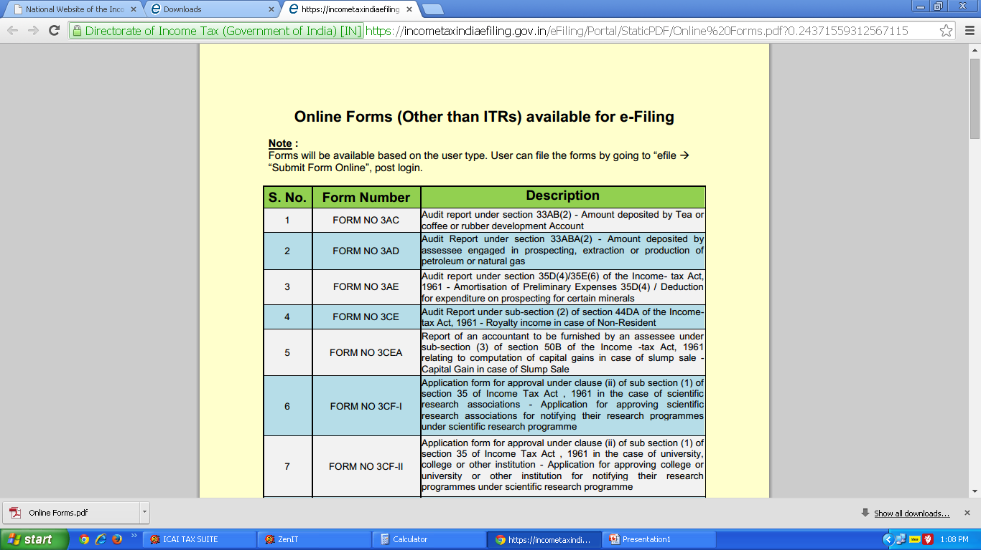
 | FORM NO 3AC | Audit report under section 33AB(2) - Amount deposited by Tea or coffee or rubber development Account
 | FORM NO 3AD | Audit Report under section 33ABA(2) - Amount deposited by assessee engaged in prospecting, extraction or production of petroleum or natural gas
 | FORM NO 3AE | Audit report under section 35D(4)/35E(6) of the Income- tax Act, 1961 - Amortisation of Preliminary Expenses 35D(4) / Deduction for expenditure on prospecting for certain minerals
 | FORM NO 3CE

Slide 19
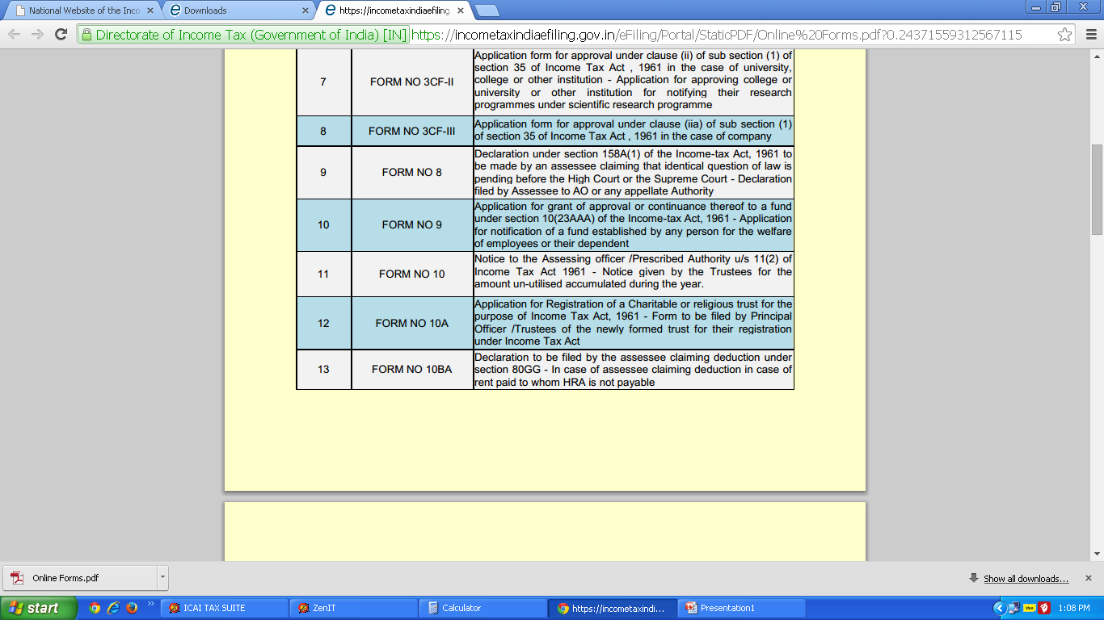

Slide 20
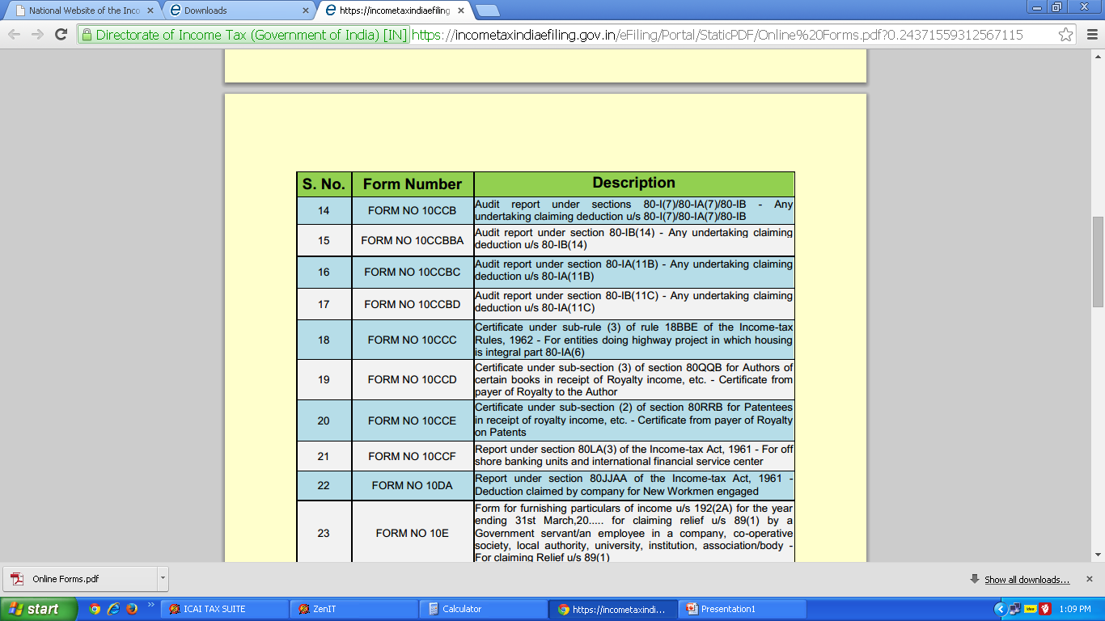

Slide 21
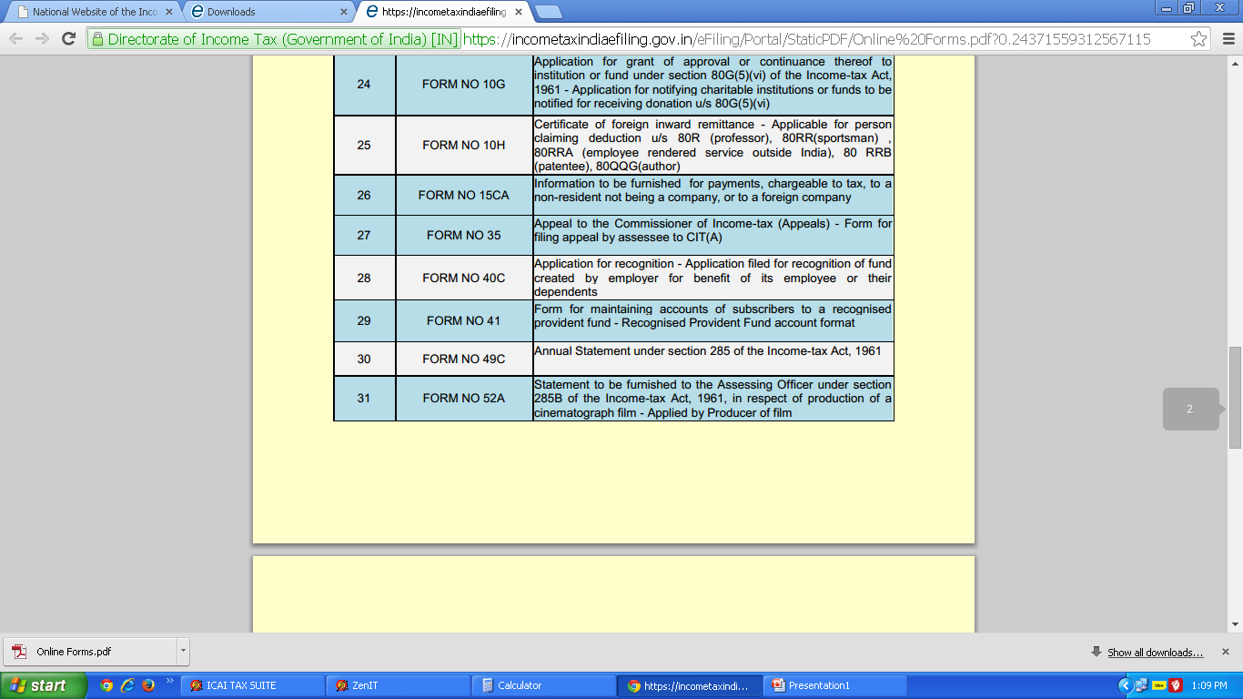

Slide 22
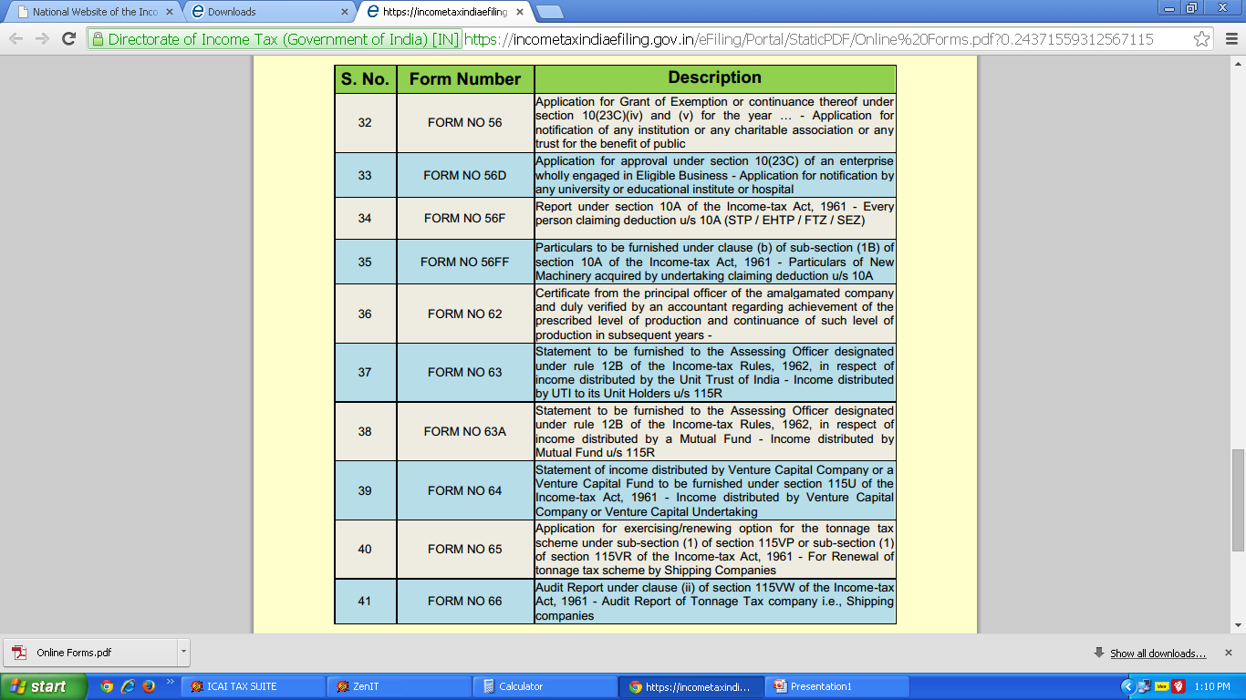

Slide 23
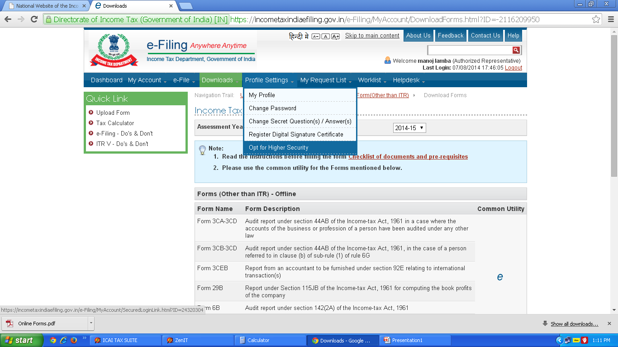

Slide 24
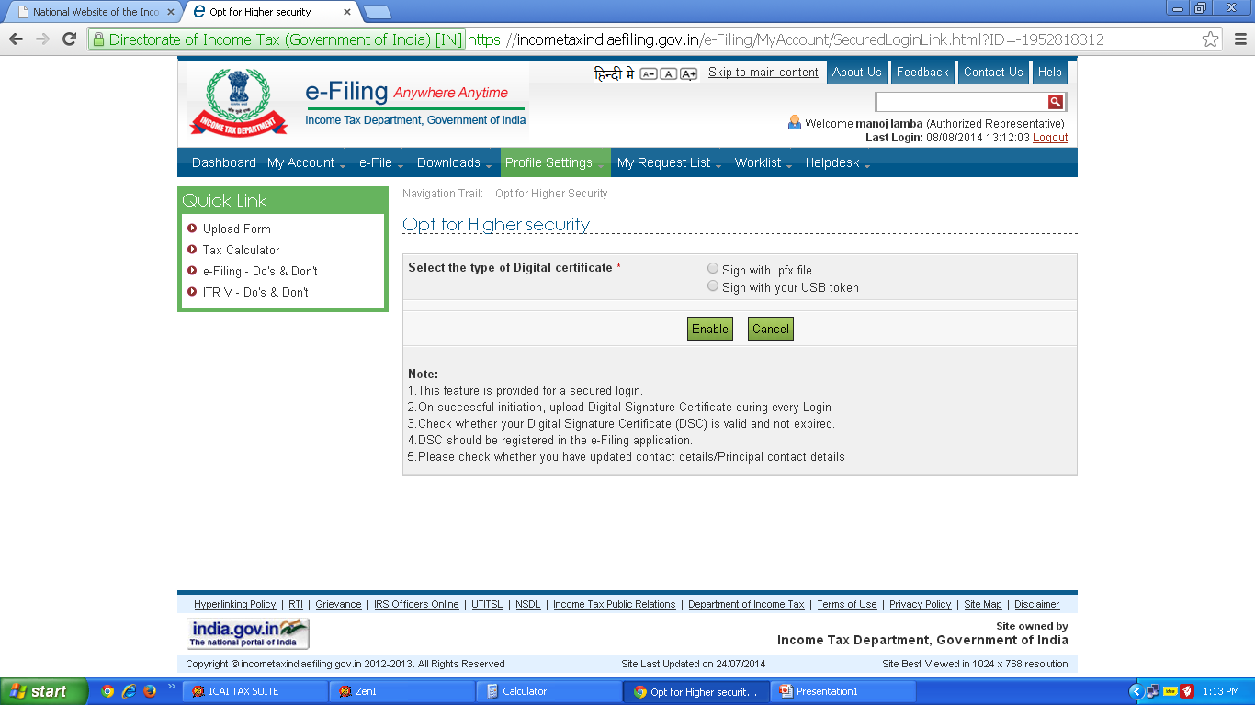

Slide 25
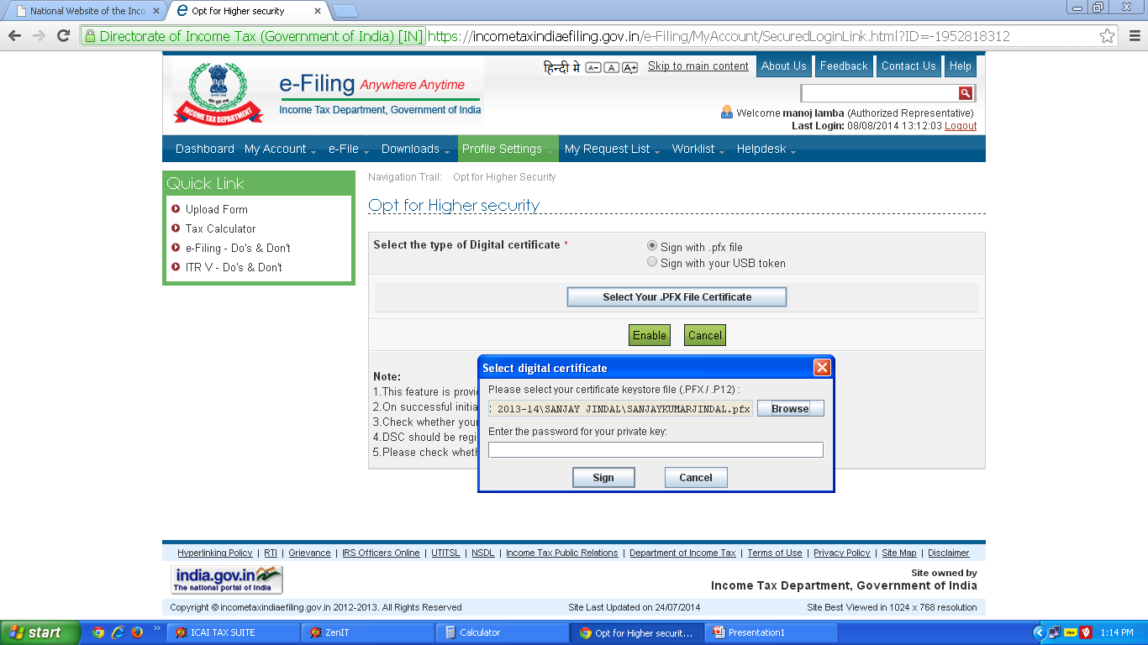

Slide 26
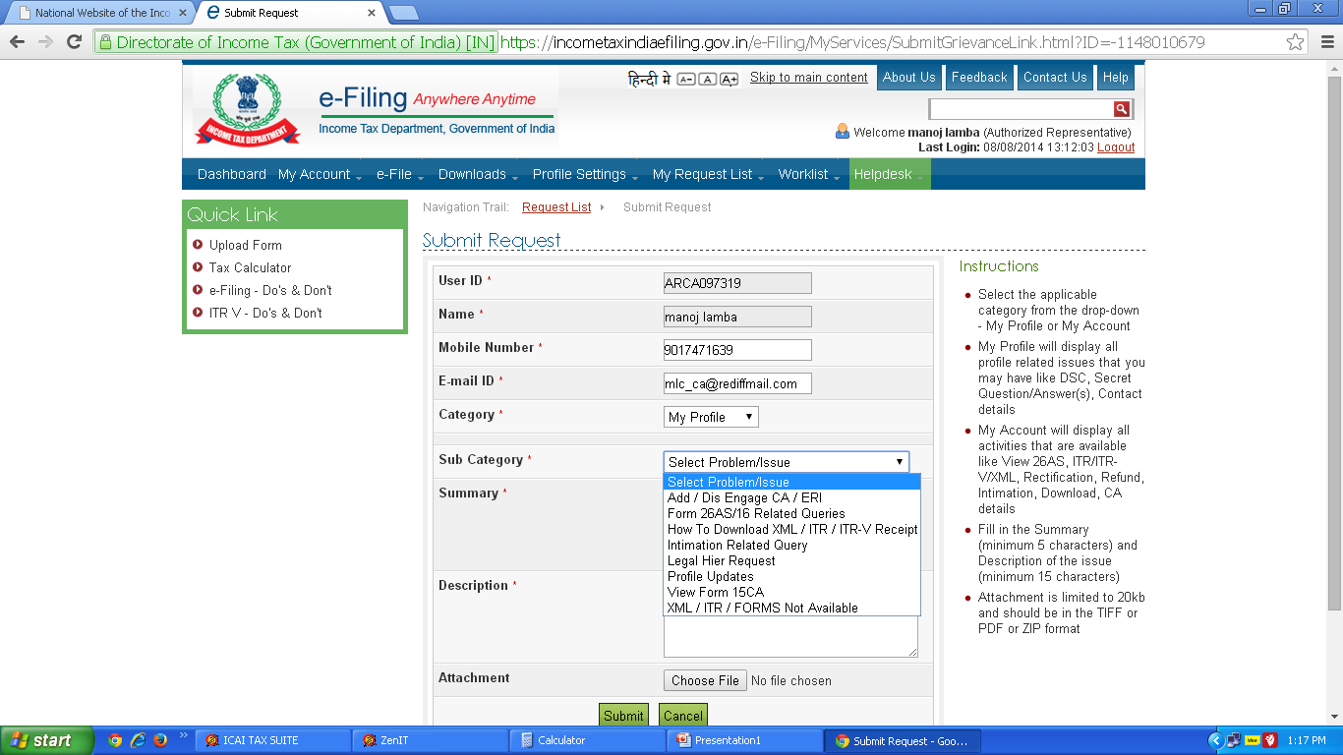

Slide 27
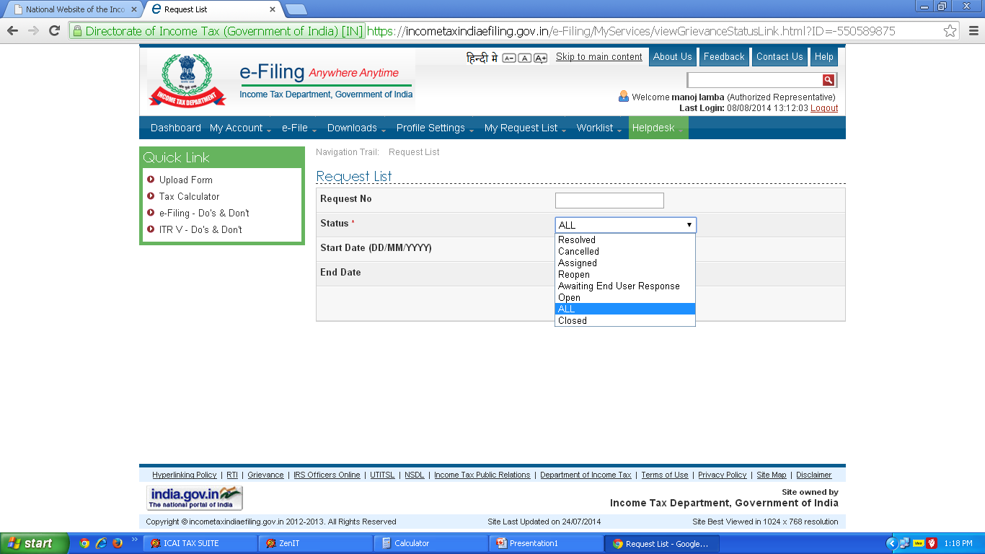

Slide 28
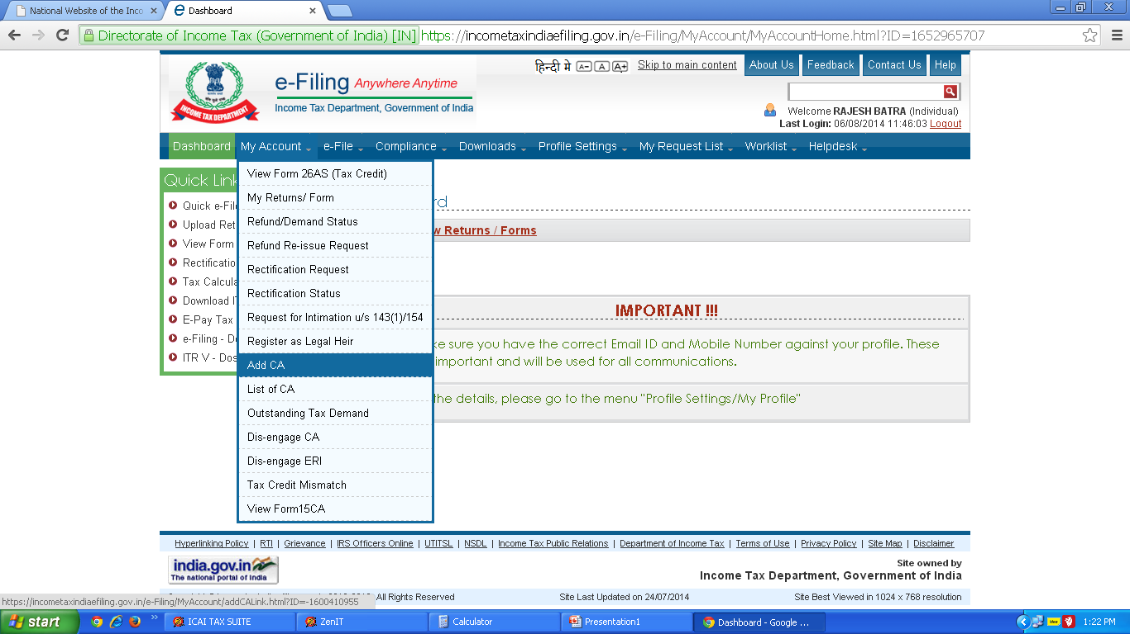

Slide 29
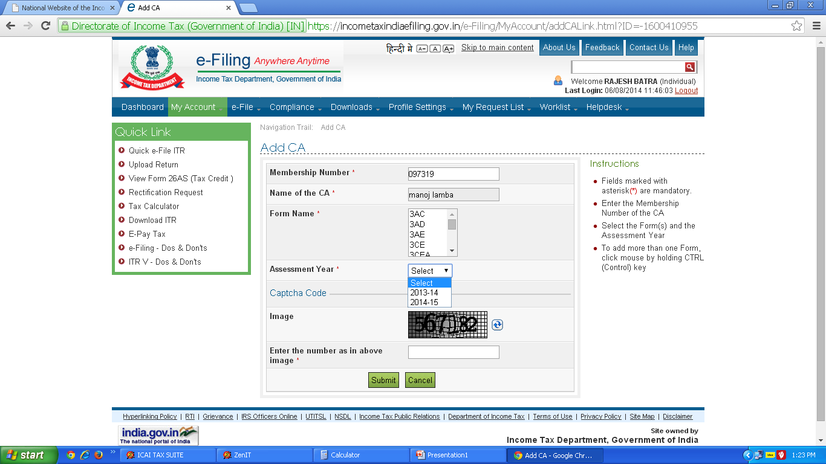

Slide 30
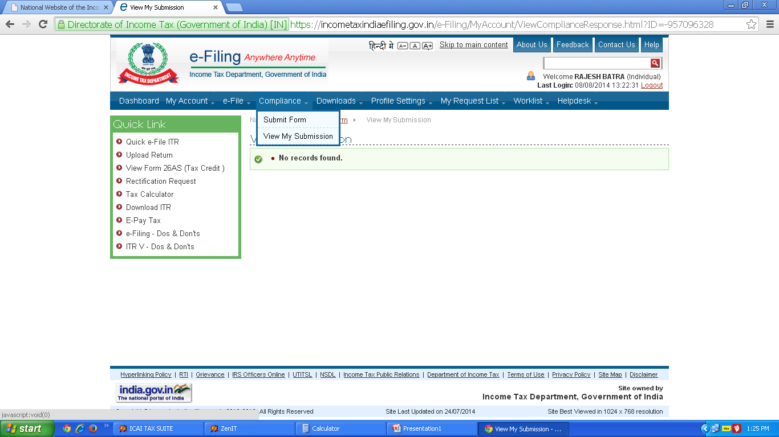

Slide 31
Safe Guard Regarding DSC

Slide 32
Safeguards
Take DSC only from CA approved by CCA.
Fill your DSC Application form yourself carefully.
Don’t forget to give correct particulars of your Identity and address.
Mention only your personal E-Mail ID which you are frequently using.
Check the PAN No. mentioned in Application Form.
Check the Class of DSC mentioned in Application Form.

Slide 33
Safeguards
Prefer to buy DSC only in E-Token.
Keep your E-Token in Lock & Key.
Frequently changed your E-Token Password.
Keep the password of Token not so simple.
Immediately make revocation request if Token is lost or unusable to CA.
Try to keep only one DSC.

Slide 34
Keep A Eye on Cyber Crimes
It is always advisable to encrypt all the important E-mails and messages over the internet so that even if it is hacked it remains of no use to the cyber criminals. At the Same time the following precautions should be taken to avoid becoming prey to the cyber criminals
    Update your antivirus/antimalware detection systems
    Take the basic precautions and don’t clink on the links you do not know.
    Try and separate internet connected system for work and for play.
    Use your own domains and not the free E-mail IDs.
    Use encryptions/digital signatures while transmitting important documents over E-mails.
    Set up standard operating procedures in the case of deviations : get on the phone.

Slide 35
Keep A Eye on Cyber Crimes
It is also suggested to use your own domain rather than free E-Mail IDs. Gmail should not be used by the Indian exporters/businessmen as their official E-Mail ID.
You generally receive missed calls from Africa/Pakistan Numbers, In case you call back to such numbers you start losing your internet minutes from mobiles and also you may expose yourself to some other frauds that the criminals may have targeted you for. It is strictly advised to not call back to the numbers from Pakistan.

Slide 36
Precautions may be adopted
Written on the Internet
  Do not Trust blindly.
  Verify them before going ahead.
  Read All E-Mails Carefully
  Look for the changes in the E-Mail IDs.
  Inform all clients abroad that bank details will never change until letter is exchanged face to face.
  Payments for goods from India will never be made to an account in the third country.
  Seek verbal confirmations before release of every payment.
  Do not use all activities like social and professional from the same mobile

Slide 37
MAJOR CHANGES IN FORM 3CA,3CB,3CD
(VIDE NOTIFICATION NO.33/2014)

Slide 38
Registration number in case of indirect tax liability:
Assesses liable to pay indirect taxes (like excise duty, service tax, sales tax, customs duty, etc.) shall furnish their registration number or any other identification number allotted to them[clause 4 of Part A]

Slide 39
Previous Year
Previous Year
From __________ to __________

Slide 40
Relevant clauses of section 44AB:
The relevant clauses of section 44AB shall be reported under which audit has been conducted[clause 8 of Part A].

Slide 41
Section 44AB of I.T. Act 1961
⁵⁶Every person,—
(a) carrying on business shall, if his total sales, turnover or gross receipts, as the case may be, in business exceed or exceeds ⁵⁷⁻⁵⁸[one crore rupees] in any previous year ⁵⁹[***]; or
(b) carrying on profession shall, if his gross receipts in profession exceed ⁶⁰[twenty-five lakh rupees] in any ⁶¹[previous year; or
(c) carrying on the business shall, if the profits and gains from the business are deemed to be the profits and gains of such person under ⁶²[section 44AE ] ⁶³[or section 44BB or section 44BBB], as the case may be, and he has claimed his income to be lower than the profits or gains so deemed to be the profits and gains of his business, as the case may be, in any ⁶⁴[previous year; or]] ⁶⁵[***]
⁶⁶[(d) carrying on the business shall, if the profits and gains from the business are deemed to be the profits and gains of such person under section 44AD and he has claimed such income to be lower than the profits and gains so deemed to be the profits and gains of his business and his income exceeds the maximum amount which is not chargeable to income-tax in any previous year,]
get his accounts of such previous year ⁶⁷[***] audited by an accountant before the specified date and ⁶⁸[furnish by] that date the report of such audit in the prescribed form duly signed and verified by such accountant and setting forth such particulars as may be prescribed :

Slide 42
Location at which books of account are kept:
New Form seeks details of the address at which books of account of assessee have been kept[clause 11(b) of Part B].

Slide 43
Nature of documents examined by the auditor:
The auditor is required to specify the nature of documents examined by him in the course of tax audit[clause 11(c) of Part B].

Slide 44
Clause XII of New 3CD
Whether the profit and loss account includes any profits and gains assessable on presumptive basis, if yes, indicate the amount and the relevant section (44AD, 44AE, 44AF, 44B, 44BB, 44BBA, 44BBB, Chapter XII-G, First Schedule or any other relevant section.)
Chapter XII-G is Now Inserted Special Provisions relating to income of shipping companies

Slide 45
Change in method of accounting/stock valuation:
A tabular format is specified for reporting of financial impact of changes in method of accounting and method of stock valuation[clause 13 and clause 14 of Part B].

Slide 46
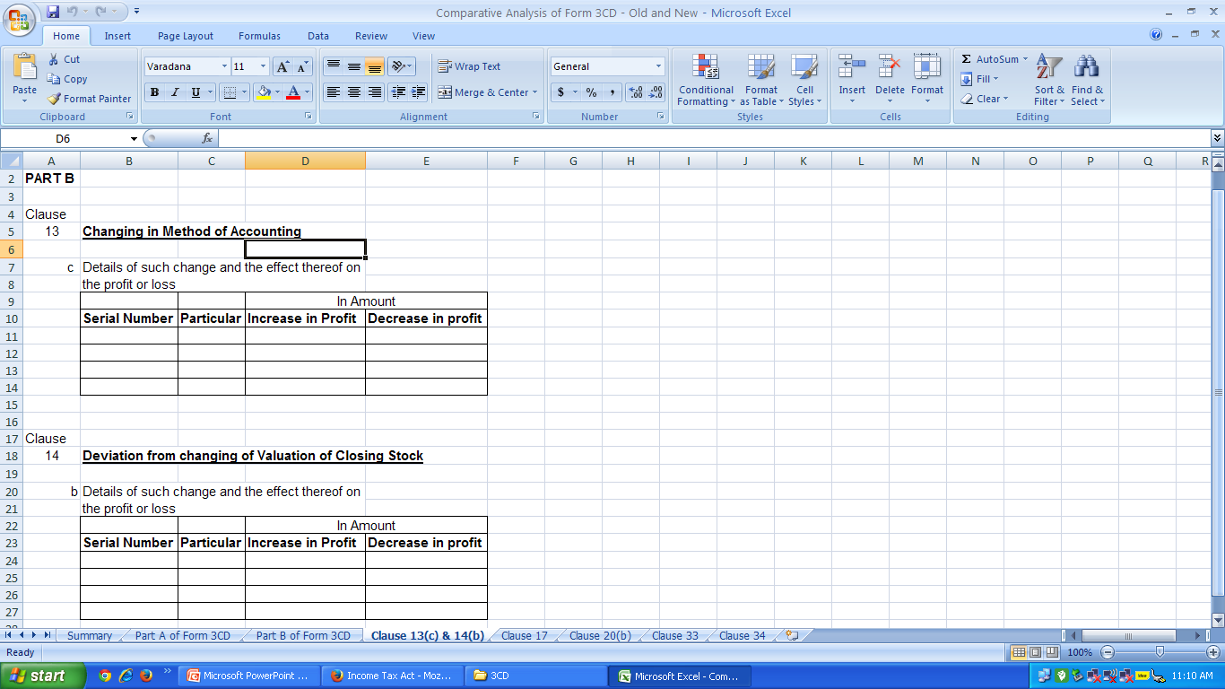

Slide 47
Transfer of land/building for less than stamp duty value:
Details of land or building transferred by assessee for less than stamp duty value (under section 43CA or under section 50C) shall be reported in new Form 3CD [clause 17 of Part B].

Slide 48
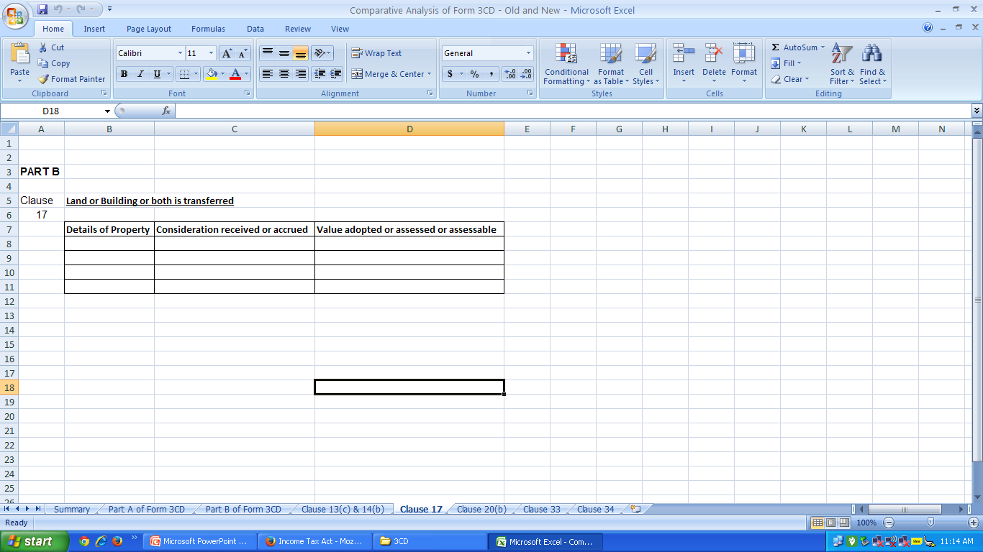

Slide 49
Deduction allowable under Sections 32AC/35AD/35CCC/35D:
Deductions allowable under sections 32AC, 35AD, 35CCC and 35DDD are also required to be reported in revised Form No. 3CD[clause 19 of Part B].

Slide 50
Sections 32AC/35AD/35CCC/35D:
Investment in New Plant & Machinery w.e.f. 01-04-2014 (Section 32AC)
Deduction in respect of expenditure on specified business (Section 35AD)
Expenditure on Agricultural extension project (Section 35CCC)
Amortization of certain preliminary expenses (Section 35D)

Slide 51
Disallowances:
Old Form3CD required reporting of inadmissible payments only when they were debited to Profit and loss account. However, the new Form 3CD requires reporting of following disallowable payments, even if they are not debited to profit and loss account[clause 21 of Part B]:
(i) Disallowance for TDS default under Section 40(a)
(ii) Disallowance for cash payments under section 40A(3)
iii) Disallowance for provision for gratuity under section 40A(7)
(iv) Disallowance under Section 40A(9)
(v) Particulars of any liability of a contingent nature
(vi) Amount of deduction inadmissible under section 14
(vii) Interest inadmissible under the proviso to section 36(1)(iii)

Slide 52
Amount inadmissible u/s 40(A)
As payment to non-resident referred to in Sub-Clause (i)
(A) Details of payments on which tax is not deducted:
(i) date of payment
(ii) amount of payment
(iii) nature of payment
(iv) name & address of the payee
(B) Details of payment on which tax has been deducted but has not been paid during the previous year or in the subsequent year before the expiry of time prescribed under section 200(1)
(i) date of payment
(ii) amount of payment
(iii) nature of payment
(iv) name & address of the payee
(v) amount of tax deducted

Slide 53
Amount inadmissible u/s 40(A)
(II) as payment referred to in sub-clause (ia):
(A) Details of payment on which tax is not deducted:
(i) date of payment
(ii) amount of payment
(iii) nature of payment
(iv) name & address of the payee
(B) Details of payment on which tax has been deducted but has not been paid on or before the due date specified in sub section (1) of section 139.
(i) date of payment
(ii) amount of payment
(iii) nature of payment
(iv) name & address of the payee
(v) amount of tax deducted
(vi) amount out of (V) deposited, if any

Slide 54
Disallowance/deemed income u/s 40A(3)
On the basis of the examination of books of accounts and other relevant documents/evidence, whether the expenditure covered under section 40A(3) read with rule 6DD were made by account payee cheque drawn on a bank or account payee bank draft. If not, please furnish the details:
Serial Number | Date of Payment | Nature of Payment | Amount | Name and Permanent Account Number of the payee, if available

Slide 55
Disallowance/deemed income u/s 40A(3)
On the basis of the examination of books of accounts and other relevant documents/evidence, whether the expenditure covered under section 40A(3A) read with rule 6DD were made by account payee cheque drawn on a bank or account payee bank draft. If not, please furnish the details of amount deemed to be the profits and gains of business or profession under section 40A(3A)
Serial Number | Date of Payment | Nature of Payment | Amount | Name and Permanent Account Number of the payee, if available

Slide 56
Deemed income under Section 32AC:
Section 32AC of the Act provides for investment allowance of 15% for investment in plant and machinery. New form provides for reporting of deemed income which results from sale or transfer of new asset, (if asset was acquired and installed by the assessee for the purpose of claiming deductions under Section 32AC) within a period of five years from the date of its installation[clause 24 of Part B].

Slide 57
Receipt of unlisted shares:
A new clause is inserted in the Form 3CD which requires reporting of all unlisted shares which were received by assessee either for inadequate consideration or without consideration in view of section 56(2)(viia)[clause 28 of Part B].

Slide 58
Issue of shares above fair market value:
A new clause is inserted in the Form 3CD which requires reporting of all transactions of issue of shares where consideration received by assessee exceeds its fair market value in view of section 56(2)(viib)[clause 29 of Part B].

Slide 59
Speculation losses:
New Form No. 3CD provides for reporting of losses from speculation business as referred to in Section 73[clause 32(c) of Part B].

Slide 60
Losses from business specified under section 35AD:
Assessee shall furnish details of losses incurred as referred to in Section 73A in respect of specified businesses mentioned in Section 35AD[clause 32(d) of Part B].

Slide 61
Reporting of deductions claimed under Sections 10A and 10AA:
If any deduction has been claimed by assessee under Sections 10A and 10AA then it shall be reported in new Form No. 3CD[clause 33 of Part B].

Slide 62
Compliance with TCS provisions:
Old Form 3CD required reporting on compliance with TDS provisions only. However, New Form No. 3CD requires reporting on compliance with TCS provisions as well[clause 34(a) of Part B].

Slide 63
TDS/TCS Reporting Format
Tax Deduction and collection Number(TAN) | Section | Nature of Payment | Total amount of payment or receipt of the nature specified in column (3) | Total amount on which tax was required to be deducted or collected out of Column (4) | Total amount on which tax was deducted or collected at specified rate out of Column (5) | Amount of tax deducted or collected out of column (6) | Total amount on which tax was deducted or collected at less than specified rate out of (7) | Amount of tax deducted or collected on (8) | Amount of tax deducted or collected not deposited to the credit of the Central Government out of (6) and (8)

Slide 64
Filing of TDS/TCS statements:
The tax auditor shall report on the compliance by the assessee with the provision of furnishing of TDS or TCS statement within prescribed time[clause 34(b) of Part B].

Slide 65
TDS/TCS Return Filing Reporting Format
Tax Deduction and collection Number(TAN) | Type of Form | Due Date of Furnishing | Date of Furnishing, if Furnished | Whether the statement of tax deducted or collected contains information about all transactions which are required to be reported

Slide 66
Assessee-in-default:
If assessee is deemed as an assessee-in-default and he is liable to pay interest under Section 201(1A) or 206C(7), the tax auditor shall furnish the TAN of assessee, interest payable and interest actually paid[clause 34(c) of Part B].

Slide 67
Assessee-In-Default Reporting Format
Tax Deduction and collection Number (TAN) | Amount of interest under section 201(1A) /206C(7) is payable | Amount paid out of column (2) along with date of payment

Slide 68
Dividend Distribution Tax:
Revised Form No. 3CD requires reporting of following reductions as referred to in clause (i) and clause (ii) of Section 115-O(1A)[clause 36 of Part B]:
i) Dividend received by domestic company from its subsidiary, and
ii) The amount of dividend paid to any person for or on behalf of the New Pension System Trust referred to in Section 10(44).
Please note this clause only to be applicable in case of companies .

Slide 69
Audits:
Cost audit:
Old Form No. 3CD required reporting only when statutory cost audit was carried out under Section 233A of the Companies Act, 1956. However, the revised Form No. 3CD specifies reporting requirement even when cost audit has been carried out voluntarily. The requirement of attachment of copy of cost audit report along with Form has been substituted with reporting of qualifications in cost audit report[clause 37 of Part B].

Slide 70
Cost Audit under Central Excise Act
The requirement of attachment of copy of cost audit report along with Form has been substituted with reporting of qualifications in cost audit report [clause 38 of Part B].

Slide 71
Special Audit under Service Tax
If any service-tax audit is carried out in relation to valuation of taxable services, the tax auditor shall report any qualifications made in relation to valuation of taxable services[clause 39 of Part B].

Slide 72
Ratios:
Unlike old form which required reporting of certain ratios pertaining to current year only, the new Form requires reporting of ratios of preceding financial year as well. Further, total turnover is to be reported for the previous year as well as for preceding financial year[clause 40 of Part B].

Slide 73
Ratios Reporting Format
S. No. | Particulars | Previous Year | Preceding Previous Year
1. | Total Turnover of the assessee
2. | Gross Profit/Turnover
3. | Net Profit/Turnover
4. | Stock-in-trade/Turnover
5. | Material Consumed/finished goods produced
(The details required to be furnished for principal items of goods traded or manufactured or services rendered)

Slide 74
Demand raised or refund issued:
The new Form seeks details of demand raised or refund issued under any tax laws (other than Income Tax Act, 1961 and Wealth Tax Act, 1957) along with details of relevant proceedings[clause 41 of Part B].

Slide 75
The word MODVAT is replaced by word CENVAT everywhere in new 3CD
This is a welcome change.

Slide 76
Controversies with regard to section 269SS/269T
Finance Act 2014 made a amendment in section 269SS and 269T making payment through E-Banking Channel valid for the purpose of these section but new form 3CD still requires reporting from CA whether loan is taken or repaid otherwise than A/c payee cheque.

Slide 77
Controversies with regard to section 40A(3)
Finance act 2014 making payment made through E-banking Channel valid for the purpose of section 269SS/269T but section 40A(3) still remains untouched. Similar amendment required here.

Slide 78
Requirement of certificates u/s 40A(3) and 269SS/269T
Earlier 3CD insists the CA to take certificate from assessee regarding payments u/s 40A(3) and 269SS/269T but now the new notified form 3CD nowhere mention about these certificates. In my opinion these certificates has gone now.

Slide 79
No space for Membership No. & FRN
There is no space for mentioning membership No. & FRN in newly notified form 3CD.

Slide 80
Annexures to 3CD
Annexure I & II of Form 3CD has been gone now

Slide 81
Some important points from old 3CD
Method of accounting employed in previous year (Clause13(a) of new 3CD).
List of Books of Accounts
Method of valuation of closing stock employed in the previous year
Deviation from the method of valuation of stock from section 145A.
Depreciation allowable
Chapter wise deduction under chapter VI A.

Slide 82
Some tests for applicability of Section 44AB
Person
Carrying on business & Profession
Turnover/Gross Receipts exceeding specified limit
Specified date

Slide 83
Some Doubtful Issues:-
Whether Tax Audit is applicable on exempt Income
Whether a partner taking remuneration in excess of one crore is liable to tax audit
How to determine turnover in some special cases
Whether the tax audit is require for assesses claiming exemption under part C of chapter VI A.

Slide 84
Thanks
For Suggestions & Queries mail me at mlc_ca@rediffmail.com

