Slide 1



Knowledge Session

Slide 2
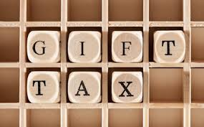
Taxation of Gifts

Slide 3







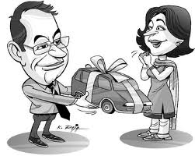
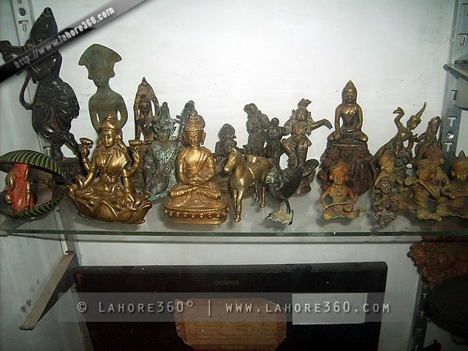

Gifts

Slide 4

Gift - definition
No definition under the Income Tax Act
U/S 122 of TP Act:
“Gift is the transfer of certain existing movable or immovable property made voluntarily and without consideration by one person called the Donor to another called the Donee and accepted by or on behalf of the Donee.”

Slide 5
HISTORY AND PREAMBLE
Gift tax introduced in 1958 and abolished in 1998. Reintroduced in 2004.
Gift Tax Act,1958 in existence up to 30th September 1998.
Section 56(2)(v) from 01.09.2004 by Finance (No.2) Act, 2004.
Section 56(2)(vi) from 01.04.2006 by Taxation Laws (Amend.) Act,2006.
Section 56(2)(vii) from 01.10.2009 by Finance (No.2) Act, 2009.
Section 56(2)(viia) from 01.06.2010 by Finance Act, 2010.
Section 56(2)(viia) from 01.04.2010 by Finance (No. 2) Act, 2009.

Slide 6
Object - taxing Gifts
CBDT Circular No. 5/2005 dated 15.07.2005
“In order to curb bogus capital building and money laundering a sub section has been inserted in section 56 to provide that any sum received without consideration on or after 1st Sept. 2004…………”
If the amount so received exceeds the limit specified, the whole of the amount shall become taxable.
Section 2 (24) Definition of Income amended to include the Income referred in 56(2)(v).

Slide 7
APPLICABILITY
Section 56(2)(vii)
w.e.f. 01.10.2009
Any gift
Received by an individual or HUF in a year
In the form of any sum of money (cash/Cheque/DD) or specified property
In excess of Rs. 50,000
The whole amount is chargeable to tax.
Subject to exemption/exception clause relating to relatives or occasions.

Slide 8
Specified property
Immovable property being land or building or both
Shares and securities
Jewellery
Archaeological collections
Drawings
Paintings
Sculptures
Any work of art (or)
Bullion [w.e.f. 1.6.2010]

Slide 9
Non Applicability
Received from any relative
On the occasion of marriage
Under a will/inheritance
In contemplation of death of the payer or donor
From any local authority as defined in the Explanation to clause (20) of section 10
From any fund/foundation/university/other educational institution/hospital/ other medical institution/any trust or institution referred to in clause (23C) of section 10
From any trust or institution registered under section 12AA.

Slide 10
Meaning-Relatives
Explanation to clause (vi) of sub-section (2) of section 56
Spouse
Brothers or Sisters
Brothers or Sisters of the spouse
Brothers or Sisters of either of the parents of the individual
Parents
Parents of spouse
Lineal ascendant or descendant of the individual
Lineal ascendant or descendant of the spouse of the individual
Spouse of the person referred to in clauses (ii) to (vi);

Slide 11
Taxability u/s 56(2)(vii)
Nature of Assets | Particulars | Value Taxable
Sum of Money | Without consideration | Whole amount if same exceedsRs.50,000
Immovable property | Without consideration | Whole amount of the stamp duty value of the property, if exceeds Rs.50,000
Any specified property, other than immovable property | Without consideration | the aggregate fair market value of which exceeds Rs.50,000, the whole of the aggregate fair market value of such property
Immovable property | Inadequate consideration | Stamp duty value - Consideration > 50K Stamp duty value - Consideration = Income
Any specified property, other than immovable property | Inadequate consideration | FMV-Consideration > 50K FMV – Consideration = Income

Slide 12
Shares as gift
Section 56(2) (viia) w.e.f.1.6.10
Firm, LLP, Pvt. Ltd. Co. and unlisted Public Limited Company
Receives shares of Pvt. Ltd. Co. or Public unlisted Co. without consideration / inadequate consideration
Sec 56(2) is applicable.
Value to be considered is FMV as on transfer date
Determination of FMV as per Rule11U &11UA-notification No.23/2010 dated 08.04.2010.

Slide 13
Valuation rules
Valuation Rules – 11U & 11UA
Valuation of Jewellery, archeological collections, drawings, paintings, bullions etc:
Price it would fetch if sold in open market
Invoice value if purchased from registered dealer
Report from registered valuer
Valuation of shares & securities-
Purchase of quoted shares through recognized stock exchange transaction value recorded at stock exchange
Other than above, lowest price quoted on the stock exchange on valuation date or the lowest price quoted on immediately preceding date if there is no quotation on valuation date
FMV of unquoted shares as per prescribed formula.

Slide 14
Specific Issues
An individual or HUF receiving gifts during the assessment year needs to disclose it in the income tax return under the head Income from other sources.
Gift from HUF to Members – No exemption, HUF is not a relative of the member.
Gift from members to HUF - No exemption, members are not the relative of HUF.
Immovable Property: Effective date of donation & Receipt of Property
Sec 17 (1)(a) of The Indian Registration Act,1908 – Registration required.
Sec 47 of The Indian Registration Act,1908 – The documents operates from the date of execution and not from the date of registration.
[T V Kalyanasundaram Pillai Vs Karuppa Mooppanar AIR 1927 PC]
When the instrument of gift has been handed over by the donor to the donee and accepted by him, the former has done every thing in his power to complete the donation and to make it effective. Registration does not depend upon his consent but is the act of an officer appointed by law for the purpose. The Privy Council took the view that the transaction of gift was complete on the date on which the document was executed and not on the date on which it was subsequently registered.
Credit Card Swipes
Registration of gifts

Slide 15
Recapitulation
Gift – Definition
Preamble & History
Object
Applicability
Meaning of Specified Property
Meaning of Relatives
Non Applicability
Taxability
Valuation Rules
Specific Issues

Slide 16

Question???

Slide 17
Pathshala game
Q 1. Gifts received by Mr. S during the year 2012-13. Taxable or not?
From Mr. A – Rs. 25,000
From Mr. B – Rs. 35,000
Ans: Taxable. Aggregate of gifts received during the year from various persons.
Q 2. Gifts valuing Rs. 60K received from a relative on birthday. Taxable?
Ans: Not taxable. Received from any relative on any occasions.
Q 3. Gifts valuing Rs. 60K received from a non-relative on marriage. Taxable?
Ans: Not taxable. Received on marriage from anyone.
Q 4. Gifts valuing Rs. 60K received from a non-relative on marriage. Taxable?
Ans: Not taxable. Received on marriage from anyone.
Q 5. Gifts received from sister’s daughter. Exempt?
Ans: No. Sister’s daughter does not come under relatives definition.

Slide 18



