Slide 1

CA. Sameer Kashikar

Slide 2

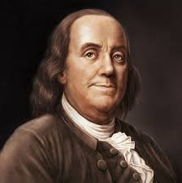
Famous quotes on Tax
“The hardest thing to understand in the world is the income tax.”
Albert Einstein
“Certainty? In this world nothing is certain but death and taxes.”
-Benjamin Franklin

Slide 3


Slide 4
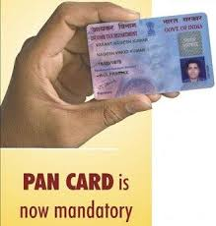
Permanent Account Number (PAN)
PAN CARD is issued by the Indian Income Tax department for the purpose of financial identification
Permanent Account Number (PAN), as the name suggests, is a permanent number and does not change during lifetime of PAN holder.

Slide 5



Uses of PAN
  For Filling Income Tax Returns
  Opening demat accounts
  Deposit of Rs 50,000 and above in the banks
  Investments in shares, mutual funds, bonds, Bank draft and post office savings in excess of Rs 50,000 each
  Sale or purchase of motor vehicles, excluding two wheelers

Slide 6


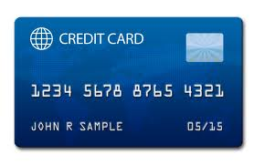
Use fo PAN (Cont . . .)
Sale or purchase of immovable properties valued at Rs 5 lakhs and above
Payment of Rs 25,000 or more against hotel bills
Getting new credit card

Slide 7
OTHER POINTS
Is Income Tax Return must be filed once you get PAN?
Just because you have PAN, it is not necessary to file Income Tax Return.
You CANNOT you have more than one PAN?
For non/wrong Disclosure of PAN there is penalty of Rs 10,000/-

Slide 8

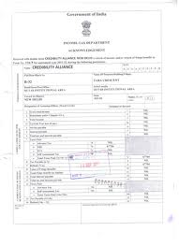

Tax terminology
Income tax : The direct tax paid by the person whose income is more than maximum exemption limit prescribed
Income Tax Return : Annual statement of income received and taxes paid in Previous F.Y.
Assessee : person by whom tax, penalty, interest etc. payable under Income Tax Act.

Slide 9
Financial Year : 1st April to 31st March
Asssessment year : Year following F.Y. in which assessment of Income & tax is made
Form 16 : This form carries details of Salary Income and Income tax deducted by employer
Form 16A : The certificate that mentions TDS on income from sources other than salary
Form 26AS : Annual Tax statement on Tax information network of Income tax department.

Slide 10

Heads of Income
1.) Income from Salary
2.) Income from House Property
3.) Income from Business/Profession
4.) Income from Capital Gains
5.) Income from Other Sources

Slide 11

Income tax slab
For Individual below 60 years of age
Slab | Tax rate
Up to 2 Lakhs | 0%
2,00,001 to 5 Lakhs | 10%
5,00,000 to 10 Lakhs | 20%
Above 10 Lakhs | 30%

Slide 12

Income tax slab
For Senior citizen age 60 years and above
Slab | Tax rate
Up to 2.5 Lakhs | 0%
2,50,000 to 5 Lakhs | 10%
5,00,001 to 10 Lakhs | 20%
Above 10 Lakhs | 30%

Slide 13

Income tax slab
For Very Senior citizen age 80 years and above
Slab | Tax rate
Up to 5 Lakhs | 0%
5,00,001 to 10 Lakhs | 20%
Above 10 Lakhs | 30%

Slide 14


Slide 15
Section 80 C
100%deduction would be available from Gross Total Income subject to maximum ceiling given u/s 80CCE.Following investments are included in this section
Contribution towards premium on life insurance (10% of the sum insured)
Contribution towards Public Provident Fund.(Max.100,000 a year)
Contribution towards Employee Provident Fund
Unit Linked Insurance Plan (ULIP).
Purchase of National Saving Certificate (NSC)
Interest accrued in respect of NSC
Equity Linked Savings Schemes (ELSS)
Repayment of housing Loan (Principal)
Tuition fees for child education

Slide 16
Section 80 C Contd . . .
Tax Saving Fixed Deposits of Post office & Schedule Bank
NABARD Bonds
Senior Citizen Saving Schemes

Slide 17

Section 80D
Deduction in respect of Medical Insurance Premia
In case of an individual – insurance on the health of the assessee, or wife or husband, or dependent parents or dependent children.
In case of an HUF – insurance on the health of any member of the family
Amount of deduction : Maximum Rs. 15,000, in case the person insured is a senior citizen (exceeding 65 years of age) the maximum deduction allowable shall be Rs. 20,000
The premium may be paid by any mode of payment, other than cash.
Amount paid for preventive check up to Rs 5,000 in total under both the heads of the individual and family members and the parents of the individual

Slide 18
Section 80DD
Deduction in respect of maintenance including medical treatment of handicapped dependent
Deduction is allowed in respect of – any expenditure incurred by an assessee, during the previous year, for the medical treatment training and rehabilitation of one or more dependent persons with disability; and
Amount deposited, under an approved scheme of the Life Insurance Corpn. Or other insurance company or the Unit Trust of India, for the benefit of a dependent person with disability
Amount of deduction : the deduction allowable is Rs. 50,000 in aggregate for any of or both the purposes specified above, irrespective of the actual amount of expenditure incurred

Slide 19
Section 80DDB
Deduction in respect of medical treatment
A resident individual or Hindu Undivided family deduction is allowed in respect of during a year for the medical treatment of specified disease (e.g.: Cancer, AIDS, renal failure, Neurological diseases) or ailment for himself or a dependent or a member of a Hindu Undivided Family
Amount of Deduction Amount actually paid or Rs. 40,000 which ever is less
allowable In case of amount is paid in respect of the assessee, or a person dependent on him, who is a senior citizen the deduction allowable shall be Rs. 60,000

Slide 20

Section 80E
Deduction in respect of Repayment of Loan taken for Higher Education
An individual assessee who has taken a loan from any financial institution or any approved charitable institution for the purpose of pursuing his higher education
Amount of Deduction : any amount paid by the assessee in the previous year, out of his taxable income, by way of repayment of loan or interest thereon, subject to a maximum of no limit

Slide 21

Section 80G -Donation
Deduction in respect of donations to certain funds, charitable institutions, etc.
100 % deduction is allowed in respect of donations to : National Defence Fund, Prime Minister’s National Relief Fund, Armenia Earthquake Relief Fund, Africa Fund, National Foundation of Communal Harmony, an approved University or educational institution of national eminence, Chief Minister’s earthquake Relief Fund etc.
In all other cases donations made qualifies for the 50% of the donated amount for deductions.

Slide 22
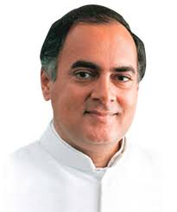
Section 80CCG -RGESS
The Rajiv Gandhi Equity Savings Scheme (RGESS) provides tax benefits under Section 80CCG for new equity investors in specified instruments.
The eligible securities include stocks listed on the BSE-100, CNX 100 indices, Maharatna, Navratna or Miniratna PSU companies, IPOs of PSUs with an annual turnover of more than Rs 4,000 crore and RGESS-compliant mutual fund ETFs.
Tax benefit is available to investors if their annual income is less than Rs 12 lakh.
The deduction is 50% of the amount invested up to a maximum of Rs 25,000.
No sale, pledge or hypothecation is allowed for one year from the date of purchase, and if violated, the tax benefits are withdrawn.
The benefit under Section 80CCG is available for a period of three years

Slide 23

Section 80TTA –Saving Bank Interest
Interest on Saving bank account up to Rs.10,000 is allowed as deduction.
Section 80GGC –Contribution to political party
Section 24 Interest on Housing loan up to Rs. 1,50,000/-

Slide 24

Section 80U -
Deduction in the case of a person with disability
The taxpayer is an individual
He is resident in india
The taxpayer suffers 40% of more bye Blindness, Low Vision, Leprosy-cured, hearing impairment, mental illness
This is certified by medical authority
a fixed deduction of Rs.50,000 is available. A higher Deduction of Rs.75,000 is allowed in respect of a person with severe disability

Slide 25
Computation of Income
1.) Income from Salary XXXX
2.) Income from House Property XXX
3.) Income from Business/Profession XX
4.) Income from Capital Gains X
5.) Income from Other Sources XXXXX
GROSS TOTAL INCOME (Sec. 14) XXXX
Less:Deductions u/chap-VI-A (Sec.80C to 80U) XXX
TOTAL INCOME [Sec.2(45)] XXXX
Tax Due XXX
Less:Rebates and Reliefs u/Chap-VIII XX
Tax Payable XXXX

Slide 26


Slide 27
Benefits of Return Filing
You are liable to pay interest at the rate of one percent for every month after the due date till the date of filing the return.
Under income tax law, if you have sustained a Business loss or loss under the head “Capital Gains”, you can carry forward the loss ONLY if you file the Income Tax Return by the due date
Revised return can be filed
The acknowledgment for filing the tax returns would come in handy in case a visa is required to be obtained; the document would serve as proof of the financial soundness of the individual.
If a loan is required to be obtained from a financial institution, the tax returns would be required to prove the ability of the person to repay the loan
If a refund is due after adjustment of prepaid taxes, it is necessary to file the Income Tax Return to get the refund from the Income Tax Department.

Slide 28

E- Filing
From A.Y. 2013-14, E-Filing of return is mandatory for all salaried individual whose Gross total income is above 5 Lakhs

Slide 29
Income Tax Forms
There are two income tax return forms, ITR-1 Sahaj & ITR-2 , for salaried individuals
Income sources decides your return form for particular A.Y.
ITR-1 (SAHAJ) : Income from Salary, Pension, other sources, one house property (except whose loss is brought forward from previous year) with tax exempt income upto Rs. 5000/-
ITR-2 : Income or loss from house property if carried forward, Capital gains from sale of house property or shares, Tax exempt above Rs. 5000/-

Slide 30

Keep preceding year’s return handy
Check tax credit statement by viewing Form 26AS downloaded from e-filing portal
Ensure disclosure of income from all sources
Personal & bank details
Keep documents ready
Don’t leave process incomplete remember to despatch signed copy of ITR-V by ordinary or speed post only

Slide 31

Don’t be afraid of filing Income tax return yourself
All you need to do is to brushup your technical skill on computers and collect some important documents, something you would need to do anyway, even if you use services of portals or professionals

Slide 32
e-Filing Process – At a glance
Select appropriate type of Return Form
Download Return Preparation Software for selected Return Form.
Fill your return offline and generate a XML file.
Register and create a user id/password
Login and click on relevant form on left panel and select "Submit Return"
Browse to select XML file and click on "Upload" button
On successful upload acknowledgement details would be displayed. Click on "Print" to generate printout of acknowledgement/ITR-V Form.
Incase the return is digitally signed, on generation of "Acknowledgement" the Return Filing process gets completed. You may take a printout of the Acknowledgement for your record.
Incase the return is not digitally signed, on successful uploading of e-return, the ITR-V Form would be generated which needs to be printed by the tax payers. This is an acknowledgement cum verification form. The tax payer has to fill-up the verification part and verify the same. A duly verified ITR-V form should be submitted with the local Income Tax Office within 120 days of filing electronically.

Slide 33
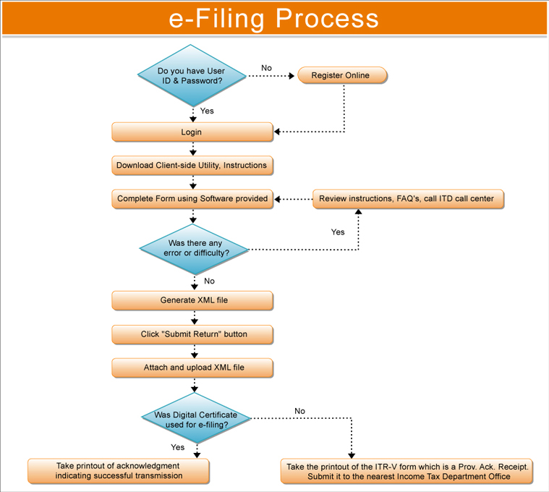

Slide 34


