Slide 1
TRANSFER PRICING
Prepared by:
Jayant Sethia
Whatsapp:91-8505854213
Facebook: www.facebook.com/jackysethia

Slide 2
Genesis for New TPR
The presence of multinational enterprises in India and their ability to allocate profits in different jurisdictions by controlling prices in their intra-group transactions has made the issue of transfer pricing a matter of serious concern.

Slide 3
Features
Introduced by the Finance Act, 2001
  Finance Act 2002 - clarificatory amendments
  Circular 14 – Memorandum explaining new TPR
Based on the Arm’s Length Principle
Initial Burden of Proof is on the Assessee

Slide 4

The process of fixation of Pricing of any Transaction between Associated Enterprises of MNC’s is known as “Transfer Pricing”

Slide 5
Overview - Indian Regulations
Provisions | Sections / Rules
Computation of Income, Expenses, CCA | S. 92
Associated Enterprises | S. 92A
Transactions subject to TPR | S. 92B
Specified Domestic Transaction | S. 92BA
Computational Provisions | S. 92C(1) / Rule 10B/10C
Powers of AO & Transfer Pricing Officer | S. 92C / S. 92CA
Safe Harbour Rules | S. 92CB
Advance Pricing Arrangement | S. 92CC – 92CD
Documentation Requirements | S. 92D / Rule 10D
Audit & Transfer Pricing Report | S. 92E, Rule 10E & Form 3CEB
Penalties | 271 (1)(c), 271AA, BA, G
Definitions | S. 92F/Rule 10A

Slide 6
Section 92
Provides for computation of –
  - Income
  - Expenses
  - Cost Contributions
at Arms Length Price (ALP)
ALP means price applied or to be applied in transactions between unrelated persons & in uncontrolled conditions.
TPR not to apply to cases which has the effect of reducing income chargeable to tax or increase the loss [s. 92(3)]

Slide 7
Concept
Associated enterprise
Independent entity
International transactions
- goods
- services
- intangibles
- loans
Resident
Resident
Transfer price
Arm’s length price

Slide 8
Associated Enterprises
Enterprise regarded as AE – Section 92A (1)
  Based on the concept of commonality of Control. Management or Capital as contained in Article 9 of the OECD Model Tax Convention
Enterprises deemed to be AE – Section 92A (2)
  Capital –
    Shareholding (a & b), Loan ( c ), Guarantee for borrowing (d), interest (e);
  Management
    Appointment of Directors or Executive Director (e & f)
  Control
    Intangible property (g), production/trading activities (h & i) , others (j & K )
  Relationship of mutual interest (m)

Slide 9
Transaction [S. 92F(v)]
Transaction includes an arrangement, understanding or action in concert –
whether or not formal or in writing;
whether or not intended to be enforceable by legal proceedings.

Slide 10
International Transaction [S. 92B]
A transaction between two
Associated Enterprises,
Either or both of whom are
Non - Residents,
in the nature of
Purchase, sale or lease of tangible or intangible property
Provision of services
Lending or borrowing money
any other transaction having a bearing on the profits, income, losses or assets of the enterprises
Cost Sharing arrangements

Slide 11
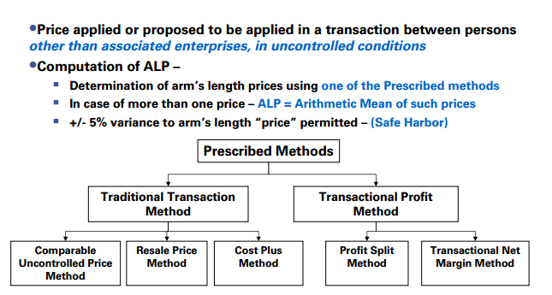
Arm’s Length Price (ALP)

Slide 12
Methods of TPR
Price applied in a transaction between independent enterprises in uncontrolled conditions
To be determined by applying the Most Appropriate Method, being one of the following five methods
  Comparable Uncontrolled Price (CUP) Method
  Resale Price Method (RPM)
  Cost Plus Method (CPM)
  Profit Split Method (PSM)
  Transactional Net Margin Method (TNMM)
In case, more than one price is determined by MAM:
  Apply Arithmetic mean
  Range of + 5% of the arithmetic mean
Traditional transaction methods
Transactional profit methods

Slide 13
Computation Provisions
ALP to be determined by any of the methods, specified under s. 92C, being the Most Appropriate Method (MAM).
MAM to be applied in the manner prescribed by Rule 10C
Range of +/- 5% permitted.

Slide 14
Methods Overview
In general
  Comparable Uncontrolled Price (“CUP”) Method compare prices
  Resale Price Method (“RPM”) compares gross margins
  Cost Plus Method (“CPM”) compares profit mark-ups on costs
  Profit Split Method (“PSM”) refers to the total profits from transactions and splits them among the parties based on the level of contribution
  Transactional Net Margin Method (“TNMM”) analyses net profit in relation to an appropriate base, such as costs, sales or assets

Slide 15
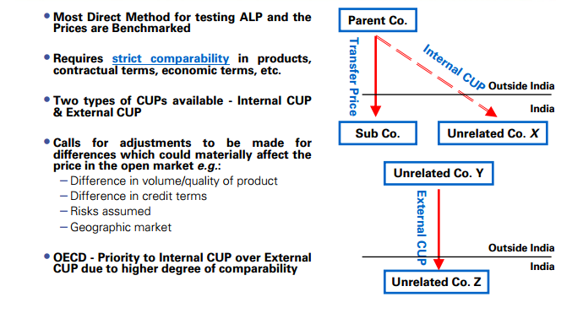
Comparable Uncontrolled Price Method (CUP)

Slide 16
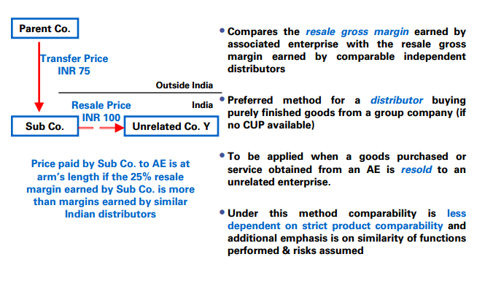
Resale Price Method (RPM)

Slide 17
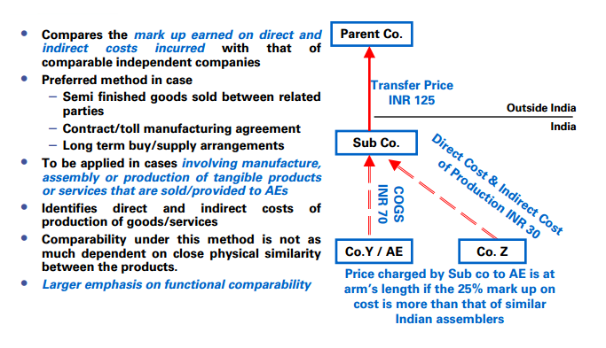
Cost Plus Method (CPM)

Slide 18
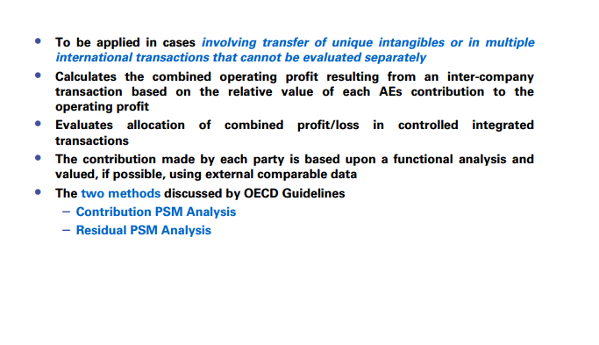
Profit Split Method (PSM)

Slide 19
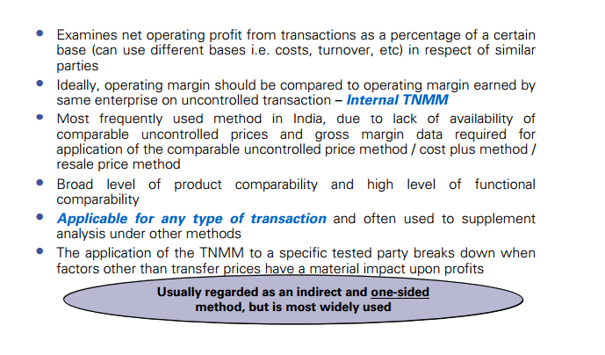
Transactional Net Margin Method (TNMM)

Slide 20
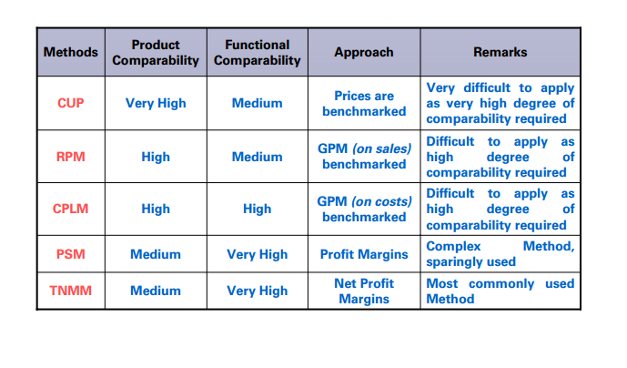
Summary of Methods

