Slide 1


Tax
dj

Slide 2

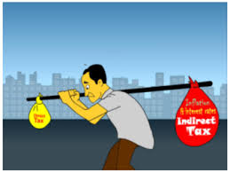
Tax
Direct Tax
Indirect Tax
1)
Income Tax
1)
ServiceTax
2)
Wealth Tax
2)
Vat
3)
Excise Duty
4)
Custom Duty
5)
Entertainment Tax

Slide 3

Interoduction
A fee Charged ("levied") by a Government on a product, income, or activity.
If tax is levied directly on personal or corporate income, then it is a direct tax.
If tax is levied on the price of a good or service, then it is called an indirect tax.
The purpose of taxation is to finance government expenditure. One of the most important uses of taxes is to finance public goods and services, such as street lighting and street cleaning. Since public goods and services do not allow a non-payer to be excluded, or allow exclusion by a consumer, there cannot be a market in the good or service, and so they need to be provided by the government or a quasi-government agency, which tend to finance themselves largely through taxes.

Slide 4


Direct Tax
If tax is levied directly on personal or corporate income, then it is a direct tax.
A tax that is paid directly by an individual or organization to the imposing entity.
A taxpayer pays a direct tax to a government for different purposes, including real property tax, personal property tax, income tax or taxes on assets.
Direct taxes are different from indirect taxes, where the tax is levied on one entity, such as a seller, and paid by another, such a sales tax paid by the buyer in a retail setting.

Slide 5


1) - Income Tax
Income tax is an annual tax on income.
The Indian Income Tax Act (Section 4) provides that in respect of the total income of the previous year of every person, income tax shall be charged for the corresponding assessment year at the rates laid down by the Finance Act for that assessment year.
Section 14 of the Income tax Act further provides that for the purpose of charge of income tax and computation of total income all income shall be classified under the following heads of income:

Slide 6
A. Salaries
B. Income from house property
C. Profits and gains of business or profession.
D. Capital gains
E. Income from other sources.

Slide 7

A. Salaries
Agreed-upon and regular compensation for employment that may be paid in any frequency but, in common practice, is paid on monthly and not on hourly, daily, weekly, or piece-work basis.

Slide 8


B. Income From House property
The annual value of any property you own is taxable under the head 'income from house property'. While there are a few deductions available from this income, income from a property is not taxable under the head 'income from house property' when...
a. The property is used for one's own business or profession.
b. The property is self-occupied.
c. It is income from a farmhouse.
d. It is the property income of a local authority.
e. It is the property income of a university or an educational institution.
f. It is the property income of a trade union.
g. It is property held for charitable or religious purposes.
h. It is the property income of a political party.
i. It is the property income of an approved scientific research association.

Slide 9

C. Profits and gains of business or profession.

Slide 10
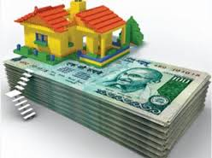
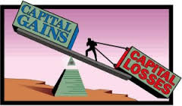
D. Capital Gains
1. An increase in the value of a capital asset (investment or real estate) that gives it a higher worth than the purchase price. The gain is not realized until the asset is sold. A capital gain may be short term (one year or less) or long term (more than one year) and must be claimed on income taxes. A capital loss is incurred when there is a decrease in the capital asset value compared to an asset's purchase price.
2. Profit that results when the price of a security held by a mutual fund rises above its purchase price and the security is sold (realized gain). If the security continues to be held, the gain is unrealized. A capital loss would occur when the opposite takes place.

Slide 11
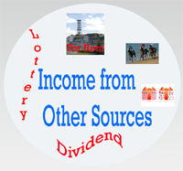
E. Income from other sources.
Income from Other Sources is residual head. In general, if an income does not fall with the classification of,
1. Salaries, or
2. Income From House Property, or
3. Profit and Gain of Business or Profession ,
4. Capita Gains, or
Then it shall be charged as Other Sources Income.

Slide 12

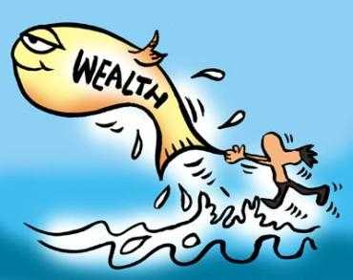
2. Wealth Tax
It is a tax based on the market value of assets that are owned. These assets include, but are not limited to, cash, bank deposits, shares, fixed assets, private cars, assessed value of real property, pension plans, money funds, owner occupied housing and trusts. An ad valorem tax on real estate and an intangible tax on financial assets are both examples of a wealth tax. Although many developed countries choose to tax wealth, the United States has generally favored taxing income.

Slide 13
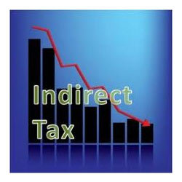
Indirect Tax
Charges levied by the State on consumption, expenditure, privilege, or right but not on income or property . Customs duties levied on imports, excise duties on production, sales tax or value added tax (VAT) at some stage in production-distribution process, are examples of indirect taxes because they are not levied directly on the income of the consumer or earner. Since they are less obvious than income tax(because they don't show up on the wage slip) politicians are tempted to increase them to generate more state revenue. Also called consumption taxes, they are regressive measures because they are not based on the ability to pay principle.

Slide 14



1. Service Tax
Service tax is a tax levied by the government on service providers on certain service transactions, but is actually borne by the customers.
Definition: Service tax is a tax levied by the government on service providers on certain service transactions, but is actually borne by the customers. It is categorized under Indirect Tax and came into existence under the Finance Act, 1994.

Slide 15


1. VAT
Specific type of turnover tax levied at each stage in the production and distribution process. Although VAT ultimately bears on individual consumption of goods or services, liability for VAT is on the supplier of goods or services. VAT normally utilizes a system of tax credits to place the ultimate and real burden of the tax on the final consumer and to relieve the intermediaries of any final tax cost.

Slide 16



1. Excise Duty
1. A percentage levied on manufacture, sale, or use of locally produced goods (such as alcoholic drinks or tobacco products).
2. A percentage tax levied on a company's revenue, instead of (like income tax) on the company's income.
3. A fixed tax levied on an activity or occupation, such as the license fee charged from attorneys, doctors, and other professionals. Also called excise tax.

Slide 17


1. Custom Duty
A tax levied on imports (and, sometimes, on exports) by the customs authorities of a country to raise state revenue, and/or to protect domestic industries from more efficient or predatory competitors from abroad.
Customs duty is based generally on the value of goods or upon the weight, dimensions, or some other criteria of the item (such as the size of the engine, in case of automobiles).

Slide 18


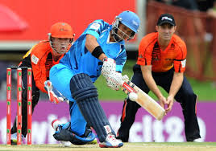
1. Entertainment Tax
In India, entertainment tax is levied on every financial transaction that is related to entertainment such as movie tickets, major commercial shows and big private festivals. As per the Indian Constitution, entertainment is included in List 2. This revenue is reserved primarily for the state governments.
Following are some other forms of entertainment that are included in the purview of entertainment taxes:
Amusement parks
Video games
Arcades
Exhibitions
Celebrity stage shows
Sports activities
Cinema hall

