Slide 1

MINIMUM
ALTERNATE
TAX

Slide 2

Why MAT???........Reasons for its Introduction
MAT
Objective of MAT is to levy tax on “Zero tax companies”
To make sure that companies having large profits and declaring substantial dividends to shareholders but not paying tax to the Govt by taking advantage of the various incentives and exemptions provided in the Income-tax Act, pay a fixed percentage of book profit as minimum alternate tax.

Slide 3
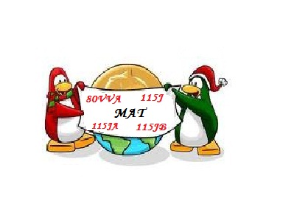
MAT
Journey of MAT
Section | Inserted By Finance Act | Applicable from | Applicable up to
80VVA | 1983 | AY 1984-85 | AY 1987-88
115J | 1987 | AY 1988-89 | AY 1990-91
115JA | 1996 | AY 1997-98 | AY 2000-01
115JB | 2000 | AY 2001-02 | Till Date
Section 80VVA
The levy of a minimum tax on companies was first introduced through this section. The method adopted by this section was to place a ceiling on the aggregate quantum of incentives available under various provisions of the Act . However , the unabsorbed incentives were allowed to be carried forward and set off against taxable income in future years.
Section 115J
The concept of tax on book profits was introduced originally under this section. Here, the tax was levied on 30% of Book Profits .

Slide 4
MAT
Journey of MAT
Contd. . .
Section 115JA
According to this section, if the taxable income of the company thus computed is less than 30% of its book profits, then the total income of such assesses chargeable to tax shall be deemed to an amount equal to 30% of such book profits.
Section 115JB
Later by the Finance Act, 2000, section 115JB was inserted in the Income Tax Act, 1961, which came into effect from the assessment year 2001-02, providing for the levy of Minimum Alternate Tax (MAT) on Companies.

Slide 5

Applicability
MAT
Applicable to
Companies (both domestic and foreign)
However the provisions of MAT contained in section 115JB would not apply to the following incomes accruing or arising on or after 1st April 2005
Income from any business carried on by an entrepreneur in a SEZ (10AA);
Income from the services rendered by an entrepreneur from a unit in a SEZ (10AA);
Income of a Developer from the development of a SEZ. (80IAB)

Slide 6


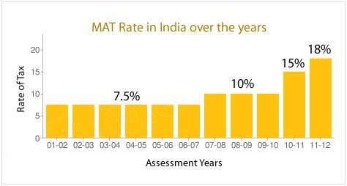
MAT
Rate of MAT
Assessment Year | Rate of MAT (% of Book Profit) | Surcharge (if book profit exceeds Rs 1 crore)
2012-13 | 18.5 | 5
2011-12 | 18 | 7.5
2010-11 | 15 | 10
2007-10 | 10 | 10
2001-07 | 7.5 | 10

Slide 7
MAT
Computation of Tax Liability
STEP - 1
Computation of Tax liability under normal provisions
a. Compute the total income of the company (ignoring the provision of section 115JB).
b. Compute the Income Tax payable on total income at normal rates on the profit calculated above.
STEP - 2
Computation of MAT Liability
Calculate Book profit.
After computing book profits, calculate 18.5 per cent of book profits (as per the provisions of section 115JB).
STEP - 2
STEP - 1
then the tax payable by the company will be equal to 18.5% of book profits.
IF

Slide 8
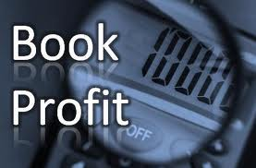
MAT
Book Profit
The book profit shall mean the net profit as shown in the profit and loss account prepared in accordance with the provisions of Part II and III of Schedule VI to the Companies Act, 1956 as adjusted by certain additions/deductions as specified.

Slide 9
MAT
Book Profit
Contd. . .
ADDITIONS
(a) | The amount of income-tax paid or payable*, and the provision therefore
(b) | The amounts carried to any reserves, by whatever name called, other than a reserve specified under section 33AC
(c) | The amount or amounts set aside to provisions made for meeting liabilities, other than ascertained liabilities
(d) | The amount by way of provision for losses of subsidiary companies
(e) | The amount or amounts of dividends paid or proposed
(f) | The amount or amounts of expenditure relatable to any income to which section 10 [other than the provisions contained in clause (38) thereof] or section 11 or section 12 apply
(g) | the amount of depreciation
(h) | the amount of deferred tax and the provision therefore
(i) | The amount or amounts set aside as provision for dimi­nution in the value of any asset
(j) | the amount withdrawn from any reserve or provision, if any such amount is credited to the profit and loss account

Slide 10
MAT
Book Profit
Contd. . .
DEDUCTIONS
(a) | The amount withdrawn from any reserve or provision
(b) | The amount of income to which any of the provisions of section 10 [other than the provisions contained in clause (38) thereof] or section 11 or section 12 apply
(c) | The amount of depreciation debited to the profit and loss account (excluding the depreciation on account of revaluation of assets)
(d) | The amount withdrawn from revaluation reserve and credited to the profit and loss account, to the extent it does not exceed the amount of depreciation
(e) | The amount of loss brought forward or unabsorbed depreciation, whichever is less as per books of account
(f) | The amount of deferred tax, if any such amount is credited to the profit and loss account
*Note: Income Tax includes Dividend Distribution Tax / Tax on Distributed Income, interest, Surcharge, Education Cess, Secondary and Higher Education Cess.

Slide 11

MAT
MAT Credit entitlement (Section 115 JAA))
This section provides that where tax is paid in any assessment year in relation to the deemed income under section 115JB, the excess of tax so paid over and above the tax payable under the other provisions of the Income-tax Act, will be allowed as tax credit in the subsequent years.
The tax credit is, therefore, the difference between the tax paid under section 115JB and the tax payable on the total income computed in accordance with the other provisions of the Act.
The tax credit shall be allowed to be set off in a year in which tax becomes payable on the total income computed in accordance with provisions of the Act other than section 115JB.
This tax credit is allowed to be carried forward for ten assessment years succeeding the assessment year in which the credit became allowable.
Such credit is allowed to be set off against the tax payable on the total income in an assessment year in which the tax is computed in accordance with the provisions of the Act, other than 115JB, to the extent of excess of such tax payable over the tax payable on book profits in that year.

Slide 12
MAT
MAT Credit entitlement (Section 115 JAA))
MAT credit shall be allowed to be carried forward as follows:
Finance Act | Period of carry forward
Finance Act , 2005 | 5 years
Finance Act , 2006 | 7 years
Finance Act , 2010 | 10 years
Note : The amount of MAT Credit to be carried forward shall be exclusive of Cess and Surcharge.

Slide 13
MAT
A Numerical Illustration
Assessment Year | Normal Tax Liability | Tax Liability U/s 115JB | Tax Payable [Higher of (2) and (3)] | MAT Credit Entitlement (4) – (2) | Credit U/s 115JAA Utilized | Credit available for carry forward
(1) | (2) | (3) | (4) | (5) | (6) | (7)
2009-10 | 200 | 290 | 290 | 90 | - | 90
2010-11 | 270 | 300 | 300 | 30 | - | 120
2011-12 | 320 | 260 | 320 | - | 60 | 60
2012-13 | 360 | 290 | 360 | - | 60 | -

Slide 14
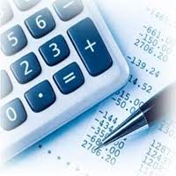
MAT
Accounting for MAT
MAT credit entitlement will be treated as an asset and the accounting will be done by crediting the Profit & loss A/c, if there is a virtual certainty that the company will be able to recover the MAT credit Entitlement in future limited period. It will be disclosed under Loans and Advances. In the year of adjustment full provision shall be made for Tax Liability, and in the Balance Sheet the Provision for Tax shall be shown net off MAT credit Entitlement.
Note: The Accounting for MAT Credit entitlement is governed by a guidance note issued by the ICAI in this regard.

Slide 15
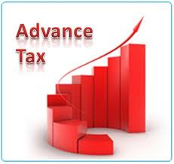
MAT
Does Advance tax apply to MAT?
Yes it is compulsory to pay advance tax in the case of MAT as mentioned in CBDT Circular No.13/2001 dated 09/11/2001. Also Karnataka High Court in the case of Jindal Thermal Power has held that advance tax is payable under MAT. The companies liable to pay MAT are liable for the payment of advance tax and failing to do so will attract interest u/s 234B and 234C of the Act.

Slide 16

MAT
Report to be furnished u/s 115JB
Under Sec 115JB(4), every company to which this section applies, shall furnish a report in Form No. 29B, as prescribed under rule 40B, from an accountant, certifying that the Book Profits has been computed in accordance with the provisions of Sec 115JB. This report has to be accompanied with the return of income filed under Sec 139(1) or 142(1)(i).
Role of Chartered Accountant
Section 115JB, inserted by the Finance Act, 2000 has cast a responsibility on the chartered accountant to certify that the book profit has been computed in accordance with the provisions of the Income-tax Act. He has also to certify the income-tax payable by the company.

Slide 17
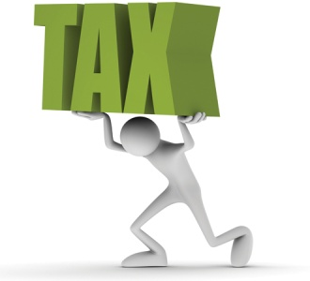
MAT
Way Forward….. MAT under Direct Tax Code
MAT Rate increased from 18.5% to 20% on Book Profit MAT Credit forward period increased from 10 years to 15 years. Wealth tax paid to be added back Tax on Branch profit paid by foreign company to be added back No allowance of deduction u/s 80HHC of IT Act
No Specific Grandfathering provision for MAT credit accumulated under IT Act

Slide 18


