Slide 1
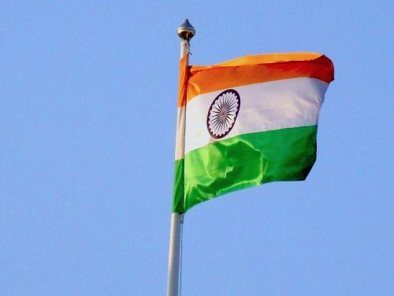
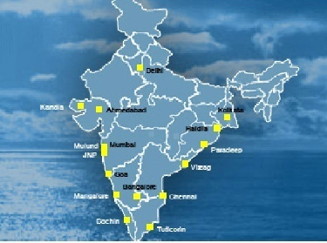
Taxes in India

Slide 2
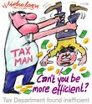
TYPES OF TAXES IN INDIA
DIRECT TAXES
Income tax
Wealth tax
Property tax etc.
INDIRECT TAXES
Sales tax
Vat
Excise duty
Custom duty etc.
  If the taxpayer bears its incidence and is not able to pass on the burden, such tax is direct tax.
  If the taxpayer is just a conduit and every stage the tax-incidence is passed on till it finally reaches the consumer, who really bear the brunt of it, such tax is indirect tax.

Slide 3
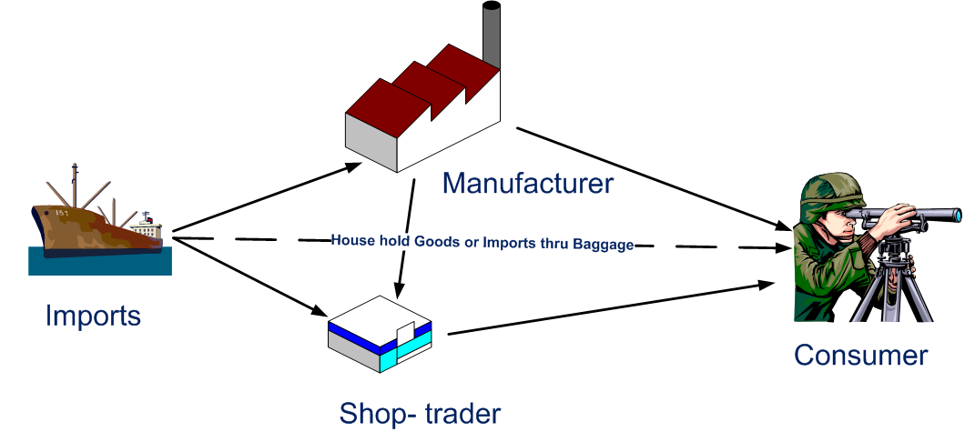
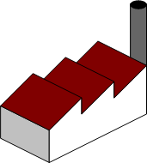
How Goods Move

Slide 4
Constitutional Framework...
Taxes levied by Central Government and State Government(s)
Authority to levy a tax is derived from the Constitution of India
  Which allocates power to levy various taxes between the Centre and State
  Article 265 of the Constitution which states that "No tax shall be levied or collected except by the authority of law”
Article 246 of the Indian Constitution, distributes legislative powers including taxation, between the Parliament of India and the State Legislature
Schedule VII enumerates use of three lists;
  List - I Where the parliament is competent to make laws
  List - II Where only the state legislature can make laws
  List - III Where both the Parliament and the State Legislature can make laws upon concurrently

Slide 5
……Constitutional Framework
Union List | State List | Concurrent List
Income Tax Custom Duty Excise Duty Corporation Tax Service tax Central Sales Tax Stamp duty in respect of bills of exchange, cheques, promissory notes, etc | Taxes on lands and buildings Excise duty on alcoholic liquor etc Entry tax Sales Tax Tolls Luxury Tax Stamp duty in respect of documents other than those specified in the provisions of List I | Stamp duties other than duties or fees collected by means of judicial stamps, but not including rates of stamp duty

Slide 6
Constitutional Amendment Bill
Introduction of Article 246A in the Constitution:
  “Parliament and the Legislature of every State, have power to make laws with respect to goods
  and services tax imposed by the Union or by that State respectively.
  Provided that Parliament has exclusive power to make laws with respect to goods and services tax where the supply of goods, or of services, or both takes place in the course of inter-State trade or commerce.”

Slide 7
Service Tax
By State Government
Value Added Tax (VAT)
By Central Government
Indirect Tax Regime
Central Excise
Central Sales Tax (CST)
Entry Tax/ Octroi
Custom Duty
On manufacture of goods
On import of goods
On rendering of service
On sales of goods outside the state
Sale of goods with in the state
On entry of goods in state

Slide 8
Excise Duty
Excise duty is a tax on manufacture or production of Excisable goods.
Excisable goods-Means the goods which are mention in CETA.
Excise duty on alcohol, alcoholic preparations, and narcotic substances is collected by the State Government and is called "State Excise" duty.
The Excise duty on rest of goods is called "Central Excise" duty.
Payable at the time of removal of goods from factory/warehouse
With provision of set off (Cenvat /Modvat Credit)

Slide 9
Basic Conditions for Charging Excise Duty-4 M’s
Goods Must be Mention in CETA i.e. Excisable
The Goods must be Movable and Marketable.
The Goods must be Manufacture/ produced in India

Slide 10
Excise Duty Valuation Method
Basis of Valuation-
Based on Specific Duty
Based on Tariff Section 3(2) of Central Excise Act
Based on Compound Levy Scheme (Rule 15 of Central Excise Rules 1944)
Based on MRP (Section 4A of the Central Excise Act 1944)
Based on Assessable Value with reference to Transaction Value Section 4(1) of Central Excise Act 1944

Slide 11
Based On Specific Duty
Based on Length
-Excise duty on Cigarette id based on the length of the Cigarette irrespective of the price at which it is sold.
Based on Weight, Volume etc.
-Excise duty on Sugar is based on quintals of Sugar Produced.

Slide 12
Based on Tariff Value
Tariff Value is Fixed as per Section 3(2) of the Act
Applied on the Whole Sale Price or the Average Price of the manufacturer.
Excise duty is then applied on the Tariff value
- Eg: Government Fixes 60% as the Tariff rate for readymade garment. The tariff is 8%. Then a Rs. 1000 shirt will suffer 1000 x 60% x 8% =Rs. 48 as Excise Duty.

Slide 13
Based on Compound Levy scheme
Applicable to Stainless Steel Pattas /patties and Aluminium Circles.
As per rule 15 of the Act
Rates are
-Rs. 30,000 per Cold rolling machine per Month for SS
-Rs. 12,000 per blanking Machine per Month for AI

Slide 14
Based on MRP
As per section 4A of the Act
-Goods Specified Under Weight and Measurement Act 1976.
Rates of Abatement given by Government of India
Eg : MRP of Auto Component Costs Rs. 1000/-, abetment is 50% then Excise duty Rate will be 6%.

Slide 15
Based on Transaction Value
Transaction Value will be Assessable Value If the below given four conditions are satisfied-
Goods must be sold
Delivery at the time and place of removal.
The assessee and the buyer are not related.
The price should be the sole consideration for the sale.
If the above conditions are not satisfied then the assessable value would be determine as per Valuation Rules 2000.

Slide 16
Transaction value

Slide 17
Excise Duty Exemption Cases
Export Sale-Direct Export
Merchant Export Sale – Export by the person other than Manufacturer
Deemed Export Sales –Domestic Sales which are treated equivalent to Export Sale e.g. Supply to SEZ/EOU /Ultra & Mega Power projects / Solar Projects etc.
Note the above exemption is subject to fulfilment of other conditions -

Slide 18
Excise Cases Where Cenvat reversal required
Except Supply to the below cases , in all the cases Cenvat Reversal @ 6% is required-
Direct Export
SEZ /SEZ Developer
100% EOU
EHTP/STP
Projects funded by United Nations, World Bank, Asian Development Bank (ADB), or other approved organisations (under N.No.108/95 amended by 13/08)
Foreign Diplomatic Missions/Agents(N. No -06/2006)

Slide 19
Custom Duty
The customs duty is levied, primarily, for the following purpose:
Restricting Imports for conserving foreign exchange.
Protecting Indian Industry from undue competition.
Prohibiting imports and exports of goods for achieving the policy objectives of the Government.
Regulating export.
Co-coordinating legal provisions with other laws dealing with foreign exchange such as Foreign Trade Act, Foreign Exchange Regulation Act, Conservation of Foreign Exchange and Prevention of Smuggling Act, etc.

Slide 20
Components of Customs Duty
Basic Customs Duty
  All goods imported into India are chargeable to a duty under Customs Act, 1962.
  The duty may be a percentage of the value of the goods or at a specific rate.
Additional (Countervailing) Duty of Customs
  This countervailing duty is leviable as additional duty on goods imported into the country and the rate structure of this duty is equal to the excise duty on like articles produced in India. The base of this additional duty is c.i.f. value of imports plus the duty levied earlier.
Special CVD
  This is payable @ 4% on imported goods. This is in lieu of Vat/sales tax to provide level playing field to Indian goods.

Slide 21
SERVICE TAX REGIME
Following are the Provisions under Service Tax:-
Section 65B - Definition
Section 66B – Charging Section
Section 66C – Place of Provision
Section 66D – Negative List
Section 66E – Declared Services
Section 66F - Classification
Section 67A – Rate and Value
Section 68 – Payment of Service tax

Slide 22
Central Sales Tax (CST)-
Tax on Interstate Sale of Goods
Tax collected by the state where movement of goods commences
No CST on-
Stock Transfer/Branch Transfer
In Transit Sales (E-1/ E-2 sales etc)
Sale in the course of Imports (High Seas Sales)
Export Sale

Slide 23
Rate of CST
If Declaration form provided by Dealer
(i.e. Form –C)- Concessional Rate (as applicable in State)
If No Declaration form provided by Dealer- Rate equal to VAT rate applicable in the State from where movement of goods start

Slide 24
Declaration Forms under CST
Form-C (For Concessional Rate of Tax)
Form-E-1 & E-2 (For Exemption from Sale tax during the course of Transit only against Form –C purchases)
Form-F (For Stock Transfer/Branch Transfer)
Form-H (For Exemption of sale prior to Export Sale- i.e. Penultimate sales- deemed to be in the course of Export)
Form-I (For procurement of Goods by SEZ units without Sales Tax-Form I can be issued by SEZ units only)

Slide 25
General Mechanics of E-1 Transaction
Physical movement
of goods
State 1
Form C
KEI
Form E-1
State 2
BUYER
Endorsement of GR by B in favour of C & raising of fresh invoice
Form C
State 3
In-transit Sale
No VAT/CST
CONSIGNEE

Slide 26
CONDITIONS for E-1 Transaction
First sale (preceding the in-transit sale) must be an interstate sale
Sale invoice is be issued by KEI on BUYER and by BUYER on CONSIGNEE but goods to be consigned to CONSIGNEE (as per instruction from BUYER)
Continue…

Slide 27
CONDITIONS for E-1 Transaction
Sale from BUYER to CONSIGNEE would be exempt as in-transit sale, only if
  The movement of goods (from KEI to CONSIGNEE) is not interrupted
  Sale is effected by BUYER, via “transfer of document of title to the goods” (typically by endorsing the document of title i.e. GR/LR in favour of CONSIGNEE)
  Sale should happen during the movement of goods
  BUYER should not take delivery of the goods
  BUYER and CONGINEE both must issue Form C declarations to KEI and BUYER respectively
  KEI to issue declaration in Form E-1 to BUYER

Slide 28
VAT
The practice of VAT executed by State Governments is applied on each stage of sale, with credit of the input VAT paid. VAT in India can be classified under the following tax slabs:
  0% for essential commodities
  1% on gold ingots and expensive stones
  5% on industrial inputs, capital merchandise and commodities of mass consumption
  5% to 16% on other items ( state-dependent)
  Variable rates (state-dependent) are applicable for petroleum products, tobacco, liquor etc.

Slide 29
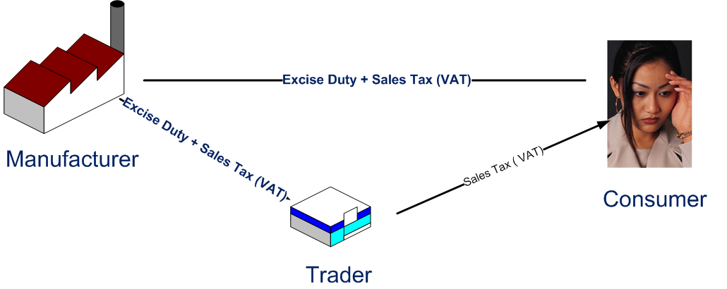
SALES TAX VAT
Just as Excise Duty has been made CENVATABLE, VAT also can be taken as set off for subsequent Sales, subject to certain conditions
For our understanding let us define Trader as the one who simply sells goods Manufactured by others

Slide 30
Applicability of VAT
Applicable on sale of goods with in the state
VAT not levied on -
  Inter State Sales/ Branch Transfer
  Imports
  0% VAT Rate on Exports
Rate of VAT
VAT rates differ state wise & item wise (From 0% to 25%)

Slide 31
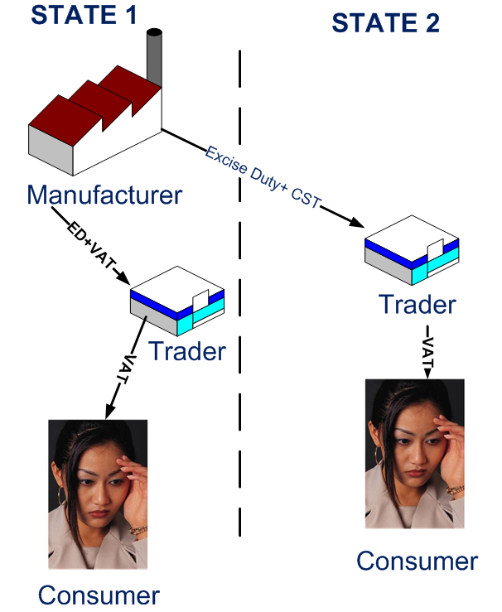
CST VS VAT
Re-sale within a State only can be
taken as set-off.
Central Sales Tax is not set-off’ able.

Slide 32
Entry Tax /Octroi
Entry of specified goods into a State
Levied by the State in which goods are entered
For the purpose of consumption , use or sale

Slide 33
SUMMARY
Import Duty consists of two components – of which the CVD component is cenvatable ( set-off) to a excise registered manufacturer
Excise Duty paid while buying goods, can be taken as credit ( set-off) by another manufacturer – but not by Trader.
VAT is imposed by a given state – hence resale within that state can take VAT paid earlier as set-off Central Sales Tax (CST) can not be taken as a set-off.
Sales across the state attracts only CST and not VAT.
Service tax is on services – installation etc. ( labor related)
Works Contract Tax is optional – in lieu of VAT + Service Tax
If the Re-seller is not paying excise duty ( for whatever reason) then he is not entailed to claim CENVAT.

Slide 34
CHECK LIST FOR PROJECT COSTING
( for taking care of duties and taxes)
Final location of the Project
  Within the State ( VAT)
  Outside the State ( sale in transit/that state laws!)
Outsourcing Material:
  From manufacturer or trader? ( CENVAT or no)
    From Trader/manufacturer who can’t give ED invoice, then ED is a cost!
  From within the state or outside the state(VAT or CST)
Outsourcing Services:
  Is the Service Provider Service Tax registered ? ( ST set-off possibility)
  Labor law compatibility ( especially in civil works)
Sale Contract:
  Divisible or Indivisible?
If the Final Product is not excise-able ( for what ever reason) then .
CENVAT credit can not be claimed. Therefore, ED is a cost!

Slide 35

Don't Run Away From
It's Only For Our Benifits

Slide 36
Thank You

