Slide 1
CBDT
INCOME TAX AUTHORITIES OF INDIA
BY CA .SAYANTAN BASU

Slide 2
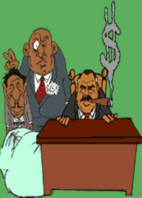

INCOME TAX
AUTHORITIES

Slide 3

Income Tax Department
Their Vision
Their Mission
Their Values

Slide 4
Who are income tax authorities? (Sec 116)
(a) the Central Board of Direct Taxes.
(b) Directors-General of Income-tax.
(c)Directors of Income-tax or Commissioners of Income-tax.
(d)Deputy Directors of Income-tax or Deputy Commissioners of Income-tax.
(e)Assistant Directors of Income-tax or Assistant Commissioners of Income-tax.

Slide 5

(f)Income-tax Officers.
(g)Tax Recovery Officers.
(h) Inspectors of Income-tax.
(i) Additional Directors of Income tax.
(j) Joint Directors of Income tax and Joint Commissioners.

Slide 6
Importance of the Assessing Officer
Plays a vital role in the organizational setup.
Primary authority who initiates proceedings and directly connected with public.
Orders passed by him can be challenged only on appeal.

Slide 7
Appointment of Income Tax Authorities
Power of Central Government.
Powers of the Board and other High Authorities.
Powers to appoint executive and ministerial staff.

Slide 8

CENTRAL BOARD OF DIRECT TAXES (CBDT)
Since 1 January 1964 the Central Board of Direct Taxes (CBDT) has been charged with all matters relating to various direct taxes in India and it derives its authority from Central Board of Revenue Act 1963.

Slide 9
Powers of CBDT
>> Instructions to subordinate authorities
>> Orders issued by way of relaxation of certain provisions under section 119(2)(a)
>> Orders giving extension of time limit [Sec. 119(2)(b)]
>> Orders giving relaxation for claiming deduction [119(2)(c)]

Slide 10
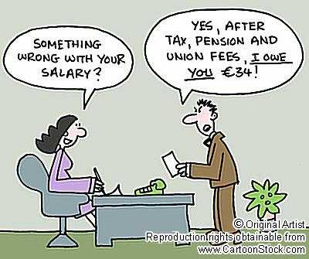
Director General/Chief Commissioner of Income tax
Appointment:
By the central Govt.
Jurisdiction:
Determined by CBDT.
Functions:
CBDT assigns functions by general or special order.

Slide 11
Powers:
Exercise powers of an assessing officer.
Appoint income tax authorites below the rank of assisstant commissioner.
Make enquiries on investigations into concealment – Section 131 (1A)
Giving instructions to income tax officers Section 119 (2)
Power of Survey- Section 133A
Power to make enquiry – Section 135

Slide 12

Commissioners/Directors of Income Tax
Appointment:
By central govt.
Jurisdiction:
Determined by central board
of direct taxes.
Functions :
The Board assigns functions
by general or special order.

Slide 13
Powers:
Commissioner may exercise powers of an assessing officer.
Power to transfer any case from one or more assessing officers to any other assessing officer.
Grant approval for an order issued by the assessing officer.
Prior approval is required for reopening of an assessment.
Power to revise an order passed by an assessing officer.

Slide 14

Deputy Commissioner/Assistant commissioners of income tax.
Appointment:
By central govt.
Jurisdiction:
Determined by central
board of direct taxes.
Functions :
The Board assigns functions by general or special order.

Slide 15

Powers:
Empowered to accord to sanction to levy additional income tax.
Power to exercise powers of an assessing officer.
Cancel registration of a firm.
Power to issue instructions to assessing officer.

Slide 16

Joint commissioner
Functions:
Detect tax evasions and supervise
subordinate officers.
Powers:
Accord approval to adopt fair market value as full consideration – section 52.
Instructions to income tax officers – section 119 (3).

Slide 17

- Exercise powers of income tax officers section 125 a.
- Power to call information section 133.
- Power to inspect registers of companies section 134.
- Power to make any enquiry section 135.

Slide 18

Assisstant Commissioner/ Income tax officer
Jurisdiction:
Determination of CBDT.
Instructions by Director General.
Concurrent jurisdiction .
Disputes regarding jurisdiction.
Jurisdiction not to be disputed.

Slide 19
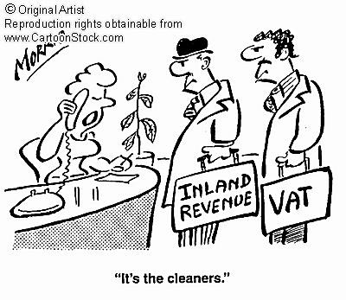
Powers:
Power of civil court.
Powers of search and
seizure
Power of assessment.
Power to call
information.
Power of survey.
Power to inspect registers of companies.

Slide 20
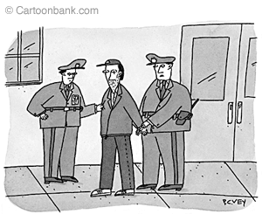
Income tax officers
Class I service - appointed by central govt.
Class II service - appointed by commissioner of income tax.
Powers, functions and
duties of the income
tax officer.

Slide 21
Search and seizure and Income Tax Raid ( Sec 132 of I.T. ACT
Under the Income Tax Act, the Search and Seizure operations are a carefully and secretly devised plan of action on the basis of authentic and bonafide information and material (something more than a rumor and gossip), which may be gathered on its own or given by some informer.

Slide 22
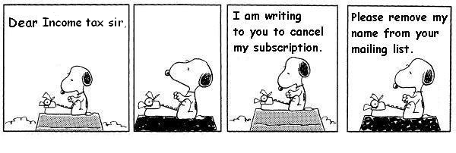
The authorities can exercise these powers when due to the information in their possession; they have firm reason to believe :
Any person to whom a summon or notice has been or might be served, has failed or would not produce the books of accounts or other documents as called for.
Any person is in possession of money, bullion, jewellery or such property which has not been disclosed.

Slide 23
The tax payer has the following rights in case of search-
Examining the search warrant which must clearly specify the name of the party to be searched and be duly signed by the officer. The search warrant issued in the name of the firm cannot be used to seize assets of individual partners.
Calling two or more respectable inhabitants of the locality to act as witnesses.
Verifying the identity and make personal search of each member of the search party.
Calling a doctor in case of emergency.
Inspect seals placed on various objects
Inspect and take photocopies of the seized books of account and documents.

Slide 24
Income tax raid
What leads to income tax raids, searches and seizures?
The main reasons are non-compliance with summons under Section 131(1) of the Income Tax Act, 1961, or the possession of undisclosed property or income. It is therefore absolutely necessary for a current income tax assessee or a likely income tax assessee to comply with the summons or notice issued by the Assessing Officer, or any other such authorised person.
A tax raid may also be conducted against a person in possession of undisclosed income or property not belonging to him but to someone else.

Slide 25
5 steps to prevent an Income tax raid
1. Make correct disclosure of income and wealth in returns.
2. Comply with summons or notices to prevent a tax raid.
3. How to declare exempted or non-taxable income and wealth.
4. Preserve important vouchers and other documentary evidence for the acquisition of assets.
5. How to prevent an income tax raid on lockers, and safe deposit vaults.

Slide 26

Income Tax raid in Himesh Reshamiya’s house
- Taxman came visiting his house in
Mumbai.
Come under the scrutiny of the Income Tax Department for allegedly paying less service tax.
- The intensive survey of his residence is part of the verification process.

Slide 27

Disclosure of information regarding assesses to certain authorities
(Section 138)
The Board or any other authority so authorised by Board, may furnish or cause to be furnished any information which the income tax authorities have obtained while performing their duties to any officer, authority or body performing any function under any law relating to imposition of tax,
duty or cess or in foreign exchange
dealings or any other authority so
notified.

Slide 28
Quick facts..
The Karnataka & Goa Region is within the administrative and cadre control of the Chief Commissioner of Income-tax, Bangalore.
The Region of Karnataka and Goa has at its apex five Chief Commissioners of Income-tax and Director General of Income-tax .
The Chief Commissioners of Income Tax are stationed at Bangalore, Hubli & Panaji, while the Director General of Income Tax is stationed at Bangalore. Besides, the Region has 24 Administrative & 13 Appellate Commissioners of Income Tax.

Slide 29
THE END

