Slide 1
E-FILING OF RETURN
BY PRAKASH KUMAR SINGH
Email: prakashkumarsingh29@yahoo.in

Slide 2
CREATION OF USER ID & PASSWORD
Get registered on the official website of the Income Tax Department at
www.incometaxindiaefiling.gov.in

Slide 3
PROCEDURE OF REGISTRATION
Go to the webpage www.incometaxindiaefiling.gov.in
Click on Register as new user
Mention your PAN, as PAN would be the User-Id.
If the PAN is not registered a new page will open otherwise a message will appear “PAN is already registered”
The assesses has to submit his Name, Father’s Name, Date Of Birth, E-Mail Id , Phone No & Password of his own choice

Slide 4
PROCEDURE OF REGISTRATION (Continue…)
Opt one secret question out of four questions given and also provide any answer of choice.
Fill the verification code given and click on Register.
After successful registration the user will receive an e-mail on the e-mail id given at the time of registration wherein a link would be given which is to be activated.
Once the link is activated, the user would be authorized to use all the services offered by Income Tax Department & can e-file his return

Slide 5
PRECAUTIONS
Name, Father’s Name & Date of Birth should match with the details available with the Income Tax Department i.e. given in the PAN Card.
Surname is Mandatory.
In case of assesses other than individuals, name has to be mentioned in surname field.
Furnishing of live E-mail ID is important as all the correspondence in future will be sent on the registered e-mail id.

Slide 6
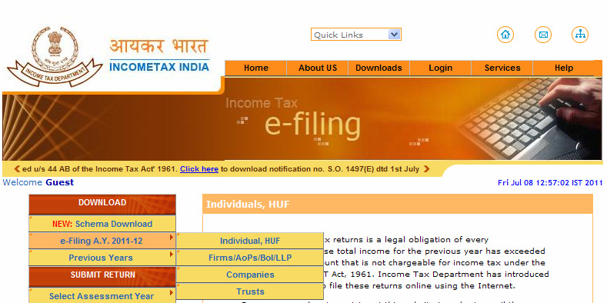
INCOME TAX RETURN PREPARATION UTILITY
Go to the portal: www.incometaxindiaefiling.gov.in
A screen as shown here would appear

Slide 7
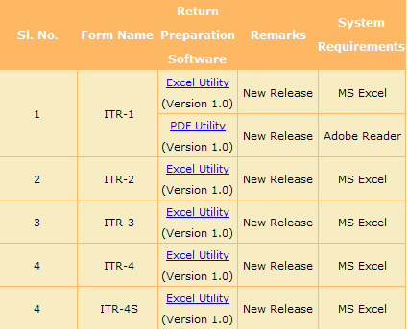
INCOME TAX RETURN PREPARATION UTILITY (Continue….)
Select ‘e-filing A.Y. 2011-12’ as shown above.
Then, select the assessee (i.e. Individual/HUF, Firms/AOPs/BOI/ LLP, Companies, Trusts) who is going to file the income tax return and click on the assessee icon so selected.
By clicking on Individual/HUF, a screen would appear as below. Thereafter, one may SELECT and DOWNLOAD the appropriate utility as per the ITR Form applicable to the assessee.

Slide 8
SELECTION OF APPROPRIATE ITR FORM

Slide 9
SAHAJ/ITR-1 *
SAHAJ is to be used by an individual having :
Salary /Pension Income or
Income from One House Property (excluding cases where loss is brought forward from previous years); or
Income from Other Sources (excluding Winning from Lottery & Income from Horse Races); or
Income from Capital Gains which is exempt u/s 10; or
Agriculture Income upto Rs 5,000/-.

Slide 10
SAHAJ/ITR-1 *(CONTINUE…)
SAHAJ CANNOT be used by an individual having:
Income from more than one House Property; or
Winning from Lottery or Income from Horse Races ; or
Income from Business or Profession; or
Income from Capital Gains which are not exempt; or
Agriculture Income more than Rs 5,000/-.

Slide 11
*EXEMPTION FROM E-FILING
CBDT has vide Notification No. 36/ 2011, dated- June 23, 2011 notified the scheme for exempting
salaried taxpayers with total income up to Rs. 5 lakh from filing income tax return for the assessment year 2011-12, which will be due on July 31, 2011.
For details refer the link:
http://law.incometaxindia.gov.in/DIT/Notifications.aspx

Slide 12
ITR-2
ITR -2 is to be used by individuals & HUF not having any income under the head “PROFIT & GAINS FROM BUSINESS OR PROFESSION”

Slide 13
ITR-3
ITR-3 is to be used by an individual & HUF
who is a partner in a partnership firm and
Do not have any other income under the head “PROFIT & GAINS FROM BUSINESS OR PROFESSION” except interest, salary, bonus, commission or remuneration, by whatever name called, from such partnership firm.

Slide 14
ITR-4
ITR-4 is to be used by an individual & HUF who is carrying out a proprietary business or profession

Slide 15
ITR-4S SUGAM
A simplified income tax return form for business concerns

Slide 16
For Whom….?

Slide 17
For an individual or HUF having:
Income under the head of “PROFIT AND GAINS FROM BUSINESS OR PROFESSION” computed in accordance with section 44AD & 44AE; or
Income from salary/pension or ,
Income from One House Property (excluding cases where loss is brought forward from previous years); or
Income from Other Sources (Except Income from Lottery & Winning of Race Horses) or
Income from Capital Gains which is exempt u/s 10 or
Agriculture Income upto Rs 5,000/-

Slide 18
But not for……

Slide 19
An individual or HUF
Having Income from more than one House Property; or
Having Income from Lottery or Winning from Race Horses; or
Having Income from Speculative Business or Special Incomes; or
Who is required to maintain books of accounts u/s 44AA; or
Who is required to get their accounts audited u/s 44AB; or
Having Income from Capital Gains which are not exempt; or
Having Agriculture Income more than Rs 5,000/-.

Slide 20
ITR-5
FOR
BUT NOT FOR
Partnership firms
Limited Liability Partnership firms
Association of Persons
Body of Individuals
Artificial juridical person
Cooperative society and
local authority.
A person required to file return of income under sections-
139(4A),
139(4B),
139 (4C) or
139 (4D).

Slide 21
ITR-6
ITR-6 is to be used by Companies other than the Companies claiming exemption u/s 11 of the Income-tax Act, 1961.

Slide 22
ITR-7
FOR
NOTE:
Persons including Companies
required to furnish return of
income under sections
139 (4A)
139 (4B)
139 (4C) or 139 (4D).
This ITR form CANNOT be filed electronically and is required to be filed in PAPER form.

Slide 23
PRE-REQUISITE FOR FILLING OF FORMS
Enable Macros in excel worksheet before filling the ITR.
Filling of excel utility.

Slide 24
A: ENABLING MACROS

Slide 25
WHY TO ENABLE MACROS ?
To activate the buttons on the Right hand side of the excel utility.

Slide 26
How to enable the macros in the excel utility?

Slide 27
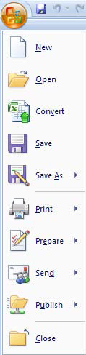

STEP NO-1
Go to office button- Click on ‘Excel Options’ window as shown here:

Slide 28
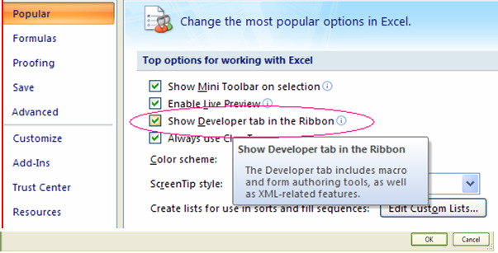
STEP NO-2
Click on ‘Popular’ Option and then click on ‘Show Developer tab in the ribbon’.
The window appears as

Slide 29
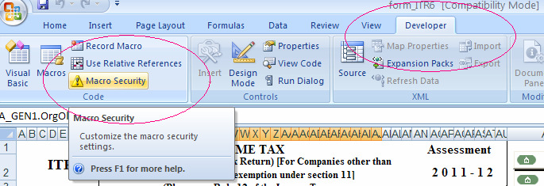
Step No-3
Now click “Macro Security” option in the Toolbar option (will appear after 2nd Step) as shown here:

Slide 30
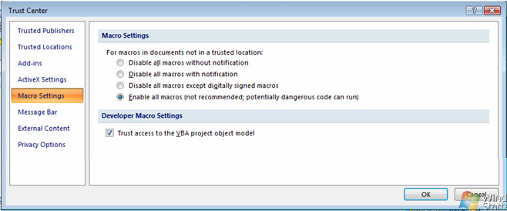
Step No-4
After clicking on the ‘Macro Security ‘ option, Click on “Macro Settings” to enable all macros
Also, tick “Trust access to the VBA project object model” as shown here.
Now options in Excel utility will start working.

Slide 31
B: FILLING THE EXCEL uTILITY

Slide 32
Go through the instructions before filling forms
For downloading instructions, refer to the link :
http://incometaxindia.gov.in/download_all.asp

Slide 33
Few instructions:
Do NOT use ‘Ctrl X’ or Cut Paste while data entry.
Fill all green colored fields.
Fill all mandatory fields which are marked as RED.
Before filling details of TDS/Advance Tax/Self Assessment Tax, verify/import the details from
Form 26AS.

Slide 34
IMPORT OF DATA- FORM 26AS

Slide 35
Step No.1
First log in at www.incometaxindiaefiling.gov.in by providing the user-id and password of the assessee.
Go to ‘My Account’.
Click ‘View Tax Credit Statement (Form 26AS)’ and provide the necessary details as required.

Slide 36
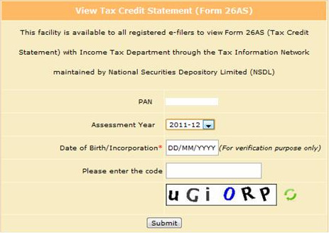
Click on ‘Submit’, then a new window appears as follows:

Slide 37
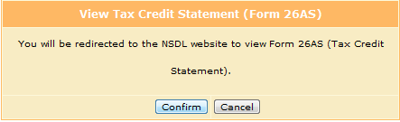
Click on ‘Confirm’ then Form 26AS appears.

Slide 38
Step No-2
Copy the data of Form-26AS from the site and paste on the normal excel worksheet.
Retain the columns containing the data mentioned below and delete other rows and columns
TAN OF THE DEDUCTOR (1) | NAME OF THE DEDUCTOR (2) | TOTAL TAX DEDUCTED (3) | AMT OUT OF (3) CLAIMED THIS YEAR (4)

Slide 39
Step No-3
Copy the format cells (Green Color) from the TDS schedule of excel utility and paste on the normal excel worksheet.
Using the ‘Format Painter’ copy the format of TDS schedule of excel utility on all the columns of that normal excel worksheet

Slide 40
Step No-4
Insert requisite number of rows in the TDS schedule in the excel utility.
Paste the TDS details from that normal excel worksheet to the TDS Schedule of the excel utility.

Slide 41
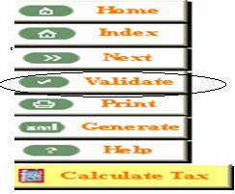
VALIDATION OF FILES
After filling the appropriate income tax return:
STEP-1
SHOWING VALIDATE OPTION IN EACH SHEET
Click on the ‘VALIDATE’ button, shown on each and every sheet of income tax return as shown here.
Notes:
SHOWING VALIDATE OPTION IN EACH SHEET

Slide 42
SHOWING VALIDATE OPTION IN EACH SHEET
This helps in identifying the error in the sheet, if any. If there is no error in the sheet then the window appears as ‘SHEET IS OK’.
The same procedure is to be followed in respect of each and every sheet.
Do not use special characters like %, &, etc, as they will not be accepted by the income tax return software.

Slide 43
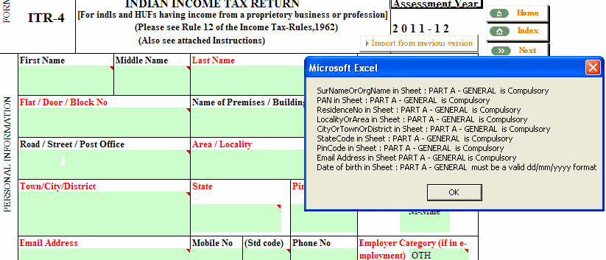
VALIDATION OF FILES (Continue…)
STEP NO -2
SHOWING ERROR IN FILE
‘Validate’ option helps in identifying the error in the sheet, if any.
If there is any error message will be displayed as

Slide 44
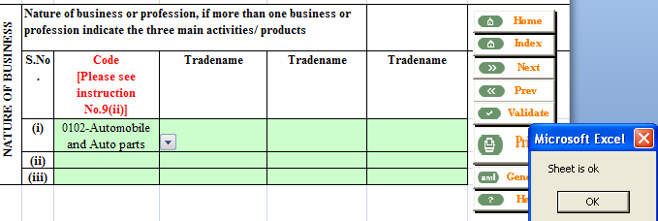
VALIDATION OF FILES (Continue…)
STEP NO -3
SHOWING SHEET IS OK
If there is no error in the sheet then the window appears as ‘SHEET IS OK’.
The same procedure is to be followed in respect of each and every sheet.
Do not use special characters like %, &, etc, as they will not be accepted by the income tax return software.

Slide 45
GENERATION OF XML FILE

Slide 46
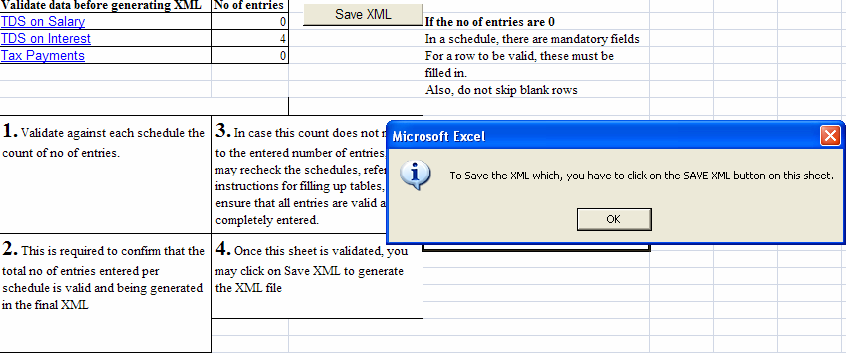
GENERATION OF XML FILE
.
After all required schedules have been filled and validated, click on “Generate XML” which will recheck all sheets and show a final validation sheet.
After the generation of xml, the next option which appears is for the saving the xml as shown here

Slide 47
GENERATION OF XML FILE (Continue….)
For saving the xml click on the button ‘Save XML’ and save xml in the folder in which excel return is saved.
The saved file will carry a name ending with the PAN number followed by the file extension. The same may be changed by the assessee.

Slide 48
UPLOADING THE INCOME
TAX RETURN

Slide 49
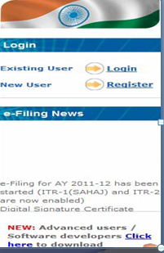
UPLOADING THE INCOME TAX RETURN
The validated XML file generated is ready for uploading with
Income Tax Department by adopting the following procedure:
Login at the website of Income Tax Department with the User Id & Password already created.

Slide 50
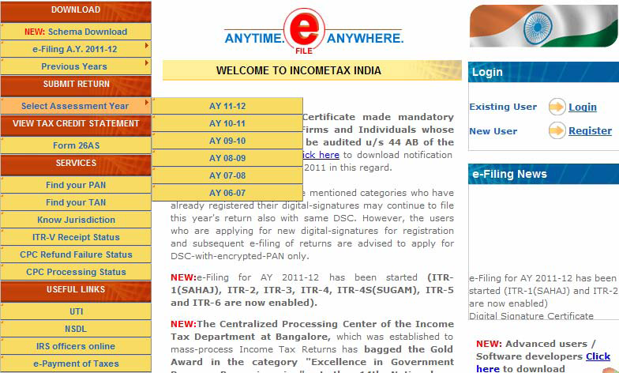
UPLOADING THE INCOME TAX RETURN (Continue…..)
Click on “Submit Return” on the left panel and select the assessment year for which return is to be filed.

Slide 51
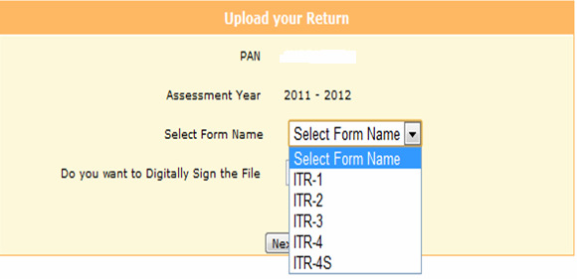
UPLOADING THE INCOME TAX RETURN (Continue…..)
Select the ITR Form to be filed.

Slide 52
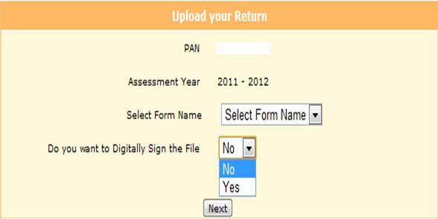
UPLOADING THE INCOME TAX RETURN (Continue…..)
Select the option of filing the ITR form with or without digital signature.
Click on the “NEXT” button.

Slide 53
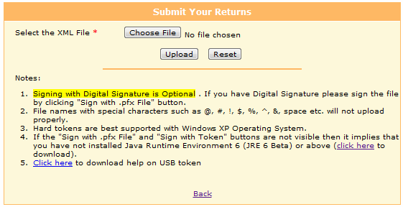
UPLOADING THE INCOME TAX RETURN (Continue…..)
Now a screen will appear as follows:
Provide the path of validated XML File by clicking on “Choose File”.

Slide 54
TWO WAYS OF FILING OF RETURN
With Digital Signature
Without Digital Signature

Slide 55
WITHOUT DIGITAL SIGNATURE
If the return is to be filed without digital signature press “Upload” button

Slide 56
WITH DIGITAL SIGNATURE

Slide 57
WITH DIGITAL SIGNATURE
Mandatory use of digital signature
Companies
Individuals/ Firms/ HUF liable to tax audit u/s 44AB of the Income-tax Act, 1961.

Slide 58
How to get digital signature?
WITH DIGITAL SIGNATURE (Continue…..)
Digital signature can be purchased through:-
ICAI – For details click on the link below: http://www.icai.org/post.html?post_id=1847&c_id=227
Private vendors.

Slide 59
WITH DIGITAL SIGNATURE (Continue…..)
Format of digital signature
pfx file
USB token

Slide 60
Update the digital signature with the department

Slide 61
HOW TO UPDATE?

Slide 62
Update the digital signature with the department
STEP -1
Install Java by clicking on the link below: http://www.oracle.com/technetwork/java/javase/downloads/index.html

Slide 63
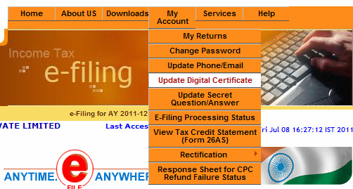
Update the digital signature with the department (Continue…)
For updating the digital signature with the Department click on ‘My Account’ and window would appear as shown here:

Slide 64
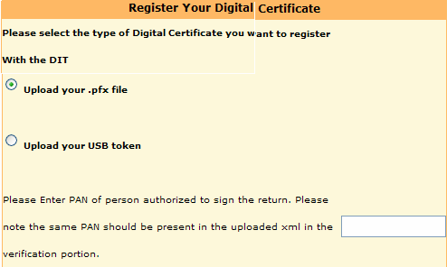

Update the digital signature with the department (Continue…)
After Clicking on “Updating Digital Signature” a window would appear as shown here:
After clicking on the “Register”
button and a box shown as ‘You
have successfully registered your
digital signature’ would appear.
After this Digital Signature would
get updated with the Department.

Slide 65
Signing with digital signature and uploading the return.

Slide 66
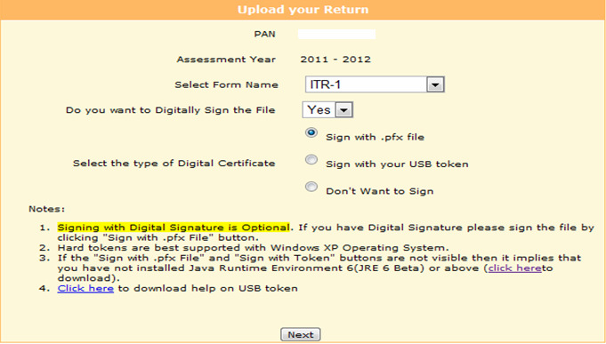
Signing with digital signature and uploading the return
After steps taken upto Slide 53, if a person selects filing of ITR form with digital signature, a window as shown here would appear
Select the type of digital signature with which you want to sign the return and click on next button

Slide 67
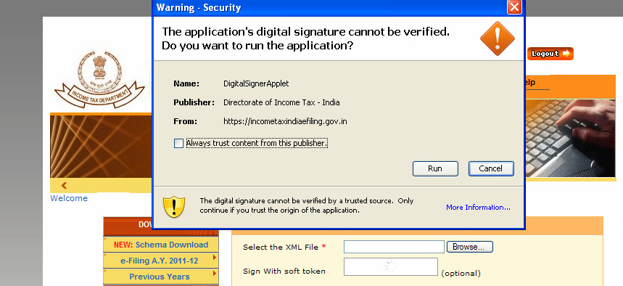
Signing with digital signature and uploading the return (Continue…)
After clicking on next button a window appears as shown here:
Click on “Run” button
Automatically Java runs.
Browse the xml file.
Sign the file with digital signature and upload.
With this, the procedure for signing and uploading the return with digital signature getsover.

Slide 68
ACKNOWLEDGEMENT RECEIPT
After successful uploading of Income Tax Returns, an acknowledgement receipt is generated known as “ITR-V”

Slide 69
ACKNOWLEDGEMENT RECEIPT
A. If return is filed with digital signature
If the return is electronically furnished with digital signature then ITR-V is NOT REQUIRED to be furnished to the Income Tax Department.
The ITR-V generated after uploading the return is to be treated as receipt of filing of return.
The date of filing of return will be the same as mentioned in the ITR-V.

Slide 70
ACKNOWLEDGEMENT RECEIPT (Continue…)
B. If return is filed without digital signature
If the return is electronically furnished without digital signature then ITR-V is REQUIRED to be furnished to the Income Tax Department as verification of filing the Income Tax Return.
This ITRV has to be filed within 120 days of transmitting the data electronically.

Slide 71
ACKNOWLEDGEMENT RECEIPT (Continue…)
B. If return is filed without digital signature (Continue..)
The date of filing of return will be the same as mentioned in ITR-V if the same is received by the CPC within specified time limit.
In case the ITR-V is not received by the CPC within specified time limit then the return filed will be treated as null & void.

Slide 72
ACKNOWLEDGEMENT RECEIPT (Continue…)
B. If return is filed without digital signature (Continue..)
ITR-V form is required to be sent to
Income Tax Department
Post Bag No-1
Electronic City Post Office
Bengaluru
Karnataka- 560100.

Slide 73
Do’s and Don’ts for printing and submitting of ITR-V.
ITR-V should be legible & signed in original.
ITR-V must be sent to the CPC within specified time limit.
The ITR-V to be sent at Income Tax Department, CPC Bengaluru by ORDINARY POST/SPEED POST.
Courier & other means should not be adopted.
For other do’s and don’ts click the link below:
https://incometaxindiaefiling.gov.in/portal/index.do.

Slide 74
Track ITR-V status

Slide 75
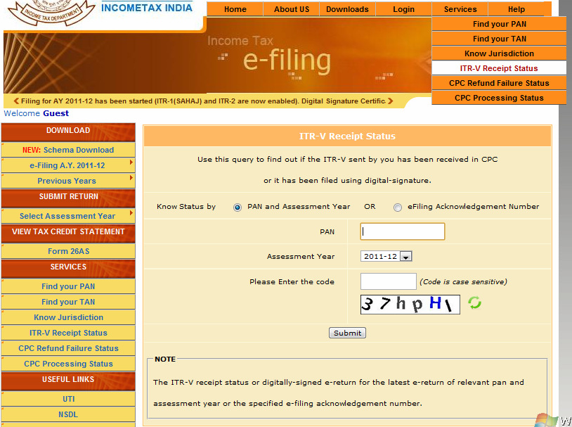
Track ITR-V status
Go to
https://incometaxindiaefiling.gov.in
ITR-V receipt and processing status at CPC Bangalore can be checked under ‘Services’ menu on the menu bar on top.
Note: This can be checked
either with login or without
login.

Slide 76
QUESTIONS????????

