Slide 1
E-Payment Of Tax
INCOME TAX

Slide 2
Go to http://www.incometaxindia.gov.in/home.asp
Choose the option “Pay Taxes Online”
When you will click “Pay Taxes Online” , it will direct you to the website of NSDL
The Screenshot of the site is in the following Slide.

Slide 3
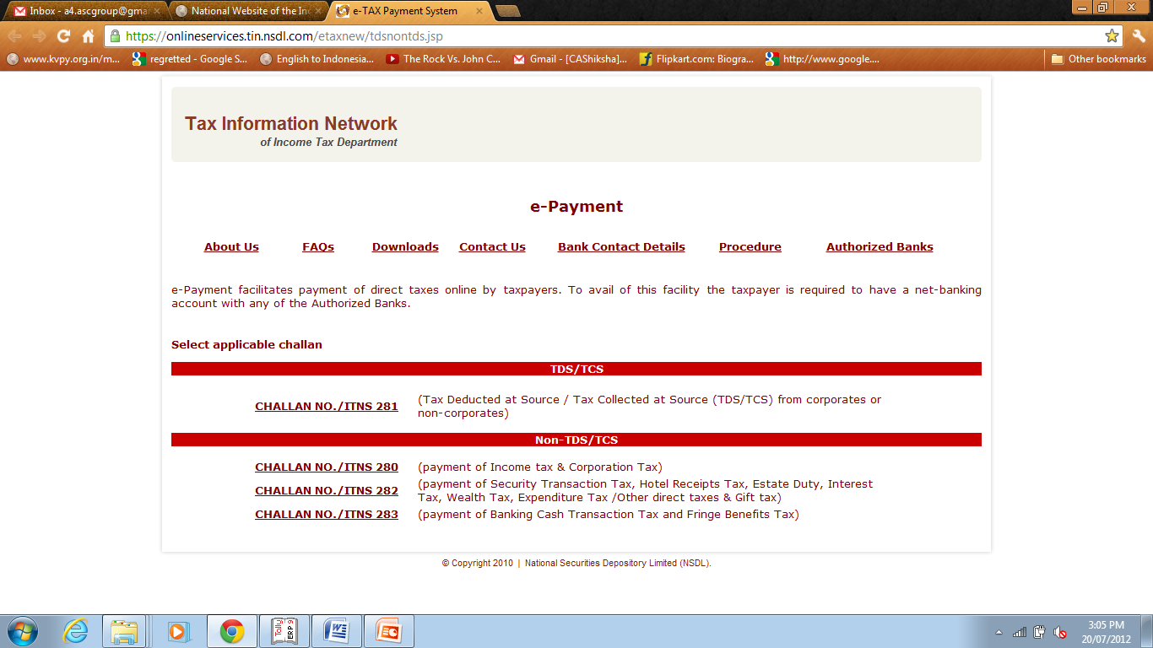

Slide 4
From the Home Page of the Website select
“CHALLAN NO./ITNS 280” for Income Tax
The Challan Will open like this
(in the next slide)

Slide 5
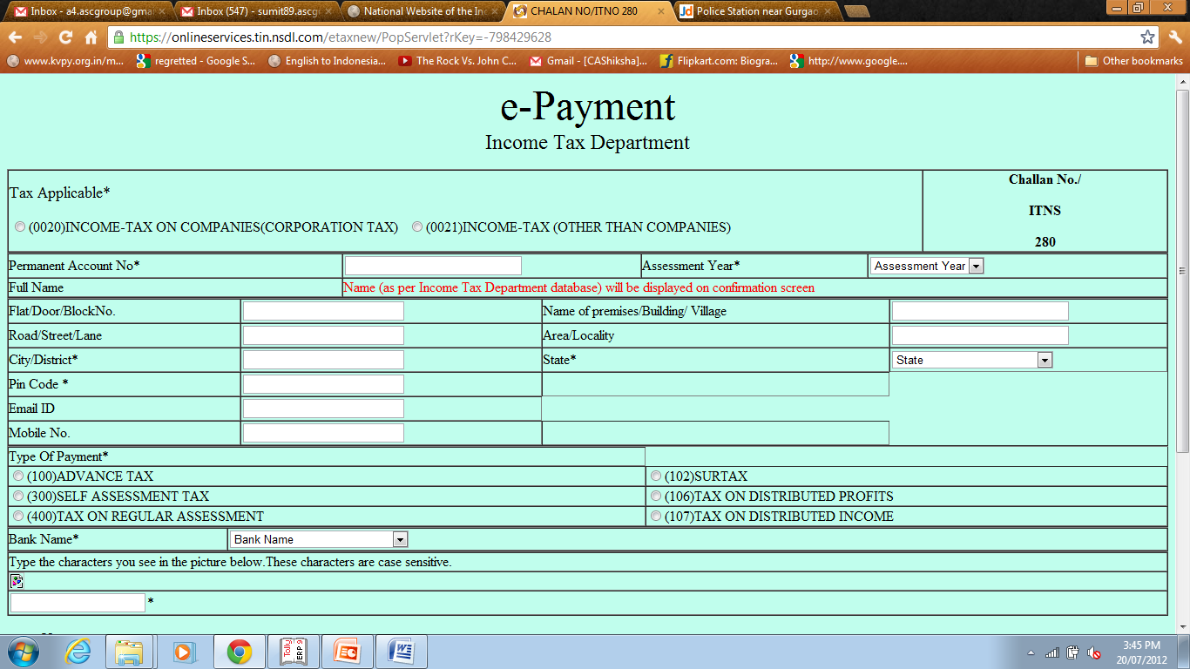

Slide 6
In challan first of all select “(0020)Income Tax On companies(Corporation Tax) or (OO21)Income Tax(other then companies)
After this fill the other details accordingly.
From the “Type Of Payment” select (300) Self Assessment Tax.
At last choose the Bank from the lower most select box. It will display the complete list of banks which are authorized to accept e-payment.
After you select the Bank, fill the character appearing lower left, then select the “proceed” tab.

Slide 7
After you click the “proceed tab, it will display the details filled in challan and ask for you to confirm them.
After your confirmation, you will have to click the “submit” button.
Then you will be directed to the payment gateway of Bank, fill your login Details and then fill the details of tax separately as follows:
:-Income Tax -
:-Education Cess -
:-Interest -
After this complete the payment & save the Acknowledge receipt.

Slide 8
Thank You

