Slide 1
Transfer Pricing

Slide 2
Overview
Transfer Price – What & Why?
OECD vis-à-vis Transfer Pricing
Steps in Transfer Pricing
OECD Transfer Price Methodology
Comparables
TP Documentation - OECD Guidelines
Area’s Covered in Ford on TP
Data flow for TP

Slide 3
Transfer Price - What and Why?
Transfer Pricing refers to pricing of international transactions between two associated enterprises (AEs)
Due to special relationship between related parties, transfer price (TP) may be different than the price that would have been agreed between unrelated parties
A price between unrelated parties is known as the “arm’s length” price

Slide 4
Transfer Price - What and Why?
Approximately 60% of the total transactions across the world are between related parties.
If the transactions are across different tax jurisdictions, where tax rates are different, shifting is beneficial

Slide 5
Transfer Price - What and Why?
Associated enterprise
Independent entity
International transactions
- Goods
- Services
- Intangibles
- Loans
Resident
Resident
Transfer Price
Arm’s Length Price

Slide 6
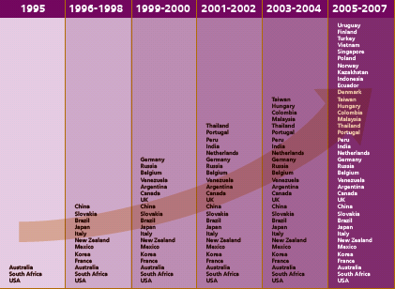
Evolution of TP in Various Countries
This table shows the dramatic increase since 1995 in the number of countries with developed transfer pricing regimes

Slide 7
What is OECD?
OECD = the Organization for Economic Co-Operation and Development
30 Members – 20 founding members in 1961:
  USA, Canada, UK, France, Japan, Germany, Italy, Australia, South Korea, Mexico - and 20 other countries
OECD formulated “Guidelines on transfer pricing”. They serve as generally accepted practices by the tax authorities

Slide 8
OECD vis-à-vis Transfer Pricing

Slide 9
Steps in Transfer Pricing
Identify the International Transaction with related parties
Identify the nature of transactions (like Service, Supply of goods / Equipments, Intangibles)
Determine appropriate TP method as provided by OECD for the transaction
Determine the comparable price for transaction and determine TP for transaction
Monitor the TP throughout the year and make adjutments if required
Document the Transfer Pricing as per the OECD transfer Pricing requirements

Slide 10
OECD Transfer Pricing Methods
Traditional Transaction Methods
Transaction Profit Methods
Other Methods
Comparable Uncontrolled Price Method
Resale Price Method
Cost Plus Method
Profit Split Method
Transactional Net Margin Method
Global Formulary Apportionment
OECD prefers traditional methods over transactional methods

Slide 11
Comparables
All methods require comparables
Transfer price is set/ defended using data from comparable transactions
Comparable transaction should be independent and similar to tested transactions
Factors for judging comparability
  nature of transactions undertaken (i.e type of good, service etc.)
  Functions performed
  risks assumed
  contractual terms (i.e similar credit terms)
  economic and market conditions

Slide 12
TP Documentation – OECD Guidelines
Entity Related
Price Related
Transaction Related
Profile of industry
Profile of Group & Legal entity
Profile of associated enterprises
Transaction terms
Functional analysis (functions, assets and risks)
Economic analysis (method selection, comparable benchmarking)
Forecasts, budgets, estimates
Agreements
Invoices
Pricing related correspondence (letters, emails etc)

Slide 13
Data Flow for TP
Profile of Group, Industry from Commercial Department
Agreements / invoices from user departments
Functional analysis from the Corporate Tax Group
Financials from the Hyperion
Comparables data from the External Consultants

Slide 14
Questions….

