Slide 1
E FILING – Do’s, Don’t’s and other Common Errors
08 July 2011

Slide 2
Impact of Errors made while filing returns
Returns can be classified as defective u/s 139 (9) and in some scenarios the return can be declared in valid / Non Est
  ITD is not introducing this concept to cover certain types of errors in order to prevent future grievances
Computation Errors
  In electronic filing it has been noticed that most of the errors are due to data errors as filed by the assessee This includes non filling of key schedules, wrong details etc resulting in rectification requests etc which delay closure of processing
Inability to pay refunds to the assessee

Slide 3
Key rules to be followed to ensure trouble free processing
Once E filing is done (without digital signature), ITR V needs to be sent in time to CPC. In case ITR V acknowledgement is not received within reasonable time, the assessee may call up the CPC call centre to verify status Nearly 10% of assessees have failed to send the ITR V to CPC after E filing
Assessee needs to fill his email address, mobile no correctly to ensure appropriate communication from the Income Tax Department. The use of the Tax practioner/CA’s email address may not be appropriate
The assessee should make sure the correct (latest) address, bank account, MICR no. is filled
The assessee should verify tax credits available in Form 26AS/NSDL websites. Mismatches are the single largest cause of incorrect tax computation. Non credits may be taken up with the TDS deductor and/or the banker as soon as they are noticed

Slide 4
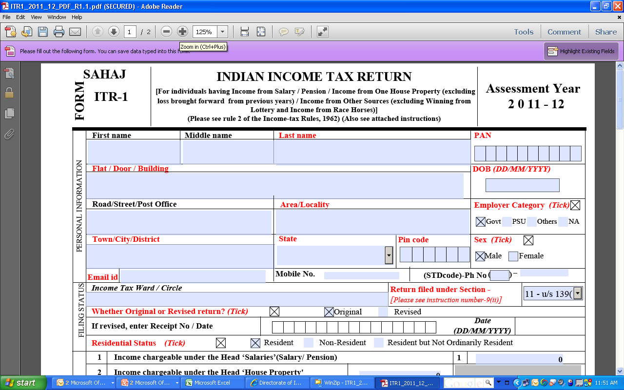
ITR 1 – the Sahaj form

Slide 5
Personal Information Schedule
Name: Has to match the PAN database
Date of Birth: Mistakes here will result in computation of higher taxes in case of senior citizens
Address: House/Flat no, City, PIN Code, are mandatory fields. Non filling will result in refund delays
E mail address: Needs to be filled correctly, is the basis of all communication from CPC. Mistake will result in non receipt of all intimations from CPC. Use of Auditor/Tax practitioner’s ID may be avoided
Mobile No:Full Mobile No without use of +91 needs to be enterered. This is essential for all SMS based communication
Sex: Should match the PAN database. If PAN database is wrong, it results in mistakes in computation
Status : Should be correctly filled
Residential Status - the status of NOR and NRI should be mentioned only where applicable as they are not eligible for certain benefits available to resident assessee

Slide 6
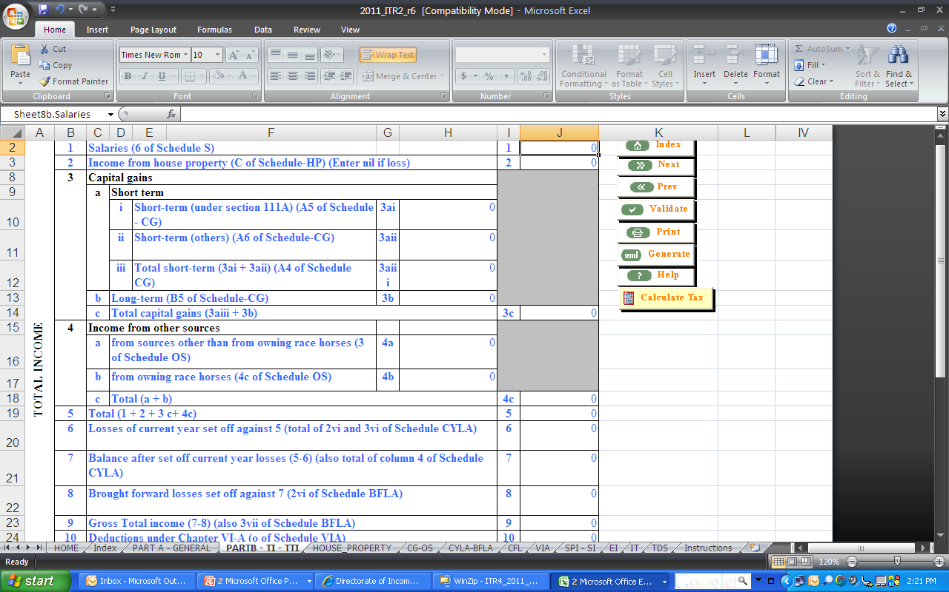
Part B - TI

Slide 7
Part B TI
Salary amount entered in BTI should be same as in TDS Salary and final value in Schedule salary.
CYLA or BFLA loss has to be mentioned in the appropriate rows, else loss will not be allowed.
In STCG – many users confuse between STCG under section 111A and STCG others and enter against one another leading doubling to income from Capital Gains.
In case of HP loss, BTI value for Income HP should be 0 or null and final value in schedule HP should be a loss
It is not enough if just part B TI is filled. Respective schedules also need to be filled for Eg Schedule HP, Sch Depreciation etc. Else the return can be treated as a defective return u/s 139 (9).

Slide 8
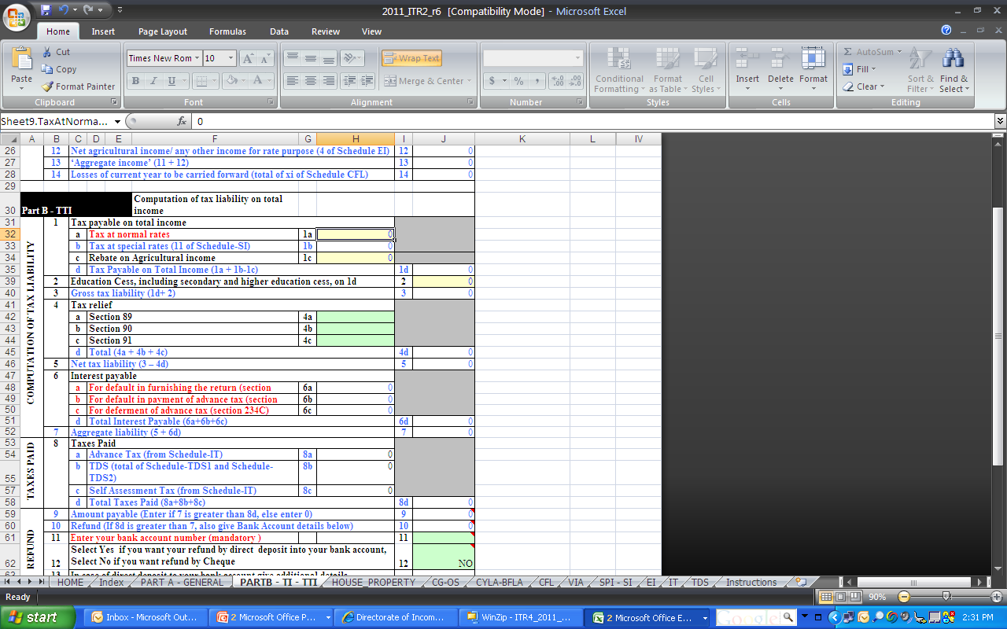
Part B TI - TTI

Slide 9
Part B TI - TTI
Relief under 89,90,91 is to be entered ONLY if applicable.
The value entered in schedule TDS, IT and TCS has to be entered in Part B TTI also. Eg. Schedule IT is entered but in no amount is mentioned in this section as Advance Tax or SAT.
The Bank account no. has to given correctly and entered even if no refund is due. This is to ensure that refund arising from recomputation of income by the ITD can be paid to the assessee. The A/c no and the name in the bank account has to tally.
The MICR No. should be in 9 DIGITS and first 3 digits of MICR code denotes the place of residence as mentioned in address’s PIN Code.
Eg. 560056025- ‘560’ refers to Bangalore whose PIN starts with 560 000. The assessees may avoid giving bank accounts where MICR starts with ‘0’.

Slide 10
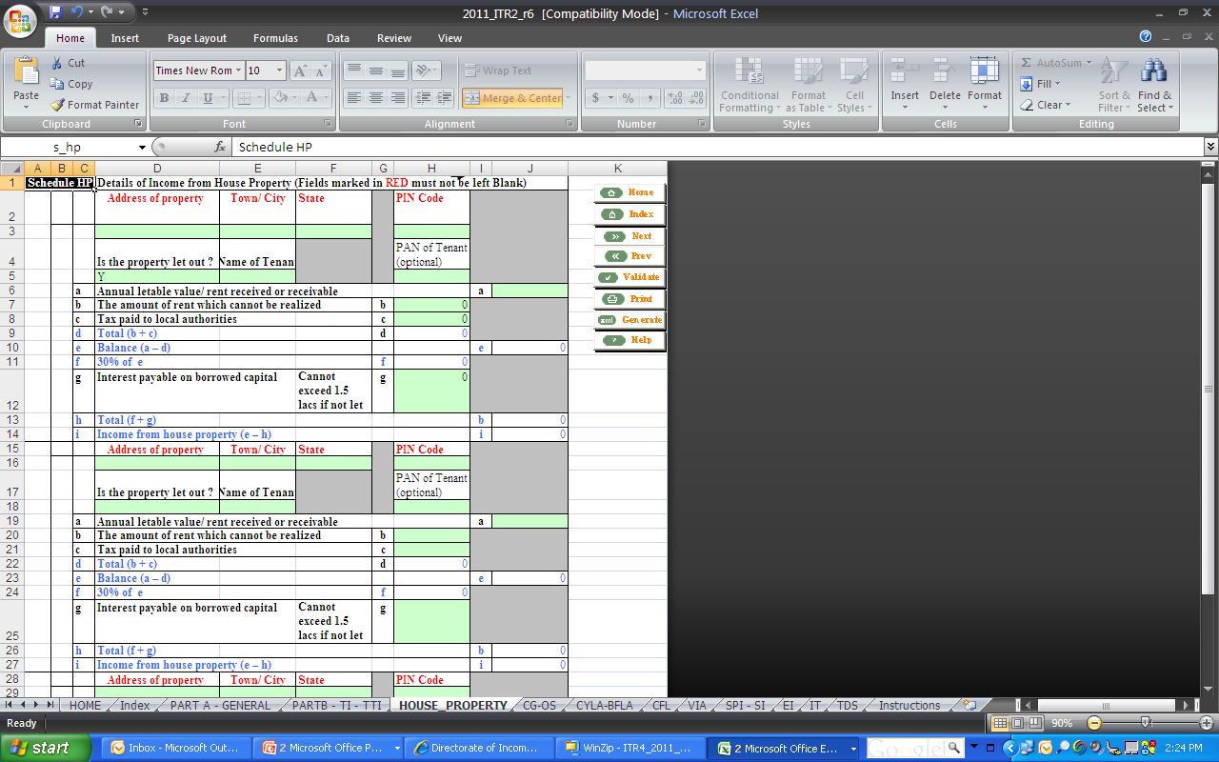
House Property

Slide 11
Income Schedules – Salary, HP
Net Salary should be entered and not Gross Salary. This will result in higher taxes
The Salary value should tally with that entered in Schedule TDS
In Schedule HP, the loss from house property has to be entered with all mandatory details of the property including details as to whether it is let out. Entering only the loss as summary makes it incomplete
Co-owners of property should enter only the income pertaining to their share in the property. Entering the gross rental receipt and thereafter offering this share of income from such rental will increase total income

Slide 12
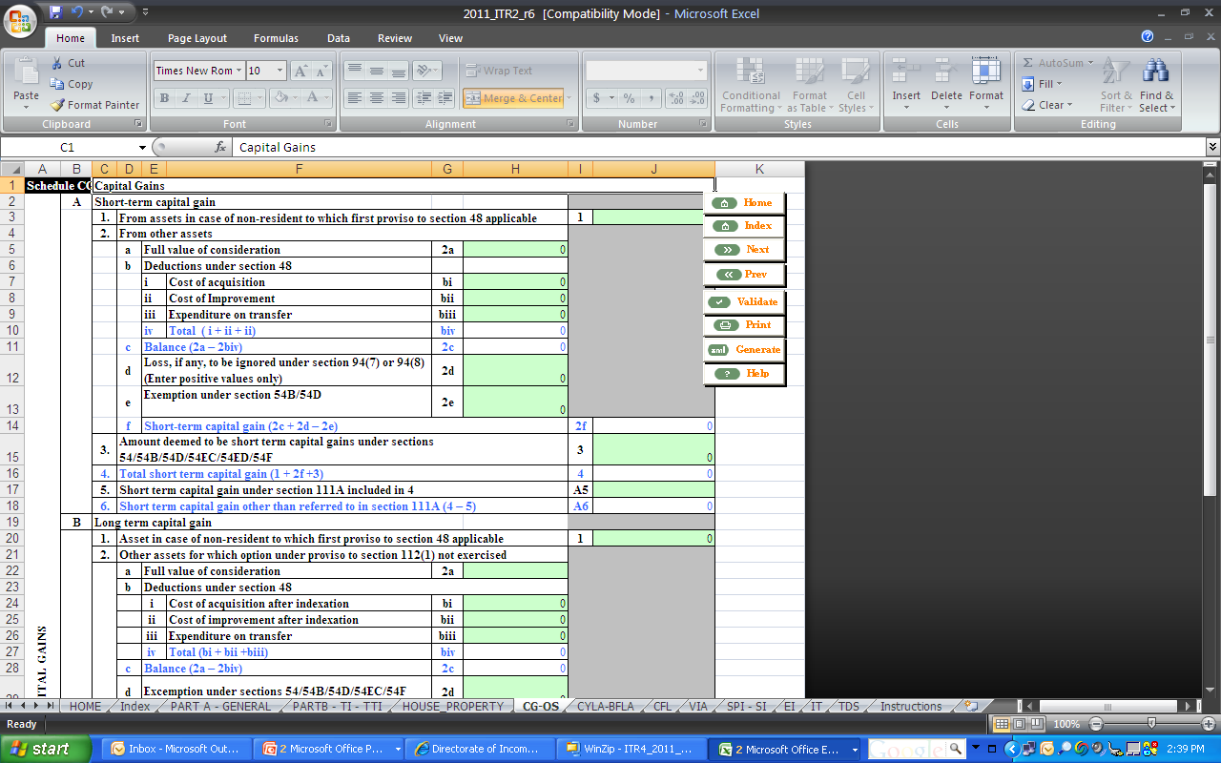
Capital Gains

Slide 13
Capital Gains
Deemed Capital Gains arising out of Schedule deprecation should be considered by the assessee in schedule CG.
Non filing of full value of consideration or filling only expenditure under various sub categories of CG leads to incorrect computation of income.
Filling of only cost of acquisition also leads to incorrect computation.
The quarterly breakup of capital gains in the CG schedule should be post set off of all losses.
Filling of accurate quarterly breakup is necessary for computation of interest under 234C.
Correct section codes should be used depending upon the type of capital gains income in the SI schedule.
Exempt LTCG should not be entered in CG schedule as well as in BTI, it has to be mentioned in Schedule EI

Slide 14
Schedule BP
PBT should NOT BE included Deprecation value
Income from speculative business included in PBT should be shown separately in Sl. 2 and Sl. 38 of schedule BP.
Income offered under other heads other than BP included in P&L should be reduced in Sl. 3 of Schedule BP.
All disallowances in Part A OI should be considered in Schedule BP.
Income offered under section 44AF(Deemed Income) if included in PBT should be reduced in Sl. 4 of Schedule BP.
Deprecation as entered In P&L should be shown in Sl.11 of Schedule BP alone and not in Sl 22 or 7 or another rows in BP. The schedule DPM, DOA should be mandatorily filled.
Assessee claiming benefit of rule 7A 7B 7C should mention appropriate code in nature of business schedule.
PBT in P&L and PBT shown in sl. No.1 of Schedule BP should be same.
Specific schedule for ESR, 10A etc should also be filled when a claim is made in schedule B

Slide 15
SCHEDULES DPM,DOA, DCG AND DEP
All the relevant values to arrive at the deprecation mentioned in Schedule BP is to be filled in Schedule DPM, DOA.
DCG arising out of deprecation schedules should be accounted for in CG and taxes paid.
The value of depreciation as per Schedule DEP and value mentioned in Schedule BP should be the same.

Slide 16
Chapter VI A, MATC
In case of deductions where separate schedules is also required to be filled, the same should be FILLED WITHOUT FAIL- Eg. 80G,80IA, 80IB, etc. Deductions will not be allowed If specific schedules are not filled,
Entering of only total deductions alone in Schedule VIA total will not be result in wrong computation of deductions. Section wise (amount claimed for 80C, 80IA, 80G etc) should be broken up and mentioned in as per the schedule
To compute and avail MAT credit in MATC, sl. No. 1 to 6 should be filled with relevant details and the final value should be claimed in sl. No. 7 (Lower value of that in Sl.No. 3 or Sl. NO 6) should be specifically filled.

Slide 17
Schedules CYLA, BFLA, CFL
SCHEDULE CYLA
Loss sought to be adjusted should be claimed against a specific income and also under the loss to be adjusted heading.
If lottery income is offered as part of OS income, the value to the extent of lottery income should be excluded while claiming income from OS in CYLA.
The respective schedules should also contain loss details for CYLA.
SCHEDULE CFL
Date of filing of return for relevant year in CFL should be filled.
Loss details should be entered under respective income sources.
SCHEDULE BFLA
Specific differentiation in allocating the losses under BFLA should be made and the claim of adjustment should be made based of the relevant heads

Slide 18
Schedule SI (Special Income) & Schedule EI (Exempt Income)
The assessee has to verify the nature of special income and enter appropriate Section Code. Entering wrong section code can lead to consideration of the incorrectly offered income for taxation
The assessee needs to bifurcate incomes taxable at special rate and normal rate and if there is no provision in respective schedules like CG or OS, he/she has to offer income chargeable at special rate- they need to be disclosed on in Schedule SI.
The income exempt from tax shown in P&L or BP or BTI should also be filled in EI and they should tally

Slide 19
Schedule TDS and TCS
TDS on salary should be claimed ONLY in schedule TDS Salary (ITR1) or TDS1 (ITR 2-4).
TDS on Interest should be claimed ONLY in TDS on interest(ITR 1) or TDS2(2-4).
Claiming of TCS claims in TDS schedules and vice versa will lead to mismatch translating into excess demand or lower refund
The claim of TDS amount should be made in TDS deducted as well as TDS Claimed for the year columns in schedule TDS2 and TCS.
TDS claims should tally with Form 26AS or NSDL database which are accessible very easily.

Slide 20
Schedule IT
Dates of deposits should be entered in DD/MM/YYYY format and not in any other format like MM/DD/YYYY format. This will lead to mismatches
Exact amount paid in the challan should be claimed in return- rounding off to nearest 10 or 100 leads to mismatch.
Individual payments should be separately claimed. Clubbing of multiple challans or entering consolidated payment will lead to mismatch.

Slide 21
Common Errors noticed in E filed rectification requests
After filing rectification application with change in bank details- assessee is not sending the Response sheet along with cancelled cheque within stipulated time.
For change of bank details for refund failure, there is no need to file rectification application. Only response sheet will suffice.
Many assessee file xml for rectification without ANY correction leading to non rectification of the case
Assessee having paid demand are filing for rectification to get a nil demand rectification order. This is NOT NECESARY.
Rectification applications where TOTAL INCOME is changed will be rejected. In case of change in TOTAL INCOME a revised return NEEDS TO be filed.
Rectification requests will be auto-rejected when an earlier rectification request is under process. In such case no specific reason is given except stating that an earlier rejection request is already under consideration.

Slide 22
Thank You

