Slide 1
Tax Planning through Investments
SECTION 115F
Exemption from
capital gain on
transfer of foreign exchange assets

Slide 2
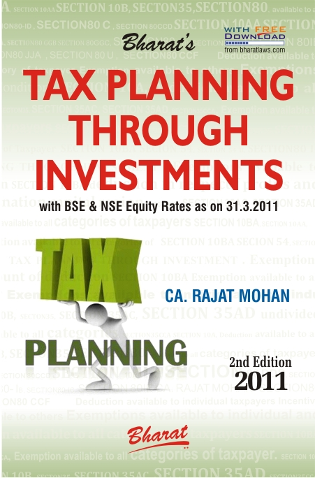

Slide 3
(A). TAXPAYER CATEGORY- SECTION 115F
This exemption is available to taxpayers, being a Non-Resident Indian

Slide 4
(B). CONDITIONS - SECTION 115F
1. Original asset transferred criteria — Long term capital gains arise from transfer of foreign exchange asset.
2. The assessee has, within a period of 6 months after the date of such transfer, invested the whole or any part of the net consideration.
3. New asset acquired criteria — Investment is to be made in any specified asset, or in any savings certificates referred to in section 10 (4B)

Slide 5
(B). CONDITIONS SECTION 115F
4. Non-transfer of new asset for 3 years criteria — The new specified asset shall neither be transferred nor be converted into money for a period of 3 years from the date of its acquisition.
However if such asset is transferred or converted into money, within a period of 3 years from the date of its acquisition, the amount of capital gain exempted under this section shall deemed to be long term capital gains of the previous year in which the new specified asset is transferred or converted into money

Slide 6
(C).AMOUNT OF EXEMPTION- SECTION 115F
(i) If the cost of the new asset is not less than the net consideration in respect of the original asset - The whole of such capital gain shall be exempt;
(ii) If the cost of the new asset is less than the net consideration in respect of the original asset, - So much of the capital gain as bears to the whole of the capital gain the same proportion as the cost of the new asset bears to the net consideration, shall be exempt.

Slide 7
(D).FORMULA FOR CALCULATING EXEMPTION SECTION 115F
EXEMPTION = Capital Gains on sale of foreign exchange Asset x cost of new specified assets
Net Consideration

Slide 8
(E). MEANING- SECTION 115F
‘Specified asset’ means any of the following assets, namely:
(i) Shares in an Indian company;
(ii) Debentures issued by an Indian company which is not a private company as defined in the Companies Act, 1956;
(iii) Deposits with an Indian company which is not a private company as defined in the Companies Act, 1956;
(iv) Any security of the Central Government as defined in clause (2) of section 2 of the Public Debt Act, 1944;
(v) Such other assets as the Central Government may specify in this behalf by notification in the Official Gazette.

Slide 9
THANK YOU
Your comments and suggestions are of utmost importance and are always welcomed.
CA. Rajat Mohan
B.Com(H), ACA, ACS, DISA
MOHAN AGGARWAL & ASSOCIATES
Chartered Accountants
Head Office
F-31 D.B. Gupta Market, Karol Bagh, New Delhi-110005
Office Phone: 011-23672609 / 23535809
Branch Office
18A, IInd Floor, North Avenue Road, West Punjabi Bagh, New Delhi-110026
office Phone: 011-47322696/97
Website: www.delhicamohan.com
E-mail: rajat.mohan@icai.org

