Slide 1
Tax Planning through Investments
SECTION 54EC.
EXEMPTION FROM CAPITAL GAIN ON INVESTMENTS MADE
IN CERTAIN BONDS.

Slide 2
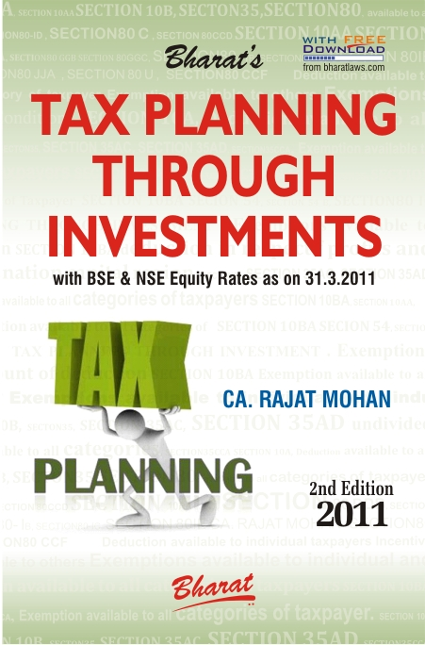

Slide 3
(A). TAXPAYER CATEGORY-SECTION 54EC
This exemption is available to all categories of taxpayers.

Slide 4
(B). CONDITIONS - SECTION 54EC
Nature of Capital Gains on sale of original asset criteria — The capital gain arises from the transfer of any long-term capital asset.
2. The assessee has, within a period of 6 months after the date of such transfer, invested the whole or any part of capital gains.
3. New asset acquired criteria — Investment shall be made in the long-term specified asset.

Slide 5
(B). CONDITIONS - SECTION 54EC
4. Non-transfer of new asset for 3 years criteria — The new long-term specified asset so acquired under this section shall not be transferred for a period of 3 years from the date of its acquisition.
However where the long-term specified asset is transferred or converted into money at any time within a period of 3 years from the date of its acquisition, the amount of capital gains exempted under this section shall be deemed to be Long Term Capital Gains of the previous year in which the long-term specified asset is transferred or converted into money. In case assessee takes any loan or advance on the security of such new long-term specified asset, he shall be deemed to have converted such specified asset into money on the date on which such loan or advance is taken.

Slide 6
(C). AMOUNT OF EXEMPTION SECTION 54EC
If the cost of the long-term specified asset is not less than the capital gain arising from the transfer of the original asset - The whole of such capital gain shall be exempt.
(b) If the cost of the long-term specified asset Is less than the capital gain arising from the transfer of the original asset – Amount invested in long-term specified asset shall be exempt.
However, the investment made on or after 1 April, 2007 in the long-term specified asset by an assessee during any financial year does not exceed Rs. 50 Lacs.
The cost of specified assets, which is considered for the purpose this section, shall not be eligible for deduction under section 80C.

Slide 7
(D). MEANING SECTION 54EC
i) ‘Long-term specified asset’ means any bond, redeemable after 3 years and issued on or after 1 April, 2007 by:
National Highways Authority of India constituted under section 3 of the National Highways Authority of India Act, 1988 or
Rural Electrification Corporation Limited, a company formed and registered under the Companies Act, 1956.

Slide 8
THANK YOU
Your comments and suggestions are of utmost importance and are always welcomed.
CA. Rajat Mohan
B.Com(H), ACA, ACS, DISA
MOHAN AGGARWAL & ASSOCIATES
Chartered Accountants
Head Office
F-31 D.B. Gupta Market, Karol Bagh, New Delhi-110005
Office Phone: 011-23672609 / 23535809
Branch Office
18A, IInd Floor, North Avenue Road, West Punjabi Bagh, New Delhi-110026
office Phone: 011-47322696/97
Website: www.delhicamohan.com
E-mail: rajat.mohan@icai.org

