Slide 1
Tax Planning through Investments
SECTION 35AC
EXPENDITURE ON ELIGIBLE PROJECTS OR SCHEMES.

Slide 2
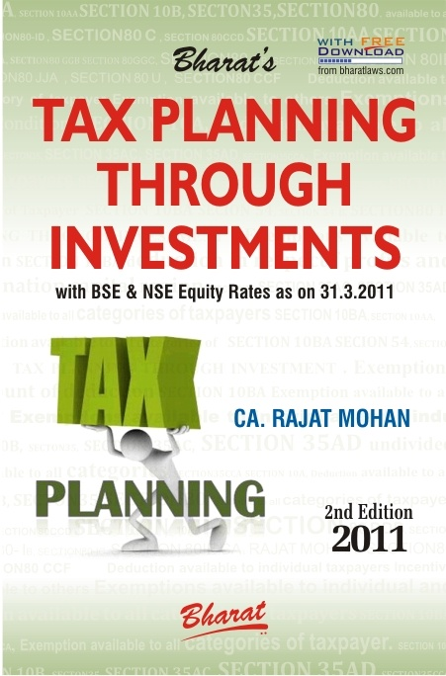

Slide 3
(A). TAXPAYER CATEGORY SECTION 35AC
This benefit is available to all categories of taxpayers.

Slide 4
(B). CONDITIONS SECTION 35AC
Assessee has a business
(b) Assessee incurs any expenditure by way of payment of any sum to a:
(i) Public sector company or
(ii) Local authority or
(iii) Association or institution approved by the National Committee[
for carrying out any eligible project or scheme.
However, a company may, even incur such expenditure either by way of payment of any sum as stated above or directly spend it on the eligible project or scheme.

Slide 5
(B). CONDITIONS SECTION 35AC
(c) Certificate criteria — Assessee shall along with his return of income furnish a certificate:
(i) Where the payment is to a public sector company or a local authority or an association or institution — Form No. 58A from such public sector company or local authority or, as the case may be, association or institution; or
(ii) In any other case — Form No. 58B from an accountant.
(d) Dual benefit not allowed criteria — Expenditure referred in this section shall not be allowed to the assessee under any other section.

Slide 6
(C). MEANING SECTION 35AC
‘Eligible project or scheme’ means such project or scheme for promoting the social and economic welfare of, or the uplift of, the public as the Central Government may, by notification in the Official Gazette, specify in this behalf on the recommendations of the National Committee.

Slide 7
THANK YOU
Your comments and suggestions are of utmost importance and are always welcomed.
CA. Rajat Mohan
B.Com(H), ACA, ACS, DISA
MOHAN AGGARWAL & ASSOCIATES
Chartered Accountants
Head Office
F-31 D.B. Gupta Market, Karol Bagh, New Delhi-110005
Office Phone: 011-23672609 / 23535809
Branch Office
18A, IInd Floor, North Avenue Road, West Punjabi Bagh, New Delhi-110026
office Phone: 011-47322696/97
Website: www.delhicamohan.com
E-mail: rajat.mohan@icai.org

