Slide 1

WEALTH TAX ACT 1957
A COMPLETE SUMMARY.

Slide 2
Charge Of WEALTH Tax
Sec.3 -Wealth tax shall be charged to every individual, H.U.F, Trust and company @ 1% of the amount by which net wealth exceeds Rs.30.00 Lacs as on corresponding valuation date i.e last day of financial year.
Note-assets must belong on last movement of valuation date.
Sec.45 –Act not apply to any company registered u/s 25 of company act, any social club, political party, co-operative society or any mutual fund specified in sec 10(23D) of income tax act.
Note: No education cess on wealth tax.

Slide 3
How to compute wealth tax
(A) Value of assets belonging to assessee as on valuation date (Assets as per sec. 2(ea) xxxx
(B) Deemed assets (Sec.4) xxxx
(C) Exempt Assets (Sec.5) xxxx
Gross Wealth A+B-C xxxx
Less: Liabilities incurred on assets
included in wealth. xxxx
Net Wealth xxxx
Value as per schedule III read with sec.7 of wealth tax act.

Slide 4
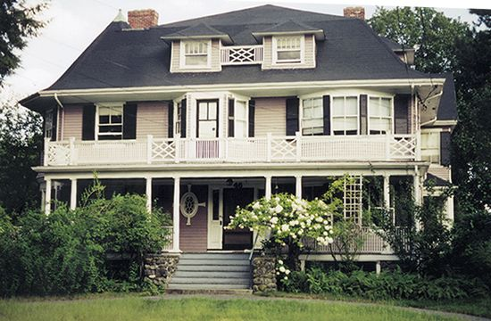
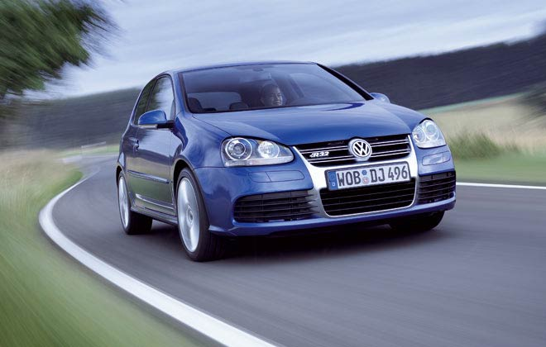
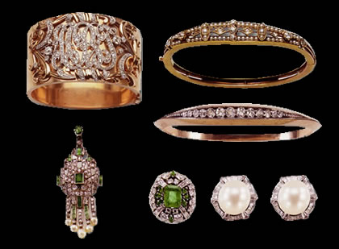


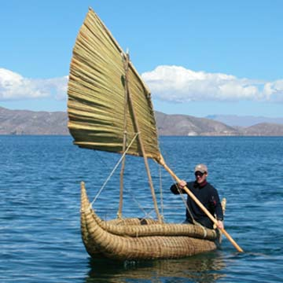
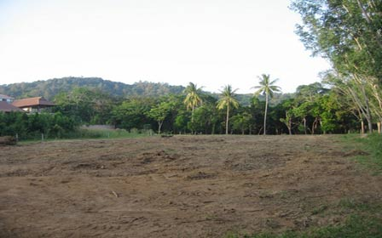


ASSETS AS PER WEALTH TAX
ASSETS INCLUDES :- BUILDINGS, CARS,JEEP, JEWELLERY, AIRCRAFTS,
BOAT, YACTS, URBAN LAND AND CASH

Slide 5
Assets 2(ea)
(i) Any building or land appurtenant thereto means house whether used for residential or commercial or guest house purposes or farm house (situated with in 25 km from local limits of municipality.) or otherwise.
Not to include:
If used for business or profession carried on by assessee. If assessee is partner in firm, even used for firm business is eligible for not including in asset
If held as stock in trade.
Any commercial establishments or complexes.
Any residential property let out for 300 days or more in p.y
House (Residential) allotted (not let out) to (whole time) employee or director or officer by COMPANY having gross annual salary (in money terms whether taxable or not) of < 5 Lacs.

Slide 6
Assets 2(ea) Continue…..
(ii) Indian or Imported Motor Cars including jeep, jonga, motor van but excluding bus, truck, delivery van, ambulance, two wheelers or three wheelers etc. Even if use for business or profession.
Not to include:
if held as stock or used for the business of running them on hire.
Note:
If leased out asset in the hands of leasing co.
If hire purchase asset in the hands of hire purchaser
(iii) Jewellery (ornaments and semi precious or precious stones) , bullion, furniture, utensils or any other article made wholly or partly of gold, silver, platinum or any precious metal.
Not to include if held as stock in trade.

Slide 7
Assets 2(ea) Continue…..
(iv) Boats, yachts, aircraft including helicopter exclude ships.
Not to include:
if held as stock or used for commercial purpose (to be seen from license granted by ministry of civil aviation.
(v) Urban Land means situated in municipality whose population > 10 thousand (Latest census figures published before valuation date) or situated within 8 km (as central govt. notifies)form local limits of municipality(vacant) Even if agriculture.
Not to include:
If held as stock for a period of 10 years from its acquisition date.
If occupied by building (approved).

Slide 8
Assets 2(ea) Continue…..
If construction not permissible under any law for the time being in force in area in which land situated. If for dispute not constructed then asset.
if any unused land used by assessee for industrial purposes for a period of 2 years from date of acquisition.
Note: Plot on land on which construction going on , till completion of construction it is land after completion it is building.
(vi) Cash in hand in case of Individual or HUF if more than 50 thousand. (whether recorded or not) and in case of any other person if not recorded it is asset but if recorded it is not an asset even if it exceed 50 thousand.

Slide 9
Deemed Assets Sec.4
Assets transferred to wife without consideration or adequate consideration but not in connection with agreement to live apart.
Assets transferred to sons wife without adequate consideration
Assets transferred to a person or association of person without adequate consideration for the direct or indirect or immediate or deferral benefit of the person who transferred or his/her spouse or his/her son’s wife.
A person who is holder of impartibly estate.
Assets held by minor including step or adopted child but not being a married daughter
Exceptions: Disable minor (80U sec) or assets acquired by minor from manual work income or his skill, talent, specialized knowledge and experience.

Slide 10
Deemed Assets Sec.4 continue….
Note: Assets of minor to be included in wealth of parent whose net wealth is more excluding this minor’s wealth if marriage of parents subsist otherwise to be included in the wealth of the person who maintains child.
Once included in once parent wealth it continues unless A.O satisfy that necessary to change after giving opportunity of being heard.
Assets transferred otherwise than irrevocable transfer (i.e which is revocable after 6 years or which is not revocable during life time of transferee and under which transferor derives no direct or indirect benefit during transfer period ).
Note: No power to revoke, during irrevocable transfer period, if power arise then it will be deemed asset for transferor. Actual revocation not necessary
Interest of partner of firm or member of AOP other than co-operative society. (Minor partner interest in parents income.)

Slide 11
Deemed Assets Sec.4 continue….
Conversion by individual his self acquired property into joint family property without adequate consideration
Note: if on partition of family, out of assets transferred by individual, share received by spouse that to be deemed asset for individual (Assume it is indirect transfer)
Member of cooperative housing society (Asset is house allotted from allotment date) Amount payable under such scheme is deducted as debts owned in relation to asset.
Building or Right in building (not land) acquired in following cases:
a) On lease for a period of 12years or more (excluding right from period not > 1 year)
b) Possession obtained in part performance of contract u/s 53A of Transfer of property Act.
Note: Building on lease for 12 years or more for right more that 1 year also included in real owner wealth, hence double taxation.
10) Gift by book entries unless AO satisfy money’s actual delivery.

Slide 12
Notes on clubbing of assets or deemed assets
If properties are assets as on valuation date then it is to be clubbed in transferor wealth even if these were not assets at time of transfer.
Relationship must exist at time of transfer and also as on valuation date.
Accretions to Assets is taxable in transferee hand, it will not be clubbed with transferors wealth.
Case::: Minor earn from skills….> buy house….>give it on rent….> with rent income buy car then this car is to be clubbed with parents wealth. But house is child’s wealth.

Slide 13
EXEMPTIONS IN RESPECT OF CERTAIN ASSETS (SEC.5)
(i) Any property (in India or outside India) held under trust or under legal obligation for any public purpose of charitable or religious nature in India.
Note: Exemption is available for business assets only when such business in incidental and separate books maintained.
If trust deed provides that property can also be used for other than charitable or religious purposes then exemption not available.
Interest in co-parcenary property of HUF.
Any one building in occupation (i.e own possession but not let out) of Ruler which was declared by C.G as his official residence.
Heirloom jewellery (kept permanently in India and in original shapes) in possession of Ruler not being his personal property.

Slide 14
EXEMPTIONS IN RESPECT OF CERTAIN ASSETS (SEC.5) continue….
(v) An Indian citizen or person of Indian origin who was Non Resident and who has returned to India with intention of permanently residing in India, then the money and assets brought to India and value of assets acquired out of money sent from abroad and NRE account within one year immediately preceding his date of return and assets acquired after coming back out of such money shall be exempt for a period of 7 successive A.Y. commencing with A.Y next following date on which he returned.
Note: If Assessee brought assets (not money) from o/s India and convert them into other assets in India, Assets converted in India will also be eligible for exemption. As per Kerla high court decision.
(vi) Any one house (may be let out, Residential, commercial, farm house, self occupied, or Guest house etc.) or part of a house or a plot of land (land area 500 Sq. Mt.or less) belonging to Individual or HUF.
Note: If exemption under sub sec. (iii) then no expemption to ruler under sub section (vi)

Slide 15
DEBTS SEC.2 (m)
Debt owned on the valuation date by assessee on assets included in wealth are deductible.
Note: If assets included but exempted u/s 5 then debt owned not deductible.
Even if value of assets are less, whole amount of debt is deductible.
Debts outside India is deductible if such debts have been incurred to acquired assets in India included in Wealth.
If single debt is on asset and non asset both and it is not possible to compute debt portion for asset, then use following formula to calculate debt for asset
Total Debt X Actual cost of asset / Actual cost of asset and non asset together.

Slide 16
Sec.6 EXCLUSION OF ASSETS N DEBTS IN WEALTH OF CERTAIN PERSONS.
In case of Individual or HUF who is Non Resident or Not ordinarily resident.
Company which is non resident
Individual who is non citizen of India
    During the year ending on valuation date, Assets located outside India and debts on such (even if debts in India) shall not be included for wealth calculation.

Slide 17
VALUATION (SCHEDULE III)
Assets
Building or Land Appurtenant thereto
Assets of Business
Interest in Firm/AOP
Jewellery
Urban Land, Cars, Yachts, Aircrafts, Boats.
Rule numbers
3 to 8
14
15,16
18,19
20
Even Valuation Officer has to follow Schedule III.
For Valuation of Building or Land appurtenant thereto Sec. 7 also relevant.

Slide 18
VALUATION OF LAND OR BUILDING APPURTENANT THERETO AS PER RULE 3 TO 8
If property acquired or constructed after 31/03/1974-
a) Net Maintainable Rent X Capitalization Factor
b) Total cost of acquisition or construction and cost of improvements
a or b which ever is higher.(Rule 3,4,5)
If before 01/04/74 then only ‘a’ condition.
Exception- For one house exclusively used by assessee for his own residence throughout p.y and whose costs (Acquisition or construction and improvement) not exceed 25 Lacs (50 Lacs for metro cities) only condition ‘a’.
Note-(Sec.7 which is discussed later exemption can also be used for this same house)
Add: Adjustment of unbuilt area of plot of land (Rule 6)
Less: Adjustment of unearned increase in value of land (Rule 7)

Slide 19
VALUATION OF LAND OR BUILDING APPURTENANT THERETO AS PER RULE 3 TO 8 continue…..
Capitalization factor:
  If property is on freehold land 12.50
  If on leasehold land and unexpired
  period of lease on valuation date is
  50 years or more 10.00
  If on leasehold land and unexpired
  period of lease on valuation date is
  less than 50 years 8.00
  Net Maintainable Rent (NMR):
  Gross Maintainable Rent (GMR)
  Less 15% of GMR
  Less Municipal Taxes (Accrual basis) whether borne by tenant or assessee.

Slide 20
GMR- (RULE 3 TO 8 continue…..)
If property not let out- Fair Market Rent or annual value as assessed by local authority if property falls in jurisdiction of local authority.
If property let out- Annual Rent or Annual value of local authority whichever more.
Annual Rent= Actual Rent X 12 / No of months for which property let out.
Actual Rent (for property let out period)=
Actual rent received or receivable for property let out period
+ 1/9th of Actual rent received or receivable for repair if repairs borne by tenant
+ Taxes agreed to be borne by tenant (for property let out period)
+ 15% interest (on monthly outstanding balances ignoring part of month on Refundable or non refundable deposit (other than advance rent for 3 or less months) from tenant, reduced by interest actually paid to tenant on such if any
+ Lease premium or non refundable lease out deposit divided by no. of years of lease (for property let out period)
+ Value of benefit received by assessee for leasing property (for property let out period)
+ Any obligation of owner met by tenant (for property let out period)

Slide 21
RULE 3 TO 8 continue…..
Rule 6- Adjustment of unbuilt area of plot if unbuilt area > specified area
Specified area (permissible unbuilt area) is 70% of aggregate area (60% for metro cities and 65% for some specified cities)
If % of unbuilt area less specified area over aggregate area is-
  Upto 5% then no addition as per rule 6
  >5% but upto 10% then 20% of value as per rule 3,4 and 5
  > 10% but upto 15% then 30%.....
  > 15% but upto 20% then 40%.....
  > 20% then rule 8 will apply above rules 3 to 7 not apply.

Slide 22
RULE 3 TO 8 continue…..
Rule 7-Adjustment for unearned increase=
If property is constructed on lease hold land from govt. or govt. authority and govt. is entitled to recover a specified percentage of unearned increase in value of land at time of transfer of property then value as per 3,4,5 and 6 shall be reduced by
a) 50%
b) Unearned increase value to be recovered by govt.
whichever is less (a or b)
Unearned increase is Value of land on valuation date as determined by govt. for computing unearned increase less lease premium paid or payable to govt.

Slide 23
RULE 3 TO 8 continue…..
Rule 8 states that notwithstanding rule 3 to 7 the value of property shall be estimated to be price it would fetch if sold in open market on valuation date in the opinion of Assessing Officer.
Rule 8 only if- difference b/w unbuilt and specified area is >20% of aggregate area or where property on lease hold land and where lease expires within 15 years from valuation date and lease deed not gave option for renewal of lease. Or where Assessing officer with prior approval of joint commissioner is of opinion that it is not practically possible to apply rule 3 to 7.

Slide 24
SECTION 7
Value of any one house (can apply different house in next year) exclusively used by assessee for residential purposes during p.y may at assessee option taken to be:
a) value as per rule 3 to 7
OR
b) value as per rule 3 to 7 as on valuation date next following the date assessee became owner (date of construction completed if constructed house) or value as on 31/03/1971 which ever later.

Slide 25
RULE 14 (VALUATION OF BUSINESS ASSETS)
A) Value of assets(Sec.2(ea)) as in balance sheet.
B) Schedule III Value
If Value as per B above exceeds value as per A above by >20% of value as per A then take value as per B. otherwise value as per A.

Slide 26
Rule 15 & 16 (valuation of interest of partner in assets of firm or member in assets of aop/boi)
A) Determine net wealth of firm/AOP/BOI as if it were an assessee as per rule 14 without exemption u/s 5.
B) The portion of ‘A’ above, upto capital of the firm/AOP/BOI should be allocated to partners/members in capital contribution ratio.
C) Balance of ‘A’ should be allocated in dissolution ratio. If dissolution ratio not available then in profit sharing ratio.
Note: If partner or member is minor distribute his share also. After that, this minor share will be clubbed accordingly in his/her parents wealth as per clubbing rules discussed earlier

Slide 27
Rule 15 & 16 continue…
If net wealth of firm includes sec.5 exempt asset, then the exemption in respect of such asset shall be available to member/partner in dissolution ratio and in absence of dissolution ratio, in profit sharing ratio.
If firm has assets located outside India but partner is non resident or not ordinary resident or non citizen then following shall not be included in partners net wealth:-
Such partner share as per 15 & 16 X (Assets located outside India- Debts in respect of such assets) / Net wealth of Firm.

Slide 28
Rule 18 & 19 valuation of jewellery
Valuation at price, it will fetch if sold in Open Market as on valuation date.
Return should support a statement in O-8A form if valuation not more than 5 lacs, otherwise Report in O-8 from registered valuer for one year and for next 4 subsequent A.Y new report not required but same report shall be adopted even if value of jewellery > 5 Lacs. Only Adjustment of Market value of gold etc. or Adjustment of acquisition or sale of jewellery required.
A.O can make reference to Valuation officer u/s 16A in respect of subsequent 4 A.Y

Slide 29
Rule 20: valuation of motor cars, yachts, boats, aircrafts and urban land.
Valuation at price, it will fetch if sold in Open Market as on valuation date.
Rule 21:
Restrictive covenants (Restrictive conditions etc. on sale)to be ignored in determining market value of Assets.
However, if property is attached by govt. etc. then market value will be reduced.

Slide 30
Other important sec.’s
Procedure of Assessment under wealth tax is almost similar to Income Tax Act.
Return below specified exemption limit i.e 30 Lacs deemed never furnished.
No Advance Tax and Education cess in wealth Tax.
Wealth R/off to nearest 100 Rs.
Tax liabilities of deceased can be recovered form legal representative upto estate inherited. However, no penalty can be levied on legal heir

Slide 31

COMPILED BY:
CA Varun Chadha
EMAIL: cavarunchadha@yahoo.com varun.chadha@icai.org

