Slide 1

Outbound Investments
Process of structuring investments outside India
CA. Dayavanti Khilolani
K.C. Mehta & C0.
Articles Training Programme
16th January 2010

Slide 2

INTRODUCTION
Conceptual Birth
Sea Change in Laws
Meaning
Future Prospects
Types of Investments

Slide 3


TYPES OF INVESTMENTS
Pure Investment
Private Equity Investment
Direct Investment

Slide 4
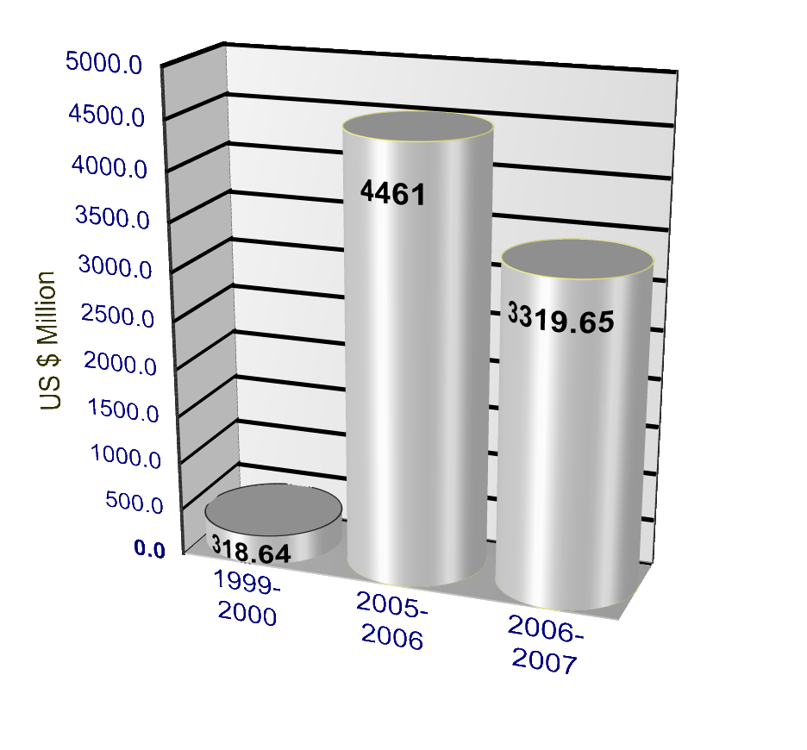
STATISTICS
Direct Investment outside India - outflows

Slide 5
STATISTICS
Mode of Overseas Investments – (1996 to 2007)

Slide 6
STATISTICS
Inflows from Overseas Investments – (1999 to 2007)

Slide 7
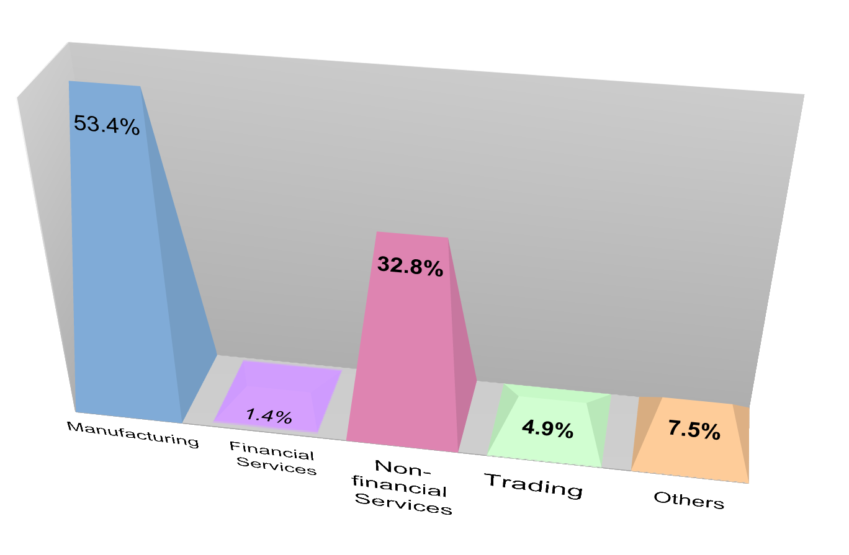
STATISTICS
Sector wise Investment Outflow – (1999-2007)

Slide 8
STATISTICS
Overseas Investment – Top 10 Countries – (1996-2007)

Slide 9


PURPOSE
Business Expansion Opportunities
  Expanding Customer Base – Global Market
  Backward/Forward Integration
  Technology/Skill Transfer
  Employment Generation
Exchange Earnings
  Dividend
  Interest
  Royalty
  Fees for technical services
  Increased Exports

Slide 10

FACTORS TO BE CONSIDERED
Study Business Plan for knowing
  Purpose of Investment
  Amount Proposed to be Invested
  Where to Invest?
  How to Invest?
  When to Invest?

Slide 11
FACTORS TO BE CONSIDERED – Contd.
List of factors
  Direct/Indirect investments
  Choice of entity
  Choice of territory
  Funding Options
  Availability of tax benefits
  Repatriation of Funds
  Tax efficient exit

Slide 12
DIRECT/INDIRECT INVESTMENTS
Direct Investment
Indirect Investment
Indian Entity
Investment in
Foreign Entity
Indian Entity
Investment in
SPV
Investment in
Foreign Entity

Slide 13
CHOICE OF ENTITY
Branch Office
Liaison Office
Project Office
Subsidiary Company
LLP
JV
Partnership
Proprietor-ship

Slide 14
CHOICE OF TERRITORY
DTAA – Treaty network
With-holding taxes
Corporate Laws and Taxes
Repatriation – retention and remittance
Exchange Controls

Slide 15
FUNDING OPTIONS
Equity
- Decision making power, higher returns
Preference
- Fixed share in profits
Debt
- Interest, tax deductibility, trading on equity
Debentures
- Loan Funds, thin capitalisation
Other forms of capital
- Intellectual property, technology, etc.

Slide 16
OTHERS
Availability of tax Benefits
Repatriation of Funds
  Retention Vs Remittance
  Investment of Funds globally
  Worldwide increment in value of the entity

Slide 17
TAX EFFICIENT EXIT
Sale of Shares of the Foreign Entity – Taxability
Sale of Assets of the Foreign Entity– Taxability
Sale of shares of the Indian Entity (parent company) – Taxability
Buy Back of Shares – Taxability
Redemption of Preference Shares
Liquidation of the Foreign Entity - Taxability

Slide 18

FINAL DECISION MAKING
Example

Slide 19
DETAILS AVAILABLE
Manufacturing entity in Vadodara – India
Prospective Customers - China
Interested person for investing – China
Decided to set up distribution companies – China
Amount of investment – US $ 30 million
JV Partnership ratio - 51% Indian Entity , 49% Chinese Partner
Indian entity may start manufacturing in China in future
How should the investment be made considering all the aspects???

Slide 20
OPTIMUM STRUCTURE DECIDED
Indian Entity – Flagship Company
100% equity investment
49% Equity
WOS UAE – Trading Company
2% equity
Balance Loan
49% Equity
Balance Loan
Singapore JV
JV Partner China
Min. 25%
investment in each
Distribution Co.
Distribution Co.
Distribution Co.
Distribution Co.

Slide 21

THANKYOU

