Slide 1

Gift
The Income Tax Act 1961 has been amended w.e.f 1st October 2009 to provide taxability of gift.

Slide 2

Gift
Gift will be taxable if:-
Received by Individual/HUF and
2. following circumstances exist:
(i) receipt of any sum of money,
without consideration,
the aggregate value of which exceeds Rs.50,000/-,
the whole of the aggregate value of such sum will be taxable;

Slide 3
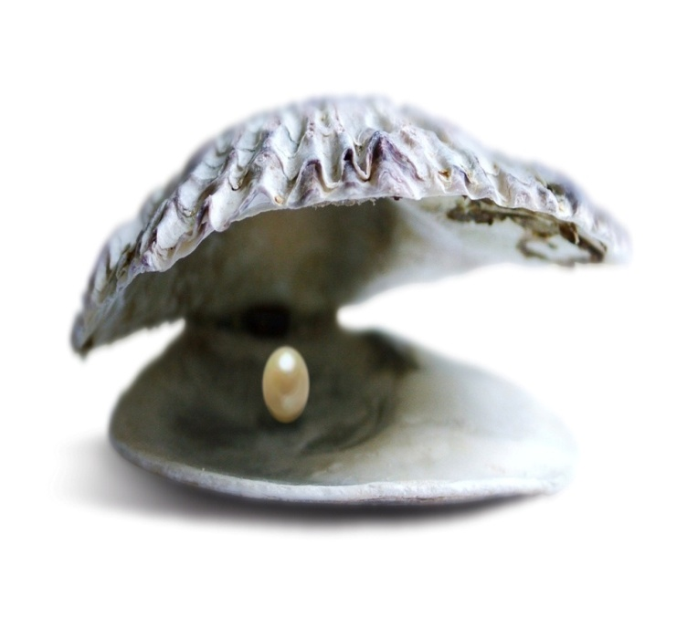
Gift
(ii) receipt of any immovable property
a. without any consideration,
the stamp value of which exceed
Rs.50,000/-or
b. with consideration, which is less than
the stamp value of such property by
Rs.50,000/-
value of such property exceeding such consideration will be taxable

Slide 4

Gift
(iii) any movable property
(i) without consideration,
the aggregate fair market value
of which exceeds 50,000/-,
the whole of the aggregate fair market value of such property will be taxable;
or
(ii) for a consideration
which is less than the
aggregate fair market value of
the property
by an amount exceeding
50,000/-
the aggregate fair market value of such property as exceeds such consideration will be taxable.

Slide 5

Gift
Not Taxable in following case:
any sum of money or any property received
(a) from any relative; or
on the occasion of the marriage of the individual; or
under a will or by way of inheritance; or
(d) in contemplation of death of the payer or donor; or
(e) from any local authority; or
(f) from any fund or foundation or university or other educational institution or hospital or other medical institution or any trust or institution; or
(g) from any trust or institution registered under section 12AA.

Slide 6

THANK YOU
CA Rajnish Kumar
9899113350

