Slide 1

ISSUES ON TAX AUDIT WITH T.D.S.
Vaibhav Jain
M: +91 98 681 44380
vaibhav1986@gmail.com
New Delhi, India
NRO 0147335

Slide 2
CONTENTS
Section 2
Issues in Tax Audit
Section 4
TDS Issues and Reporting in Form 3CD
Section 3
Amendments as proposed by Finance Bill (No. 2) 2009 in TDS
Section 1
Basic Components in Form 3CD

Slide 3

Basic Components of
Form 3CD
SECTION 1

Slide 4
Form no 3CD information can be divided into five segments
Basic information of assessee
Relating to Computation
Compliance of provision and violation
Information about the health and performance of the assessee
Detail of Computation of value of Fringe benefit

Slide 5
Form no 3CD … (Contd…)
I) Basic information of assessee | Name , Pan , nature of business, method of accounting, list of maintenances of books , payment to a relative etc , cost audit and excise duty etc.
II) Relating to Computation
a) Income | not an exhaustive list but the information of ; Income not included in profit and loss account Income under section 41 Deemed income u/s 33AB or 33ABA or 33AC
b) Admissible expenses | Not an exhaustive list but the information of ; (Clause 15) 33AB, 33 ABA, 33 AC, 35 D 35 DDA etc. Partner salary and interest as per section 40 b
c) Inadmissible expenses | Capital exp, personnel exp, due to non deduction of TDS , income tax, wealth tax etc.
d) brought forward loss and deprecation
e) deductions | Under chapter VI A

Slide 6
Form no 3CD … (Contd…)
III compliance of provision and violation | Loan taken and given over Rs. 20000/- other than accounting payee cheque. TDS Compliance Maintenance of books as prescribed Following the accounting system Deposit of divided distribution tax
IV) information about the health and performance of the assessee | Accounting ratios, stock movements, annexure –I Credit side of the balance sheet, interest, commission ,Deprecation and tax paid
V) Detail of Computation of value of Fringe benefit

Slide 7
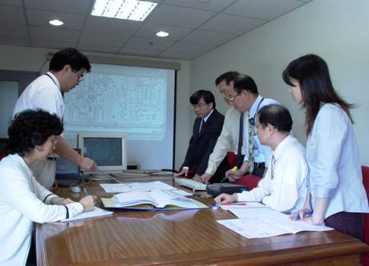
ISSUES ON TAX AUDIT
SECTION 2

Slide 8
section 2(12a)-books of accounts
"Books or books of account" include ledgers, day-books, cash books, account-books and other books, whether kept in the written form or as print-outs of data stored in a floppy, disc, tape or any other form of electro-magnetic data storage device. - Is it necessary to take printouts?
If the assessee has maintained proper books of account, the provisions of Sec 145(1) shall apply and the Income has to be assessed on the basis of the books of account. Thus, unless, the books of account are rejected, or no books of account are maintained, the Income disclosed cannot be disturbed as held in
ITO Vs Amar Singh Jain (1992) 43 TTJ (Jp Trib) 11.
Non maintenance of stock register & non recording of sales with identifiable details was held to be good ground for rejection of account books in Kishan Chand Chella Vs CIT (1978-114 ITR 671)
System of Accounting cannot be rejected merely because the disclosed gross profit was low.
Chandra timber traders Vs CIT (1996 54 TTJ 544 Del Tri)

Slide 9
Can the tax auditor revise his tax audit report?
Guidance notes on Revision / Rectification of Financial statement, state that the auditor may revise the audit report provided.
Revision of accounts of company after its adoption in the annual general meeting.
Changes in law
e.g. Retrospective Amendment
Change in interpretation
e.g. CBDT circular, judgment etc.,
He gives it in the manner suggested by the institute.
But normally the report u/s 44AB should not be revised.
However, it may be revised on the following grounds

Slide 10
Depreciation (Section 32)
At Full Rate : - Opening WDV + Put to Use for More than 180 Days
At 50% Rate : - Put to use for less than 180 days[Proviso to 32 (1)]
Additional depreciation : - is available on new P & M (Section 32 (iia))
20% of Cost of Assets
Conditions: -
manufacturing of articles and things
180 days mean – additions on or after 3rd October
not used before installation (means new Assets )
not installed in – office premises or residential accommodation
not available to office appliance or road transport vehicle.

Slide 11
Issues relating to Section 32
Addition of Building
i.e. Separate the Cost of Land & Building
Immovable Assets
When possession taken, payment made but registration pending (allowable depreciation).
Renovation of Office taken on Leasehold
Allowed as Depreciation
Allowance of Depreciation
Whether Mandatory or Discretionary – [Ans: Mandatory]
Explanation 5 to Sec. 32 (1)
Explanation 1 to Sec. 32 (1)
No Depreciation
When Allowed as Deduction under Section 42
Rate to be determined as per Usage
Depreciation on Car
i.e. Higher Rate available even if the Car is not used in the business of running it on hire by the person claiming depreciation, but instead by the person who has taken it on lease from him

Slide 12
Brought Forward Loss & Depreciation
All loss to be reported
Income from house property
Income from business –
business loss
speculation loss
unabsorbed depreciation
income from capital gain
short term capital gain
long term capital gain
Income from other source :
Horse maintenance for running in horse races.

Slide 13
Payment Of ESI/ EPF & Others U/S 43B
EMPLOYER’S AND EMPLOYEES’ CONTRIBUTION
DIFFERENT TREATMENT
Income u/s Section 2(24) Clause (x)
Employee Contribution
Employer’s Contribution
Section 43B
Deduction is allowed in year of actual payment
or
in the year for which the assessee becomes liable
to make such payment provided the same is paid
before due date of filing ROI
Section 36(1)(va)
allows deduction only if credited by assessee to the employee account in relevant fund by due date (+grace period as per Guidance Note)

Slide 14
Other Issues in 43B
Interest on Sales Tax
Part of Sales Tax
Covered U/S 43 B 260 ITR 218
Excise Duty
Collected but Disputed Hence, Not Paid
SECTION 43B HAS GOT NO APPLICATION WHEN NO DEDUCTION WAS CLAIMED
CIT VS INDIA CARBON LTD 262 ITR 327(GAUHATI)
261 ITR 69(AT) (AHEMDABAD)/ 125 TAMAN 819(RAJ)
Amount deposited in FD, Bank Guarentee Furnished
Not Equivalent to Payment Disallowed U/S 43B

Slide 15
Section 40A (2)
APPLICABLE TO REVENUE EXPENDITURE ALONE
IN APPLICABLE TO INCOME - GOODS SOLD TO ASSOCIATES AT LOWER THAN THE MARKET PRICE-SECTION 40A(2) NOT APPLICABLE-123 ITR 592(MAD),139 ITR 827(MP)
BURDEN TO PROVE UPON REVENUE-CIRCULAR 6P DT 6-7-1968-BUT INITIAL EVIDENCE MAY BE LED BY ASSESSEE
DISALLOWANCE ONLY OF EXCESSIVE AND NOT WHOLE OF THE EXPENSE
RELATIONSHIP MUST BE ONE OUT OF THE SPECIFIED RELATIONSHIPS ONLY
SPECIFIC FINDING AS TO EXCESSIVENESS NECESSARY- 117 ITR 569(SC)
REASONABLENESS OR LEGITIMATE NEEDS OF THE BUSINESS TO BE VIEWED FROM THE POINT OF VIEW OF THE BUSINESSMAN-265 ITR 77(ALL)

Slide 16
Section 40A (3)
GENUINE AND BONAFIDE TRANSACTIONS ARE ALSO HIT AFTER AMENDMENT
REVENUE EXPENDITURE ALONE HIT AND NOT THE CAPITAL EXPENDITURE- PURCHASES ALSO COVERED- Attar Singh Gurmukh Singh 191 ITR 667(SC)
ADVANCE PAYMENT FOR REVENUE EXPENDITURE ALSO COVERED-169 ITR 12 (RAJ)
PAYMENT EXCEEDING RS 20000/- ALONE COVERED. (Proposed to Increase to Rs. 35000/- only for Payment to Transporters, in Finance Bill (No. 2) 2009.
PAYMENT TO EMPLOYEES FOR SALARIES ALSO COVERED
DISALLOWANCE OF EXPENSE TO BE IN THE YEAR OF INCURRENCE OF EXPENDITURE – Held in “Vijay Kumar Ajit Kumar” → Discussed in Next Slide

Slide 17
Proviso to 40A(3)) Vs. Income (40A(3)(a))
DISALLOWANCE OF EXPENSE TO BE IN THE YEAR OF INCURRENCE OF EXPENDITURE – Held in “Vijay Kumar Ajit Kumar” → Discussed Below
Expenses incurred in earlier year paid during the year, other than by an A/c. payee cheque.
Up to A. Y. 2007-08 disallowance in the year in which expense claim
w.e.f. A. Y. 08-09 treated as income

Slide 18
Section 40A (3) and Rule 6DD
Crossed Cheque
Account Payee
Vs
Certificate from management to be obtain as required in form No. 3CD.
Regarding Payment made by Account Payee cheque and further not maintaining record of copy of issued cheque

Slide 19
The New Rule 6DD
Amended by Income Tax Eight Amendment Rules, 2007 w.e.f. A.Y. 2008-09
Permitted
Use of electronic clearing system through bank
credit card
debit card
Disallowance
20% V/s 100%
Up to A.Y. 07-08 w.e.f. A.Y. 08-09
Consolidate – All Cash Payments to a
Single Person in a Single Day

Slide 20
Section 269SS / 269T
(CORRESPONDING PENALTIES U/S 271D AND 271E)
Applicable to Loans and Deposits and Not on Capital
Contra Decisions on Share Application Money
RECENT DECISION OF JHARKHAND HIGH COURT IN THE CASE OF BHALOTIA ENGG WORKS LTD 275 ITR 399-SHARE APPLICATION MONEY RECEIVED IN CASH PARTAKES CHARACTER OF DEPOSIT
52 ITD 504(Jp)-NO OBLIGATION TO REFUND SHARE APPLICATION MONEY-ESSENTIAL OF DEPOSIT NOT EXISTING
NEGATIVELY WORDED- TRANSFER ENTRIES AND BOOK ADJUSTMENTS LIABLE TO BE HIT
GENUINENESS OF LOANS AND DEPOSITS
BUT 88 TTJ 85 (DELHI) LAYS THAT LOANS THROUGH BOOK ADJUSTMENTS ARE NOT IN MONEY AND HENCE SECTION 269SS NOT APPLICABLE-ALSO 89 TTJ 324(AHEMDABAD)
NOT A CONSIDERATION-283 ITR 329 (MADRAS)-276 ITR 638(P&H)-263 ITR 487(GAUHATI)

Slide 21
Other Issues
PAYMENT TO CLUB :- Only for information , no disallowance if incurred for the business.
FINE & PENALTY : -
VIOLATION OF ANY LAW
Not covered contractual breach or for redressal or for contractual wrongs.
Concept of materiality
Not to express opinion of allowability of expenses
Purely compensatory is nature – allowable expenses not an fine and penalty
PRAKASH COTTON MILLS PVT.LTD. (1983) 201 ITR 684 (SC)
SWADESHI COTTON MILLS (1998) 233 ITR 199 (SC)
CIT Vs. AHMEDABAD COTTON MFG. CO. LTD. (1993) 205 ITR 163 (SC)
MALWA VANASPATIC CHEMICALS CO Vs. CIT (1997) 225 ITR 383 (SC)

Slide 22

Amendments as proposed by
Finance Bill (No. 2) 2009
IN TDS
SECTION 3

Slide 23
Amendments…
TDS Rates Applicable for AY 2010-11 (FY 2009-10).
Major Changes of TDS
Tax Deducted at Source on Rental Payment u/s 194 I,
on contract payment u/s 194 C, Payment to transports.
Surcharge and cess is abolished.
Other various amendments has been done.
Please see details given below for amendments related to TDS / Tax deducted at source.

Slide 24
194-I: Rental Payments
Earlier rates:
Plant and Machinery = 10%
Land or building or furniture or fittings to Individual/HUF = 15%
Land or building or furniture or fittings to Others = 20%
Revised Rates
Plant and Machinery = 2%
Land or building or furniture or fittings to anyone = 10%

Slide 25
194-C: Payment to Contractors
Earlier rates:
Contracts = 2%
Sub-Contracts = 1%
Advertisement Contracts = 1%
Revised Rates
Contracts to Individuals/HUF = 1%
Contracts to others = 2%

Slide 26
Surcharge and Cess
No surcharge or Cess is applicable for TDS. Only the specified TDS rates should be considered for deduction
Applicable for AY 2010-11 (FY 2009-10).

Slide 27
Payment to Transporters
For any Transporters, if they Provide the PAN number, the TDS on contract payments is NIL.
But, if they do not provide the PAN during the payment, 1% TDS has to be made for Individuals/HUF and at 2% for others.
Payments to transporters without deducting TDS (as they have quoted PAN) should be reported by Deductor with PAN details to the Income Tax Department in the prescribed format.
Applicable for AY 2010-11 (FY 2009-10).

Slide 28
Compulsory PAN
(Section 206AA)
It is mandatory to quote PAN in all correspondence, bills and vouchers exchanged between Deductor and deductee.
TDS shall be made at a flat rate of 20% (or actual rate, whichever is higher) for any payments, where assessee has not quoted the PAN during the payment.
This is applicable even in case where assessee gives Form 15G/15H u/s 197A.
This is also applicable for Non resident Payments.
Assessing officer shall not rise the letter for lower/no deduction, If assessee doesn’t quote a PAN.

Slide 29
TDS reconciliation
(Section 200A)
A new section 200A is introduced.
TDS return filed by the deductor will be processed by the following way:
TDS deductible will be computed on the basis of data in TDS statement, after adjusting any arithmetic error or an incorrect claim.
The interest, if any, shall be computed on the basis of the sums deductible on the basis of data in TDS statement.
Any amount payable by / refund to Deductor shall be determined.

Slide 30
TDS returns
Currently returns has to be filed Quarterly in Form 24Q/26Q/27Q/27EQ
Currently government is not allowed to decide the Periodicity of TDS returns, as the power is limited only for structure of forms and the manner.
In order to provide administrative flexibility in deciding the periodicity of such TDS related statements, the existing provisions are modified, so as to allow the Government to prescribe periodicity of such TDS statements besides prescribing their form and manner.
Applicable from 01st October 2009

Slide 31
Computerized processing of TDS returns
Currently every TDS return involves manual-cum-computerized processing inside the department.
To make the process efficient, department will computerize whole process, where statements regard to TDS will be processed.
This will be on the same lines, how IT returns processing has been computerized in Income Tax Department.
This processing will allow manual interference for Any arithmetical error in the statement.
An incorrect claim, if such incorrect claim is apparent from any information in the statement, for example, in respect of rate of deduction of tax at source where such rate is not in accordance with the provisions of the Act.
A Centralized Processing Center may be established in this regard.
Applicable for AY 2011-12 (FY 2010-11).

Slide 32
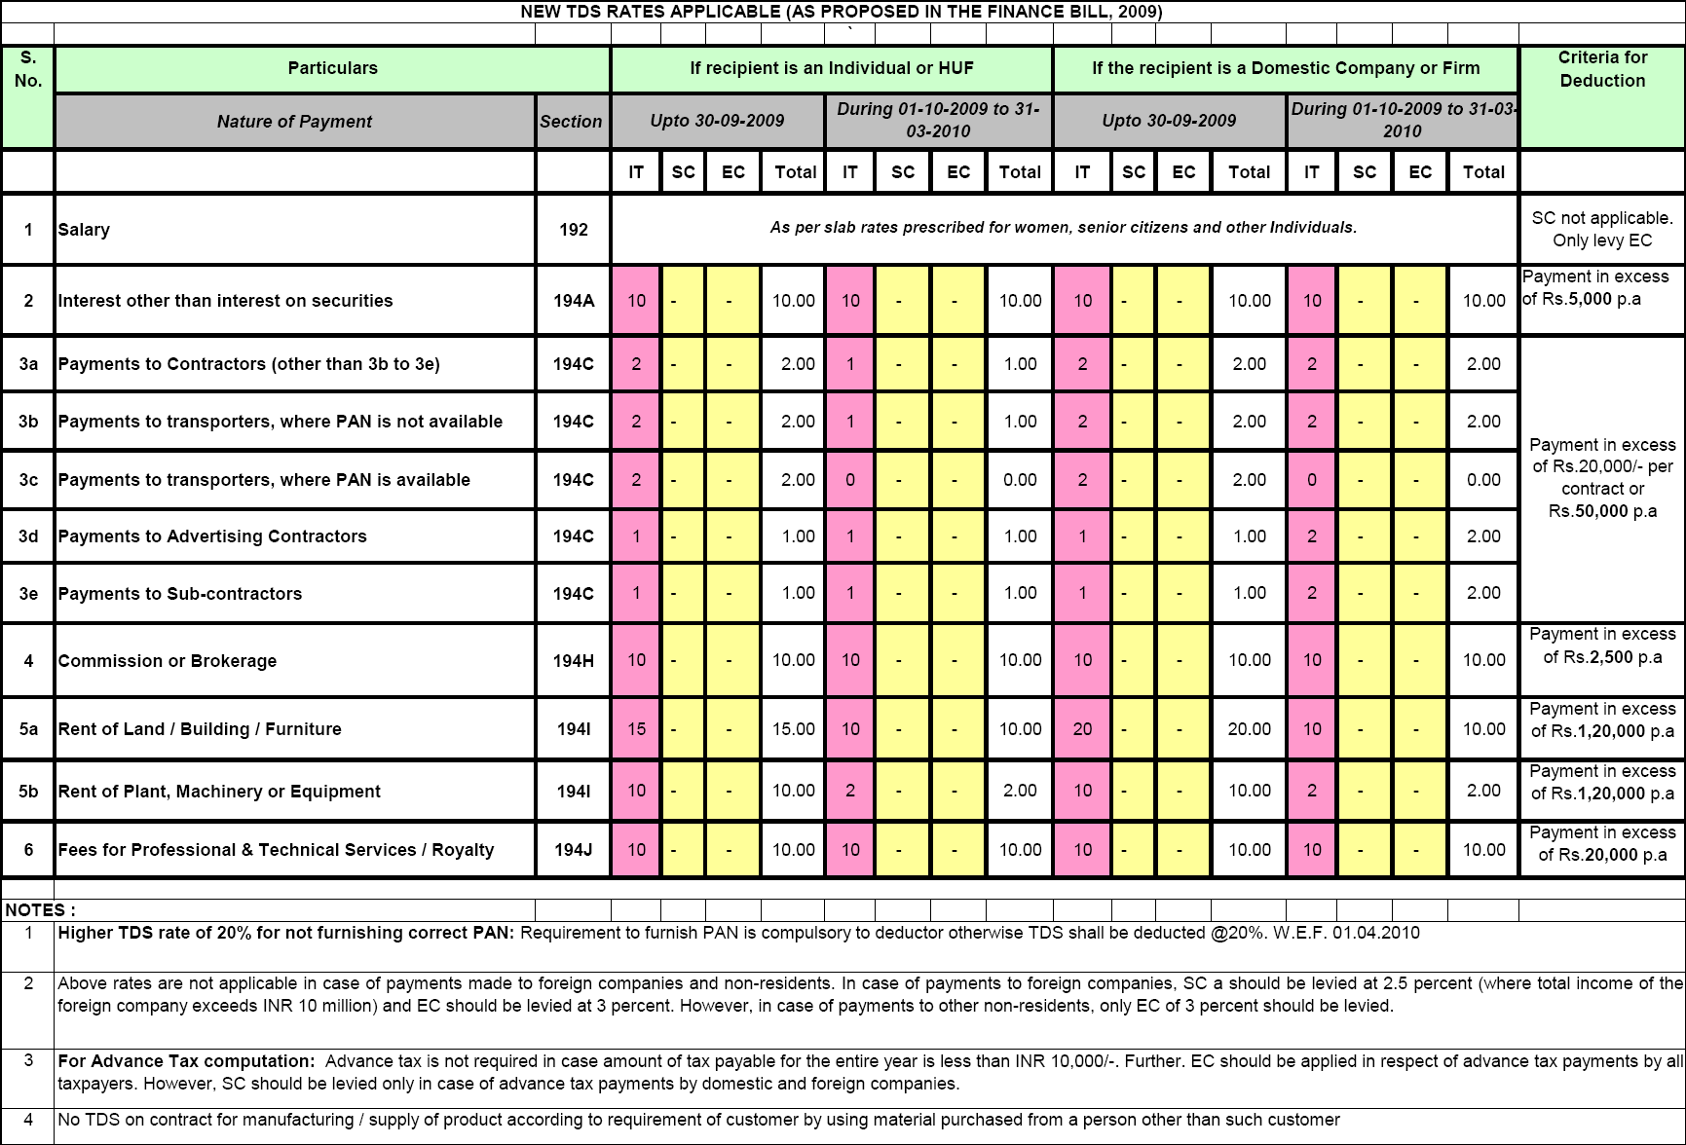
New Rates of TDS as Proposed by Finance Bill (No.2), 2009

Slide 33

TDS ISSUES AND REPORTING IN 3 CD
SECTION 4

Slide 34
CONTENTS
Disallowance of Expenditure
Section 40 (a) (i)/ (ia) / (iii)
TDS Issues : Case Studies
Reporting in Form 3 CD

Slide 35
Disallowance of Expenditure
No allowance in case of failure to deduct or failure to pay after deduction of tax
Section 40 (a) (i)
Section 40 (a) (iii)
Payment of salary to non – residents
Payment to non – residents (interest, royalty, fees from technical services or other sum chargeable under the Act)
Expenditure deductible in the year of payment of tax, except in some cases:
After deduction payment during the year or during the stipulated time
Allowable in subsequent year as and when paid.
Section 40 (a) (ia)
Payments to residents (interest, commission or brokerage, rent, royalty, fees for professional / technical services, contract payments)
Expenditure deductible in the year of payment of tax, except in some cases:
After deduction payment during the year or during the stipulated time.
Allowable in subsequent year as and when paid.
Expenditure NOT deductible in the year of payment of tax.

Slide 36
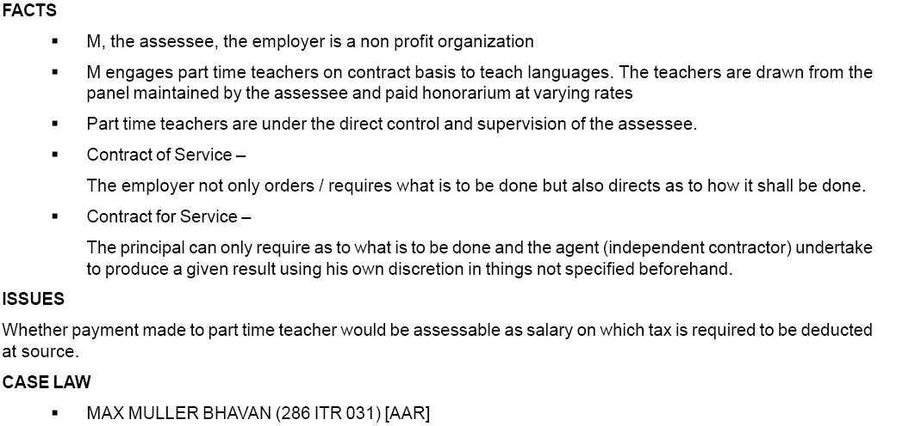
CASE STUDY 1
Where the question how the service is to be done is also determined by the employer, the employer, employee relationship is established, and hence deduction of TDS as salary. In any other case it is not assessable as salary.

Slide 37
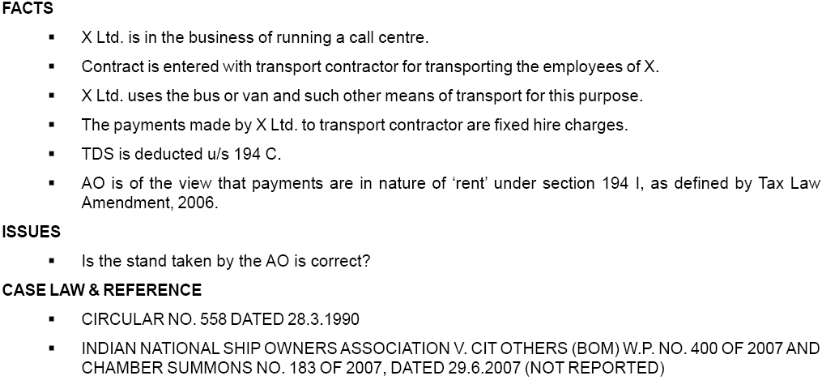
CASE STUDY 2
It is a Contact Payment U/S 194 C

Slide 38
REPORTING IN FORM 3CD
Details of payments referred to in section debited to P & L to be obtained.
Professional judgment to be exercised.
Reliance can be placed on judicial pronouncements.
In case of disagreement, both views to be stated.
Reliance can be placed on legal opinions and CA certificate.
Need to report only if different opinion.
Clause 17(f) – amounts inadmissible u/s 40 (a)

Slide 39

Questions ??
Suggestions ??
Comments ??
Monday
August 3, 2009

Slide 40


THANK YOU…!!!
Vaibhav Jain
M: +91 98 681 44380 vaibhav1986@gmail.com
New Delhi, India NRO 0147335

