Slide 1
Borrowings

Slide 2
Borrowings
  Executive Summary of Presentation
  Objective
  Documents to be collected from Client
  Points to be checked
  Common Errors found
  Loan Agreements : Key terms
  Statutory Compliance
  i) CARO, 2016 and CARO, 2020
  ii) Companies Act, 2013
  Finance Cost
  Disclosure in Financial Statements

Slide 3
Borrowings
Objective: To ensure
  Compliance with Companies Act, 2013 (180(1)(c))
  Compliance with the terms of loan agreement
  Interest Expenses has been correctly recorded
  Loan amount has been correctly disclosed
  Disclosures in the financial statement
  CARO Reporting

Slide 4
Borrowings
Document
  Minutes of Board meeting/shareholder’s meeting
  Loan agreements for new loan taken during the period
  Register of Charge and Form CHG-1 filed during the period.
  Interest working
  Direct Balance Confirmation (through letter/mail)
  Minutes of meeting with lenders
  Document relating to Interest rate change
  No dues certificate (if loan fully repaid)

Slide 5
Borrowings
Point to be checked
  Whether interest accrued but not due has been accounted for.
  Whether shareholder’s approval has been taken for Loan if it together with loan already taken is in excess of paid up share capital and free reserve (Section 180(1)(c))
  Read the terms of loan agreement and ensure adequate disclosure in the financial statement
  Check whether charge has been created for the same with ROC (Form CHG-1).
  Whether any amount is overdue for repayment as at reporting date- needs to be reported in financial statement.
  Whether Loan installment is paid as per the repayment schedule- if not to be reported in CARO
  Whether loan has been utilised for the purpose for which it was obtained- if not to be reported in CARO
  In case of debenture, debenture redemption reserve has been created (Rule 18(7) of Companies (Share Capital and Debentures) Rules, 2014
  In case of debenture invest or deposit on or before the 30th day of April in each year atleast 15% of the amount of its debentures maturing during the year ending on the 31st day of March of the next year (Rule 18(7) of Companies (Share Capital and Debentures) Rules, 2014
  Balance confirmation process

Slide 6
Borrowings
Common errors found
  Delay in repayment
  Error in classification of long term or short term
  Error in measurement of current maturities of long term debt
  Under/overbooking of Interest
  Non matching of loan confirmation with book balance (due to penal interest/timing of recording).
  Non deduction of TDS on interest paid to non financial institution

Slide 7
Loan Agreements : Key terms
1. Purpose of Loan Agreement (Inclusive list)
i. Acquisition of PPE
ii. Project development related expenses
iii. Long term/Short term working capital requirement
iv. Onward lending to subsidiaries/associate Companies
v. Investment in subsidiaries/group/associate Companies
2. Date of Loan agreement and disbursement
check the date of disbursement of loan to identify the period of Loan.
3. Period of Loan (Tenure)
check the period of loan to verify whether the loan agreement has not been expired during the audit period
Sample clause

Slide 8
Loan Agreements : Key terms
4. Loan Agreement expired
Obtain a rollover document (document for extension of loan period)
If provided by Client
If not provided by Client
Check the due date in rollover document and classify accordingly as Current or Non-Current
It means repayment of principle and interest deemed to be due from the due date of expired agreement
Classify it as Current
Disclosure for default in repayment of principal and payment of interest (Period of default & amount of default)

Slide 9
Loan Agreements : Key terms
5. Rate of Interest
i. Fixed interest rate – which will not change during the course of loan (i.e. 12% fixed)
ii. Floating interest rate – based on interest rate margin added to benchmark rate
iii. Interest may be Simple interest or Compound interest payable quarterly or half-yearly or annually

Slide 10
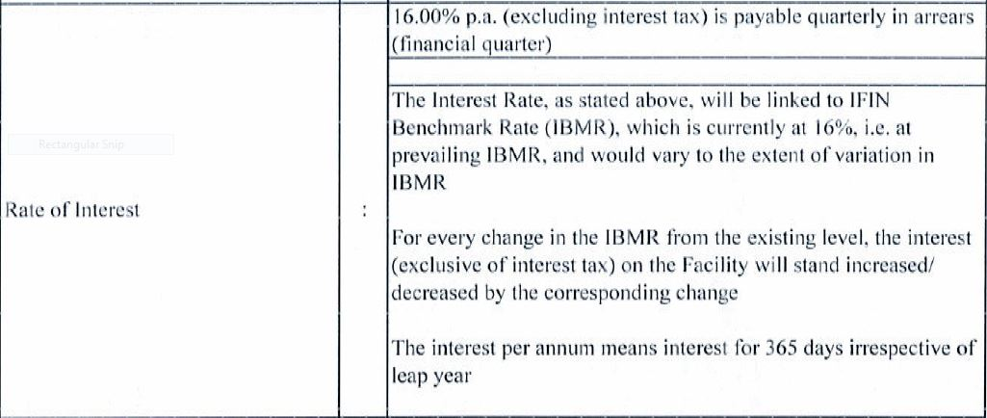
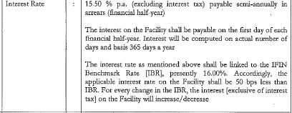
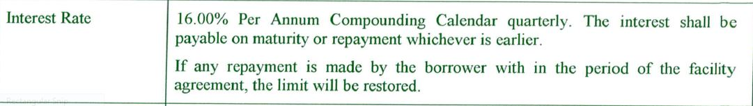
Loan Agreements : Key terms
5. Rate of Interest
iv. Sample clause of Rate of Interest:

Slide 11
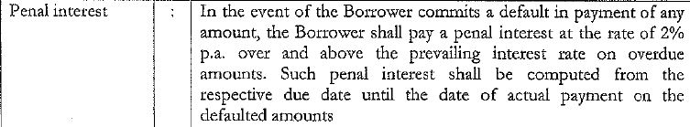
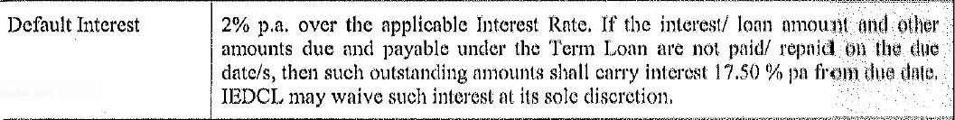
Loan Agreements : Key terms
6. Penal Interest
This clause increases the interest rate that is payable on amounts which are not paid when they fall due. Check that the penal interest has been considered in the financial statements in case of default in repayment of any amount as stated in the said loan agreement.
Sample clause of Penal interest

Slide 12
Loan Agreements : Key terms
7. Repayment of Loan
check the date of repayment of Loan for classification purpose
i. Falls within 12 months from the reporting date
ii. In case of breach of terms of loan agreement (refer point no. 8 “Events of Default”)
Yes
No
Classify as Current maturities of long term borrowings
Classify under Current borrowings
Classify under Non Current borrowings
Sample clause of Repayment

Slide 13
Loan Agreements : Key terms
8. Events of Default
The major events of default that you should look out for are:
A. Cross Default
Where default under any other on-demand facilities provided by the lender to the borrower will automatically cause a default under this loan agreement
B. Breach of Loan Agreement
where any breach of a term of the loan agreement will automatically cause a default
C. Non-Payment
where any non-payment of interest or capital automatically triggers a default
D. Insolvency
where the borrower going into insolvency is an event of default

Slide 14
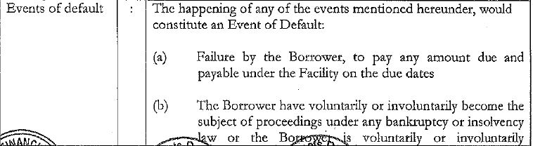
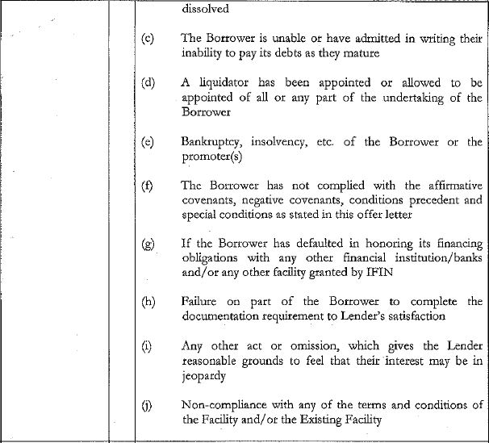
Loan Agreements : Key terms
8. Events of Default
Sample clause

Slide 15
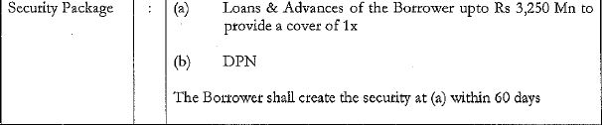
Loan Agreements : Key terms
9. Security
Check whether loan is secured or unsecured
If Secured
If Unsecured
1. Check the value of security in w.r.t. amount of loan
2. Charge to be created at MCA Portal
1. No charge will be created
2. Check other points of recoverability of Loan
i. Obtain Form CHG-1 from Client
ii. Check the MCA Portal to cross verify the charges
In case value of the security falls below the amount of loan outstanding, examine whether loan is classified as secured only to the extent of market value of security
Sample clause of Security

Slide 16
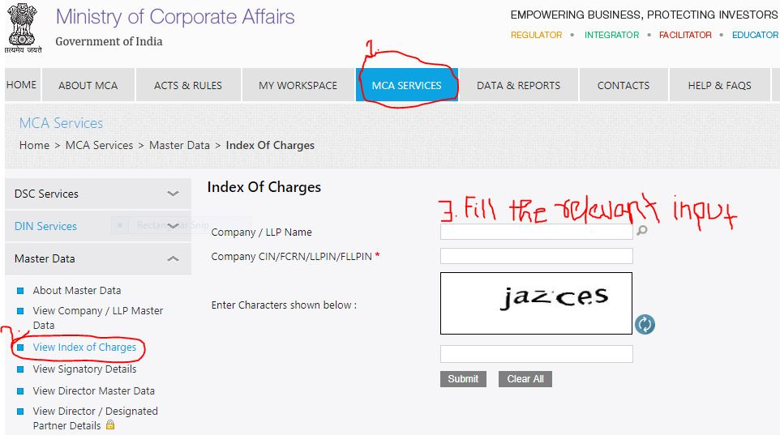
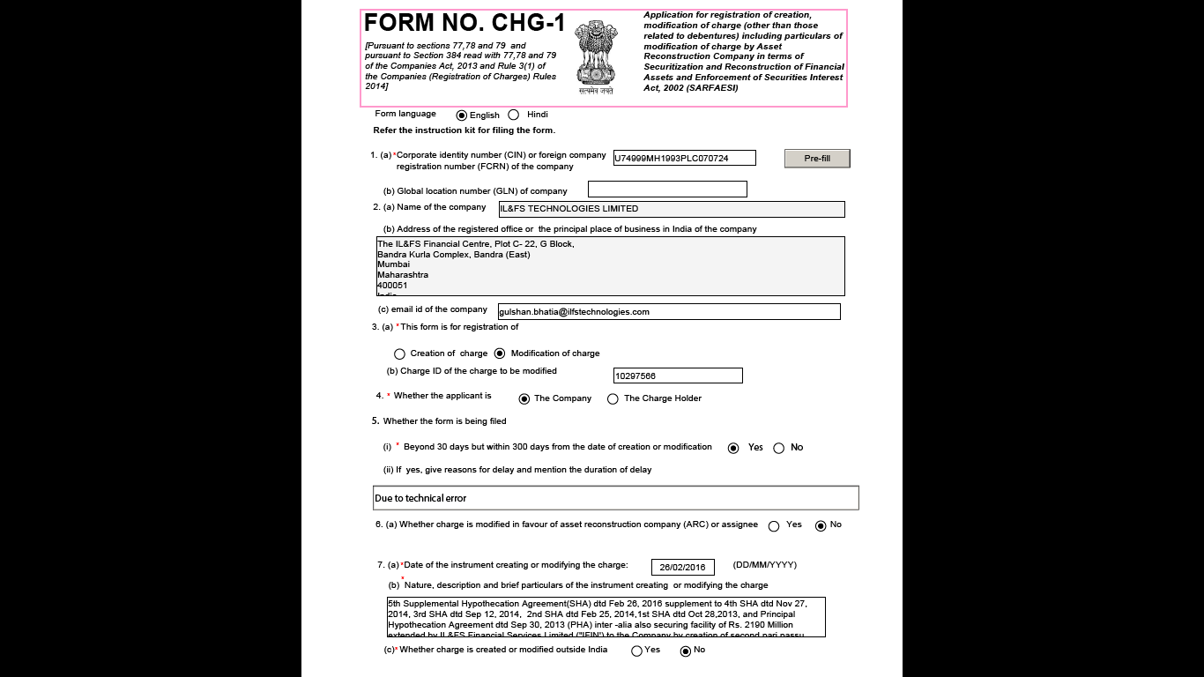
Loan Agreements : Key terms
9. Security
MCA Portal for verifying the creation, registration and modification of charge
Form CHG-1 for creation, registering and modification of charge

Slide 17
Statutory Compliance
1. Compliance with CARO
CARO, 2016
whether the company has defaulted in repayment of loans or borrowing to a financial institution, bank, Government or dues to debenture holders? If yes, the period and the amount of default to be reported (in case of defaults to banks, financial institutions, and Government, lender wise details to be provided).
Clause viii
a) whether moneys raised by way of initial public offer or further public offer (including debt instruments) and term loans were applied for the purposes for which those are raised. If not, the details together with delays or default and subsequent rectification, if any, as may be
applicable, be reported;
Clause ix

Slide 18
Statutory Compliance
1. Compliance with CARO
CARO, 2020
(a) whether the company has defaulted in repayment of loans or other borrowings or in the payment of interest thereon to any lender, if yes, the period and the amount of default to be reported as per the prescribed format which includes:
(b) whether the company is a declared wilful defaulter by any bank or financial institution or other lender
(c) whether term loans were applied for the purpose for which the loans were obtained; if not, the amount of loan so diverted and the purpose for which it is used may be reported;
(d) whether funds raised on short term basis have been utilised for long term purposes, if yes, the nature and amount to be indicated;
(e) whether the company has taken any funds from any entity or person on account of or to meet the obligations of its subsidiaries, associates or joint ventures, if so, details thereof with nature of such transactions and the amount in each case
(f) whether the company has raised loans during the year on the pledge of securities held in its subsidiaries, joint ventures or associate companies, if so, give details thereof and also report if the company has defaulted in repayment of such loans raised;
Nature of borrowing, including debt securities | Name of lender | Amount not paid on due date | Whether principal or interest | No. of days delay or unpaid | Remarks, if any
 | lender wise details to be provided in case of defaults to banks, financial institutions and Government
Clause ix
Clause x
(a) whether moneys raised by way of initial public offer or further public offer (including debt instruments) during the year were applied for the purposes for which those are raised, if not, the details together with delays or default and subsequent rectification, if any, as may be applicable, be reported;

Slide 19
Statutory Compliance
2. Compliance with Companies Act, 2013
Section 180(1)(c)
Board of Directors, need the consent of the Company by Special Resolution,:
to borrow money, where the money to be borrowed, together with the money already borrowed by the company will exceed aggregate of its paid-up share capital and free reserves, apart from temporary loans obtained from the company’s bankers in the ordinary course of business:
“temporary loans” means loans repayable on demand or within six months from the date of the loan such as short-term, cash credit arrangements, the discounting of bills and the issue of other short-term loans of a seasonal character, but does not include loans raised for the purpose of financial expenditure of a capital nature;
Provided that the acceptance by a banking company, in the ordinary course of its business, of deposits of money from the public, repayable on demand or otherwise, and withdrawable by cheque, draft, order or otherwise, shall not be deemed to be a borrowing of monies by the banking company within the meaning of this clause.

Slide 20
Borrowings
Finance Cost
Re-compute the Interest expenses for the year as per the terms of the Loan agreement.
Re-compute the interest accrued for the year
Match the re-computed interest on loan with financial statement
Analyse the current year interest expenses with the previous year interest expenses and document the reason of variation
Upfront fees paid has been amortisation over the loan period

Slide 21
Borrowings
Disclosure in financial statement
Classification into Long term borrowing and short term borrowing
Current maturities of long-term debt – i.e. dues within next 12 months to be disclosed as current liability
Borrowings shall further be sub-classified as secured and unsecured
Nature of security shall be specified separately in each case.
Where loans have been guaranteed by directors or others, the aggregate amount of such loans under each head shall be disclosed.
Terms of repayment of term loans and other loans shall be stated.
Period and amount of continuing default as on the balance sheet date in repayment of loans and interest, shall be specified separately in each case.

