Slide 1

UK NFRA Blasts KPMG
KPMG

Slide 2

UK Parliament
Unhappy
Majority of Big 4s have their head quarter in UK. Parliamentarians in UK are not happy with conduct of Big4s. They are also unhappy with Financial Reporting Council (Like NFRA in India) for not taking enough actions. As Big4s failed to red flag, report big corporate-collapses.

Slide 3
FRC comes in to Action
After these observations, Financial Council imposed fine of 130 Crores in 2 days.
KPMG
PWC
KPMG fined for around 40 crores for audit of technology company Quindell.
Issued warning KPMG’s audit work is of an unacceptable standard and the firm will face increased scrutiny.
PwC fined of around 90 crore for collapse of departmental stores company BHS Ltd.
PwC partner Steve Denison was also fined 45 Crores for the BHS and Taveta audits, severely reprimanded and ordered him not to perform any audit work for a period of 15 years.

Slide 4

Break Big4s
There is open speculation in Parliament about breaking up the Big Four audit firms to increase competition and improve standards.
Lawmakers have called for a separate report by the FRC and the U.K.’s Competition and Markets Authority to consider whether the “Big Four” auditors Ernst & Young, PwC, Deloitte and KPMG should be broken up to create more competition.
Michael Izza, head of the U.K. Institute of Chartered Accountants in England and Wales, said that the drive for higher fines is at odds with a push to break up the Big Four. He argued that bigger penalties scare off smaller competitors, as “the risk in imposing ever-greater financial sanctions is that these increase the risk profile of auditing.”

Slide 5
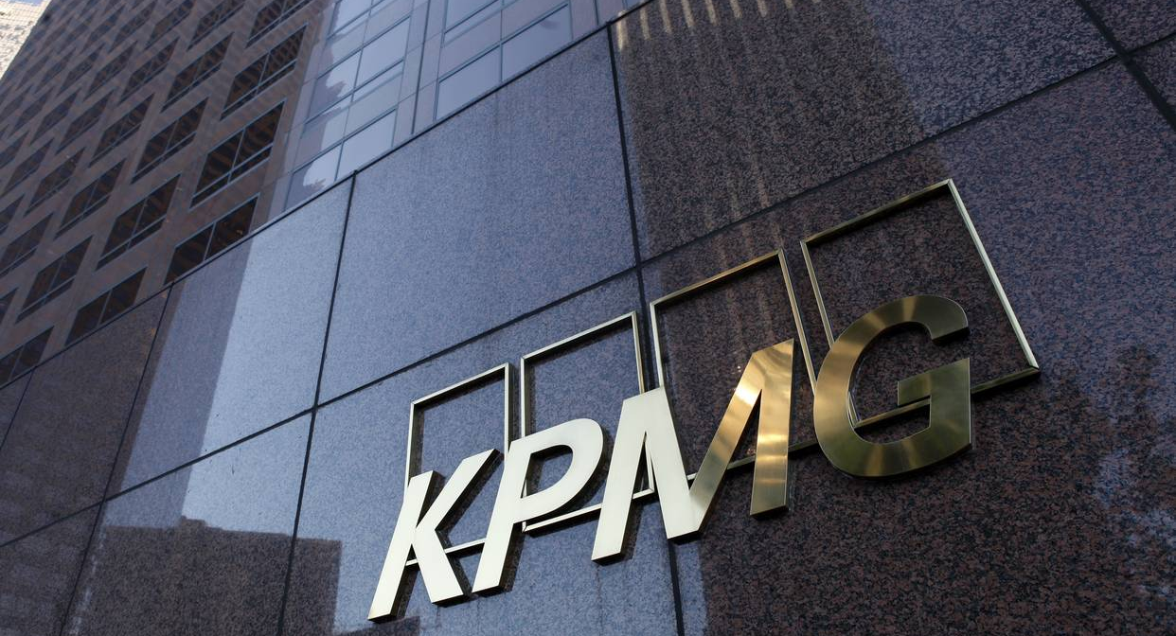
KPMG Auditors are Not Skeptical
Auditors at KPMG don’t challenge management enough, aren’t sufficiently skeptical and are inconsistent in their execution of audits. To address the poor performance, the FRC will increase the number of KPMG audits it inspects in the current financial year by 25 percent.

