Slide 1
Sox Compliance &
Control Environment
August 2014

Slide 2
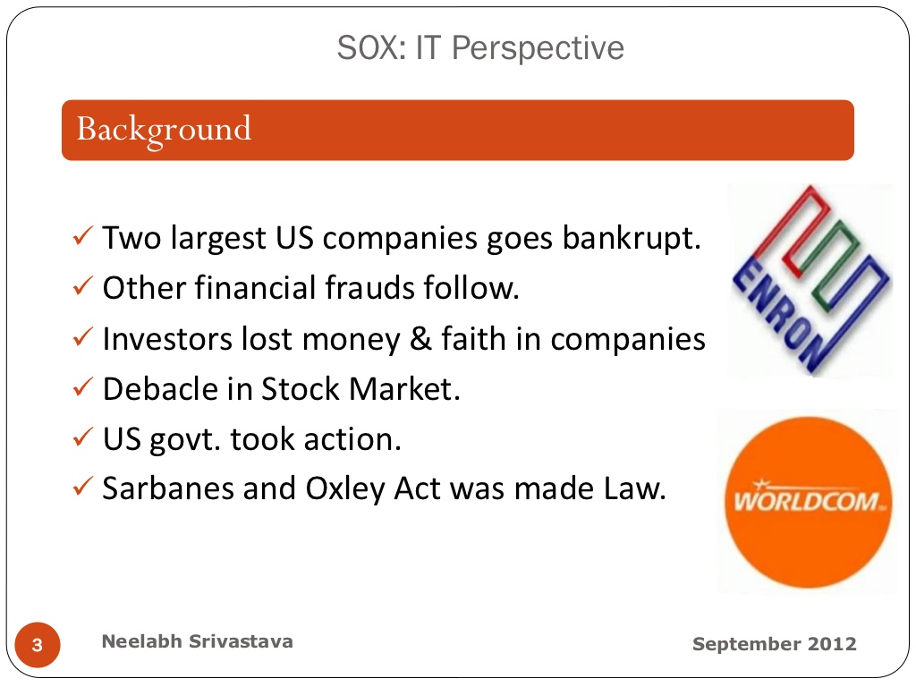
SOX – What it is …?

Slide 3
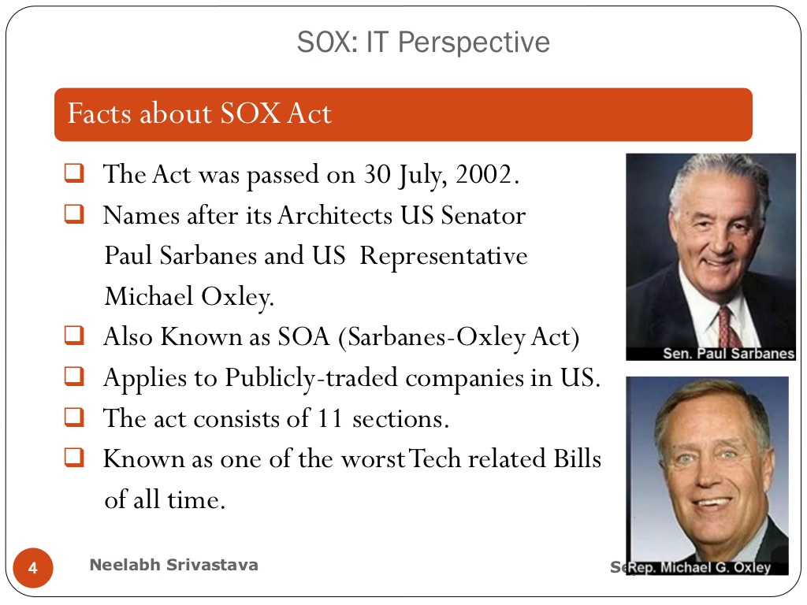
SOX – What it is …?

Slide 4
SOX – What it is …?
Some important provisions of SOX are as follows:
More independence to be given to Audit Committee and auditor.
Ban on personal loan to Directors/ Executive Officers of a Company.
Strict reporting by an auditor on insider trading.
Additional disclosures imposed on financial reporting.
The Audit committee is empowered to resolve any conflict between company and its auditor.
Higher penalties and criminal prosecution on financial frauds, etc.

Slide 5
SOX – What it is …?
As per SOX, the company’s CEO and CFO are personally and criminally labile for :
The Quality and effectiveness of their organization's internal controls.
CEO and CFO have to attest to the public that :
An organization's internal controls are effective.
Internal controls can be expected to provide only a reasonable assurance, not an absolute assurance;
Organization must ensure that its financial statements comply with AS, local rules via policy enforcement and risk avoidance methodology called "Internal controls “ i.e There must be a system of checks and balances.

Slide 6
SOX - Applicability
Applicable to:
    Companies listed or traded in the U.S (including non U.S Companies)
    Subsidiaries of U.S Companies
    Foreign accounting firms that prepare or furnish audit report for an issuer
    Sometimes compliance expected by U.S Companies from business partners e.g BPO Companies

Slide 7
SOX - Applicability
Most of the SOX titles are directed towards “Issuers” of securities whether US or non–US, there is no distinction.
Law contains no specific exemption for non-US companies. Non- US companies are bound to Comply Sox Provisions if they are listed in US under SEC or they are subsidiaries of US Listed Companies .
Subsidiaries or business units of US Parent companies who need to comply with SOX in full could be subject to compliance in various aspects, most of which would be planned and taken care of the US Parent Company

Slide 8
SOX - Applicability
Probably the most important would be the compliance of Section 404 – Management assessment of internal controls.
The parent would determine the multiple locations that need to be covered for Internalcontrol testing.
This is usually based on the Significant accounts and the impact that the numbers of the subsidiary/business unit has on the overall company’s financial reports.
The Law has not established specific percentages to determine coverage.

Slide 9
SOX - Applicability
Often the goal of the parent company would be to determine which locations are individually important (financially significant) and thus yield sufficient coverage using meaningful quantitative metrics.
The usual benchmark seen in practice is to cover at least 60 to 70 per cent of the company’s operations and financial position.
The metrics could possibly be to cover any location that has more than 5% of annual revenues or pre tax income or total assets or equity (if applicable).

Slide 10
SOX - Applicability
Once a location is determined to be important, the planned procedures would include a detailed evaluation and tests of controls over significant (or ‘specific risk’) accounts and disclosures at that location and testing of company level controls.
Locations selected Need to work closely with the parent to ensure proper controls risk management, disclosures,and various other aspects.

Slide 11
Indian Perspective
The need for a new legislation in the US has arisen because of its Federal structure.
At Federal level, US does not have a company law nor provide for accounting auditing and other issues sought to be covered under the new Act.
In India, the situation is far different. The Companies Act, 1956 does provide comprehensively in regard to accounts and audit , formats of the financial statements and also prescribes for qualifications in the audit report, role and responsibility of the auditors, Director's responsibility for preparation and presentation of Financials Statement .

Slide 12
Comparison Sox V/s Indian Co’s Act
SOX
CEO/CFO Certification .
2) Reimbursement for misstatement
3) Ban on loans to directors
4) Code of Conduct/Ethics
5) Independent Board/ Committee
6) Disclosure of Off Balance Sheet/transactions that may have future impact
7 ) Audit Partner Rotation
Indian Companies Act
1) Financials to be signed by Two Directors .
2) Reimbursement for misstatement
3) Restriction on loan to directors
4) Written/Public Code of Conduct
5) Independent Board of Directors
6) More limited disclosures-but left open for consideration
7) Audit Partner Rotation

Slide 13
Comparison Sox V/s Indian Co’s Act
SOX
Audit Committee
  Financial Literacy
  One financial expert
  Oversee auditor
  Approve related party transactions
  Whistleblowers policy
Indian Companies Act
Audit Committee
  Financial Literacy
  One financial expert
  Oversee auditor
  Approve related party transactions
  Whistleblowers policy

Slide 14
Proposed Amendments in Co’s Act 2013
Proposed amendments to clause 49 and Draft Companies Bill address major issues :
  - Appointment of a Chief Accounting Officer by a Company
  - Definition of related party transactions expanded and specific approval requirements introduced
  - Disclosure of all contingent liabilities
  - Timely communication of Risk Management activities
  - CEO/ CFO certification requirements

Slide 15
The Definition of Internal Control
Internal Control is a process developed by or under the super vision of Company’s Top Management to Ensure :
Integrity and Reliability of Information
Effectiveness and Efficiency of Operation
Reliability of Financials Reporting .
Compliance with Policies , Laws and Regulations .
Safeguarding of Assets .
Economical and Efficient use of Resources .
Accomplishment of Established Objective and Goals.

Slide 16
In Simple Words
Internal control : What we do to see that
- Things we want to happen will happen and
- Things we don’t want to happen Will not happen.
Internal Controls are everywhere:
We exercise internal control principles in our personal life when
- We Lock our house when we leave
- We Keep copies of important papers in our safety deposit box
- We Keep our ATM/debit card PIN number separate from our card

Slide 17
Objective of Internal Controls
STRATEGIC : High Level Goals and Objective aligned with supporting the mission.
OPERATIONAL : Effective and Efficient use of Resources .
REPORTING : Integrity and Reliability of Reporting.
COMPLIANCE : Compliance with Applicable Laws and Regulations .
STEWARDSHIP : Protection and Conservation of Assets.

Slide 18
Weak Internal Control
Weak Internal Controls Increases Risk through …
Business Interruption : System Break Down ,Excessive Rework to Correct the Errors .
Erroneous Management Decision : Due to Inadequate or Misleading information .
Fraud , Embezzlement or Theft : By Management , Employees Customers and Suppliers .
Statutory sanctions :Penalties due to failure to comply with regulatory requirement as well as overt violations.

Slide 19
Control Effectiveness
Control Effectiveness
Financial Controls must be suitably designed using established criteria
· Control objectives and related financial controls are appropriately documented
  · Documentation is auditable
  · Key financial controls are identified (Assertions)
· Management perform the own tests of:
  the design of controls over financial reporting
  the effectiveness based on key financial controls
· Deficiencies are documented, disclosed and addressed.

Slide 20
Types of Control
Preventative and Detective Controls
Manual and Automated Controls
Business Performance Review / Monitoring Controls
General Computer Controls (IT Level Controls)
Application Controls (Transaction Level Controls in Computer System)

Slide 21
Control objectives for Transaction Processing
Completeness of records (C) - controls over completeness are designed to ensure that:
  - All transactions are recorded once and only once.
  - All transactions are recorded in the correct period and in the correct legal entity.
Accuracy of records (A) - controls over accuracy are designed to ensure that:
  All transactions are accurately recorded in the general ledger, including correct classification to ensure compliance with disclosure requirements.
  Assets and liabilities are recorded at an appropriate value.
  Changes to standing data are accurately input.

Slide 22
Control Obhective - Transaction Processing
Validity of records (V) - controls over validity are designed to ensure that:
  Transactions are authorized.
  Transactions are genuine and they relate to Company.
  Changes to standing data are authorized.
Restricted access to assets and records (R) - controls to restricted access are designed to ensure that:
  There is appropriate segregation of duties with respect to key controls.
  Physical assets (e.g. gold bullion) are appropriately safeguarded.

Slide 23
Documentation Standards
Management must document the design of controls related to all relevant assertions for all significant financial statement accounts
Documentation must encompass the entire process of:
  - initiating
  - authorising
  - recording
  - processing
  - reporting individual transactions
The required documentation might take various forms: flowcharts, policy manuals, accounting manuals, narrative memoranda, decision tables, procedural write-ups or completed questionnaires
Flowcharts, supplemented by narrative descriptions, are frequently the most effective form of control documentation

Slide 24
Gaps Identified in Hanil
Gaps Identified in Hanil
Processes not adequately documented (scope and quality)
Controls not implemented
Controls poorly designed
Controls not working effectively
Control-related roles not assigned
Non-existence of policies

Slide 25
Steps to be Taken
What is to be done ? … in Hanil
Confirms that the documentation prepared by the company reflects its actual processes
Confirm that controls described in the documentation are actually those applied “in the field”
Confirm that, at least, all key controls have been documented appropriately (completeness of the process documented)
Already we are in the process of the above through SOP

Slide 26
SOP – Scope
SOP – Requirement
Process requires documentation :
Purchase of Materials and Accounts Payable
Production Accounting
Stock Accounting
Sales Accounting and Accounts Receivables
Treasury and Banking Transactions
Fixed Assets
General Accounting Ledger

Slide 27
Purchase of Materials and AP
Supplier Selection
Master maintenance – BOM & Suppliers
Issue of purchase orders
GRN and Inventory Verification
Raising debit notes on creditors
Accounting for creditors
Payment processing

Slide 28
Production Accounting
Production Accounting
Material Issues
Production accounting – back flashing
Costing and standard updation

Slide 29
Stock Accounting
Stock Accounting
Physical Verification
Stock valuation
3P Management

Slide 30
Sales Accounting and Receivables
Master maintenance
Receiving and accepting sales orders
Dispatching
Accounting sales and debtors
Provision for debtors

Slide 31
Treasury and Banking Transactions
Payment and receipt of money
Schedule of authority
Banking of receipts
Accounting for FOREX conversion and forward covers
Export Packing credit management
Bank Recos.

Slide 32
Fixed Asset Accounting
Fixed Assets
Capital Proposal approval and capital advances accounting
Receiving and accounting for capital WIP
Additions to FA and deletion from FA
Depreciation Accounting
Impairment provisions
Physical verification

Slide 33
General Accounting
General Ledger
Inter Unit Transactions
Cut offs and period end/ consolidation
Journal entries
Restructuring provisions

Slide 34
Thank You
Question ?

