Slide 1
Tax Audit
Section 44AB of Income Tax Act, 1961
Audit of accounts of certain persons carrying on business or profession.
A.Y. 2014-15
Presented By: CA. Sanjay Agarwal
Assisted By: CA Apoorva Bhardwaj & CA Jyoti Kaur
Email id: agarwal.s.ca@gmail.com

Slide 2
Contents…..
Tax Audit Report
Recent Developments
  Amendment in Form No. 3CA/ 3CB & Form No. 3CD
  E-filing of Tax Audit Report
Overview of Provisions of Sec. 44AB
Remaining Clauses of Form 3CD

Slide 3
Tax Audit Report
Under Section 44AB r.w. Rule 6G
Form 3CA/3CB
Form 3CD

Slide 4
Form No. 3CA/3CB- Rule 6G
Form 3CA
In case of a person carrying business or profession whose accounts are required to be audited under any other law.
Form 3CB
Person other than those referred in Form 3CA.
Person whose accounts are required to be audited under any other law but whose accounting year is different from the financial year. [Circular : No. 561, dated 22-5-1990]

Slide 5
Recent Developments
Part I - Amendment in Form No. 3CA, Form No. 3CB & Form No. 3CD [Notification No. 33/2014, F.No.133/1/2014-TPL dated 25th July, 2014]
[Inserted by Income-tax (7th Amendment) Rules, 2014]
Part II - Report of audit u/s 44AB shall be furnished electronically [Notification No. 34 /2013/ F.No.142/5/2013-TPL dated 1st May, 2013]
[Inserted by Income-tax (3rd Amendment) Rules, 2013]

Slide 6
Part I - Amendment in Form No. 3CA, Form No. 3CB & Form No. 3CD
Notification No. 33/2014 dated 25th July, 2014
Form No. 3CA/3CB
  Amendments in Form No. 3CA
  Amendments in Form No. 3CB
  Other amendments
Form No. 3CD
  Newly inserted clauses
  Amendments in clauses
  Specific format provided

Slide 7
Amendments in Form 3CA/3CB
1.
  Amendments in Form No. 3CA
  Amendments in Form No. 3CB
  Other Amendments

Slide 8
a. Amendments in Form 3CA…..
Contd….
Scope of Auditor increased
Old | New
3. In *my/our opinion and to the best of *my/our information and according to explanations given to *me/us, the particulars given in the said Form No. 3CD and the Annexure thereto are true and correct. | 3. In *my/our opinion and to the best of *my/our information and according to examination of books of account including other relevant documents and explanations given to *me/us, the particulars given in the said Form No.3 CD are true and correct subject to the following observations/ qualifications, if any
List provided in e-utility

Slide 9
b. Amendments in Form 3CB…..
Contd….
Dispensed with Annexures to Form No. 3CD and provided space for specifying observations and qualification.
Old | New
5. In *my/our opinion and to the best of *my/our information and according to explanations given to *me/us, the particulars given in the said Form No.3 CD and the Annexures thereto are true and correct. | 5. In *my/our opinion and to the best of *my/our information and according to explanations given to *me/us, the particulars given in the said Form No.3 CD are true and correct subject to following observations/qualifications, if any: a. b. c.
List provided in e-utility

Slide 10
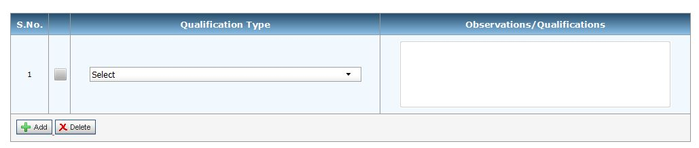
Contd….
a. Amendments in Form 3CA/3CB…..
Format in e-Utility

Slide 11
Contd….
a. Amendments in Form 3CA/3CB…..
Format in e-Utility……
Select
Proper books of account, to unable reporting reporting in form 3CD, have not been maintained by the assessee.
All the information and explanations which to the best of my/our knowledge and belief were necessary for the purpose of my/our audit has not been provided by the assessee.
Documents necessary to verify the reportable transaction were not made available.
Proper Stock records are not maintained by the assessee.
Valuation of closing stock is not possible.
Yield/percentage of wastage is not ascertainable.
Records necessary to verify personal nature of expenses not maintained by assessee.
TDS returns could not be verified with the books of account.
Records produced for verification of payments through account payee check were not sufficient.

Slide 12
Contd….
a. Amendments in Form 3CA/3CB…..
Format in e-Utility……
Select
Amount of expenses related to exempt income u/s 14A of Income-tax Act, 1961 could not be ascertained.
Creditors under Micro, Small and Medium Enterprises Development Act, 2006 are not ascertainable.
Prior period expenses are not ascertainable from books of account.
Fair market value of shares u/s 56 (2) (viia)/(viib) is ascertainable.
Reports of audit carried by Excise/Service tax Department were not made available.
GP Ratio is not ascertainable from the financial statements prepared by the assessee.
Information regarding demand raised or refund issued during the previous year under any tax laws other than Income-tax Act, 1961 and Wealth tax Act, 1957 was not made available.
Others

Slide 13
Contd….
Issues on Form No. 3CA/ 3CB…..
While striking off the reference to Annexure to Form No. 3CD in Form No. 3CB, sufficient space provided for specifying the observation or qualification of the Tax Auditor [similar to Form No. 3CA]
However, the scope of tax auditor has been increased in Form No. 3CA only by including “examination of books of account including other relevant documents” and no such amendment has been made in Form No. 3CB.

Slide 14
c. Other Amendments in Form 3CA/ 3CB…..
Contd….
Stamp/ Seal of Signatory to Tax Audit Report required
Balance Sheet date and Period of Profit & Loss A/c to be mentioned
Form 3CA
Old | New
profit and loss account/ income and expenditure account for the year ended on 31st March,….; | profit and loss account / income and expenditure account for the period beginning from ….to ending on ....
balance sheet as at 31st March,…. | balance sheet as at, ….;

Slide 15
c. Other Amendments in Form 3CA/ 3CB…..
Contd….
Not amended in e-utility
Form 3CB
Old | New
1…… balance sheet as at 31st March,…. and the profit and loss account/ income and expenditure account for the year ended on that date | 1…… Balance sheet as on,…….. and the profit and loss account / income and expenditure account for the period beginning from ….to ending on ....
3(b)(C)(i)…. balance sheet, of the state of the affairs of the assessee as at 31st March,… ;and (ii)….. Profit & loss account / income & expenditure account of the profit / loss or *surplus / deficit of the assessee for the year ended on that date. | 3(b)(C)(i)….. balance sheet, of the state of the affairs of the assessee as at 31st March,….;and (ii) profit & loss account/ income & expenditure account of the *profit/ loss or *surplus / deficit of the assessee for the year ended on that date.
Not amended in Revised form or e-utility

Slide 16
c. Other Amendments in Form 3CA/ 3CB…..
Contd….
Reference to Section 44AB given for the signing of the Forms
Old | New
**This report has to be signed by- a chartered accountant within the meaning of the Chartered Accountants Act, 1949 (38 of 1949); or any person who, in relation to any State, is, by virtue of the provisions of sub-section (2) of section 226 of the Companies Act, 1956 (1 of 1956), entitled to be appointed to act as an auditor of companies registered in that State; or any person who is, by virtue of any other law, entitled to audit the accounts of the assessee for the relevant previous year. | **This report has to be signed by a person eligible to sign the report as per the provisions of section 44AB of the Income Tax Act, 1961. Section 44AB, "accountant" shall have the same meaning as in the Explanation below sec.288(2) Explanation to Sec.288(2) "accountant" means a CA within the meaning of the Chartered Accountants Act, 1949, and includes, in relation to any State, any person who by virtue of the provisions of sec. 226(2) of Companies Act, 1956, is entitled to be appointed to act as an auditor of companies registered in that State.

Slide 17
Issues on Form No. 3CA/ 3CB…..
Contd….
Meaning of “Accountant”
Earlier, any person who is, by virtue of any other law, entitled to audit the accounts of the assessee for the relevant previous year was also entitled to conduct tax audit u/s 44AB. However, under the revised Forms, reference to Sec. 44AB is given wherein only an Accountant within the meaning of Sec. 288 can conduct tax audit u/s 44AB which does not include such person.
Sec. 288(2) refers to Sec. 226(2) of Companies Act, 1956 [Sec. 141 of Companies Act, 2013] Corresponding amendment has not been made in IT Act.
Restricted State Auditors earlier qualified to be auditors of companies u/s 226(2) of the 1956 Act are not qualified u/s 141 of Companies Act, 2013.
Under Sec. 141 of Companies Act, 2013, only a Chartered Accountant is qualified to conduct audit of companies.

Slide 18
Issues on Form No. 3CA/ 3CB…..
Contd….
In the case of those assessee whose business or profession has started during the financial year, the tax auditor can specify the actual period for which tax audit is conducted.

Slide 19
Amendments in Form 3CD
2.
Newly inserted Clauses
Amendment in Clauses
Specific format provided

Slide 20
Form No. 3CD- Rule 6G(2)
Statement of particulars required to be furnished u/s 44AB of the Income-tax Act, 1961 shall be in Form No. 3CD.
CBDT has amended tax audit Form No. 3CD vide notification no. 208/2006 [F. No. 142/2/2006-TPL], dated 10th August, 2006 and notification no. 36/2009 [F. No. 149/86/2008 –TPL], dated 13th April 2009.
Further amended by Notification No. 33/2014, F.No.133/1/ 2014- TPL dated 25th July, 2014.

Slide 21
Key Highlights…..
Increased reporting requirements of the assessee and the auditor.
12 new clauses (including sub-clauses inserted, amendments made in 19 clauses (including sub-clauses) and format specified for 2 clauses.
Examination of books of account and relevant documents along with declaration by the assessees.
Required to visit the locations at which books of account maintained.
Tax auditor to determine assessed or assessable values of properties (land or building or both), value of shares of private company.
Consolidation of details under various laws.
Amendments by Finance Act, 2014 under Central Excise Act, 1944- Obligation to furnish information return.

Slide 22
List of Clauses…….
Part - A
New Clause No. | Old Clause No. | Remarks
1 | 1 | No Change
2 | 2 | No Change
3 | 3 | No Change
4 | - | Newly Inserted
5 | 4 | No Change
6 | 5 | Amended
7 | 6 | No Change
8 | - | Newly Inserted

Slide 23
List of Clauses…….
Part - B
New Clause No. | Old Clause No. | Remarks
9 | 7 | No Change
10 | 8 | No Change
11 | 9 | Sub clause ‘a’- No Change Sub clause ‘b’- Amended Sub clause ’c’- Amended
12 | 10 | Amended
13 | 11 | Sub clause ‘a’- No Change Sub clause ‘b’- No Change Sub clause ’c’- Format provided Sub clause ’c’- No change
14 | 12 | Sub clause ‘a’- No Change Sub clause ‘b’- Format provided

Slide 24
List of Clauses…….
Part – B…….
Contd….
New Clause No. | Old Clause No. | Remarks
15 | 12(A) | No Change
16 | 13 | No Change
17 | - | Newly Inserted
18 | 14 | Sub clause ‘a-c’- No Change Sub clause ‘d’- Amended Sub clause ‘e-f’- No Change
19 | 15 | Amended
20 | 16 | Sub clause ‘a’- No Change Sub clause ‘b’- Amended
21 | 17 | 17(a-e) substituted by 21(a)- Amended 17(f) substituted by 21(b)- Amended 17(g) substituted by 21(c)- Amended 17(h) substituted by 21(d)- Amended 17(i-m) substituted by 21(e-i)- No change

Slide 25
List of Clauses…….
Part – B…….
Contd….
New Clause No. | Old Clause No. | Remarks
22 | 17A | No Change
23 | 18 | No Change
24 | 19 | Amended
25 | 20 | No Change
26 | 21 | No Change
27 | 22 | Amended
28 | - | Newly Inserted
29 | - | Newly Inserted
30 | 23 | No Change
31 | 24 | Sub clause ‘a’ – No Change Sub clause ‘b’ - No Change Sub clause ’c’ - Amended

Slide 26
List of Clauses…….
Part – B…….
Contd….
New Clause No. | Old Clause No. | Remarks
32 | 25 | Sub clause ‘a’ – No Change Sub clause ‘b’ - No Change Sub clause ’c-e’ - Newly Inserted
33 | 26 | Amended
34 | 27 | Amended
35 | 28 | Amended
36 | 29 | Amended
37 | 30 | Amended
38 | 31 | Amended
39 | - | Newly Inserted
40 | 32 | Amended
41 | - | Newly Inserted

Slide 27
Newly inserted Clauses
a.
S. No. | New Clause No. | S. No. | New Clause No. | S. No. | New Clause No.
1 | 4 | 6 | 29 | 11 | 34(b)
2 | 8 | 7 | 32(c) | 12 | 39
3 | 17 | 8 | 32(d) | 12 | 41
4 | 21(b) | 9 | 32(e)
5 | 28 | 10 | 34(b)

Slide 28
New Clause no. 4 [newly inserted]
Whether the assessee is liable to pay indirect tax like excise duty, service tax, sales tax, customs duty, etc. if yes, please furnish the registration number or any other identification number allotted for the same.
Brief: Registration number under other laws also to be specified.

Slide 29
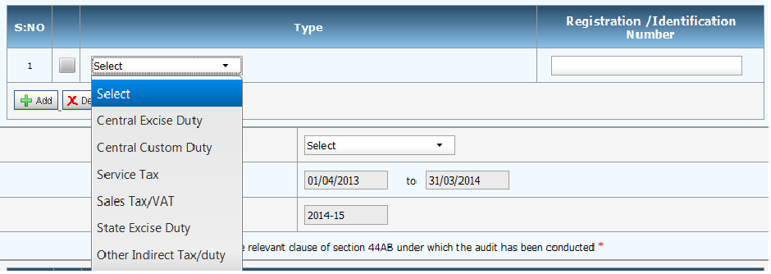
New Clause no. 4 [newly inserted]
Contd….
Format in e-utility……

Slide 30
Issues / points to be considered- New Clause no. 4 [newly inserted]
Contd….
What if the assessee have not obtained Registration number even though he is liable to pay indirect taxes?
Whether the Tax auditor needs to have expertise of indirect tax laws?
The Article 246 of the Constitution of India provides power to the Union or the State Legislature to levy indirect taxes such as Customs duty, Excise Duty, Central Sales Tax and Service Tax, sales tax (Value Added Tax) and other indirect taxes Entry Tax, Octroi, Luxury Tax, Entertainment Tax etc (Article 265 ). Since, the term “indirect taxes” is not defined, the list should be an inclusive list and may include any other indirect tax levy introduced in India from time to time.
Obtain a management representation for the list of indirect taxes applicable to the assessee alongwith registration numbers or any other identification number allotted under said laws. [Refer Standard on Auditing 580 “Written Representation”].
In case of multiple registrations, a copy of all registration certificates is to be obtained. Where there is no registration requirement under Indirect laws appropriate identification number may be reported. For example, in Customs Act, 1962, a copy of Export Import Code (IEC) may be obtained and furnished information accordingly.
Note: Apply due diligence, knowledge and professional judgment in determining the applicability of the Indirect taxes.

Slide 31
Amendments by Finance Act, 2014 - Obligation to furnish information return.
Amendments by Finance Act, 2014
Section 15A inserted in the Central Excise Act empowering the Central Government to prescribe an authority or agency to whom the information return shall be filed by the specified persons such as Income-tax authorities, State Electricity Boards, VAT or Sales Tax authorities, Registrar of Companies.
Information can be collected for the purposes of the Act, such as, to identify tax evaders or recover confirmed dues. It also seeks to insert new section 15B which provides for imposition of penalty on failure to furnish information return.
Provisions of Sec. 15A & 15B of Central Excise Act, 1944 made applicable in Service Tax and corresponding amendment made in Sec. 83 of Finance Act, 1944.

Slide 32
New Clause no. 8 [newly inserted]
Indicate the relevant clause of section 44AB under which the audit has been conducted.
Brief: Relevant clause of Sec. 44AB also to be specified.
Clause (a)- If total sales, turnover or gross receipt in business exceeds Rs. 1 crore
Clause (b)- If his gross receipts in profession exceed Rs.25 lakh
Clause (c)- If Profits u/s 44AE, 44BB or 44BBB claimed to be lower than the presumptive profits and gains
Clause(d)- If Profits u/s 44AD claimed to be lower than the presumptive profits and gains

Slide 33
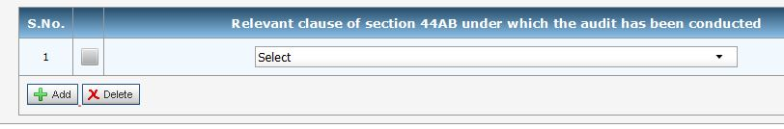
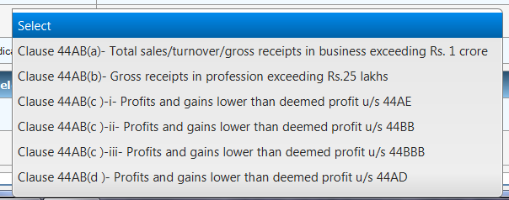
New Clause no. 8 [newly inserted]
Contd….
Format in e-utility

Slide 34
Issues on New Clause no. 8 [newly inserted]
Contd….
Whether the clause is inserted in view of the limit of audits prescribed by the ICAI?
Where the assessee is covered under more than one clause, the same may be specified.

Slide 35
New Clause no. 17 [newly inserted]
Where any land or building or both is transferred during the previous year for a consideration less than value adopted or assessed or assessable by any authority of a State Government referred to in section 43CA or 50C, please furnish:
Details of property | Consideration received or accrued | Value adopted or assessed or assessable
Brief: Stamp Duly value to be specified for land or building or both sold whether held in nature of Capital assets or Stock in trade.

Slide 36
New Clause no. 17 [newly inserted]
Contd….
Format in e-utility
S. No. | Details of Property | Address of Property |  |  |  |  | Consideration received or accrued | Value adopted or assessed or assessable
 |  | Line 1 | Line 2 | City/ Town | State | Pin code
State outside India also covered

Slide 37
Issues on New Clause no. 17 [newly inserted]
Contd….
Sec. 43CA- Special provision for full value of consideration for transfer of assets other than capital assets in certain cases [Introduced by Finance Act, 2013, w.e.f. 1-4-2014]
Sec. 50C- Special provision for full value of consideration in certain cases. [for Capital assets]
Issues/ Points to be considered..….
obtain a list of all properties transferred during the P.Y. And verify the same from the financial statement.
Under the heading “consideration received or accrued”, the tax auditor should furnish the amount of consideration received or accrued, during the relevant P. Y. in respect of land/building transferred during the year as disclosed in the books of account.
For the value adopted or assessed or assessable, If the property is registered, obtain a copy of the registered sale deed. If the property is not registered, verify relevant documents from relevant authorities to satisfy the compliance of section 43CA/ section 50C of the Act. And in case unable to obtain relevant documents then state the same through an observation in the report under form 3CA/CB.

Slide 38
New Clause no. 28 [newly inserted]
Whether during the previous year the assessee has received any property, being share of a company not being a company in which the public are substantially interested, without consideration or for inadequate consideration as referred to in section 56(2)(viia), if yes, please furnish the details of the same.
Brief: Receipt Detail of shares of Pvt. Ltd. Company without consideration or for inadequate consideration is to be provided
Note: No reporting requirement in respect of the assessee other than firms and companies in which public is not substantially interested.

Slide 39
New Clause no. 28 [newly inserted]
Contd….
Following relevant details should be complied to comply with reporting requirements:
Sr. No. | Name of the person from whom shares have been received | PAN of the person, if available | Nature of shares (Quoted in RSE/Quoted in URSE/ unquoted shares etc) | Name of the Company whose shares received | CIN of the company | No. of Shares Received | Fair Market value as per Rule 11UA(1)(c) | Consideration paid | Amount taxable under section 56(2)(viia) (if the difference (e)-(f) exceeds Rs.50,000) | Remarks
(a) | (b) |  | (c) |  |  | (d) | (e) | (f) | (g)
Format in e-utility
S. No. | Name of the person from which shares received | PAN of the person, if available | Name of the company whose shares are received | CIN of the company | No. of shares received | Amount of consideration paid | Fair Market Value of Shares

Slide 40
Issues on New Clause no. 28 [newly inserted]
Contd….
Firm/ Pvt. Ltd. Company
Shares of Pvt. Ltd
Company
Any Person
Recipient
Applicable w.e.f 1st day of June, 2010 as inserted by Finance Act, 2010.
Issues/ points to be considered ..….
Provision of Rule 11UA(1)(c ) should be considered.
Obtain a list containing the details of shares received and verify the same from the books of account & relevant documents. However, if such shares received without consideration then same may verified from the relevant documents such as share certificates issued, if any, demat account statement etc.
Where the assessee does not discloses the complete information to the Tax Auditor in respect of such transaction.

Slide 41
New Clause no. 29 [newly inserted]
Whether during the previous year the assessee received any consideration for issue of shares which exceeds the fair market value of the shares as referred to in section 56(2)(viib), if yes, please furnish the details of the same.
Brief: Detail in respect of shares issued by a Pvt. Ltd. Company at value more than FMV is to be provided
Note: This clause is only applicable to the private limited companies.

Slide 42
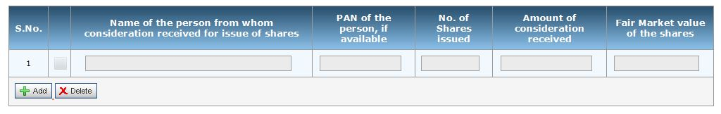
Issues on New Clause no. 29 [newly inserted]
Contd….
Consideration for
issue of shares exceeding FV
Pvt. Company Resident
Recipient
Applicable w.e.f 1st day of April, 2013 as inserted by Finance Act, 2012.
Format in e-utility
Issues/ points to be considered..….
Obtain a list of shares issued to any person being a resident and verify the same from the books of account and other relevant documents.
Provisions of Rule 11UA(1) & 11UA(2) should be considered to determine FMV.

Slide 43
New Clause no. 32(c), (d),(e) [newly inserted]
New Clause no. 32 (a)/(b) [same as old clause no. 25(a)/(b)] are discussed later…………
Whether the assessee has incurred any speculation loss referred to in section 73 during the previous year, If yes, please furnish the details of the same.
whether the assessee has incurred any loss referred to in section 73A in respect of any specified business during the previous year, if yes, please furnish details of the same.
In case of a company, please state that whether the company is deemed to be carrying on a speculation business as referred in explanation to section 73, if yes, please furnish the details of speculation loss if any incurred during the previous year.
Issues/ Points to be considered:
Scrutinize the books of account and other relevant documents as to whether the assessee is carrying on any speculation business.
Applicability of provisions of Sec. 73 in case of loss in trading of derivatives being shares and stocks
Whether the term “speculative Business” should be r.w. the term “speculative transactions”

Slide 44
Section 73- Losses in speculation business……
Contd….
Any loss, computed in respect of a speculation business carried on by the assessee, shall not be set off except against profits and gains, if any, of another speculation business.
Where for any A.Y. any loss computed in respect of a speculation business has not been wholly set off under sub-section (1), so much of the loss as is not so set off or the whole loss where the assessee had no income from any other speculation business, shall, subject to the other provisions of this Chapter, be carried forward to the following A.Y., and—
  it shall be set off against the profits and gains, if any, of any speculation business carried on by him assessable for that assessment year; and
  if the loss cannot be wholly so set off, the amount of loss not so set off shall be carried forward to the following A.Y. and so on.
In respect of allowance on account of depreciation or capital expenditure on scientific research, the provisions of Sec. 72(2) shall apply in relation to speculation business as they apply in relation to any other business.
No loss shall be carried forward under this section for more than 4 A.Y. immediately succeeding the A.Y. for which the loss was first computed.

Slide 45
Section 73A- Carry forward and set off of losses by specified business.…
Contd….
Any loss, computed in respect of any specified business referred to in section 35AD shall not be set off except against profits and gains, if any, of any other specified business.
Where for any A.Y. any loss computed in respect of the specified business referred to in sub-sec. (1) has not been wholly set off under sub-sec. (1), so much of the loss as is not so set off or the whole loss where the assessee has no income from any other specified business, shall, subject to the other provisions of this Chapter, be carried forward to the following A.Y., and—
  it shall be set off against the profits and gains, if any, of any specified business carried on by him assessable for that A.Y.; and
  if the loss cannot be wholly so set off, the amount of loss not so set off shall be carried forward to the following A.Y. and so on.

Slide 46
Explanation to Section 73…….
Contd….
Where any part of the business of a company
other than
  a company whose gross total income consists mainly of income which is chargeable under the heads "Interest on securities", "Income from house property", "Capital gains" and "Income from other sources", or
  a company the principal business of which is the business of banking or the granting of loans and advances
consists in the purchase and sale of shares of other companies,
such company shall, for the purposes of this section, be deemed to be carrying on a speculation business to the extent to which the business consists of the purchase and sale of such shares.

Slide 47
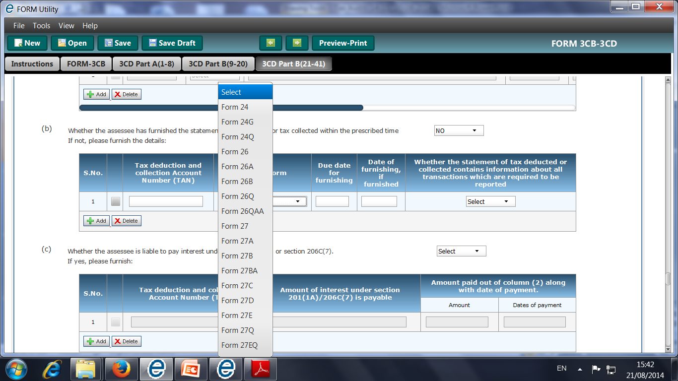
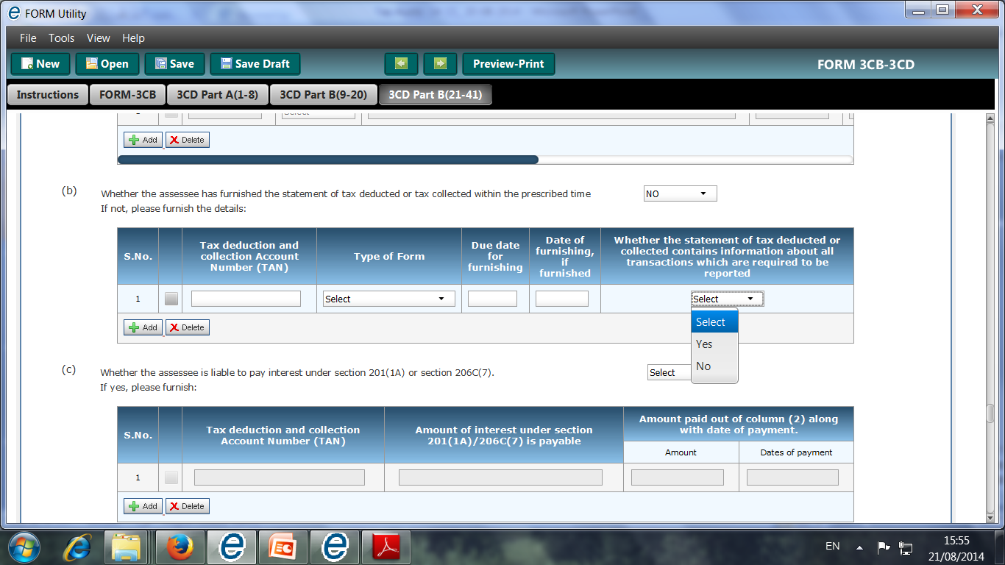
New Clause no. 34(b) [newly inserted]
Amendments in New Clause no. 34(a) [old clause no. 27(a)] are discussed later…………
whether the assessee has furnished the statement of tax deducted or tax collected within the prescribed time. If not, please furnish the details:
Tax deduction and collection Account Number (TAN)0 | Type of Form | Due date for Furnish-ing | Date of furnishing, if furnished | Whether the statement of tax deducted or collected contains information about all transactions which are required to be reported

Slide 48
Issues on New Clause no. 34(b) [newly inserted]
Contd….
Whether such detail is required to be provided only in case of default on the part of assessee in filing statement of tax deducted or collected?
The Tax Auditor cannot merely rely on information provided by the client but have to examine books of account to determine the transaction on which provisions of Chapter-XVIIB and Chapter XIIBB.
Whether it is practically possible for the tax auditor to verify all the transactions to report compliance with provisions of Chapter XVII-B or XVII-BB, where the tax audit is time bound like in Banks.
A disclaimer may be provided by the tax auditor
Option provided in Form 3CA and Form 3CB under Qualification Type - “TDS returns could not be verified with the books of account”
Disclaimer: During the year, It is not possible for us to verify whether all the transactions of the assessee due to voluminous entries in the book of account and the transactions have been verified on test-check basis and explanation provided by the assessee.

Slide 49

New Clause no. 34(c) [newly inserted]
whether the assessee is liable to pay interest under section 201(1A) or section 206C(7). If yes, please furnish:
Tax deduction and collection Account Number (TAN) | Amount of interest u/s 201(1A)/ 206C(7) is payable | Amount paid out of column (2) along with date of payment.
Brief: Detail in respect of interest u/s 201(1A) & 206C(7), if any to be provided.
Sec. 201(1A)- Levy of simple interest on failure to deduct tax or payment thereof to the credit of Central Government
Sec. 206C(7)- Levy of simple interest on failure to collect tax or payment thereof to the credit of Central Government

Slide 50
New Clause no. 39 [newly inserted]
Whether any audit was conducted under section 72A of the Finance Act, 1994 in relation to valuation of taxable services, if yes, give the details, if any, of disqualification or disagreement on any matter/item/value/quantity as may be reported/ identified by the auditor.
Brief: Detail of disqualification or disagreement in the report of audit u/s 72A of the Finance Act, 1994 (Special Audit) also to be specified
**Note: If such audit is not completed on time then auditor should report the same.
under this clause no need to express any opinion in a case where such audit has been ordered but the same has not been carried out.

Slide 51
Section 72A of Finance Act, 1994
Special Audit
If the Commissioner of Central Excise, has reasons to believe that any person liable to pay service tax (herein referred to as "such person”,—
  has failed to declare or determine the value of a taxable service correctly; or
  has availed and utilised credit of duty or tax paid—
    which is not within the normal limits having regard to the nature of taxable service provided, the extent of capital goods used or the type of inputs or input services used, or any other relevant factors as he may deem appropriate; or
    by means of fraud, collusion, or any wilful mis-statement or suppression of facts; or
  has operations spread out in multiple locations and it is not possible or practicable to obtain a true and complete picture of his accounts from the registered premises falling under the jurisdiction of the said Commissioner,
  he may direct such person to get his accounts audited by a chartered accountant or cost accountant nominated by him, to the extent and for the period as may be specified by the Commissioner.

Slide 52
New Clause no. 41 [newly inserted]
Please furnish the details of demand raised or refund issued during the previous year under any tax laws other than Income Tax Act, 1961 and Wealth tax Act, 1957 along with details of relevant proceedings
Brief: Demand/ refund under laws other than the Income Tax Act, 1961 and Wealth Tax Act, 1957 to be furnished along with assessment particulars.

Slide 53
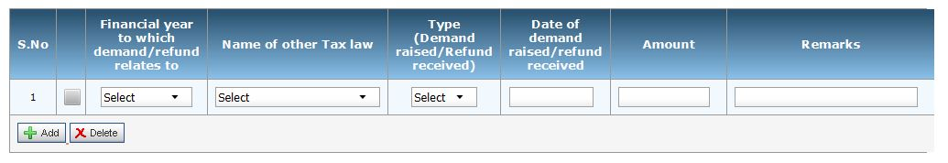
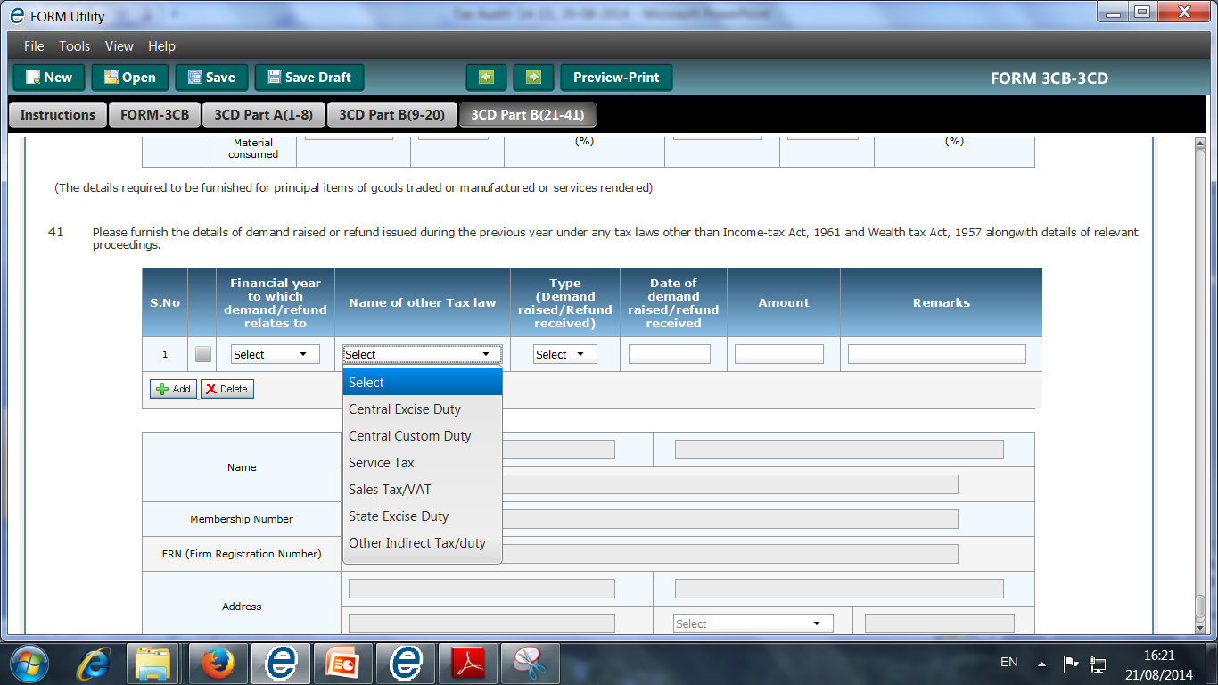
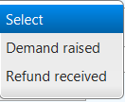
New Clause no. 41 [newly inserted]
Contd….
Format in e-utility

Slide 54
Issues / points to be considered on New Clause no. 41 [newly inserted]
Contd….
Legislative intention of insertion of this clause in the Tax Audit report under Income Tax Act: Probably due to determine whether such demand has been claimed as expenditure by the assessee or not or whether the refund has been included in income or not.
Generally, under other tax laws the Indirect tax laws such as Central Excise Duty, Service Tax, Customs Duty, Value Added Tax, CST, Professional Tax, etc should be covered [However, Octroi Duty, Entry Tax, cess or duty such as Marketing Cess, Cess on Royalty, etc. should not be covered as other tax laws].
The tax auditor need not furnish detail in respect of those proceedings in which neither demand is raised nor refund is issued.-
Obtain a copy of all the demand/ refund orders issued by the governmental authorities during the P.Y. under any tax laws other than Income Tax Act and Wealth Tax Act.
Where the demand/refund order is pertain to a period other than the relevant P.Y. but issued during the P.Y., the same should also be reported.
If there is any adjustment of refund against any demand, the auditor shall also report the same.

Slide 55
Issues on New Clause no. 41 [newly inserted]
Contd….
The reporting by the tax auditor is subject to availability of information from the assessee.
In case of refunds, the tax auditor should also verify whether the interest on such refund has been shown as income or not?
The tax auditor should also report the consequential penalty if debited to P+L A/c in New Clause No. 21
New Clause No. 21(a) [old clause no. 17(e)]-
Expenditure by way of penalty or fine for violation of any law for the time being force.
Expenditure by way of any other penalty or fine not covered above

Slide 56
Important Amendment in Clauses
b.(i)
S. No. | New Clause No. | Old Clause No.
1 | 11 | 9
2 | 19 | 15
3 | 21(d) | 17(h)
4 | 31 | 24
5 | 34 | 27

Slide 57
New Clause no. 11 [Old Clause 9]
No change
Whether books of account are prescribed under section 44AA, if yes, list of books so prescribed.

Slide 58
New Clause no. 11 [Old Clause No. 9]
Contd….
Clause 11 (b)…
Old Provision:
Books of account maintained.
(In case books of account are maintained in a computer system, mention the books of account generated by such computer)
New Provision:
List of books of account maintained and the address at which the books of accounts are kept.
(In case books of account are maintained in a computer system, mention the books of account generated by such computer system. If the books of accounts are not kept at one location, please furnish the addresses of locations along with the details of books of accounts maintained at each location. )
Brief: To specify List of books of account maintained along with Detail of Address of all locations where books of account are kept.

Slide 59
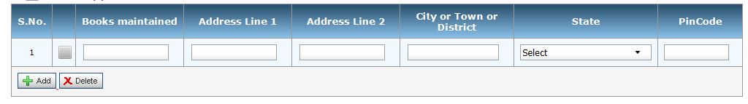
Issues on New Clause no. 11….. [Old Clause No. 9]
Contd….
Format in e-utility
Whether the tax auditor is required to mention the address where books of account were kept during the year or at the time of tax audit?
Whether the tax auditor is required to visit all the premises wherever books of account are kept by the assessee? Even where the books of account are maintained in computerized system.
Whether the tax auditor should maintain documentary evidences to substantiate his visit to all the premises?
State outside India also covered

Slide 60
New Clause no. 11 [Old Clause No. 9]
Contd….
Clause 11 (c)…
Old Provision:
List of books of account examined.
New Provision:
List of books of account and nature of relevant documents examined.
Brief: Scope of Auditor widened by including requirement to specify nature of all the documents examined.

Slide 61
Issues on New Clause no. 11….. [Old Clause No. 7]
Contd….
Earlier the tax auditor was only required to specify the list of books of account examined. However, in the revised Form, the tax auditor is also required to specify nature of all the relevant documents on basis of which the tax audit has been conducted, consequently increasing the scope of Tax Audit.
Similar, amendment made in Form No. 3CA by including “examination of books of account including other relevant documents”.
The tax auditor should maintain working papers accordingly.

Slide 62
Requirement to maintain books…..
Issues on New Clause no. 11….. [Old Clause No. 7]
Contd….
***
*
/
*
**
**
Note:
* In any 1 of the 3 yrs immediately preceding the previous year or the previous year in which business is setup, if first year.
**Any books means the books so as to enable the AO to compute his total income in accordance with the provisions of this Act.
*** legal, medical, engineering, architectural, accountancy, technical consultancy, interior decoration or any other notified profession

Slide 63
Prescribed Books [RULE 6F (2) &(3) ]
Issues on New Clause no. 11….. [Old Clause No. 7]
Contd….
Cash book
Journal (if the accounts are kept on mercantile bases)
Ledger
Serial numbered carbon copies of the bills and receipts issued
Original purchase bill/ payment vouchers.
If person carrying on medical profession in addition to above books, a daily case register in form no. 3C and an inventory of stock of drugs, medicines & other consumable accessories used for his profession.
Prescribed books of account are to be kept at the place of profession or principal place of profession, if carried at more than one place [sub-rule (4)]
To be maintained for a period of 6 years from the end of the relevant assessment year. [Sub-rule (5)]

Slide 64
Issues on New Clause no. 11….. [Old Clause No. 7]
Contd….
Notified Specified Profession
Authorized representative and film artist - vide notification : No. SO 17(E), dated 12-1-1977.
Company Secretary – vide Notification : No. SO 2675, dated 25-9-1992
Profession of information technology – vide Notification : No. SO 385(E), dated 4-5-2001
  Books or Books of account defined Sec 2(12A) to include:-
    Ledgers, Day Books, Cash books, Account books, Others
For the purpose of section 44AB, it is not necessary that any books of account or any accounts maintained by the assessee should at first be such books of account as are required u/s 44AA. Whether the books of account as prescribed u/s 44AA are maintained or not, other books of account are subject to be audited u/s 44AB. S.J Agarwal and Co. v. ITO [2008] 114 ITD 27(Pune) (SMC)

Slide 65
New Clause no. 19 [Old Clause No. 15]
Old Provision:
Amounts admissible under Sections
debited to the Profit and Loss Account (showing the amount debited and deduction allowable under each section separately);
not debited to the Profit and Loss Account
33AB | 35ABB | 35D
33ABA | 35AC | 35DD
33AC (wherever applicable) | 35CCA | 35DDA
35 | 35CCB | 35E

Slide 66
New Clause no. 19 [Old Clause No. 15]
New Provision:
Amounts admissible under sections:
Section | Amount debited to profit and loss account | Amounts admissible as per the provisions of the Income Tax Act, 1961 and also fulfils the conditions, if any specified under the relevant provisions of Income Tax Act, 1961 or Income Tax Rules,1962 or any other guidelines, circular, etc., issued in this behalf.
Brief:
New Sections Specified- 32AC, 35AD, 35CCC, 35CCD
Section Deleted- 33AC
Breakup of Section 35 provided- 35(1)(i), 35(1)(ii), 35(1)(iia), 35(1)(iii), 35(1)(iv), 35(2A) and 35(2B)

Slide 67
List of Sections…..
Contd….
Section | Particulars
32AC | Expenditure on prospecting certain minerals
33AB | Tea Development
33ABA | Site Restoration Fund
35(1)(i) | Revenue expenditure in respect of scientific research related to the business
35(1)(ii) | Amount paid to research association which has as its object the undertaking of scientific research or to a university, college or other institution to be used for scientific research
35(1)(iia) | Amount paid to a company to be used by it for scientific research
35(1)(iii) | Amount paid to research association which has as its object the undertaking of research in social science or statistical research or to a university, college or other institution to be used for research in social science or statistical research
35(1)(iv) | in respect of any expenditure of a capital nature on scientific research related to the business carried on by the assessee, such deduction as may be admissible under the provisions of sub-section (2)
35(2AA) | Amount paid to National Laboratory or a University or an Indian Institute of Technology or a specified person with a specific direction to use such amount for scientific research undertaken under a programme approved by the prescribed authority

Slide 68
List of Sections…..
Contd….
Section | Particulars
35(2AB) | Expenditure on scientific research on in-house research and development facility as approved by the prescribed authority by a company engaged in business of bio-technology or business of manufacture/ production of any article or thing other than specified in Eleventh Schedule
35ABB | Expenditure on license to operate telecommunication services
35AC | Eligible Projects/Schemes
35AD | Deduction in respect of expenditure on specified business
35CCA | Rural development programme
35CCB | Conservation of Natural resources*** Deleted from A.Y 2003-04
35CCC | Expenditure on agricultural extension project.
35CCD | Expenditure on skill development project
35D | Amortization of Preliminary Expenses
35DD | Amortisation of Expenditure in case of amalgamation or demerger
35DDA | Amortisation of expenditure incurred under voluntary Retirement Scheme
35E | Expenditure on prospecting certain minerals

Slide 69
Amendments in by Finance Act, 2014
Contd….
Section 32AC (1A) inserted [w.e.f. 01-04-2015]
Where a company
engaged in the business of manufacturing or production of any article or thing,
acquires & install new asset and
the amount of actual cost of such new assets acquired and installed during any P.Y. exceeds Rs. 25 Crore
then there shall be allowed a deduction of a sum equal to 15% of the actual cost of such new assets.
No deduction under sub sec.(1A) shall be allowed
For A.Y. 2015-16 to the assessee, which is eligible to claim deduction under sub sec.(1) for the said A.Y.
any A.Y. 2018-19 and onwards

Slide 70
Amendments in by Finance Act, 2014
Contd….
Section 35AD [w.e.f. 01/04/2015]
No deduction shall be allowed U/s 35AD (8)(c) in respect of the specified business claimed deduction u/s 10AA for same or any other A.Y.
Two new businesses are added in the list of specified business u/s 35AD(8)(c) namely:
- laying & operating a slurry pipeline for the transportation of iron ore;
-setting up and operating a semi-conductor wafer fabrication manufacturing unit notified by the Board in accordance with such guidelines as may be prescribed.
Specified Assets should be used at least for 8 years for specified purpose.
Amount of deduction allowable u/s 35AD is chargeable under PGBP if specified Assets are not used for specified purpose during specified period of 8years subject to depreciation to be allowed.
The provisions of Section 7B not apply to company become Sick company during specified period of 8 years.

Slide 71
Issues on New Clause no. 19 [Old Clause no. 15]
Contd….
Earlier, Amount debited to the P+L Account as well as amount not debited to the P+L Account was required to be specified by the tax auditor. However, in the revised Form, amount debited to the P+L Account and the amount admissible under the provisions of the Income Tax Act/Rules/other guidelines/circular, etc. needs to be reported.
The tax auditor need to specify the capital expense incurred and allowed as deduction for Computation of Profit & Gain as per the provisions of Income Tax Act/Rules/other guidelines/circular, etc. under this clause.
The tax auditor is also required to report whether the conditions specified in these sections have been fulfilled by the assessee or not.

Slide 72
New Clause no. 21…… [Old Clause No. 17]
Contd….
New Clause 21(d) [Old Clause No. 17(h)]
Old Provision:
whether a certificate has been obtained from the assessee regarding payments relating to any expenditure covered under section 40A(3)
amount inadmissible under section 40A(3), read with rule 6DD [with break-up of inadmissible amounts]
Particular | Section | Amount | Computation
Particulars | Amount

Slide 73
New Clause no. 21…… [Old Clause No. 17]
Contd….
New Clause 21(d) [Old Clause No. 17(h)]
New Provision:
Disallowance/deemed income under section 40A(3):
On the basis of the examination of books of account and other relevant documents/evidence, whether the expenditure covered under section 40A(3) read with rule 6DD were made by account payee cheque drawn on a bank or account payee bank draft. If not, please furnish the details:
Serial number | Date of payment | Nature of payment | Amount | Name and Permanent Account Number of the payee, if available

Slide 74
New Clause no. 21…… [Old Clause No. 17]
Contd….
New Provision…….
On the basis of the examination of books of account and other relevant documents/evidence, whether the payment referred to in section 40A(3A) read with rule 6DD were made by account payee cheque drawn on a bank or account payee bank draft If not, please furnish the details of amount deemed to be the profits and gains of business or profession u/s 40A(3A):
Serial number | Date of payment | Nature of payment | Amount | Name and Permanent Account Number of the payee, if available
Brief: Disallowance u/s 40A(3) to be reported on the basis of examination of books of account. Certificate from Assessee would not be sufficient.

Slide 75
Section 40A….
Contd….
(3) Where the assessee incurs any expenditure in respect of which a payment or aggregate of payments made to a person in a day, otherwise than by an account payee cheque drawn on a bank or account payee bank draft, exceeds twenty thousand rupees, no deduction shall be allowed in respect of such expenditure.
(3A) Where an allowance has been made in the assessment for any year in respect of any liability incurred by the assessee for any expenditure and subsequently during any previous year (hereinafter referred to as subsequent year) the assessee makes payment in respect thereof, otherwise than by an account payee cheque drawn on a bank or account payee bank draft, the payment so made shall be deemed to be the profits and gains of business or profession and accordingly chargeable to income-tax as income of the subsequent year if the payment or aggregate of payments made to a person in a day, exceeds twenty thousand rupees.

Slide 76
Rule 6DD…..
Contd….
Notification No 208/2007, dt 27.06.2007
Rule 6DD- no disallowance of sum exceeding Rs 20,000 made to a person in a day otherwise than by a/c payee cheque or draft for payment for following:
Payment made to – RBI, SBI, Cooperative/land mortgage Bank, Primary agricultural credit society, LIC
Payment to Govt. for legal tender
Payment made by- LC, Mail or Telegraphic t/f, Book adjustment in bank or inter bank, BE, ECS, Credit card, Debit card
Payment made by way of adjustment against the amount of any liability incurred by the payee for any goods supplied or services rendered by the assessee to such payee.

Slide 77
Rule 6DD…..
Contd….
Payment for purchase of
  Agriculture or forest produce
  Production of animal husbandry.
  Fish or fish products
  Products of horticulture or apiculture
  Payment for purchase product produced without aid of power in cottage industry.
Payment made in village or town & date of payment is not served by bank.
Payment not exceeding Rs 50,000 by an assessee to his employee or his heirs as gratuity, retrenchment compensation etc.
Payment of Salary to employee (Sec 192).
Payment made on date when banks were closed.
Payment made by person to his agent who requires to make cash payment for goods.
Payment by authorized dealer for purchase of foreign currency

Slide 78
New Clause no. 31 [Old Clause no. 24]
No Change
(a)* Particulars of each loan or deposit in an amount exceeding the limit specified in section 269SS taken or accepted during the previous year:-
  Name of the lender or depositor;
  Address of the lender or depositor;
  PAN (if available with the assessee) of the lender or depositor;
  Amount of loan or deposit taken or accepted;
  Whether the loan or deposit was squared up during the previous year;
  Maximum amount outstanding in the account at any time during the previous year;
  whether the loan or deposit was taken or accepted otherwise than by account payee cheque or account payee bank draft
  *(These particulars need not be given in the case of a Government company, a banking company or a corporation established by a Central, State or Provincial Act.)

Slide 79
New Clause no. 31 [Old Clause no. 24]
Contd….
No Change
(b) Particulars of each repayment of loan or deposit in an amount exceeding the limit specified in Section 269T made during the previous year :—
    name of the payee;
    address of the payee;
    PAN (if available with the assessee) of the payee;
    Amount of repayment;
    maximum amount outstanding in the account at any time during the previous year;
    whether the repayment was made otherwise than by account payee cheque or account payee bank draft.

Slide 80
New Clause no. 31 [Old Clause no. 24]
Contd….
Clause 31(c) [Old clause no. 24(c)]
Old Provision:
Whether a Certificate has been obtained from the assessee regarding taking or accepting Loan or Deposit, or repayment of the same through an Account Payee Cheque or an Account Payee Bank Draft. [Yes/No]
New Provision:
Whether the taking or accepting loan or deposit, or repayment of the same were made by account payee cheque drawn on a bank or account payee bank draft based on the examination of books of account and other relevant documents.
Reply to be given in Yes/ No/ N.A.
Brief: Transactions covered under section 269SS/T to be reported. Certificate from Assessee would not be sufficient.

Slide 81
Issues on New Clause no. 31 [Old Clause No. 24]
Contd….
Amendment by Finance Act, 2014 [w.e.f. 01.04.2015]
ECS, RTGS and NEFT etc. are now allowed as permissible mode to accept or repay the deposit or loan specified u/s 269SS & 269T respectively.
Transaction of current a/c also covered in ‘Deposits’.
In case of mixed a/c, transactions only related to Loans/Deposits are to be reported.
Advance received against Sale & Agreement of sale is not a Loan or Deposit.
Opening balance of Loan a/c is to be considered for calculation of maximum amount outstanding.
Security Deposit against contract etc covered under Deposits.

Slide 82
Issues on New Clause no. 31 [Old Clause No. 24]
Contd….
Accepting/ repaying loans/ advances via journal entries:
The provisions of section 269SS of the Act does not get attracted merely for transfer of amount to a loan account in the form of book entry. CIT Vs. Worldwide Township Projects Ltd., ITA No. 232/2014, Date of Judgment: 21.05.2014, High Court of Delhi
Contrary view has been taken by High Court of Bombay in CIT vs Triumph International Finance (I) Ltd. [2012] 345 ITR 270 (Bombay) wherein held that repayment of loan/deposit by merely debiting account through journal entries contravenes provisions of section 269T.
Further, held by ITAT- Bombay in Lodha Builders Pvt Ltd vs. ACIT ITA No. 481/M/2014, Date of decision 27-06-2014, that penalty cannot be levied if the transactions are bona fide & genuine even where accepting/ repaying loans/ advances via journal entries contravenes s. 269SS & 269T.

Slide 83
Issues on New Clause no. 31 [Old Clause No. 24]
Contd….
  Where the transaction is by an A/c Payee Cheque and no payment was made in Cash. Provisions of Sec 269SS shall not be attracted. CIT Vs Noida Toll Bridge Co. Ltd 262 ITR 260 (Del)
  If the cheque or bank draft through which loan is received is ‘crossed’ but words ‘account payee’ is not written in the crossing but the transaction is otherwise genuine and the bank confirms that these amounts have been deposited in assessee’s account and are as per the banking norms and there was no flaw in the transaction, penalty under section 271D is not imposable for such a trivial violation. CIT v. Makhija Construction Co. [2002] 123 Taxman 1003 (MP)

Slide 84
New Clause no. 34 [Old Clause No. 27]
Old Provision:
  Whether the assessee has complied with the provisions of Chapter XVII-B regarding deduction of tax at source and regarding the payment thereof to the credit of the Central Government. [Yes/No]
If the provisions of Chapter XVII-B have not been complied with, please give the following details*,namely
(i) Tax Deductible and not deducted at all
(ii) Shortfall on account of lesser deduction than required to be deducted
Name of party | PAN | Section under which tax was deducted | Amount
Name of party | PAN | Section under which tax was deducted | Amount
* Please give the details of cases covered in (i) to (iv) above

Slide 85
New Clause no. 34…… [Old Clause No. 27]
Contd….
Old Provision……..
(iii) Tax deducted late
(iv) Tax deducted but not paid to the credit of the Central Government
Name of party | PAN | Section under which tax was deducted | Due date of deduction | Amount deducted | Amount
Name of party | PAN | section under which tax was deducted | Date of deduction | Amount deducted | Reason for not making payment to credit of central government
* Please give the details of cases covered in (i) to (iv) above

Slide 86
New Clause no. 34…… [Old Clause No. 27]
Contd….
New Provision:
(a) Whether the assessee is required to deduct or collect tax as per the provisions of Chapter XVII-B or Chapter XVII-BB, if yes please furnish:
Tax deduction and collection Account Number (TAN) | (1)
Section | (2)
Nature of payment | (3)
Total amount of payment or receipt of the nature specified in column (3) | (4)
Total amount on which tax was required to be deducted or collected out of (4) | (5)
Total amount on which tax was deducted or collected at specified rate out of (5) | (6)
Amount of tax deducted or collected out of (6) | (7)
Total amount on which tax was deducted or collected at less than specified rate out of (7) (5) | (8)
Amount of tax deducted or collected on (8) | (9)
Amount of tax deducted or collected not deposited to the credit of the Central Government out of (6) and (8) (7) and (9) | (10)

Slide 87
Issues on New Clause no. 34…… [Old Clause No. 27]
Contd….
Newly inserted Clause no. 34(b)/(c) already discussed…………
In-built checks not provided. For example, Column (5)- ‘Total amount on which tax was required to be deducted or collected out of (4)’, should not exceed the amount specified in column (4).
The detail is to be provided in accordance with the nature of payment.
The tax auditor is required to provide the detail irrespective of any default on the part of assessee in complying with the provisions of Chapter-XVII-b or XVII-BB.

Slide 88
Issues on New Clause no. 34…… [Old Clause No. 27]
Contd….
As per Guidance note issued by the ICAI
Rates of deduction is to be consider as per the law relevant to the P. Y.
Refer relevant provisions, rules, circulars, notifications and such certificates obtained from the auditee to verify the cases where tax has been short deducted at source.
In case the payer deducts/recipient collects tax at source at a rate lower than the specified rate on the basis of certificate issued u/s 195 or 197, the lower rate or nil rate, as the case may be will be considered as the specified rate for the purpose of reporting under this clause.
As per the provisions of sections 195/ 197, certificate can be issued for no deduction or lower deduction of tax at source.
In case of payment to non-residents, the applicable rate of TDS is to be read along with the Double Taxation Avoidance Agreement.

Slide 89
Issues on New Clause no. 34…… [Old Clause No. 27]
Contd….
In Column No. (8)/ (10), reference of Column no. (5)/ (6) and (8) has been wrongly made instead of (5)/ (7) and (9) respectively.
For example-
The assessee has incurred Legal & Professional expenses amounting to Rs. 2,00,000/- (Rs. 1,00,000/-, Rs. 50,000/-, Rs. 40,000/- and Rs. 10,000/-).
Out of this, TDS u/s 194J is required to be deducted on Rs. 1,90,000/-.
The person to whom payment of Rs. 40,000/- is made has furnished Certificate u/s 197A to deduct tax @ 5% and TDS has not been deducted on payment of Rs. 50,000/-.
Now the detail is to be given as per next slide:

Slide 90
Issues on New Clause no. 34……
Contd….
 |  | ICAI View | Alternate View
Tax deduction and collection Account Number (TAN) | (1) | TAN | TAN
Section | (2) | 194J | 194J
Nature of payment | (3) | Professional fees | Professional fees
Total amount of payment or receipt of the nature specified in column (3) | (4) | 2,00,000/- | 2,00,000/-
Total amount on which tax was required to be deducted or collected out of (4) | (5) | 1,90,000/- | 1,90,000/-
Total amount on which tax was deducted or collected at specified rate out of (5) | (6) | 1,40,000/-* | 1,00,000/-*
Amount of tax deducted or collected out of (6) | (7) | 12,000/- | 10,000/-
Total amount on which tax was deducted or collected at less than specified rate out of (7) (5) | (8) | NIL | Rs. 40,000/-
Amount of tax deducted or collected on (8) | (9) | NIL | Rs. 2,000/-
Amount of tax deducted or collected not deposited to the credit of the Central Government out of (6) and (8) (7) and (9) | (10) | 1,500/- (assumed) | 1,500/- (assumed)
*Other view- Specified rate may be considered as rate mentioned in the relevant section prior to considering Sec. 195/ 197A certificate.

Slide 91
Issues on New Clause no. 34…… [Old Clause No. 27]
Contd….
There is no specific column to mention non- deduction of tax at source in the specified format. However, the amount may be calculated as follows
Non- deduction = Column (5) less [(6) plus (8)]
Since the reference to Chapter XVII-B is made, it is clear that TDS under Income-tax Act is only covered. TDS under other laws (e.g. TDS on works contracts under State VAT laws) are not covered. The tax auditor is also not responsible for reporting timely deposit with the State Government of Profession Tax deducted from salaries of employees - ICAI’s Issues on Tax Audit.
If tax auditor does not agree with the auditee’s views on deductibility/non-deductibility of tax in particular cases, it would be advisable to state both views (his views as well as the auditee’s views)

Slide 92
Other Amendment in Clauses
b.(ii)
S. No. | New Clause No. | Old Clause No. | S. No. | New Clause No. | Old Clause No. | S. No. | New Clause No. | Old Clause No.
1 | 6 | 5 | 7 | 21(b) | 17(f) | 13 | 35 | 28
2 | 9 | 7 | 8 | 21(c) | 17(g) | 14 | 36 | 29
3 | 12 | 10 | 9 | 21(e)-(i) | 17 (i)-(m) | 15 | 37 | 30
4 | 18 | 14 | 10 | 24 | 19 | 16 | 38 | 31
5 | 20 | 16 | 11 | 27 | 22 | 17 | 40 | 32
6 | 21(a) | 17(a)-(e) | 12 | 33 | 26 | 18 | Notes | Notes

Slide 93
New Clause no. 6 [Old Clause No. 5]
Old Provision:
Previous year ended: 31st March _____
New Provision:
Previous year from ………..to ……………
Brief: Period to be specified

Slide 94
New Clause no. 9 [Old Clause no. 7]
*No change
If firm or Association of Persons, indicate names of partners/members and their profit sharing ratios.
Name | Profit sharing ratio (%)
Note: The revised e-utility requires additional information not notified in Notification dated 25-07-2014,
“In case of AOP, whether the shares of members are indeterminate or unknown”

Slide 95
New Clause no. 9….. [Old Clause No. 7]
Contd….
New Clause 9(b) [Old clause no. 7(b)]
Old Provision:
If there is any change in the partners/ members or in their profit sharing ratio, the particulars of such change.
New Provision:
If there is any change in the partners or members or in their profit sharing ratio since the last date of the preceding year, the particulars of such change.
Brief: Clarification provided

Slide 96
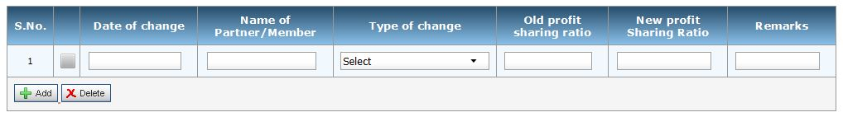
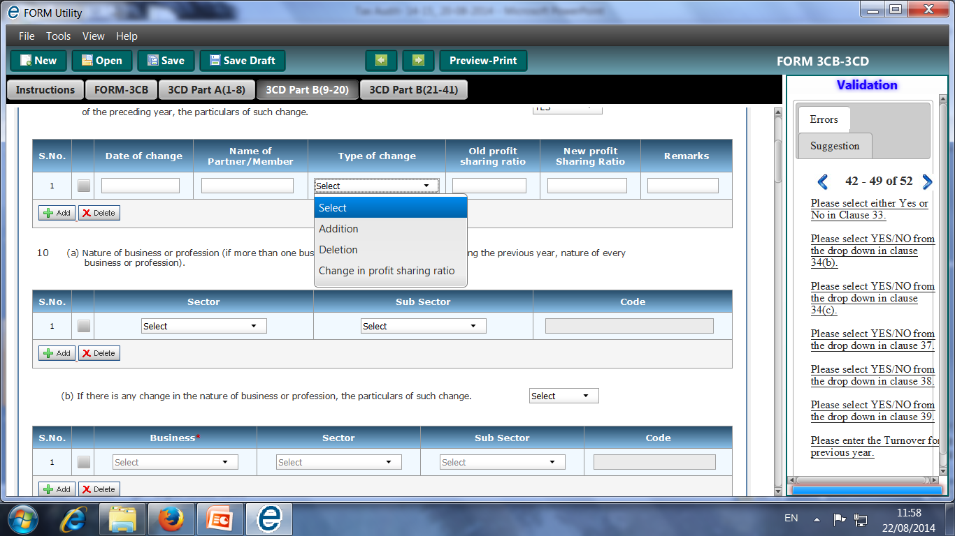
New Clause no. 9….. [Old Clause No. 7]
Contd….
Format in e-utility

Slide 97
Issues on New Clause no. 9 [Old Clause No. 7]
Contd….
This applies to Firm, Association of Persons (AOPs) and LLPs
“Profit Sharing Ratio” would include Loss sharing ratio also as “Loss” is nothing but negative profit.
All the changes occurring during the entire previous year must be stated.
Change in remuneration not to be reported- The clause would not cover any change in relation to payment of remuneration or interest to partners or members without change in Profit/ Loss Sharing ratio .

Slide 98
New Clause no. 12 [Old Clause No. 10]
Old Provision:
Whether the Profit and Loss Account includes any Profits and gains assessable on presumptive basis, if yes, indicate the amount and the relevant section (44AD, 44AE, 44AF, 44B, 44BB, 44BBA, 44BBB or any other relevant section)
New Provision:
Whether the profit and loss account includes any profits and gains assessable on presumptive basis, if yes, indicate the amount and the relevant section (44AD, 44AE, 44AF, 44B, 44BB, 44BBA, 44BBB, Chapter XII-G, First Schedule or any other relevant section.)
Brief: Chapter XII-G (Special provisions relating to income of Shipping companies) and First Schedule (Insurance Business) also covered.

Slide 99
List of Sections……….
Contd….
S. No. | Section / Chapter/ Schedule | Business Covered
1. | 44AD | Special provision for computing profits/gains of business on presumptive basis
2. | 44AE | Transport business
3. | 44AF | Retail Business (This section is inoperative w.e.f A.Y 2011-2012 and covered in s.44AD itself)
4. | 44B | Shipping business of a non-resident
5. | 44BB | Providing service/ facilities in connection with, or supplying plant and machinery on hire used, or to be used, in the prospecting for, or extraction or production of, mineral oils.
6. | 44BBA | Operation of aircraft by non-resident.

Slide 100
List of Sections……….
Contd….
S. No. | Section / Chapter/ Schedule | Business Covered
7. | 44BBB | Civil construction etc. in certain turnkey power project by non-residents.
8. | Chapter XII-G | Special provisions relating to income of shipping companies
9. | First Schedule | Rules for Section 44- Insurance Business
10. | Any other relevant section | This refers to the sections not listed above under which income may be assessable on presumption basis like section 44D and sec 115A(1)(b) and will include any other section that may be enacted in future for presumptive taxation.

Slide 101
Issues on New Clause no. 12 [old clause no. 10]
Contd….
The value of material supplied by the client is not included in Gross receipt and value of work in progress would not constitute turnover.
In case of composite business, if the books of accounts are commonly maintained, apportionment of the common expenses is on reasonable estimate.
Turnover basis is mostly accepted by I-Tax Dept.
If profit is credited directly to Profit & Loss a/c, appropriate qualification will be needed but if credited to capital a/c of partners/members, no need to report here.

Slide 102
New Clause no. 18 [Old Clause no. 14]
Particulars of depreciation allowable as per the Income-tax Act, 1961 in respect of each asset or block of assets, as the case may be, in the:-
Description of asset/ block of assets.
Rate of Depreciation (in percentage)
Actual cost or written down value, as the case may be.

Slide 103
New Clause no. 18 [Old Clause no. 14]
Contd….
Additions/deductions during the year with dates; in the case of any addition of an asset, date to put to use;
  Date of addition/deductions, Particulars, Amount, In case of addition- date put to use. In case of deduction- NA
  Adjustments on account of
    Modified Value Added Tax Central Value Added Tax credit claimed and allowed under the central Excise Rule,1994 in respect of assests acquired on or after 1st march,1994
    Change in the rate of exchange of currency, and
    Subsidy or grant or reimbursement, by whatever name called.
Depreciation allowable
Written down value at the end of the year.
Brief: Central Value Added Tax is substituted with Modified Value Added Tax

Slide 104

New Clause no. 18 [Old Clause no. 14]
Contd….
S. No. | Description of the Block of Assets/ Class of Assets | Rate of Depreciation | Opening WDV / Actual (A)
Additions
Details | Purchase Value (1) | Adjustments on Account of |  |  | Total Value of Purchases (B) (1+2+3+4)
 |  | CENVAT (2) | Change in Rate of Exchange (3) | Subsidy/Grant (4)
Additions CSV Template Deductions CSV Template Help
Details | Deduction (C) | Depreciation Allowable (D) | Written Down Value at the end of the year (A+B-C-D)

Slide 105
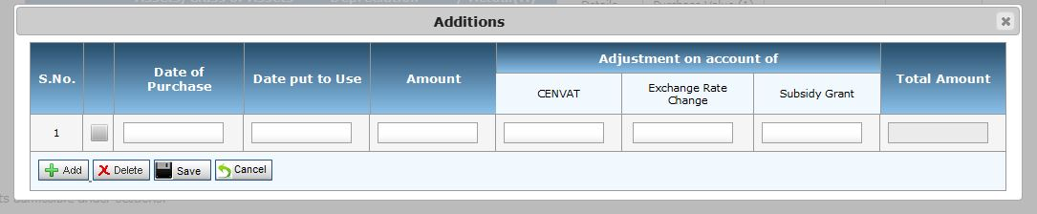
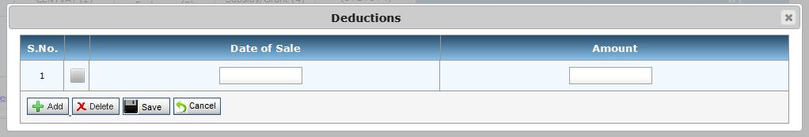
New Clause no. 18 [Old Clause no. 14]
Contd….
Revised e-utility also provides facility to import CSV template to fill the details of additions and deductions.
The e-utility does not provide CSV template. Thus, CSV file has to be created with same columns as specified in “Fill Data” option which are as follows:

Slide 106
Issues on New Clause no. 18…. [Old Clause no. 14]
Contd….
It is compulsory for all assessee to claim depreciation or additional depreciation (in terms of S. 32(1)(ii)) in calculating taxable income otherwise no deduction will be allowed & WDV will be treated as reduced – Explanation 5 to Sec 32 (w.e.f A.Y. 2002-03).
‘Allowable” implies permissible deduction under provision of Act and Rules.
“Used” means actual use and is not kept ready for use.
  Assets used partly for Business purpose, deduction u/s 32(1) restricted to proportionate part.
Under ‘Change in the rate of exchange of currency’ – adjustment is contemplated u/s 43A & AS-11. (u/s 43A deduction on cash basis but AS-11 (revised) deduction on accrual basis)
Depreciation debited to P&L A/c as per requirement of Schedule VI not reported under this clause.
Notes:
Additional depreciation:
W.e.f 2006-07 additional depreciation allowed to all the assessee engaged in the business of manufacturing or production of any article or thing in respect of New machinery or Plant installed on or after 31st day of March,2005.

Slide 107
Issues on New Clause no. 18 [Old Clause no. 14]
Contd….
Depreciation is not allowed on an amount equivalent to CENVAT credit claimed and allowed.
Depreciation is allowed on “Actual Cost”- term defined u/s 43(1) of I.T. Act.
An assessee can claim depreciation on actual cost even if he follows Cash method of accounting.
Subsidy received over & above of WDV of block of asset in the absence of specific provisions not taxable.
Interest relatable to any period after such asset is first put to use is not a part of actual cost.
In case of dispute between Assessee, Department & Auditor regarding classification of assets, rate of depreciation etc in earlier year, a suitable disclosure is required.

Slide 108
New Clause no. 20 [Old Clause no. 16]
*No change
Clause 20(a) [Old clause 16(a)]
Any sum paid to an employee as bonus or commission for services rendered, where such sum was otherwise payable to him as profits or dividend. [Section 36(1)(ii)].
Description | Amount
“Sec. 36(1)(ii)- any sum paid to an employee as bonus or commission for services rendered, where such sum would not have been payable to him as profits or dividend if it had not been paid as bonus or commission”

Slide 109
New Clause no. 20 [Old Clause no. 16]
Clause 20(b) [Old clause 16(b)]
Old Provision:
Any sum received from employees towards contributions to any provident fund or superannuation fund or any other fund mentioned in section 2(24)(x); and due date for payment and the actual date of payment to the concerned authorities under section 36(1)(va).
New Provision:
Details of contributions received from employees for various funds as referred to in section 36(1)(va)
Name of Fund | Amount | Actual Date | Due Date
Serial number | Nature of fund | Sum received from employees | Due date for payment | The actual amount paid | The actual date of payment to the concerned authorities

Slide 110
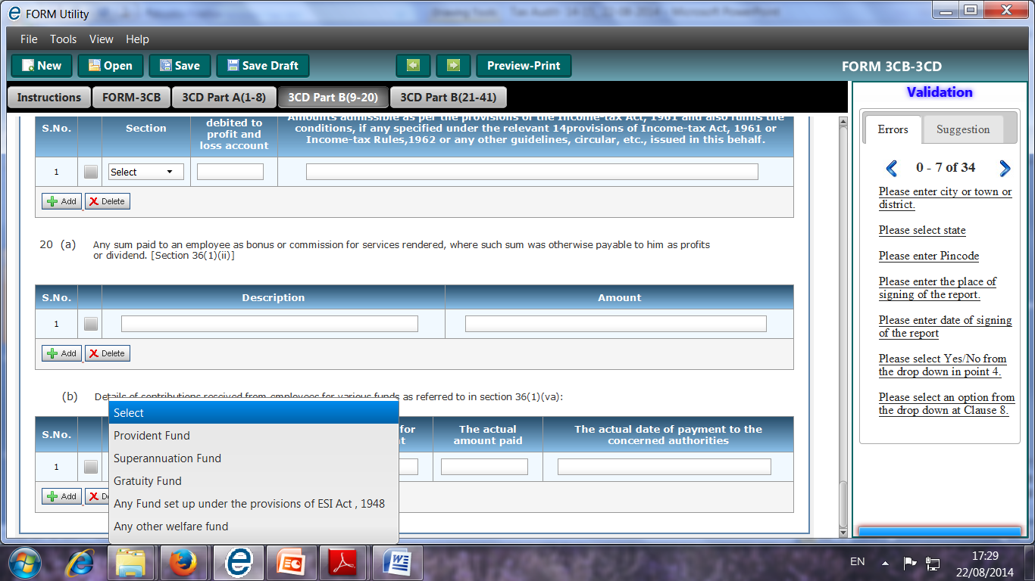
Issues on New Clause no. 20 [Old Clause no. 16]
Contd….
Funds covered:
Now, the amount not deposited to the relevant fund but received from the employees are also required to be reported under this clause.
Amount received from employees as contributions as referred in Sec. 2(24)(x) is taxable u/s 56(2)(ic) if such income is not shown under PGBP.
Only amounts which are not in nature of reward for services will be covered by this item.
Only disclosure of amount is required but the Auditor’s opinion about its allowability or otherwise is not required.
Fund not specifically mentioned in Sec 2(24)(x)

Slide 111
New Clause no. 21 [Old Clause No. 17]
New Clause 21(a) [Old Clause No. 17(a) – (e)]
Old Provision:
Amount debited to the Profit and Loss Account, being:-
expenditure of capital nature;
expenditure of personal nature;
expenditure on advertisement in any souvenir, brochure, tract, pamphlet or the like, published by a political party;
expenditure incurred at club,—
(i) as entrance fees and subscriptions;
(ii) as cost for club services and facilities used;
(e) (i) expenditure by way of penalty or fine for violation of any law for the time being in force;
(ii) any other penalty or fine;
(iii) expenditure incurred for any purpose which is an offence or which is prohibited by law;

Slide 112
New Clause no. 21….. [Old Clause No. 17]
Contd….
New Clause 21(a) [Old Clause No. 17(a) – (e)]
New Provision:
Please furnish the details of amounts debited to the profit and loss account, being in the nature of capital, personal, advertisement expenditure etc
Nature | Serial number | Particulars | Amount in Rs.
Expenditure incurred at clubs being cost for club services and facilities used.
Expenditure by way of penalty or fine for violation of any law for the time being force.
Expenditure by way of any other penalty or fine not covered above
Expenditure incurred for any purpose which is an offence or which is prohibited by law

Slide 113
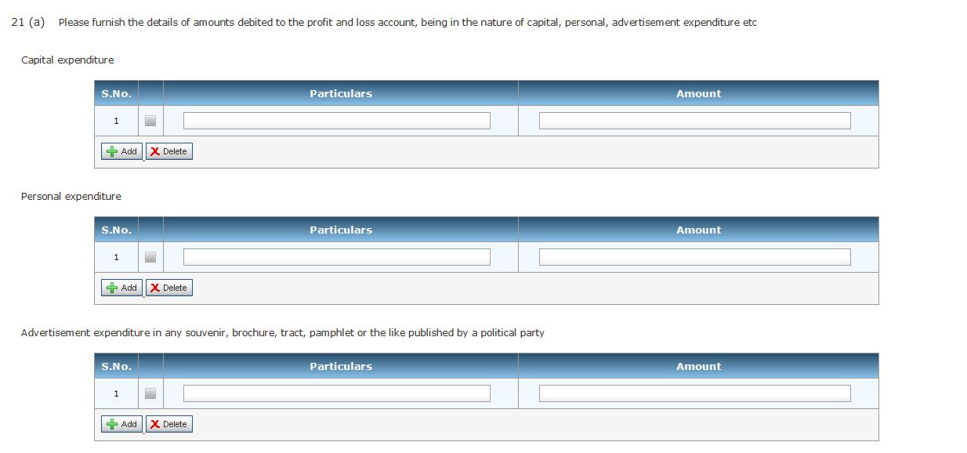
Issues on New Clause no. 21 [Old Clause No. 17]
Contd….
The amendments as specified in new Clause no. 21(a) have not been incorporated in the revised e-utility.……

Slide 114
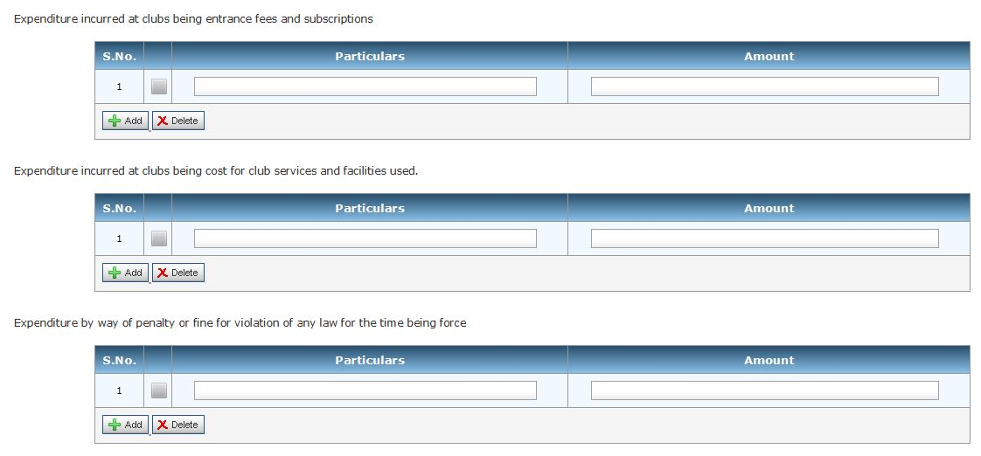
Issues on New Clause no. 21 [Old Clause No. 17]
Contd….

Slide 115
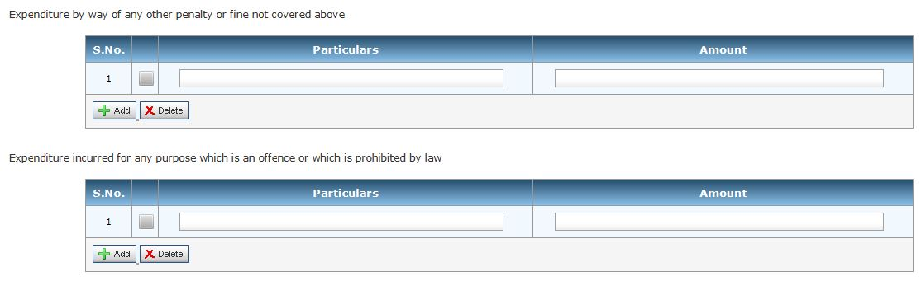
Issues on New Clause no. 21 [Old Clause No. 17]
Contd….
Amendment incorporated

Slide 116
Issues on New Clause no. 21 [Old Clause No. 17]
Contd….
Earlier the expenses u/s 37(2B) were required to be reported. Whether the tax auditor now needs to report all the expenses incurred on advertisement irrespective of the status of assessee?
Whether the tax auditor should specify each and every transaction? The format as specified in the notification includes Serial number, particulars, amount.
“Sec. 37(2B)- Notwithstanding anything contained in sub-sec. (1), no allowance shall be made in respect of expenditure incurred by an assessee on advertisement in any souvenir, brochure, tract, pamphlet or the like published by a political party.”

Slide 117
Issues on New Clause no. 21 [Old Clause No. 17]
Contd….
Cost of repairs & current repairs to building – not capital expenditure.
Current repairs to machinery – Plant & Furniture – not capital expenditure. Explanation to Sec 30 & 31
Separately indicate capital expenses allowed as deduction in computation to total income under the Act.
“Personal” is confined & related with assessee only.
Company cannot have personal expenses because it is an artificial entity, which does not have personal needs and thus use of vehicles for directors cannot be treated as personal use by the company. [Sayaji Iron and Engg. Co. v. CIT[2002] 253 ITR 749 (Guj.)]
Donation paid directly to political party, expense on advertisement in newspaper not to be reported.

Slide 118
Issues on New Clause no. 21 [Old Clause No. 17]
Contd….
Expenditure by way of penalty or fine for violation of any law is not admissible as expenditure.
Infraction of law even if not deliberate may discredit the claim for deduction.
Allowance of legal expenses depends on nature & purpose of legal proceeding in relation to business whose profits are under computation & is not affected by final outcome of the proceeding. Vivek P. Talwar vs Asst. CIT [2010] 8 Taxmann.com 268 (Mum.). Also see CIT v. Hirjee [1953] 23 ITR 427 (SC)
In case of illegal business, fine or penalty imposed thereon is not deductible (Expln. to Sec. 37(1)).
It was held that where the assessee is required to pay amount comprising both the element of compensation & penalty. Only the amount of compensation deductible as Business expense. Malura Vanaspati & Chemical Co Vs CIT (1997) 225 ITR 383 (SC)
Notes:
Sec. 40(a):
Amendment to sub clause(ia) by Finance Act, 2010 provides for disallowance if tds deducted during the previous year is not deposited by the due date of ITR filing in respect of payments being interest, commission, brokerage, rent, royalty for Professional/Technical fees service, payment to Contractor or Sub contractor
Sub clause(ib) providing for disallowance on account of STT –omitted w.e.f 1-4-2009 since allowed u.s 36(1)(xv).
Sub clause (ic) inserted by Finance Act, 2005 provides for disallowance of FBT
New Sub clause (v) of Sec 40(a) tax referred in Sec 10(10ccc) paid by the employer on non- monetary perquisites provided to employees shall not deducted.

Slide 119
New Clause no. 21….. [Old Clause No. 17]
Contd….
New Clause 21(b) [Old Clause No. 17(f)]
Old Provision:
amounts inadmissible under section 40(a)
New Provision:
(b) Amounts inadmissible under section 40(a):-
(i) as payment to non-resident referred to in sub-clause (i)
Details of payment on which tax is not deducted:
date of payment | amount of payment | nature of payment | name and address of the payee
Revised e-utility also requires PAN, if available

Slide 120
New Clause no. 21…… [Old Clause No. 17]
Contd….
New Provision……
Details of payment on which tax has been deducted but has not been paid during the previous year or in the subsequent year before the expiry of time prescribed under section 200(1)
date of payment | amount of payment | nature of payment | name and address of the payee | amount of tax deducted
Revised e-utility also requires PAN, if available

Slide 121
Section 40(a)(i)…..
Contd….
any interest (not being interest on a loan issued for public subscription before 01-04-1938), royalty, fees for technical services or other sum chargeable under this Act, which is payable,—
(A) outside India; or
(B) in India to a non-resident, not being a company or to a foreign company,
on which tax is deductible at source under Chapter XVII-B and such tax has not been deducted or, after deduction, has not been paid during the previous year, or in the subsequent year before the expiry of the time prescribed u/s 200(1).
Provided that where in respect of any such sum, tax has been deducted in any subsequent year or, has been deducted in the previous year but paid in any subsequent year after the expiry of the time prescribed u/s 200(1), such sum shall be allowed as a deduction in computing the income of the previous year in which such tax has been paid.

Slide 122
New Clause no. 21…… [Old Clause No. 17]
Contd….
New Provision……
(ii) as payment referred to in sub-clause (ia)
Details of payment on which tax is not deducted:
Details of payment on which tax has been deducted but has not been paid on or before the due date specified in Sec. 139(1).
date of payment | amount of payment | nature of payment | name and address of the payee
date of payment | amount of payment | nature of payment | name and address of the payer | amount of tax deducted | amount out of (V) deposited, if any
Revised e-utility also requires PAN, if available

Slide 123
Section 40(a)(ia)…..
Contd….
any interest, commission or brokerage, rent, royalty, fees for professional services or fees for technical services payable to a resident, or amounts payable to a contractor or sub-contractor, being resident, for carrying out any work (including supply of labour for carrying out any work), on which tax is deductible at source under Chapter XVII-B and such tax has not been deducted or, after deduction, has not been paid on or before the due date specified in Se. 139(1)
Provided that where in respect of any such sum, tax has been deducted in any subsequent year, or has been deducted during the previous year but paid after the due date specified in Sec. 139(1), such sum shall be allowed as a deduction in computing the income of the previous year in which such tax has been paid.
Provided further that where an assessee fails to deduct the whole or any part of the tax in accordance with the provisions of Chapter XVII-B on any such sum but is not deemed to be an assessee in default under first proviso to Sec. 201(1), then, for the purpose of this sub-clause, it shall be deemed that the assessee has deducted and paid the tax on such sum on the date of furnishing of return of income by the resident payee referred to in the said proviso.

Slide 124
New Clause no. 21…… [Old Clause No. 17]
Contd….
New Provision……
(iii) under sub-clause (ic) [Wherever applicable]
(iv) under sub-clause (iia)
Section 40(a)(ic)- any sum paid on account of fringe benefit tax under Chapter XIIH.
Section 40(a)(iia)- any sum paid on account of wealth-tax.

Slide 125
New Clause no. 21…… [Old Clause No. 17]
Contd….
New Provision……
(v) under sub-clause (iib)
Section 40(a)(iib)-
Any amount—
(A) paid by way of royalty, licence fee, service fee, privilege fee, service charge or any other fee or charge, by whatever name called, which is levied exclusively on; or
(B) which is appropriated, directly or indirectly, from,
a State Government undertaking by the State Government.
Inserted by Finance Act, 2013, w.e.f. 1-4-2014

Slide 126
New Clause no. 21…… [Old Clause No. 17]
Contd….
New Provision……
(vi) under sub-clause (iii)
date of payment | amount of payment | name and address of the payee
Revised e-utility also requires PAN, if available
Section 40(a)(iii)- Any payment which is chargeable under the head "Salaries", if it is payable—
(A) outside India; or
(B) to a non-resident,
and if the tax has not been paid thereon nor deducted therefrom under Chapter XVII-B

Slide 127
New Clause no. 21…… [Old Clause No. 17]
Contd….
New Provision……
(vii) under sub-clause (iv)
Section 40(a)(iv)- any payment to a provident or other fund established for the benefit of employees of the assessee, unless the assessee has made effective arrangements to secure that tax shall be deducted at source from any payments made from the fund which are chargeable to tax under the head "Salaries"

Slide 128
New Clause no. 21…… [Old Clause No. 17]
Contd….
New Provision……
(viiii) under sub-clause (v)
Section 40(a)(v)- any tax actually paid by an employer referred to in clause (10CC) of section 10.
Section 10(10CC)- in the case of an employee, being an individual deriving income in the nature of a perquisite, not provided for by way of monetary payment, within the meaning of Sec. 17(2), the tax on such income actually paid by his employer, at the option of the employer, on behalf of such employee, notwithstanding anything contained in sec. 200 of Companies Act, 1956.
Brief: Detail of each payment is to be provided on which provisions of Section 40(a) are applicable in specific format

Slide 129
Issues on New Clause no. 21 [Old Clause No. 17]
Contd….
Revised e-utility also provides facility to import CSV template to fill the details in Clause 21(b) along with CSV template with specified format.
Amendment by Finance Act, 2014
The disallowance u/s 40(a)(ia) is restricted to only 30% of the amount in respect of which either TDS has not been deducted or having been deducted has not been deposited.
The earlier definition of the specified payments have been enlarged to include ALL PAYMENTS stated under Chapter XVII-B of the Act, including Salary, Cross Word puzzles prizes, etc which have been claimed as expenditure.
          [w.e.f. 01.04.2015]

Slide 130
New Clause no. 21…… [Old Clause No. 17]
Contd….
New Clause 21(c) [Old Clause No. 17(g)]
Old Provision:
Interest, Salary, Bonus, Commission or Remuneration inadmissible under Section 40(b)/40(ba) and computation thereof;
New Provision:
Amounts debited to profit and loss account being, interest, salary, bonus, commission or remuneration inadmissible under section 40(b)/40(ba) and computation thereof;
Brief: Clarification provided

Slide 131
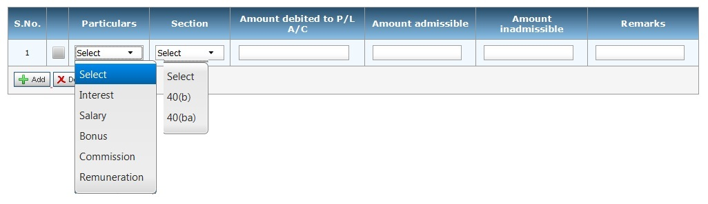
New Clause no. 21…… [Old Clause No. 17]
Contd….
Format in e-utility…..

Slide 132
Contd….
New Clause no. 21…… [Old Clause No. 17]
New Clause 21(d) [Old Clause 17(i)] already discussed…..
No Change
New Clause 21(e) [Old Clause 17(i)]
provision for payment of gratuity not allowable under section 40A(7);
Section 40A(7)-
Subject to the provisions of clause (b), no deduction shall be allowed in respect of any provision (whether called as such or by any other name) made by the assessee for the payment of gratuity to his employees on their retirement or on termination of their employment for any reason.
Nothing in clause (a) shall apply in relation to any provision made by the assessee for the purpose of payment of a sum by way of any contribution towards an approved gratuity fund, or for the purpose of payment of any gratuity, that has become payable during the previous year

Slide 133
Contd….
New Clause no. 21…… [Old Clause No. 17]
*No Change
New Clause 21(f) [Old Clause 17(j)]
any sum paid by the assessee as an employer not allowable under section 40(9);
Section 40A(9)-
No deduction shall be allowed in respect of any sum paid by the assessee as an employer towards the setting up or formation of, or as contribution to, any fund, trust, company, association of persons, body of individuals, society registered under the Societies Registration Act, 1860 (21 of 1860), or other institution for any purpose, except where such sum is so paid, for the purposes and to the extent provided by or u/s 36(1)(iv)/(iva)/(v), or as required by or under any other law for the time being in force.

Slide 134
Contd….
New Clause no. 21…… [Old Clause No. 17]
*No Change
New Clause 21(g-h) [Old Clause 17(k-l)]
particulars of any liability of a contingent nature.
amount of deduction inadmissible in terms of section 14A in respect of the expenditure incurred in relation to income which does not form part of the total income.
Nature of Liability | Amount
Particulars | Amount

Slide 135
Contd….
New Clause no. 21…… [Old Clause No. 17]
*No Change
New Clause 21(i) [Old Clause 17(m)]
amount inadmissible under the proviso to section 36(1)(iii).
Section 36(1)(iii) –
The amount of the interest paid in respect of capital borrowed for the purposes of the business or profession
Provided that any amount of the interest paid, in respect of capital borrowed for acquisition of an asset for extension of existing business or profession (whether capitalised in the books of account or not); for any period beginning from the date on which the capital was borrowed for acquisition of the asset till the date on which such asset was first put to use, shall not be allowed as deduction.
*No Change

Slide 136
Issues on New Clause no. 21 [Old Clause No. 17]
Contd….
The broad principles enunciated in the guidelines of the Council of ICAI may be kept in mind while verifying the amount of inadmissible expenditure. After verifying the amount of inadmissible expenditure, if the tax auditor:
  is in agreement with the assessee, he should report the amount with suitable disclosures of material assumptions, if any.
  is not in agreement with the assessee with regard to the amount of expenditure determined, he may give:
      A qualified opinion:
      An adverse opinion:
      The disclaimer of opinion:

Slide 137
New Clause no. 24 [Old Clause No. 19]
Old Provision:
Amounts deemed to be profits and gains under section 33AB or 33ABA or 33AC
New Provision:
Amounts deemed to be profits and gains under section 32AC or 33AB or 33ABA or 33AC
Brief: Expenditure on prospecting certain minerals u/s 32AC also to be reported.

Slide 138
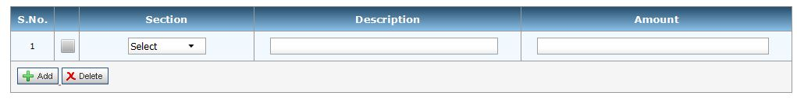
New Clause no. 24 [Old Clause No. 19]
Contd….
Format in e-utility…..
S. No. | Section | Particulars
1 | 32AC | Investment in new plant or machinery
2 | 32AB | Tea development account, coffee development account and rubber development account
3 | 33ABA | Site Restoration Fund
4 | 33AC | Reserves for shipping business

Slide 139
Section 32AC- Investment in new plant or machinery…..
Contd….
Sub-Sec. (1)
Where an assessee, being a company,
engaged in business of manufacture or production of any article or thing,
acquires & installs new asset
After 31-03-2013 but before 01-04-2015 and
the aggregate amount of actual cost of such new assets exceeds Rs. 100 crore,
then, there shall be allowed a deduction,—
  for A.Y. 2014-15, of a sum equal to 15% of actual cost of new assets acquired & installed after 31-03-2013 but before 01-04-2014, if the aggregate amount of actual cost of such new assets exceeds Rs. 100 crore; and
  For A.Y. 2015-16, of a sum equal to 15% of actual cost of new assets acquired & installed after 31-03-2013 but before 01-04-2015, as reduced by the amount of deduction allowed, if any, under clause (a).

Slide 140
Section 32AC- Investment in new plant or machinery…..
Contd….
Sub-Sec. (2)
If any new asset acquired & installed by the assessee is sold or otherwise transferred,
except in connection with the amalgamation or demerger,
within a period of 5 years from the date of its installation,
the amount of deduction allowed under sub-sec. (1) or (1A)* in respect of such new asset shall be deemed to be the income of the assessee chargeable under the head “PGBP" of the previous year in which such new asset is sold or otherwise transferred, in addition to taxability of gains, arising on account of transfer of such new asset.
Sub-Sec. (3)
Where the new asset is sold or otherwise transferred in connection with the amalgamation or demerger
within a period of 5 years from the date of its installation,
the provisions of sub-sec. (2) shall apply to the amalgamated company or the resulting company, as the case may be, as they would have applied to the amalgamating company or the demerged company.
*Inserted by Finance Act, 2014

Slide 141
Section 32AC- Investment in new plant or machinery…..
Contd….
Sub-Sec. (4)
For the purposes of this section, "new asset" means any new plant or machinery (other than ship or aircraft) but does not include—
any plant or machinery which before its installation by the assessee was used either within or outside India by any other person;
any plant or machinery installed in any office premises or any residential accommodation, including accommodation in the nature of a guest house;
any office appliances including computers or computer software;
any vehicle; or
any plant or machinery, the whole of the actual cost of which is allowed as deduction (whether by way of depreciation or otherwise) in computing the income chargeable under the head "Profits and gains of business or profession" of any previous year.

Slide 142
Section 32AC- Investment in new plant or machinery…..
Contd….
Sub- sec. (1A) inserted by Finance Act, 2014 [w.e.f. 01-04-2015]
Where a company
engaged in the business of manufacturing or production of any article or thing,
acquires & install new asset and
the amount of actual cost of such new assets acquired and installed during any P.Y. exceeds Rs. 25 Crore
then there shall be allowed a deduction of a sum equal to 15% of the actual cost of such new assets.
No deduction under sub sec.(1A) shall be allowed
For A.Y. 2015-16 to the assessee, which is eligible to claim deduction under sub sec.(1) for the said A.Y.
any A.Y. 2018-19 and onwards

Slide 143
New Clause no. 27 [Old Clause No. 22]
Old Provision:
Amounts of Modified Value Added Tax Credits availed of or utilised during the previous year and its treatment in the profit and loss account and treatment of outstanding Modified Value Added Tax credits in the accounts.
Particulars of income or expenditure of prior period credited or debited to the profit and loss account.
Amount | Treatment in profit & loss account.
Amount | Treatment of outstanding Modified value added tax credits in accounts:
Type | Particulars | Amount | Prior Period

Slide 144
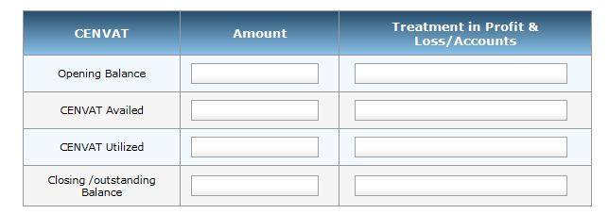
New Clause no. 27 [Old Clause No. 22]
Contd….
New Provision:
Amount of Central Value Added Tax credits availed of or utilised during the previous year and its treatment in the profit and loss account and treatment of outstanding Central Value Added Tax credits in the accounts.
Brief: Central Value Added Tax is substituted with Modified Value Added Tax

Slide 145
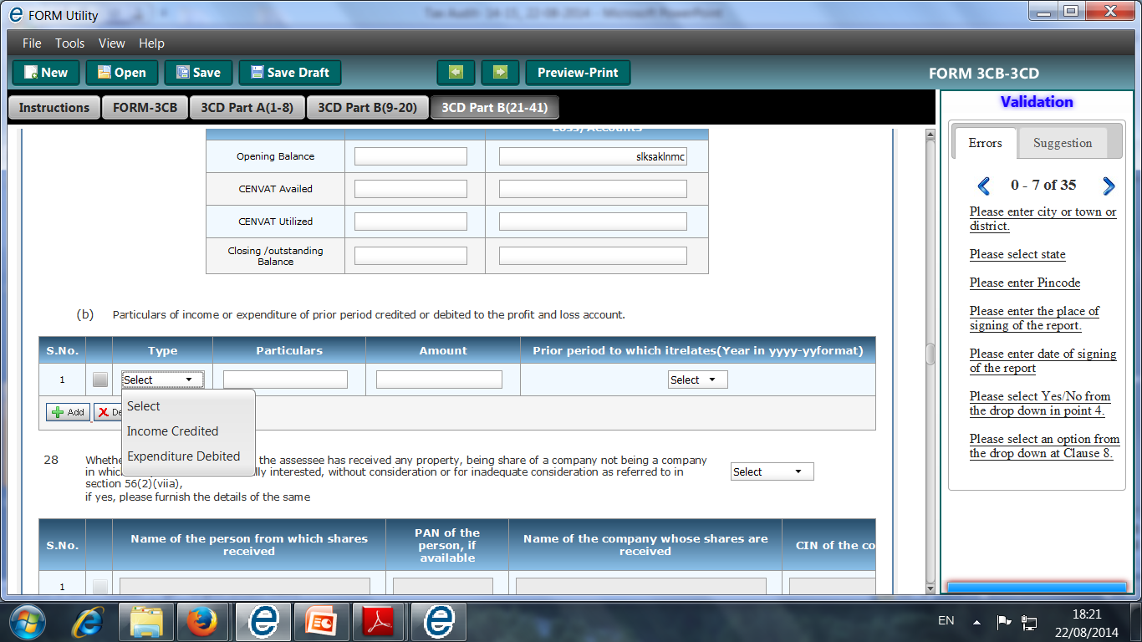
New Clause no. 27 [Old Clause No. 22]
Contd….
New Provision:
Particulars of income or expenditure of prior period credited or debited to the profit and loss account.

Slide 146
Issues on New Clause no. 27 [Old Clause no. 22]
Contd….
Clause (b) is applicable on the assessee following Mercantile System of Accounting.
U/s 145 - Material Charges (expense) or credit (income) which arise in the current year as a result of error or omission in the account of earlier years will be considered as prior period items. AS-5 issued by ICAI need to be considered for the purposes of this clause.
Assessee sustained loss due to theft in one year, but became finally irrecoverable in subsequent year. Held it was allowable in the year in which loss became irrecoverable. CIT vs Durga Jewelers 172 ITR 134 (M.P)
Expenditure of the earlier years means expenditure which arose or which accrued in any earlier year and excludes any expenditure of an earlier year for which the liability to pay has crystallized during the year. 3i Infotech Limited, Vs. The Assistant CIT [Bombay High Court] , WRIT PETITION No. 892 of 2010

Slide 147
New Clause no. 33 [Old Clause No. 26]
Old Provision:
Section-wise details of deductions, if any, admissible under Chapter VIA.
New Provision:
Section-wise details of deductions, if any, admissible under Chapter VIA or Chapter III (Section 10A, Section 10AA).
Section under which deduction is claimed | Amounts admissible as per the provision of the Income Tax Act, 1961 and fulfils the conditions, if any, specified under the relevant provisions of Income Tax Act, 1961 or Income Tax Rules,1962 or any other guidelines, circular, etc, issued in this behalf.
Brief: Deduction u/s 10A (Special provision in respect of newly established undertakings in free trade zone, etc.) and Section 10AA (Special provisions in respect of newly established Units in Special Economic Zones) also included and specified format provided .

Slide 148
New Clause no. 35 [Old Clause no. 28]
In the case of a trading concern, give quantitative details of principal items of goods traded:
Item name | Unit | opening stock | purchases during the previous year | sales during the previous year | Closing Stock | Shortage/excess, if any
* No change

Slide 149
New Clause no. 35 [Old Clause No. 28]
Contd….
Clause 35(b) [Old clause 28(b)]
Old Provision:
In the case of a manufacturing concern, give quantitative details of the principal items of raw material, finished products and by- products:
(A) Raw materials:
Item name | Unit | opening stock | purchases during the previous year | Consumption during the previous year
sales during the previous year | Closing Stock | *yield of finished products | *percentage of yield | *Shortage/ excess, if any
  *Information may be given to the extent available.

Slide 150
New Clause no. 35 [Old Clause No. 28]
Contd….
Clause 35(b) [Old clause 28(b)]
New Provision:
In the case of a manufacturing concern, give quantitative details of the principal items of raw material, finished products and by- products:
(A) Raw materials:
Item name | Unit name | opening stock | purchases during the previous year | Consumption during the previous year
sales during the previous year | Closing Stock | yield of finished products | percentage of yield | Shortage/ excess, if any
Brief: Earlier relaxation provided (in respect of yield of finished products, % of yield and Shortage/ excess, if any) to specify the Information to the extent available now removed.

Slide 151
New Clause no. 35 [Old Clause No. 28]
Contd….
(B) Finished Products:
By- Products:
Item name | Unit name | opening stock | purchases during the previous year | Quantity manufactured during the previous year
sales during the previous year | Closing Stock | Shortage/ excess, if any
Item name | Unit name | opening stock | purchases during the previous year | Consumption during the previous year
Should be Quantity manufactured during the year
sales during the previous year | Closing Stock | Shortage/ excess, if any

Slide 152
Issues on New Clause no. 35 [Old Clause No. 28]
Contd….
“Principal Items :- Items constitute more than 10% of the aggregate value of purchase, consumption or turnover.
The tax auditor should obtain certificates from the assessee in respect of the principal items of goods traded, the balance of the opening stock, purchases, sales and closing stock and the extent of shortage/ excess/damage and the reasons thereof.
As required by SA-501 “Audit Evidence - Additional Considerations for specific items”, the tax auditor (if he is issuing Form No. 3CB also) should attend the physical stock-taking conducted by the management if the inventories are material unless such attendance is impracticable due to matters such as nature and location of the inventory.

Slide 153
Issues on New Clause no. 35 [Old Clause No. 28]
Contd….
If the assessee is engaged in the manufacture of goods where the input of raw materials and the output of finished goods are recorded in different units of measurement, unless an alternative method is available to convert the end product into the same unit of measure as the inputs, the yield and shortage cannot be ascertained.
If the end product is a standard item and can be converted back and related to the input of the raw material in the same unit of measurement, it should be done to ascertain the shortage, yield etc. If it is not possible, the tax auditor should state the fact under this clause.
In case of companies, verify that these details tally with details given in annual accounts in the notes to accounts.

Slide 154
New Clause no. 36 [Old Clause No. 29]
Old Provision:
In the case of a domestic company, details of tax on distributed profits under section 115-O in the following form :—
total amount of distributed profits | total tax paid thereon | dates of payment | Amount

Slide 155
New Clause no. 36…… [Old Clause No. 29]
Contd….
New Provision:
In the case of a domestic company, details of tax on distributed profits under section 115-O in the following form:-
total amount of distributed profits | amount of reduction as referred to in sec. 115-O(1A)(i) | amount of reduction as referred to in sec. 115-O(1A)(ii) | total tax paid thereon | dates of payment | Amount
Brief: Provisions of Section 115O-(1A) incorporated in the format
Sec. 115O(1A)- Amount of dividend to be reduced by
(i) the amount of dividend, if any, received by the domestic company during the financial year, if such dividend is received from its subsidiary………
(ii) the amount of dividend, if any, paid to any person for, or on behalf of, the New Pension System Trust referred to in clause (44) of section 10

Slide 156
Issues on New Clause no. 36…… [Old Clause No. 29]
Contd….
Amendments by Finance Act, 2014
The dividend distribution tax is to be computed after grossing up of the Dividend distribution tax.
Now, where the amount of dividend paid or distributed by a company is Rs. 85, then DDT under the amended provision would be calculated as follows:
Dividend amount distributed = Rs. 85
Increase by Rs. 15 [i.e. (85*0.15)/(1-0.15)]
Increased amount = Rs. 100
DDT @ 15% of Rs. 100 = Rs. 15
Tax payable u/s 115-O is Rs. 15
Dividend distributed to shareholders = Rs. 85
[w.ef. 01-10-2014]

Slide 157
Issues on New Clause no. 36…… [Old Clause No. 29]
Contd….
Sec 115-O Tax on distributed profits of Domestic Companies. The special levy at the prescribed rate, on the amt of dividend declared, distributed or paid (interim or other wise) out of current Profits or accumulated Profits.
This tax shall be payable even if no Income tax is payable by such Company on its total Income.
“Dividend” means dividend under clause (22) of Sec 2 exclusive of sub clause (e) advance or loan out of accumulated profit or shareholders etc.
The Date of Payment should be verified from the Challans and Books of A/cs etc.
Tax u/s 115-O should be deposited within 15 days of date of declaration/ distribution or payment which ever is earlier.

Slide 158
New Clause no. 37 [Old Clause No. 30]
Old Provision:
Whether any Cost Audit was carried out, if yes, enclose a copy of the report of such audit [See section 139(9)].
New Provision:
Whether any cost audit was carried out, if yes, give the details, if any, of disqualification or disagreement on any matter/ item/ value/ quantity as may be reported/identified by the cost auditor.
Brief: Now Cost Audit reports need not be enclosed, only detail of disqualification and disagreement to be provided.

Slide 159
Issues on New Clause no. 37 [Old Clause No. 30]
Contd….
The Auditor need not express any opinion if such Audit is ordered and not conducted.
The Auditor state the fact if such Audit is not completed by the time of his Audit Report.
Make note of any material observation made in such Report.
Give information only for that Cost Audit Report which falls within the relevant Previous Year.

Slide 160
New Clause no. 38 [Old Clause No. 31]
Old Provision:
Whether any audit was conducted under the Central Excise Act, 1944, if yes, enclose a copy of the report of such audit.
New Provision:
Whether any audit was conducted under the Central Excise Act, 1944, if yes, give the details, if any, of disqualification or disagreement on any matter/item/value/quantity as may be reported /identified by the auditor.
Brief: Now Excise Audit reports need not be enclosed, only detail of disqualification and disagreement to be provided.

Slide 161
Issues on New Clause no. 38 [Old Clause No. 31]
Contd….
This clause does not require the tax auditor to verify or examine anything. All that it requires of the tax auditor is to specify (“yes” or “no”/“N.A.”) whether any audit was conducted under the Central Excise Act, 1944.
Tax auditor is not required to study the Central Excise audit report in detail. However, he should take note of any material observation made in such Central Excise audit report which may have relevance to the tax audit conducted by him.

Slide 162
New Clause 40 [Old Clause No. 32]
Old Provision:
Accounting ratios with calculations as follows :—
Gross profit/Turnover;(%)
Net profit/Turnover; (%)
Stock-in-trade/Turnover; (%)
Material consumed/Finished goods produced.

Slide 163
New Clause 40…… [Old Clause No. 32]
Contd….
New Provision:
Details regarding turnover, gross profit, etc., for the previous year and preceding previous year:
(The details required to be furnished for principal items of goods traded or manufactured or services rendered)
Serial number | Particulars | Previous year | Preceding previous year
1 | Total turnover of the assessee
2 | Gross profit/turnover
3 | Net profit/turnover
4 | Stock-in-trade/turnover
5 | Material consumed/ finished goods produced
Brief: Detail in respect of principal items to be provided. Detail for preceding year also to be provided

Slide 164
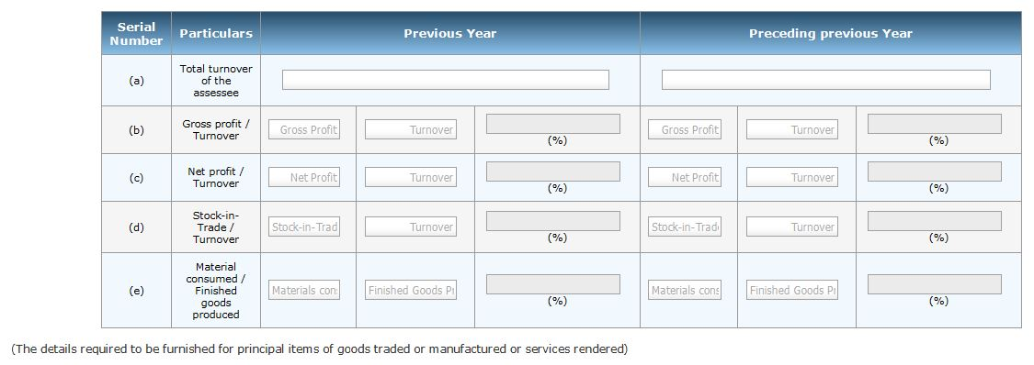
New Clause no. 40…… [Old Clause No. 32]
Contd….
Format in e-Utility

Slide 165
Issues on New Clause no. 40…… [Old Clause No. 32]
Contd….
Calculate ratios for manufacturing or trading concern in terms of value only.
Calculate Ratios for the business as a whole and not product wise.
If Closing stock is Nil, this sub clause (c) is not applicable.
Stock in trade include only closing stock of finished goods not stock of raw material & work in progress.
Overall G.P Ratio is enough if gross profit from each product is different.
Depreciation on Plant & Machinery considered for valuation of Finished goods [AS-2 (revised)]
Depreciation on P&M should be deduct to arrive at gross profit.
Exclude extraordinary items for calculation of ratios unless give material effect [AS 5, AS(IT) II].

Slide 166
Issues on New Clause no. 40…… [Old Clause No. 32]
Contd….
Take the value of Sales, Purchase & Inventories before the Statutory Adjustment (of Sec 145A).
In case of Share broker
Dealing for Commission – Calculate Net Profit Ratio
Business – Calculate Gross Profit Ratio
Case Law
N.C. Budharaja & Co, (1993) 204 ITR 412(SC)
In this Case Hon’ble Supreme Court decided that construction of tunnels, bridges, dams etc is only a Service activity and it cannot amount to manufacturing activity.

Slide 167
Notes to Form No. 3CD
Old Provision:
Annexure to this Form must be filled up failing which the Form will be considered as incomplete.
This Form and the Annexure have to be signed by the person competent to sign Form No.3CA or Form No.3CB, as the case may be.
New Provision:
This Form has to be signed by the person competent to sign Form No. 3CA or Form No. 3CB, as the case may be.
Brief: Annexures to Form 3CD removed

Slide 168
Specific Format provided
c.
New Clause No. | Old Clause No.
13 | 11
14 | 12

Slide 169
New Clause no. 13 [Old Clause No. 11]
Method of accounting employed in the previous year.
Whether there has been any change in the method of accounting employed vis-a-vis the method employed in the immediately preceding previous year.
Details of deviation, if any, in the method of accounting employed in the previous year form accounting standards prescribed u/s 145 and the effect thereof on the profit or loss.
If answer to (b) above is in the affirmative, give details of such change, and the effect thereof on the profit or loss.
Serial number | Particulars | Increase in profit (Rs.) | Decrease in profit (Rs.)
Specific Format provided

Slide 170
Issues on New Clause no. 13 [Old Clause No. 11]
Contd….
U/s 145 - The income chargeable under the head “PGBP” or “Income from other source” must be computed in accordance with either cash or mercantile system of accounting regularly employed by the assessee.
The hybrid system of accounting (i.e. mixture of cash and mercantile) is not permitted .
U/s 145(2)- Accounting Standard to be followed by all assessee following mercantile system of accounting .
The Central Government has notified two Accounting Standards [CBDT C. No. 9949 dated July 25, 1996]
Accounting Standard– I Disclosure of Accounting Policies
Accounting Standard– II Disclosure of “Prior Period and Extraordinary Items and changes in Accounting Policies

Slide 171
Issues on New Clause no. 13 [Old Clause No. 11]
Contd….
Amendment in Section 145 by Finance Act, 2014
U/s 145(2) reference to ‘Accounting Standards’ is changed with Income Computation and Disclosure Standards.
U/s 145(3) it is provided to reject the books of accounts for not regularly following the income computation and disclosure standards.
[w.e.f. 01.04.2015]

Slide 172
Issues on New Clause 13 [Old Clause 11]
Contd….
Change in accounting policy does not amount to change in method of accounting and thus need not be reported.
Change in method of valuation of stock is not a matter of change in method of accounting but only a change in accounting policy.
Where books maintained in respect of all items of income on accrual basis and interest income on seed money loan is accounted on cash basis- permitted vide N. No. GSR 770(E) dated 10-9-1990.
Clause (b) refer sec 145A in which the term “inventory” is used and according to AS-2 “inventory” includes finished goods, raw material , work-in-progress, maintenance supplies, consumables and loose tools.

Slide 173
New Clause no. 14 [Old Clause no. 12]
Method of valuation of Closing stock employed in the previous year.
In case of deviation from the method of valuation prescribed under section 145A, and the effect thereof on the profit or loss, please furnish:
Serial number | Particulars | Increase in profit (Rs.) | Decrease in profit (Rs.)
Specific Format provided

Slide 174
Issues on New Clause no. 14 [Old Clause no. 12]
Contd….
Adjustment of excise duty: The Liability for excise duty arise when the manufacture of goods is complete, a provision for unpaid liability of Excise duty on stock lying in the factory or bonded warehouse, need to be created. [Guidance Notes on Accounting treatment for Excise duty (in June 2000)] When closing stock is valued at Market Price (Being lower than cost) there is no need to add Excise duty
Adjustment of sales tax: In valuation of closing stock - no adjustment of Sales tax (as liability of sales tax arises at the time of sale).
  Adjustment of VAT: in case VAT is included in the purchase value, the same be adjusted in closing stock to neutralize the effect i.e the inventory of inputs is to be valued at net of the input tax which is refundable. If the inputs are obtained from the dealers who are exempt from the VAT, the actual cost of purchase should be considered as a part of cost of inventory.
  Section 145A is tax neutral as long as the assessee makes payment of the duty in accordance with the provisions of sec. 43B.

Slide 175
Notification No. 34 /2013 dt. 01/05/2013
Part II
Report of audit u/s 44AB shall be furnished electronically
Notification No. 34 /2013/ F.No.142/5/2013-TPL dated 1st May, 2013 provided that where an assessee is required to furnish a report of audit under sections 44AB, 92E or 115JB of the Act, he shall furnish the same electronically.

Slide 176
Procedure for e-filing
Procedure
CA to register as Tax Professional
Assessee will Add CA to his profile
Assessee will Approve the Form filed by CA
CA will upload Tax Audit Report

Slide 177
Overview of Provisions of Sec. 44AB

Slide 178
Who has to get accounts audited on compulsory basis ……….
Different taxpayers | When covered by the provisions of compulsory audit u/s 44AB
A person carrying on business (clause(a) of sec. 44AB) | If the total sales, turnover or gross receipt in business exceed or exceeds Rs. 1 crore in any previous year [limit raised from 60 lakhs w.e.f 1-4-2013 by F.A. 2012]
A person carrying on profession (clause(b) of sec.44AB) | If his gross receipts in profession exceed Rs.25 lakh in any previous year [(limit raised from 15 lakhs w.e.f 1-4-2013)

Slide 179
Contd….
Different taxpayers | When covered by the provisions of compulsory audit u/s 44AB
A person covered u/s 44AE, 44BB or 44BBB] (clause (c) of sec. 44AB) | If such person claims that the Profits and gains from the business are lower than the profits and gains computed under these sections (irrespective of his turnover).
A person covered u/s 44AD (clause (d) of sec. 44AB) [By Finance (No.2) Act, 2009 w.e.f. 01/04/2011] | If such person claims that the Profits and gains from the business are lower than the profits and gains computed under this section and his income exceeds the maximum amount not chargeable to income tax in any previous year.
Note: By F. A. (No.2),2009 w.e.f 1-4-2011, assessees covered by sec. 44AD & 44AF are not covered by clause (c) of sec. 44AB. Clause(d) is inserted to cover the assessees referred u/s 44AD.
Section 4AF has become inoperative w.e.f A.Y 2011-2012. The assessees earlier referred specifically u/s 44AF are now covered by section 44AD itself. As such clause(d) covers the assessees ref. earlier both u/s 44AD & 44AF.

Slide 180
Section 44AE…….
Amendment in Section 44AE in by Finance Act, 2014
Removed the distinction made in heavy goods carriage and other than heavy goods carriage and to provide a single amount of Rs. 7500/- to be considered as profit or gain from each goods carriage for every month or part of the month. Corresponding amendment made in Explanation in view of amendment in Sub-section (2). [w.e.f 01-04-2015]

Slide 181
Sub-section (6) of section 44AD
Inserted by the Finance Act, 2012, w.r.e.f. 1-4-2011
The provisions of section 44AD, notwithstanding anything contained in the foregoing provisions, shall not apply to—
a person carrying on profession as referred to in sec. 44AA(1);
a person earning income in the nature of commission or brokerage; or
a person carrying on any agency business.

Slide 182
Compulsory Audit of Accounts
Accounts of previous year to be audited by an accountant, before the specified date and furnish by that date, the report of such audit in the prescribed form duly signed and verified by such accountant and setting fourth such particulars as may be prescribed.
“Accountant”– as per Explanation to S.288 (2) [Explanation(i) to S.44AB]
“Specified date” – 30th day of September of A.Y. [Explanation(ii) to S.44AB]

Slide 183
Compulsory Audit of Accounts……
Contd….
Clause (b) will have no application to company or any other artificial person as a company or artificial person cannot carry on a profession.
For the purpose of attracting sec 44AB, receipts of an assessee by way of sale or trading business and receipts for doing job work can be clubbed to find out whether prescribed limit is exceeding or not. Bajrang Oil Mills v. ITO [2007] 163 Taxman 154 (Raj.)
Requirement of compulsory tax audit u/s 44AB is only in respect of business carried on by a person and not in respect of his income from other sources. Ghai Construction v. State of Maharashtra [2009] 184 Taxman 52 (Bom.)
Where the assessee is proprietor of more than one concern, aggregate of all the businesses to be taken into consideration for the purposes of compliance with the provisions of sec. 44AB. Asst. CIT & Anr. V. Dr. K. Satish Shetty [2009] 310 ITR 366 (Kar.)

Slide 184
Tax Auditor……...
A CA in part-time practice cannot be appointed as tax auditor u/s 44AB. [Para 9.4 of ICAI’s Guidance Note on Tax Audit.] 242nd meeting
An internal auditor of an assessee, whether working with the organisation or independently practising chartered accountant or a firm of chartered accountants, cannot be appointed as tax auditor. (as per the guidelines of the council dated 12-12-2008.)

Slide 185
Liability of Tax Audit……
There is no liability of tax audit if the assessee is not covered u/s 44AB.
If income of an assessee is below the taxable limit, he will also be liable to get his account audited, if the turnover in business exceeds the threshold limit.
Section 44AB not applicable to assessee covered u/s 44B and 44BBA.
Section 44AB is applicable to NRI also.

Slide 186
Applicability of Sec. 44AB- where income is exempt u/s 10
Provisions of sec 44AB not applicable to mutual fund whose income is exempt u/s 10(23D) even though his turnover or gross receipts or sales may have exceeded. Asstt. CIT v. India Magnum Fund [2002] 81 ITD 295 (Mum.- ITAT )
The provisions of S.44AB were not applicable where income of assessee was exempt u/s 10(20) and the assessee had no income which would fall under heading ‘PGBP’. CIT vs Market Committee, Sirsa [2012] 210 Taxman 20 (P&H)
However, ICAI has taken a contrary view in its Guidance Note on Tax Audit on the grounds that neither section 44AB nor any other provisions of the Act exempt an assessee from tax audit if his total income is exempt from tax. [ICAI’s Guidance Note on Tax Audit].
Notes:
The threshold limit

Slide 187
Applicability of sec 44AB to Agriculturist….
Agriculturist who does not have any income under the head “Profits and gains of business or profession” and whose sale of agricultural products exceeds prescribed limit, Such a person need not get accounts audited u/s 44AB. [ICAI’s views in Guidance Note of Tax Audit]

Slide 188
Applicability of sec 44AB to Political Parties….
Board are of the view that the income of the political parties are governed by the special provisions i.e. section 13A of the I.T Act, 1961, and accordingly the provisions of Chapter IVD which are applicable for profits and gains of business or profession cannot be applied in the cases of political parties. Income of political parties from voluntary contributions cannot be said to be income from profession so as to attract sections 44AB or 271B of the Income tax Act. [Instruction No : 1988, [F. No. 225/128/99-ITA-II(Pt.)dt.19.10.2000]

Slide 189
Issues - Applicability of section 44AB….
Provision of Se. 44AB are not applicable where assessee is engaged in promoting and developing game of hockey in the country and does not involve any business activity and Source of income is grant from Government. ITO v. Indian Hockey Federation [2011] 009 ITR (Tri.) 692, ITAT - Delhi

Slide 190
Gross Receipts…..
“Gross Receipts” is not defined in the Income Tax Act
Includes all the receipts in cash or kind, Arising from carrying on business or profession, Which is assessable as business/profession income under the Act.
the gross receipts of business and profession should not be clubbed to determine whether the limit prescribed in section 44AB(a) is exceeded or not.
U/s 145(1) “Sales”, “Turnover” or ”Gross Receipts”- compute either on cash or mercantile system.
“Sales Turnover” The aggregate amount for which sales are effected or services rendered by an enterprise. The ‘gross turnover’ & ‘net turnover’ (or ‘gross sales’ and ‘net sales’) are sometimes used to distinguish the sales aggregate before and after deduction of sales returns and trade discounts.”

Slide 191
Gross Receipts…..
Contd….
In case of Share brokers
  Transaction entered on his personal a/c also included in the sale value for purpose of Sec 44AB.
  Sub-broker is not different from a share broker.
  Turnover or Gross receipts - In case of shares, securities & derivatives
  Speculative Transaction:- Positive or negative difference amount arises on settlement of contracts is to be considered as Turnover.
  Difference of total favorable & unfavorable
    Premium received on sale of option
    Difference of any reverse trade entered
  Delivery based Transactions:- Total value of sales.

Slide 192
Gross Receipts…..
Contd….
  For an Agent, turnover is the commission earned by him and not the aggregate amount for which sales are effected or services are rendered. [ICAI’s Guidance Note on Tax Audit ]
  In case of Chit Fund Companies, subscriptions are not to be treated as ‘income’ or ‘turnover’ for tax audit purposes. Dy. CIT v. Mangal Dayal Chit Fund (P.) Ltd.[2005] 92 ITD 258 (Hyd.)
  In the case of construction business, Advance received for booking of flats is to be included in words ‘gross receipts’ as the same is to be adjusted towards cost of construction and has element of profit. Dy. CIT vs Gopal Krishan Builders [2004] 91 ITD 124 (Lucknow-ITAT)(SMC)
Notes:
Sales of scrap shown under ‘miscellaneous income’ should be included in ‘turnover’. [ICAI’s Guidance Note on Tax Audit].

Slide 193
Remaining Clauses of Form 3CD
[Not amended by Notification No. 33/2014 dated 25th July, 2014]

Slide 194
PART – A
Contd….
New Clause No. | Old Clause No. | Particulars
1 | 1 | Name
2 | 2 | Address
3 | 3 | Permanent Account Number
5 | 5 | Status
7 | 6 | Assessment year

Slide 195
Issues on New Clause no. 1,2, 5, 7
If assessee is proprietor give his/her name along with all Proprietary Firm’s name.
If there is any change in address as per income tax records, the same must be given.
‘Status’ means status as per Sec. 2 (31) of I-T Act & not ‘residential status’ [Sec 2(31) – “Person” includes an Individual, HUF, Firm etc.]
Assessment year according to the relevant Previous Year.

Slide 196
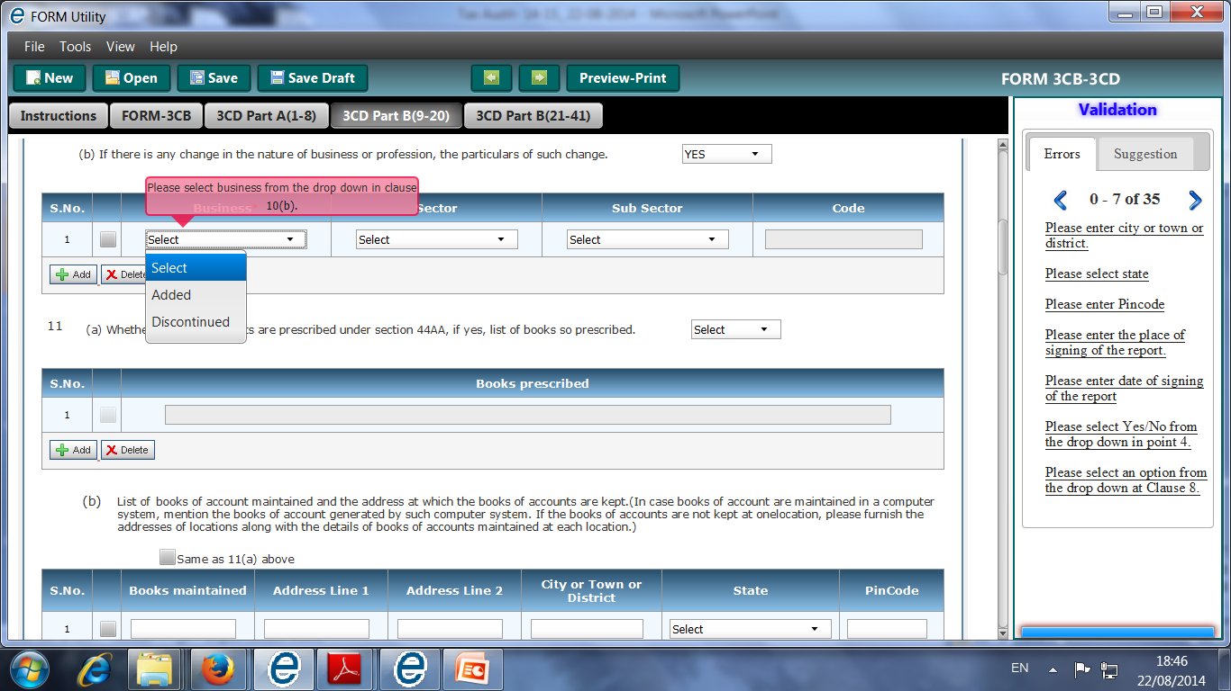
PART B-New Clause no. 10 [Old Clause no. 8]
Nature of business or profession.
If there is any change in the nature of business or profession, the particulars of such change.
Sector | Subsector | code
Business | Sector | Subsector | code

Slide 197
Issues on New Clause no. 10 [Old Clause no. 8]
Permanent discontinuance of a particular product line of business need to be reported not temporary suspension.
Effect on Carry forward of losses :- from A.Y. 2000-01 losses will be carried forward, even if the business or profession is discontinued (Sec 72(1)(i))

Slide 198
New Clause no. 15 [Old Clause no. 12(A)]
Give the following particulars of the capital asset converted into stock-in-trade
Description of capital asset | Date of acquisition | Cost of acquisition | Amount at which the asset is converted into stock-in- trade

Slide 199
Issues on New Clause no. 15 [Old Clause no. 12(A)]
Such conversion is treated as transfer u/s 2(47)
U/s 45(2) notional capital gain arise from such transfer and chargeable to tax in the year in which such stock-in-trade is sold.
No requirement of details of taxability of capital gain or business income from such deemed transfer.
Accounting standards to be followed:
  AS-2 for valuation of stock-in-trade
  AS-10 for valuation of fixed assets.
  AS-22 for provision of Income Tax as temporary timing difference.
Sec 47 & 47A also to be kept in mind.

Slide 200
Issues on New Clause no. 15 [Old Clause no. 12(A)]
Contd….
Cost of capital asset in case of:
  Purchase – From invoice, Books etc
  Self – constructed – directly related cost
  Acquired in exchange – FMV or Net Book value of asset given up
  Acquired by way of inheritance – In this case if no evidence exist – Auditor should rely upon the report of the experts such as valuers.

Slide 201
Issues on New Clause no. 15 [Old Clause no. 12(A)]
Contd….
Para 9.1 of the Accounting Standard (AS) 10, issued by the ICAI, provides that the cost of the fixed assets should include the non- refundable taxes or levies. Since the VAT is in the nature of a refundable tax, it cannot be included in the cost of the capital goods.
Information under Clause 12A should be necessary not only in the year of conversion but also in the year of sale of relevant stock in trade. Since sec. 45(2) provides only for the computation of capital gain in the year of conversion but the due date of payment of tax is in the year of sale of such converted stock-in-trade.

Slide 202
New Clause no. 16 [Old Clause no. 13]
Amounts not credited to the profit and loss account, being,—
the items falling within the scope of section 28.
the Performa credits, drawbacks, refund of duty of customs or excise or refund of sales tax, where such credits, drawbacks or refunds are admitted as due by the authorities concerned.
Escalation claims accepted during the previous year;
any other item of income;
Capital receipt, if any.
In following format
Description | Amount

Slide 203
Issues on New Clause no. 16 [Old Clause no. 13]
Under Sub clause(b) –
  Any capital receipt adjusted in actual cost for calculation of depreciation allowable reported here & under clause 18 d (ii) also.
  “Capital receipts” for this clause not cover share capital or item of gift etc.
Only claims accepted during the previous year are required to be reported under clause 13(d).
Mere claims under negotiations cannot constitute accepted claims. CIT v. Hindustan Housing and Land Development Trust Ltd. [1986] 161 ITR 524 (SC)
Income is defined u/s 2(24)
  Report all the items of income ascertain from the books of a/cs available to the tax auditor but state such income excludable u/s 10 (if any).
  The Tax auditor shall be governed by AS-9 relating to revenue recognition.

Slide 204
New Clause no. 22 [Old Clause no. 17A]
Amount of interest inadmissible under section 23 of Micro Small and Medium Enterprises Development Act, 2006.
Insertion by the IT (Tenth Amdt.) Rules,2009, w.e.f 13-04-2009.
This will have to be reported upon in all tax audit reports signed on or after 13-4-2009 irrespective of the assessment year to which the report pertains

Slide 205
Provisions of Micro Small and Medium Enterprises Development Act, 2006
Section 23 of MSME Act, provides that:
“Notwithstanding anything contained in the Income-tax Act, 1961, the amount of Interest payable or paid by any buyer, under or In accordance with the provisions of this Act, shall not, for the purposes of computation of income under the Income-tax Act, 1961, be allowed as deduction.”
Note: The inadmissible interest has to be determined on the basis of the provisions of the MSMED Act, 2006.

Slide 206
Provisions of MSME Act………..
Section 16 of MSME Act,
Where any buyer fails to make payment of the amount to the supplier, as required under section 15, the buyer shall, be liable to pay compound interest with monthly rests to the supplier on that amount from the appointed day or, as the case may be, from the date immediately following the date agreed upon, at three times of the bank rate notified by the Reserve Bank.
Section 15 of the MSME Act requires
the buyer to make payment on or before the date agreed upon in writing, or where there is no agreement in this behalf, before the appointed day. It also provides that the period agreed upon in writing shall not exceed forty five days from the day of acceptance or the day of deemed acceptance.

Slide 207
Issues on New Clause no. 22 [Old Clause no. 17A]
The tax auditor needs to report the amount of interest inadmissible under section 23 of the MSMED Act, 2006 irrespective of whether the amount of such interest has been debited to profit and loss account or not. In case the auditee has adopted mercantile system of accounting, the non-provision may affect true and fair view and the auditor should give suitable qualification.
The tax auditor should verify that TDS under section 194A is deducted from interest credited/paid to MSEs and deposited with Central Government. [Clause 34 of Form No.3CD]

Slide 208
Issues on New Clause no. 22 [Old Clause no. 17A]
Contd….
Where the tax auditor is issuing his report in Form No. 3CB, he should verify that the financial statements audited by him contain the information as prescribed u/s 22 of the MSME Act.
If no disclosure is made by the auditee in the financial statements he should give an appropriate qualification in Form No.3CB, in addition to the reporting requirement in clause 22 of Form No. 3CD.

Slide 209
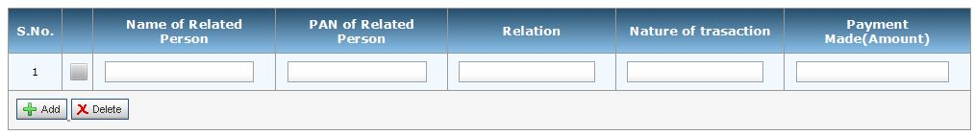
New Clause no. 23 [Old Clause no. 18]
Particulars of any payment made to persons specified under section 40A(2)(b).
Notes:
Sec 33AB - Tea Development Account.
Sec 33ABA - Site Restoration Fund
Sec 33AC – Reserve for Shipping Business.
[No deduction is allowed under this section w.e.f. A.Y 2005-06]
Amount withdrawn from such deposit account for other than the specified purposes is to be deemed income chargeable to tax.

Slide 210
Issues on New Clause no. 23 [Old Clause no. 18]
Any Payment made by AOP to its member for supply of goods should be reported.
“Specific Person” means relative, partners, members, directors or person having substantial interest.
A person will be deemed to have a substantial interest in a business or profession if, (in case of a company) the person is beneficially owning the shares (other than the preference shares), carrying not less than 20% of the voting power and in any other case, person is entitled to not less than 20% of the profits of business or profession.

Slide 211
Issues on New Clause no. 23 [Old Clause no. 18]
Contd….
Tax auditor should obtain, from assessee, the list of specified persons and expenditure/payment made to them and then scrutinize the items with reference to sec. 40A(2).
If information is not available about specified persons with the client, suitable disclaimer may be given.
Sec 40A(2) – Payment to Specific Persons & AO is of the opinion that such payments is excessive or unreasonable. Then disallow the excessive or unreasonable amount.
Amounts to be reported whether or not debited to profit and loss account.
The item does not require report of the auditor as to his own inference, whether the payment is excessive or unreasonable. He is required to specify the amounts paid to such related persons.

Slide 212
Issues on New Clause no. 23 [Old Clause no. 18]
Contd….
In case of a large Assessee, it may not be possible to verify the list of all persons covered by this section. Therefore, the information supplied by the assessee can be relied upon.
Circular No. 143, dated 20-8-1974, issued by the Board, clarifies that tax auditor can rely upon the list of persons covered u/s 13(3) as given by the managing trustee of a Public Trust.
The same analogy may be extended to this case. Where the tax auditor relies upon the information in this regard furnished to him by the assessee it would be advisable to make an appropriate disclosure.

Slide 213
Case Laws on New Clause no. 23 [Old Clause no. 18]
Dy Cit v Joshi Formulabs (p) Ltd (2000) 67 TTJ 396 (Rajkot)
A fully vouched and genuine expenditure cannot be disallowed u/s 40A(2)(b) even if made to sister concern.
Khan Carpets v CIT (2003) ITR 325 (All)
Only when there was disproportionate increase in salary without showing exceptional circumstances for it, that the increase in salary could be disallowed.

Slide 214
New Clause no. 25 [Old Clause no. 20]
Any amount of profit chargeable to tax under section 41 and computation thereof.
Name of party | Amount of income | Section | Description of transaction | Computation, if any

Slide 215
Issues on New Clause no. 25 [Old Clause no. 20]
Loss of the Previous year in which Business ceased to exists can be set off from the above deemed Profit u/s 41.
State Profit chargeable to Tax under this Clause, irrespective the relevant amount credited to P&L A/c or not.
Any amount already credited in P&L A/c is to be reported in this clause.
Computation of chargeable Profit be also reported in this clause.
Notes:
Section 41
Sec 41(1) - Recovery against any deduction.
(a) Recovery by the same Assessee.
(b) Recovery by the successor in Business or Profession.
Sec 41(2) - Balancing charge in the case of Power units.
Sec 41(3) - Sale of Capital Asset used for Scientific research
Sec 41(4) - Recovery of Bad debts allowed as deduction
Sec 41(4A) - Amount withdrawn from Special Reserve created & maintained u/s 36(1)(viii).
Sec 41(5) – Adjustment of loss (discontinued business)

Slide 216
New Clause no. 26 [Old Clause no. 21]
In respect of any sum referred to in clause (a), (b), (c), (d), (e) or (f) of section 43B, the liability for which :-
pre-existed on the first day of the previous year but was not allowed in the assessment of any preceding previous year and was
  paid during the previous year;
  not paid during the previous year
Nature of Liability | Amount
Nature of liability | Amount

Slide 217
New Clause no. 26 [Old Clause no. 21]
Contd….
was incurred in the previous year and was
paid on or before the due date for furnishing the return of income of the previous year under section 139(1);
not paid on or before the aforesaid date
(State whether sales-tax, customs duty, excise duty or any other indirect tax, levy, cess, impost, etc. is passed through the profit & loss account.)
Nature of Liability | Amount
Nature of liability | Amount

Slide 218
Issues on New Clause no. 26 [Old Clause no. 21]
Contd….
Explanation 3C & 3D to Sec 43B - Any unpaid interest or interest unpaid converted into Loan or Borrowing or Advance allowed as deduction only when actually paid. (Circular No. 7/2006 dated 17th July).
No deduction in case of waiver of interest as it is not representing actual payment.
If an assessee made Advance Payment of Excise duty without liability, no deduction shall be given on account of Sec. 43B.
Case Law: Gopikrishna Gramites Vs DCIT 251 ITR 337 (A.P), Hindustan Liver Ltd Vs K.K Pandey JCIT, 251 ITR 209(Bomb)

Slide 219
Issues on New Clause no. 26 [Old Clause no. 21]
Contd….
The provision made in the accounts for excise duty payable on the closing stock of finished goods should also be disclosed against sub-clause (i). The tax auditor should verify that the said goods have been cleared and the excise duty has been paid or adjusted against the Cenvat credit on or before the due date for filing return of income. [ICAI’s Guidance Note on Tax Audit]
If the assessee is following mercantile system of accounting, then only this clause is relevant. If assessee is following cash system of accounting, then tax auditor should write “Not applicable since cash system followed by the assessee” against this clause.

Slide 220
Issues on New Clause no. 26 [Old Clause no. 21]
Contd….
[2010] 228 CTR 72 (CAL.) Peerless General Finance & Investment Co. Ltd.v. CIT- Information contained in tax audit report does not enable Assessing Officer to make any prima facie adjustments under section 143(1)(a) with reference to provisions of sec. 43B.
CIT Vs S.P. Foundry 185 ITR 555 (All)
In certain cases Sales Tax collected are credited to separate A/c and does not form part of trading receipt, the amount is not charged in P&L A/c. Whether Sec 43B is attracted?
Judgment – The particulars should be reported whether have been debited to P&L A/c or not

Slide 221
Issues on New Clause no. 26 [Old Clause no. 21]
Contd….
CIT vs. Maruti Udyog Ltd [2010] 186 TAXMAN 407 (SC) (ruling of DHC in 92 ITD 119 reversed)- Whether question as to whether unutilized Modvat credit of earlier years adjusted in assessment year-in-question should be treated as actual payment of excise duty u/s 43B is a question of law - Held, yes
Vinir Engineering (P.) Ltd v. DCIT [2010] 186 TAXMAN 72 (KAR.)
Whether rescheduling of interest payable to financial institution by means of fresh loan can be treated as interest payment deductible under section 43B - Held, yes

Slide 222
Issues on New Clause no. 26 [Old Clause no. 21]
Contd….
In CIT v. Udaipur Distiller Co. Ltd. [2009] 180 Taxman 539 (SC), CIT v. McDowell & Co. Ltd. [2009]180 Taxman 528, 526, 524, 521, 514 (SC), it was held that bottling fees payable for acquiring a right of bottling of IMFL, which is determined under Excise Act and Rules, is neither fee nor tax, but is consideration for grant of approval by Government in respect of exclusive right to deal in bottling of liquor in all its manifestations. Therefore, bottling fee payable under Excise Law for acquiring a right of bottling of IMFL does not fall within purview of section 43B.

Slide 223
New Clause no. 30 [Old Clause no. 23]
Details of any amount borrowed on hundi or any amount due thereon (including interest on the amount borrowed) repaid, otherwise than through an account payee cheque [Section 69D].
S. No. | Name of the person from whom amount borrowed or repaid on hundi | PAN of the person, if available | Address with State & Pin code | Amount Borrowed | Date of Borrowing | Amount due including interest | Amount Repaid | Date of Repayment

Slide 224
New Clause no. 32(a),(b) [Old Clause no. 25(a), (b)]
    Details of brought forward loss or depreciation allowance, in the following manner, to the extent available:
    whether a change in shareholding of the company has taken place in the previous year due to which the losses incurred prior to the previous year cannot be allowed to be carried forward in terms of section 79.
S. No | Assessment Year | Nature of loss/ allowance | Amount as returned | Amount as assessed | Order number & Date | Remarks

Slide 225
Important Points…..
While signing the form, following should be kept in view:
judicial pronouncements may be relied upon in the matter of inclusion or exclusion of any items in the particulars to be furnished under any of the clauses of the statement.
In case of conflict of judicial opinion on any particular issue, view which has been followed may be referred to while giving the particulars under any specified clause.
General accounting principles/guidelines by ICAI/ICWAI should be followed.
Relevant changes in law relating to items to be reported on.
Since auditor is to report the particulars as true and correct, he should obtain from the assessee the statement of particulars duly authenticated by him.

Slide 226
Penalty for failure to get accounts Audited- Sec. 271B
If the assessee fails to get his accounts audited u/s 44AB,
a flat penalty u/s 271B shall be attracted.
½ of total Sales, turnover or gross receipts
Or
Sum of Rs. 150,000 (w.e.f.1-4-2011) (prior to that max. penalty was Rs. 1Lac)
(Whichever is less)
U/s 271B No penalty shall be imposed, if assessee proves that there was reasonable cause for such failure.
The penalty order u/s 271B is appealable in view of s.246A(1)(m)

Slide 227
Reasonable Causes
Reasonable Cause
Resignation of tax auditor and consequent delay;
Bona fide interpretation of the ‘turnover’ based on expert advice;
Death or physical inability of the partner in charge of the account
Labour problems such as strike, lock-out for a long period, etc;
Loss of accounts because of fire, theft, etc., beyond the control of the assessee;
Non-availability of accounts on account of seized;
Natural calamities, commotion, etc.

Slide 228
Penalty for failure to get accounts Audited- Sec. 271B…….
Contd….
No penalty under section 271B by ITO exceeding Rs. 10,000 in absence of prior approval of Joint Commissioner. Sagar Dutta Vs. CIT, ITA No. 150 of 2009, Date of Order: 17.02.2014, High Court of Calcutta
Held that no penalty is imposable u/s 271B for non-compliance with the provisions of sec. 44AB on the ground that the returns were filed belatedly. Penalty is leviable only if the assessee fails to get his accounts audited and obtain a report. CIT v. Apex Laboratories Pvt. Ltd. [2010] 320 ITR 498 (Mad)
For purpose of sec. 44AB turnover of all businesses carried on by assessee has to be considered but provisions of sec. 271B will be pressed in operation in respect of failure only and not in respect of accounts which have been audited; penalty cannot be imposed in respect of business when its books of account have been audited and filed on or before due date specified in Act. Asst. CIT v.Smt. Bharti Sharma [2011] 44 SOT 230 (Del.)

Slide 229
Penalty u/s 277 A - Falsification of books of accounts or documents etc.
The Finance (No.2) Act, 2004 has inserted section 277 A w.e.f 1-10-2004. According to this section, any person shall be punishable with rigorous imprisonment, which may extend form 3 months to 3 years and shall be liable to fine if the following conditions are satisfied;
He willfully and with intent to enable any other person (assessee) to evade any tax or interest or penalty chargeable and imposable under the Income Tax Act.
He makes or causes to be made, any entry or statement in any books or other documents relevant for any proceeding under the Act which is false
He knows it to be false or dose not believe it to be true. However, it shall not be necessary to prove that assessee has actually evaded any tax, penalty or interest chargeable or imposable under the Act.

Slide 230
Faulty tax audit report
The CBDT have issued instructions with immediate effect to the field officers to report any professional negligence on the part of the Chartered Accountants in preparing the tax audit report to the ICAI in terms of section 288, as the ICAI is entitled to institute proceedings against its member chartered accountants who submit faulty tax audit reports.
PIB Press Release, New Delhi, dated 10-12-1999.

Slide 231
Relevant Instructions
Proper utilization of information contained in the audit report submitted u/s 44AB of the I.T. Act, 1961.
The instruction specifies the steps to be followed by the AO on receipt of Tax Audit Report.
Instruction No. 1976,Date of Issue : 3.11.1999

Slide 232
Thank You!…
Presented By: CA. Sanjay Agarwal
Assisted By: CA Apoorva Bhardwaj & CA Jyoti Kaur
Email id: agarwal.s.ca@gmail.com

