Slide 1
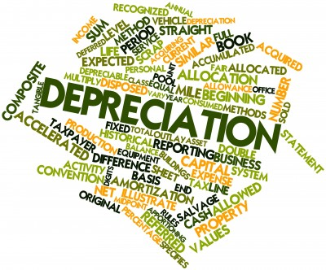
Accounting Standard-6
DEPRECIATION ACCOUNTING
Presented by:
Subodh Jain
S H R & Co.

Slide 2
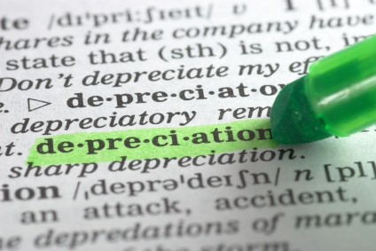
Concept of Depreciation
Depreciation is a measure of the wearing out, consumption or other loss of value of a depreciable asset arising from:
Use ;
Passage of time ;
obsolescence through technology and market changes.

Slide 3
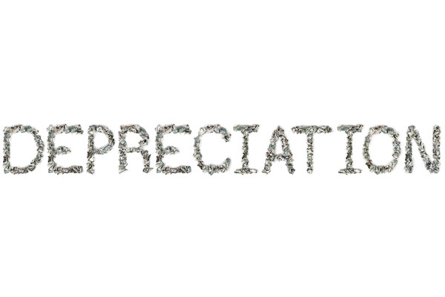
Depreciable Assets
Depreciable assets are assets which
are expected to be used during more than one accounting period; and
have a limited useful life; and
are held by an enterprise for use in the production or supply or for administrative purposes.

Slide 4

Applicability
This accounting standard is not applied on the following items.
Forests and plantations
Wasting assets
Research and development expenditure
Goodwill
Live stock.

Slide 5
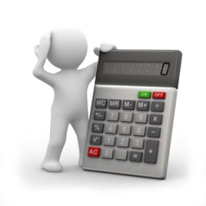
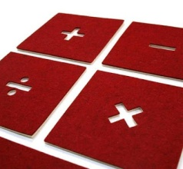
Calculation of Depreciation
The amount of depreciation is calculated as under:
Historical Cost
Estimated useful life of depreciable asset
Estimated residual/scrap value of depreciable assets
*Depreciation = Cost – (Scrap Value at the end of useful life)
Estimated useful life in no. of years
*If Straight Line method of Depreciation is followed

Slide 6
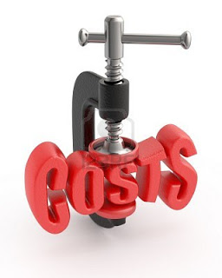
What is the cost of Depreciable Assets?
It is total cost spent in connection with its acquisition, installation and commissioning as well as for additional item or improvement of the depreciable assets. The cost may change due to following factors:
increase or decrease in the long term liability on account of exchange fluctuations
price adjustments
changes in duties
revaluation of depreciable assets
other similar reason

Slide 7

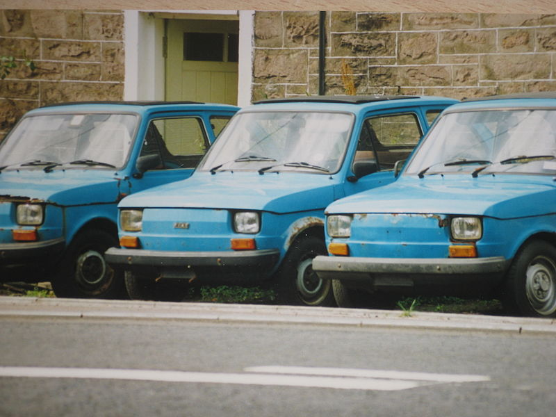
Useful Life of an Asset
Useful life is the period over which a depreciable asset is expected to be used by the enterprise.
The useful life of a depreciable asset is shorter than its physical life.
The useful life depends upon the following factors:
Pre-determined by legal or contractual limits;
Depends upon the number of shifts for which the asset is to be used;
Legal or other restrictions; etc.

Slide 8
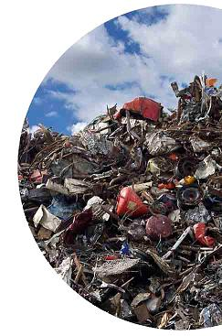
Estimated residual/scrap value of depreciable asset
It is estimated value of depreciable assets at the end of its useful life.
It is estimated at the time of acquisition, installation and at the time of at the time of revaluation of the assets.

Slide 9
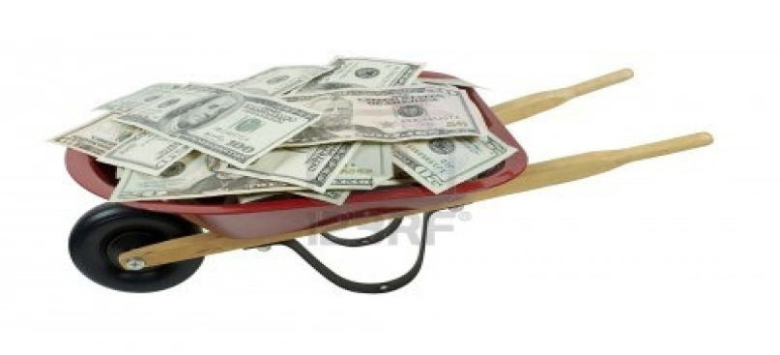
Depreciable Amount
Depreciable amount of a depreciable asset is its historical cost, or other amount substituted for historical cost less the estimated residual value.
The Depreciable amount of a depreciable asset should be allocated on a systematic basis to each accounting period during the useful life of asset.

Slide 10

Method of Charging of Depreciation
There are two method of depreciation:
Straight Line Method (SLM)
Written Down Value Method (WDVM)

Slide 11

Selection of Appropriate Method
It depends upon the following factors:
Type of Asset
Nature of the use of such of asset
Circumstances prevailing in the business.
Accounting Treatment:
Selected depreciation method should be applied consistently from period to period

Slide 12

Change in Depreciation Method
The change in method of depreciation should be made only if:
The adoption of the new method is required by statute; or
For compliance with an accounting standard; or
If it is considered that change would result in a more appropriate preparation of financial statement;

Slide 13

Procedure to be followed in case of change in method
When there is change in method of depreciation, depreciation should be recalculated in accordance with the new method from the date of the assets coming into use. (i.e. RETROSPECTIVELY)
The deficiency or surplus arising from such recomputation should be adjusted in the year of change through profit and loss account.
Such change should be treated as a change in accounting policy and its effect should be quantified and disclosed.

Slide 14

Change in Estimated Useful Life
When there is change in estimated useful of assets, outstanding depreciable amount on the date of change in estimated useful life of asset should be allocated over the revised remaining useful life of asset.

Slide 15

Depreciation charge on addition/extension to an existing asset
Addition/extension is an integral part of existing asset.
It is depreciated over the remaining useful life if the existing asset.
Addition/extension is not an integral part of existing asset.
It is depreciated over the estimated useful life of additional assets

Slide 16

When the depreciable asset is disposed of, discarded, demolished or destroyed.
Net surplus or deficiency (i.e. sale proceeds less written down value) is credited to profit or loss accounts.

Slide 17

Disclosure requirements
the historical cost
total depreciation for each class charged during the period
the related accumulated depreciation
depreciation method used ( Accounting policy)
depreciation rates if they are different from those prescribed by the statute governing the enterprise.

