Slide 1

VALUATION UNDER CENTRAL EXCISE
Indirect tax department

Slide 2
COVERAGE
Significance
Basis of Computing duty payable
Central Excise Valuation Rules, 2000

Slide 3
SIGNIFICANCE OF VALUATION
Payable on different criterion
Determine:-
1) Excisable??
2)Classification
3)Valuation
4)Duty payable

Slide 4
BASIS OF COMPUTING DUTY PAYABLE
Specific Duty
Duty based on Value
i)On Tariff value (Section 3(2) of C.E. Act,1932)
ii)Valuation u/s 4
iii) MRP based valuation (Section 4A of C.E. Act)
3) Compounded Levy Scheme (Rule 15 of C.E. Rules,2002)
4)Based on Capacity of Production (Section 3A)

Slide 5
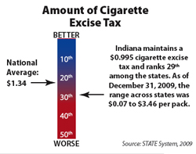
SPECIFIC DUTY
Duty payable based on certain units like
  i)Length
  ii)Weight
  iii)Volume, etc.
Example- Cigarettes
Demands frequent revision-Increase revenue

Slide 6
Chart Showing scheme of Ad Valorem
Valuation under Central Excise
Are tariff values being fixed under Section 3(2)?
Valuation under Section 3(2)
Yes
No
Are the goods notified for valuation with reference to RSP and notified for MRP based levy under Excise Law?
Valuation under Section 4A
Yes
No
Valuation under Section 4

Slide 7
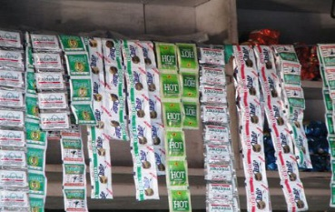
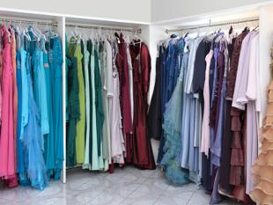
DUTY BASED ON VALUE( AD VALOREM)
As a percentage of Tariff Value fixed by the govt.:-
Govt. notifies
Easy
Two products- Pan Masala & Readymade garments
Can be altered
Diff. values-diff. classes
Diff. values-same class-mfg. by diff. classes/sold to diff. class of buyers
May be fixed on the basis of wholesale or average price.

Slide 8
Contd…..
2)As percentage of AV (Section 4)
Prior to 1st July, 2000- ‘Normal Price’ Principle
After 1st July,2000-Concept of Transaction Value

Slide 9
Contd….
Duty chargeable with reference to value, then on each removal value shall be:-
In case goods sold, for delivery at the time and place of removal-not related-price is sole consideration-TV
In any other case, including where goods not sold, value to be determined as prescribed

Slide 10
Scheme of Valuation under Section 4
Duty Chargeable with reference to value
Goods not sold or any of the four conditions is not fulfilled- Central Excise Valuation (DPEG) Rules, 2000
Where the value at which goods are sold by assessee to be the TV
Delivery at the time or removal
Delivery at the place of removal
Buyer not being Related Person
Price is the sole consideration

Slide 11
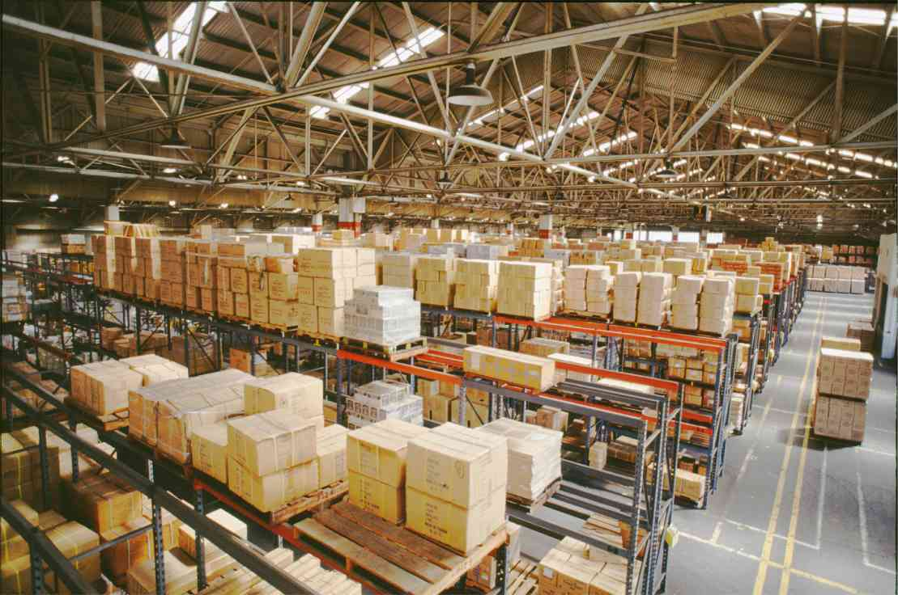

Place of Removal
Factory or other premises where goods permitted without payment of duty
Warehouse
Depot, Premises of a consignment agent

Slide 12
Related
Persons deemed to be related if:-
1)Inter connected undertakings
2)Relatives
3)Amongst them the buyer is a relative and a distributor of the assessee or sub distributor
4)Have interest directly or indirectly in each others’ business

Slide 13
Price is the sole Consideration
Any consideration in cash or kind- convert in monetary terms and add to the price
Transaction at Arm’s length
Principal to Principal basis- If not then charges paid to be added to the TV of goods

Slide 14
Ingredients of Transaction Value
Transaction Value means the price actually paid or payable when sold
And includes
In addition to the price any amount that the buyer is liable to pay to or on behalf of the assessee by reason of or in connection with the sale whether payable at the time of sale or any time thereafter

Slide 15
Contd….
“Including but not limited to”- more may be includible
Items included:-
-Advertising & Publicity
-Marketing & Selling
-Storage
-Outward Handling
-Servicing
-Warranty
-Commission
-Any other
Excise Duty/Sales tax not includible

Slide 16
Includibility of Certain Items
ITEMS OF COST | INCLUDIBILTY OR OTHERWISE
Discounts (Trade & Cash) | No. (Already factored into the definition of TV)- CBEC Circular No. 354/81/2000. – Discount to be actually passed on
Erection, Installation & Commissioning | No. Not to be included in the AV if the product is not excisable
Packing | Yes. The durable and returnable packing is deductible
Taxes & Duties | No.
Interest on deposits,advances | No.
Accessories | No. (Shriram Bearing Ltd Vs. CCE (SC))
Dharmada | Yes. (CBEC Circular No. 763/79/2003)
Freight | No.

Slide 17
ITEMS OF COST | INCLUDIBILTY OR OTHERWISE
Interest on delayed payment of receivables | No. Interest is finance charge and cannot be considered as payment by reason of sale
Warranty | Shall form part of TV if recovered from buyer
Design, Development & Engineering Charges | Yes. Is by reason of sale or in connection with sale
Transit Insurance | No. Part of transportation cost
Delayed payment charges | No. As TV relates to the price paid or payable for the goods and delayed payment charges is nothing but interest on the price of goods which is not paid during the normal credit period. To be allowed as deduction, should be separately shown in the invoice and charged over and above the sale price

Slide 18
Central Excise Valuation Rules, 2000
RULE 7- DEPOT TRANSFER:-
Of goods sold at or about the same time
-Deemed to be sale at the time of clearance from the factory
RULE 8- CAPTIVE CONSUMPTION:-
110% of COP- CAS 4

Slide 19
Contd…
RULE 9- SALE THROUGH RELATED PERSON:-
Normal TV at which the related person sells the good to the unrelated buyer
In case of no sale, uses or consumes- As per Rule 8
RULE 10- SALE THROUGH INTER-CONNECTED UNDERTAKING:-
Falling under the category of Sec.4(3)(b)(ii) OR (iii) OR (iv) OR Holding OR Subsidiary- As per Rule 9
Other than above- As per TV

Slide 20
Contd….
RULE 10A- SALE FROM JOB WORKER’S PREMISES:-
AV is the TV of the principal manufacturer
RULE 11- BEST JUDGMENT METHOD

Slide 21
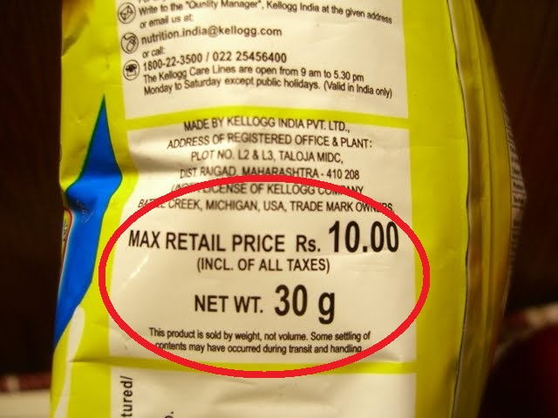
Valuation under Section 4A- MRP
Goods covered required to declare on the package the RSP
Valuation done based on RSP declared
RSP-Max. price
More than 1 RSP- Max. considered
Diff RSP-Diff Packages-Same excisable good-Diff Areas??
Statutory requirement to declare RSP for applying 4A.

Slide 22
Section 4A- Not Applicable??
Goods not notified for valuation under Section 4A
Goods not packaged commodities
No requirement for affixing MRP in terms of any law

Slide 23


Compounded Levy Scheme
CG notifies
Assessee has option to pay duty on basis of specified factors like –
a) Size of equipment employed
b) No. of machines used
c) Types of machines used
Advantage- No day-to-day formalities & maintenance of detailed accounts
Notified products are Stainless steel pattas/patties, Aluminium circles- No SSI exemption available

Slide 24
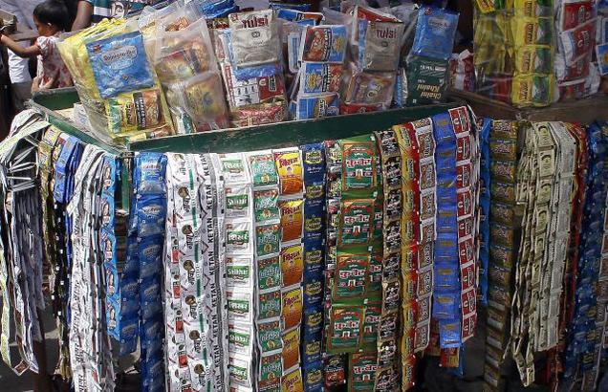


Duty on Capacity of Production
To safeguard revenue –CG notifies
Goods manufactured with the aid of packing machine and packed in pouches are notified like-
a)Pan Masala containing tobacco i.e,Gutkha
b)Unmanufactured tobacco bearing a brand name
c)Chewing tobacco
d)Jarda scented tobacco

Slide 25
Contd….
Annual Capacity- Officer not below AC
Factory operational during a part of the year- Proportionately
Factory producing notified goods- Not produced for a continuous period of 15 days or more- duty calculated is abated in respect of such period.
Not applicable to a 100% EOU

Slide 26


CCE Vs. FIAT INDIA (P.) LTD
Facts of the Case:-
Fiat--Entry into Indian market--Intense competition—S.P. below COP—Enabling Market Penetration—No Additional Consideration
Ruling of SC:-
The “loss making price” adopted by the assessee is not the “Normal Price” as contemplated under Section 4 of CEA.
The goods are NOT ORDINARILY SOLD in the course of the whole-sale trade
The price is not the sole consideration for the sale and therefore, the AA was justified in invoking clause (b) of Section 4(1) to arrive at the value of excisable goods for the purpose of levy of duty and accordingly the valuation requires to be done on the basis of Valuation Rules,1975.

Slide 27
ANALYSIS OF THE CASE
Basic understanding:-
“Sale price being the sole consideration”
No additional consideration
--Collector of CE V. Guru Nanak Refrigeration Corpn:-
Held that where Normal price is available, it would be treated as the AV even if such normal price is lower than the COP so long as there is no additional consideration and transaction at ALP.
-However in the case of FIAT, SC held that lowering the price below manufacturing cost would constitute an additional consideration and therefore, price was not the sole consideration.

Slide 28

Presented by:-
CA Navneet Kumar Agrawal

