Slide 1
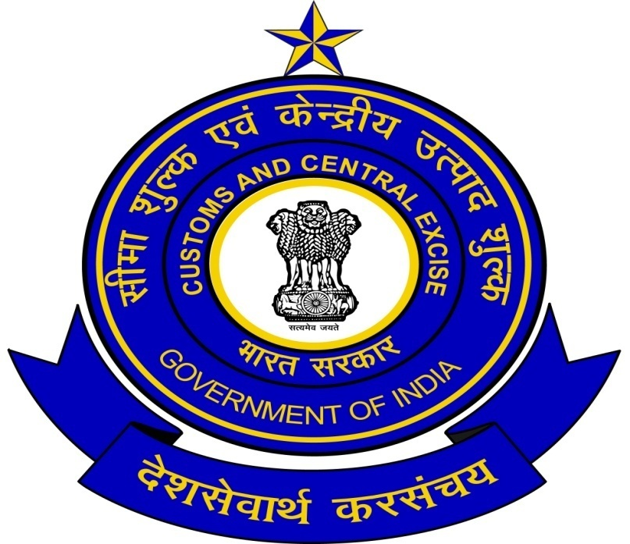
CENTRAL BOARD
OF
EXCISE AND CUSTOMS
BY CA . SAYANTAN BASU

Slide 2
Central Board of Excise and Customs
Constituted under the Central Boards of Revenue Act, 1963
Came into force on 1.1.1964
Tasked with formulation of Indirect Tax Policies
Implementation of Indirect Tax Policies through attached and subordinate offices

Slide 3
Vision
Encourage voluntary compliance by
Providing efficient and transparent mechanism of tax collection
Enforcement of cross border controls
Achieve excellence in the formulation and implementation of Customs, Central Excise and Service Tax laws

Slide 4
Mission
Realizing the revenues in a fair, equitable and efficient manner
Pragmatic administration of Government's economic, tariff and trade policies
Facilitate trade and industry - streamline and simplify business processes and help Indian business to enhance its competitiveness
Create a climate for voluntary compliance
Combat smuggling, commercial frauds and social menace including narcotics, FICN, arms & ammunitions etc
Supplement efforts for national security

Slide 5
Key Functions
Regulatory Functions
Levy and collection of Customs and Central Excise duties and Service Tax
Registration and monitoring of units manufacturing excisable goods and service providers
Receipt and scrutiny of declarations and returns filed
Prevention of smuggling and combating duty evasion
Enforcement of border controls

Slide 6
Key Functions (Contd.)
Regulatory Functions
Assessment, examination and clearance of imported goods and export goods
Implementation of export promotion measures
Clearance of international passengers and their baggage
Resolution of disputes through administrative and legal measures
Sanction of refund, rebate and drawback
Realization of arrears of revenue
Audit of assessments for ensuring tax compliance

Slide 7
Key Functions (Contd.)
Service Functions
Dissemination of information on law and procedures
Enabling online filing of declarations, returns, claims etc. and providing information on the status thereof
Assisting the right holders in protecting their intellectual property rights
Responding to public enquiries relating to Customs, Central Excise and Service Tax matters
Providing Customs services such as examination of goods and factory stuffing of export goods at exporter’s premises

Slide 8
Organisational Structure
Ministry of Finance
Deptt. of Economic Affairs
Deptt. of Expenditure
Deptt. of Revenue
Deptt. of Financial Services
Deptt. of Disinvestment
Central Board
of
Excise and Customs
Central Board
of
Direct Taxes

Slide 9
Organizational Chart of
Central Board of Excise & Customs
Chairman
Member (Central Excise)
Member (Customs /RI&I)
Member (P&V)
Member (Service Tax)
Member (Budget & Comp.)
Member (L&J)

Slide 10
Field Formation – A typical setup
Chief Commissioner
Commissioner (Adjudication)
Commissioner (Executive)
Commissioner (Appeals)
Additional/ Joint Commissioner
Deputy/ Assistant Commissioner
Superintendent/ Appraising Officer
Inspector/ Examiner/ Preventive Officer

Slide 11
Sanctioned Staff Strength
Cadre | Strength
Group ‘A’ | 3074
Group ‘B’ Gazetted | 16063
Group ‘B’ Non-gazetted | 27126
Group ‘C’ | 26828
Total | 73091

Slide 12
Offices under CBEC
Attached Offices
16 Directorates and Chief Departmental Representative and Central Revenues Control Laboratory
Subordinate Offices
23 Customs and Central Excise Zones with 93 composite Commissionerates, 7 exclusive Service Tax Commissionerates & 4 Large Taxpayer Units
11 Customs and Customs (Preventive) Zones with 35 Commissionerates

Slide 13
Central Excise
Levied on all manufactured goods (other than liquor for human consumption)
At Central VAT (CENVAT) rate of 10%, with few exceptions
Collected on transaction value or MRP
Input/ capital goods duty credit allowed
Self assessment and self removal
Payment of duty on monthly basis
General exemption to Small Scale Sector

Slide 14
Customs
Levied on import and export of goods
Peak rate for industrial goods at 10%
Major ad valorem rates of 5% and 7.5%
Collected on transaction value
Customs automation has reduced dwell time
Streamlining of procedures aimed at reduction of transaction costs

Slide 15
Service Tax
Levied on 117 specified services @ 10% of gross amount charged
Payable by service providers and in some cases by service recipients
Major services subjected to tax are:
  Telecommunication services
  Life / General insurance & insurance auxiliary service
  Stock broker service
  Banking & other financial services
  Business auxiliary services
  Port & airport services
  Broadcasting and advertising agency services
Self assessment, monthly payment of tax and half yearly returns
Threshold exemption of Rs. 10 lakhs for small Service Providers

Slide 16
Revenue from Indirect Taxes
(Rs. crore)
Heading | 2007-08 | 2008-09 | 2009-10 | 2009-10 | 2010-11
BE | 279,190 | 321,264 | 269,477 | 269,477 | 313,471
RE | 279,316 | 281,359 | 244,477 | 244,477
Actuals | 279,031 | 269,433 | 245,540 | 158,129* | 226,946*
% achievement of BE | 99.9 | 83.9 | 91.1 | 58.7* | 72.4*
% achievement of RE | 103.3 | 95.8 | 100.4 | 64.7*
% growth over last year | 15.5 | -3.4 | -8.9 |  | 43.5*
* (April – December)

Slide 17
Revenue from Indirect Taxes
Customs (Rs. crore)
Heading | 2007-08 | 2008-09 | 2009-10 | 2009-10 | 2010-11
BE | 98,770 | 118,930 | 98,000 | 98,000 | 115,000
RE | 100,766 | 108,000 | 84,477 | 84,477 | -
Actuals | 104,119 | 99,879 | 83,275 | 58,594* | 97,131*
% achievement of BE | 105.4 | 84.0 | 85.0 | 59.8* | 84.5*
% achievement of RE | 103.3 | 92.5 | 98.6 | 69.4* | -
%growth | 20.6 | -4.1 | -16.6 |  | 65.8*
* (April – December)

Slide 18
Revenue from Indirect Taxes
Central Excise (Rs. crore)
Heading | 2007-08 | 2008-09 | 2009-10 | 2009-10 | 2010-11
BE | 130,220 | 137,874 | 106,477 | 106,477 | 130,471
RE | 127,947 | 108,359 | 102,000 | 102,000 | -
Actuals | 123,611 | 108,613 | 103,946 | 62,547* | 85,560*
% achievement of BE | 94.9 | 78.8 | 97.6 | 58.7* | 65.6*
% achievement of RE | 96.6 | 100.2 | 101.9 | 61.3* | -
% growth | 5.1 | -12.1 | -4.3 |  | 36.8*
* (April – December)

Slide 19
Revenue from Indirect Taxes
Service Tax (Rs. crore)
Heading | 2007-08 | 2008-09 | 2009-10 | 2009-10 | 2010-11
BE | 50,200 | 64,460 | 65,000 | 65,000 | 68,000
RE | 50,603 | 65,000 | 58,000 | 58,000 | -
Actuals | 51,301 | 60,941 | 58,319 | 36,988* | 44,256*
% achievement of BE | 102.2 | 94.5 | 89.7 | 56.9* | 65.1*
% achievement of RE | 101.4 | 93.8 | 100.6 | 63.8* | -
% growth | 36.4 | 18.8 | -4.3 |  | 19.6*
* (April – December)

Slide 20
Trade Facilitation Measures
Customs
Electronic Payment of Customs Duty and Cess
Customs Electronic Data Interchange (EDI) upgraded to Version 1.5 - hosted on central server
Risk Management System (RMS 3.1) is operational in 47 Customs locations
Risk Management System in Export Promotion Schemes, covering about 21 such schemes, has been implemented at all EDI locations

Slide 21
Trade Facilitation Measures
Central Excise
Requirement of signing every excise invoice by the owner, MD or authorised signatory has been done away with
Superintendents of Central Excise have been empowered to adjudicate cases involving duty up to Rs. 1 lakh in certain cases
Online scheduling of factory stuffing inspection to facilitate speedy examination of the export goods
e-payment of duty and e-filing of monthly returns made mandatory in certain cases

Slide 22
Trade Facilitation Measures
Central Excise (Contd.)
Automation of Central Excise and Service Tax (ACES) rolled out in all 104 Commissionerates of Central Excise, Service Tax and Large Tax Payer Units
ACES Certified Facilitation Centres (CFCs) for taxpayers who may not have requisite IT infrastructure/ resources

Slide 23
Trade Facilitation Measures
Service Tax
Electronic payment of duty and e-filing of monthly returns made mandatory in certain cases
Conferring the power of adjudication of service tax cases on Superintendents involving service tax upto Rs. 1 lakh in certain cases
Service Tax Return Preparers Scheme for assistance of service providers

Slide 24
Enforcement Machinery
Multi-pronged enforcement strategy adopted
DRI and DGCEI for Customs & Excise/Service Tax at apex level
Specialized anti-smuggling, anti-evasion and audit wings in every Commissionerate; remote Divisions also have anti-evasion/ anti-smuggling units
Exclusive Customs Preventive Commissionerates at select locations
Automation assisted tools for enforcement such as NIDB, RMS, ISS, CAAP
24

Slide 25
Dispute Resolution
National Litigation Policy formulated to reduce Government litigation
Appeal not to be filed in the Tribunal if the duty involved or total revenue is Rs. 1 lakh or below
Appeal not to be filed in the High Court if the duty involved or total revenue is Rs. 2 lakh or below
Appeal not to be filed in the Supreme Court if the duty involved or total revenue is Rs.5 lakh or below
Alternate mechanism by way of Settlement Commission/ Authority for Advance Rulings

Slide 26
Key Workload Indicators
Description | 2002-03 | 2009-10 | % Growth over 2002-03
No. of CE Units | 79,770 | 98,654 | 24%
No. of ST Assessees | 1,33,531 | 11,83,874 | 787%
No. of Shipping Bills | 24,78,142 | 42,33,796 | 71%
No. of Bills of Entry | 12,62,828 | 31,43,513 | 149%
No. of Factory Stuffing of Containers | 1 Lakh | 8.2 lakh | 720%
No. of International Passengers | 94 Lakh | 252 Lakh | 168%

Slide 27
Automation
Central Excise and Service Tax
Online registration of Central Excise and Service Tax Assessees
Online filing of Central Excise Claims, Refunds, Intimations & Permissions
Online filing of Central Excise and Service Tax Returns
e-payment of Central Excise Duty
Web-viewing and Web-tracking of status of Central Excise / Service Tax documents
Electronic Accounting System in Excise and Service Tax (EASIEST)

Slide 28
Automation (Contd.)
Customs
Online registration of Importers/ Exporters/ CHAs
Online filing of Customs documents such as BE, SB, IGM, EGM etc.
Electronic messages for Customs Duty payment in the bank.
Online verification of DEPB /DEEC/EPCG licenses
IGM-based selection of containers for scanning on arrival at JNPT, Nhava Sheva
Electronic credit of Duty Drawback

Slide 29
Goods and Services Tax
A comprehensive goods and services tax regime
To address the problem of cascading and double taxation
To augment tax collection
Empowered Group for IT infrastructure constituted under Chairman, UIDAI
Working Groups constituted for IT architecture, business processes and draft legislations
Draft Constitutional amendments circulated among State Finance Ministers

Slide 30
SEVOTTAM @ CBEC
CBEC is one of the Departments identified to implement the Quality Management System for Public Services
SEVOTTAM facilitates a systematic, credible and authenticated self-assessment for citizen-centric service delivery
Online Grievance Redress Mechanism: CPGRAMS & ACES Service Desk
Four formations awarded IS 15700 : 2005 certificate valid up to 03-11-2013
20 more offices have been chosen for Sevottam roll out
Continual improvement in service delivery capacity is being undertaken by Department

Slide 31
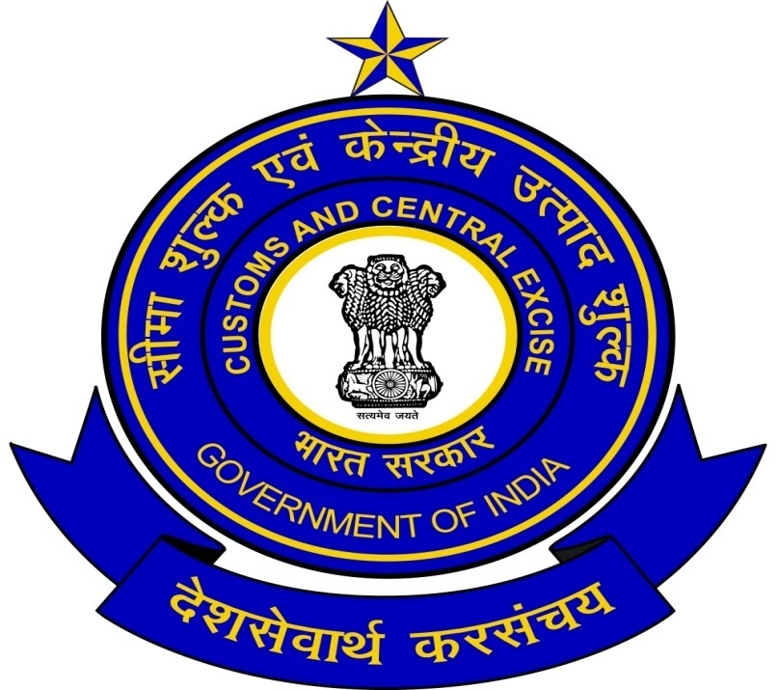
THANK YOU

