Slide 1
Continuous Clearing and
On-Realization Settlement for CTS
A Transformation in Cheque Clearing by NPCI
CA TEJKUMAR BANKAR tsbankar@gmail.com

Slide 2
Cheque Clearing System - History
Manual Clearing System – Before 1986
MICR Clearing – 1986
CTS Clearing – 2010
  CTS Compliant Cheques
  PAN India CTS Integration
  Positive Pay System
  Extended Clearing Services – Across Holidays and Weekends

Slide 3
Payments Vision 2025
Payments Vision 2025 document of Reserve Bank of India (RBI)
Migration of Cheque Truncation System (CTS) from the current approach of batch processing of presentation and return sessions to Continuous cleaning and on-realization settlement model
The project has been announced by Reserve Bank of India in the Statement on Developmental and Regulatory Policies dated August 8, 2024

Slide 4
The Shift to Continuous Clearing
Key Features
  Mandated by RBI and NPCI
  Continuous Clearing instead of Batch Processing
  Continuous processing which will take place during the business hours
  Near real-time settlement on cheque realization
  Nationwide Coverage (PAN India)

Slide 5
The Shift to Continuous Clearing
Objectives
  Speed up payments
  Improve customer experience
  Fraud Detection – Use of AI and Machine Learning to monitor transactions (Tampered Cheques)

Slide 6

Features of Continuous Clearing and On-Realization Settlement
Single presentation session with continuous delivery
  Single continuous presentation session from 10 AM to 4 PM
  Cheques received by the Bank Branches would be scanned and immediately pushed to the Centralized Clearing House during the presentation session
  The CCH will in turn release the cheque images as soon as they are received, to the drawee banks on a continuous basis

Slide 7
Features of Continuous Clearing and On-Realization Settlement
Continuous inward processing and confirmation by drawee banks
  The return session shall be open from the start of presentation session (10 AM) and close 3 hours (tentatively) after the closure of presentation session
  Processing by drawee banks is to be done continuously throughout the day and on a near real time basis
  Information of positive/negative confirmation would be pushed by the drawee banks to the CCH continuously

Slide 8
Features of Continuous Clearing and On-Realization Settlement
Time available for inward processing
  Cheques presented on a drawee bank have to be confirmed (positive / negative) by them latest in T+3 clear hours
  Otherwise, they will be considered as deemed approved
Settlement on realization
  Settlement would be arrived at the end of hourly settlement cycles till the end of return session (7.00pm)
  Same for cheques considered deemed approved

Slide 9
Features of Continuous Clearing and On-Realization Settlement
Payment to customers
  CCH will provide cheque wise status of positive/negative confirmation and deemed approval to the presenting banks
  The CCH will provide information on the cheques settled in the settlement cycle to the respective drawee and presenting banks
  The presenting banks shall process the same to release the payment to the customers immediately.

Slide 10
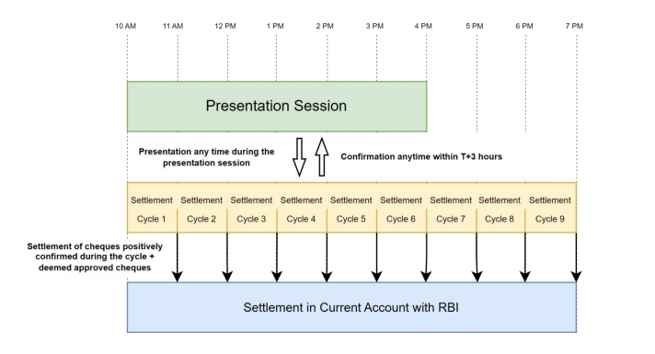
Presentation and Settlement Cycle

Slide 11
NPCI – Roll Out Plan
Roll Out Plan
  NPCI to Start UAT from 1st Oct 2024
  Tentative Go-live Date 1st Jan 2025

Slide 12
Future Scope of Realization CTS
Full Digital Integration
  Linking realization CTS with mobile apps and online banking for real-time updates.
User of advanced AI
  Enhanced fraud detection using machine learning algorithms
Expansion to other payment Instruments
  Applying continuous processing to other payment instruments

Slide 13
Thank You !!

