Slide 1

KAMAINDIA PVT. LTD.
까마인디아
08 th Presentation
TALLY
SHASHIKANT MISHRA

Slide 2


INDEX
ABOUT TALLY
CREATE COMPANY
GATEWAY OF TALLY
CREAT LEDGER & GROUP
DEFULT LEDGER & GROUP
VOUCHER TYPES
HOW TO PASS ENTRYS
STOCK JOURNAL
DISPLAY MENU
TRIAL BALANCE
PROFIT & LOSS A/C
BALANCE SHEET
STOCK SUMMARY
RATIO ANNLYSIS
DAY BOOK
PURCNASE&JOURNAL REGISTER
STATISTICS
AGING REPORT
CASH /FUND FLOW
RECEIPTS & PAYMENTS
LIST OF LEDGERS
EXCEPTION REPORTS
SHORTCUT KEYS

Slide 3

TALLY

Slide 4
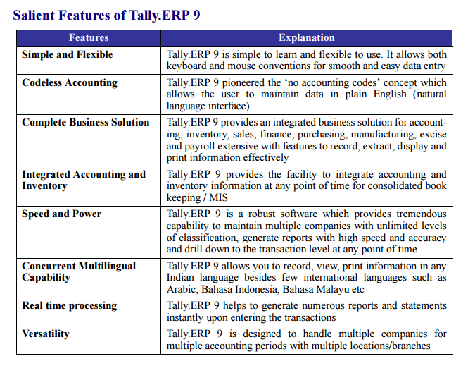
FEATURES

Slide 5
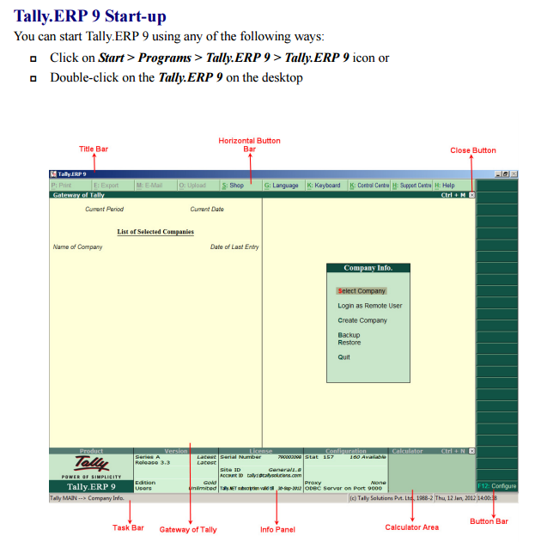
TALLY START UP
FEATURES
FEATURES

Slide 6
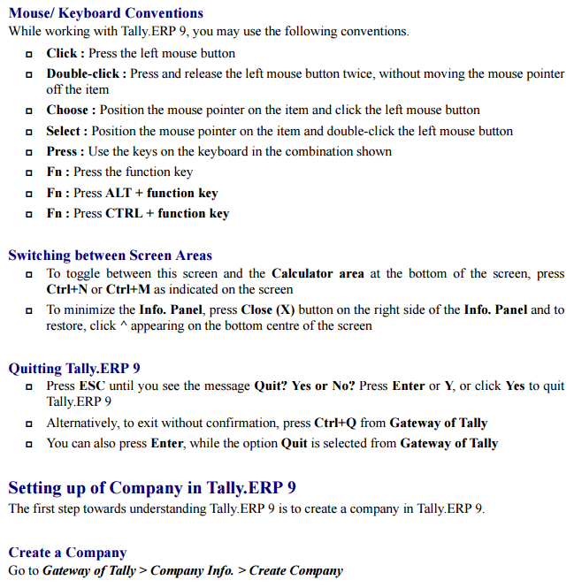

Slide 7
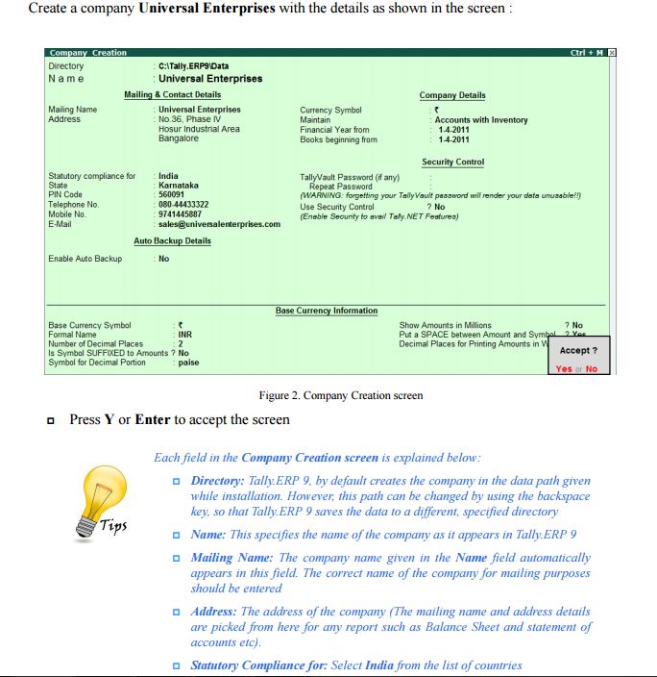

Slide 8
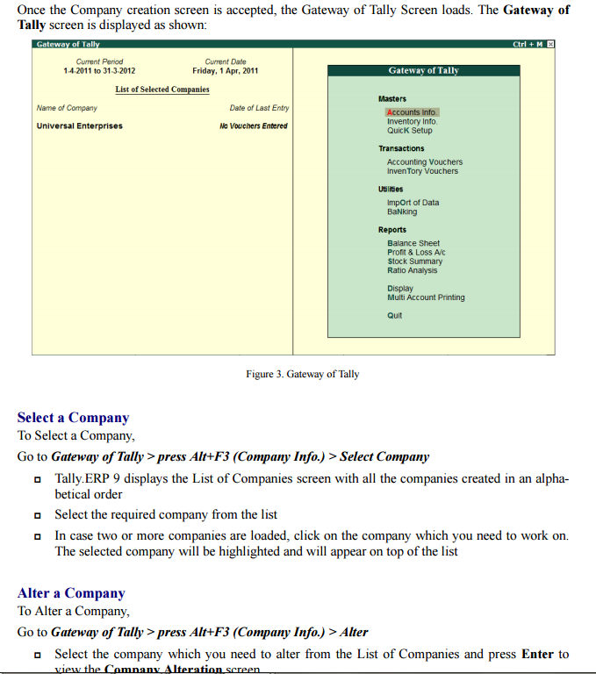

Slide 9
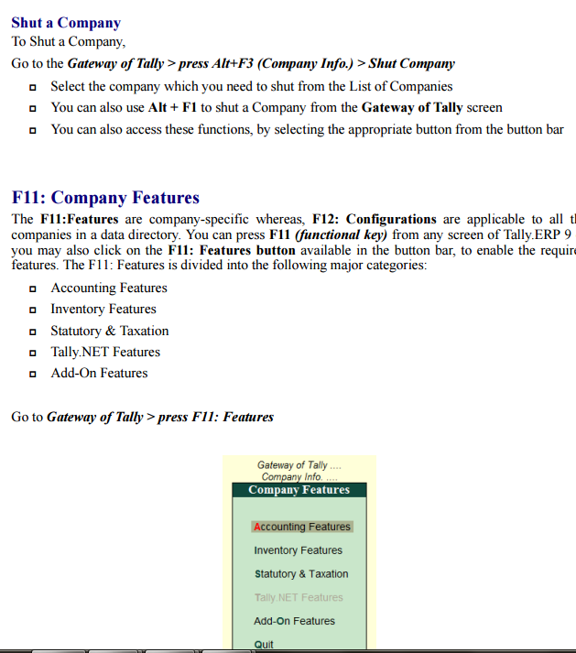

Slide 10
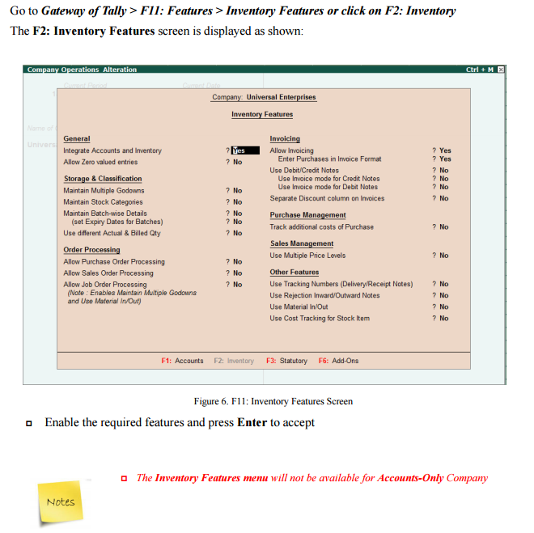

Slide 11
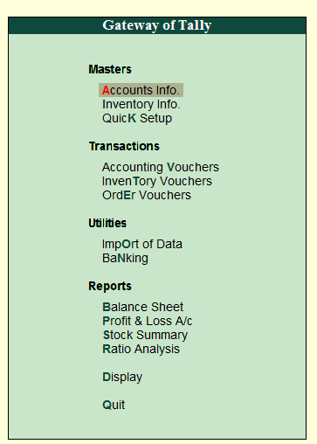
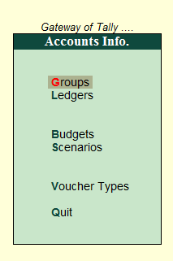
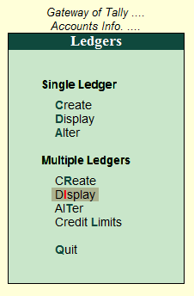
GATEWAY OF TALLY
HOW TO CREAT LEDGER & GROUP

Slide 12
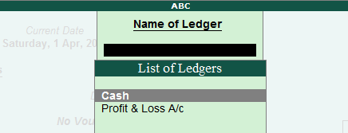
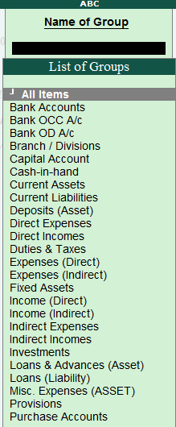
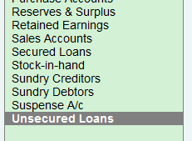
LEDGER
BY DEFULT LEDGER & GROUP

Slide 13
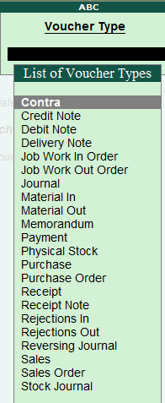
VOUCHER TYPES

Slide 14
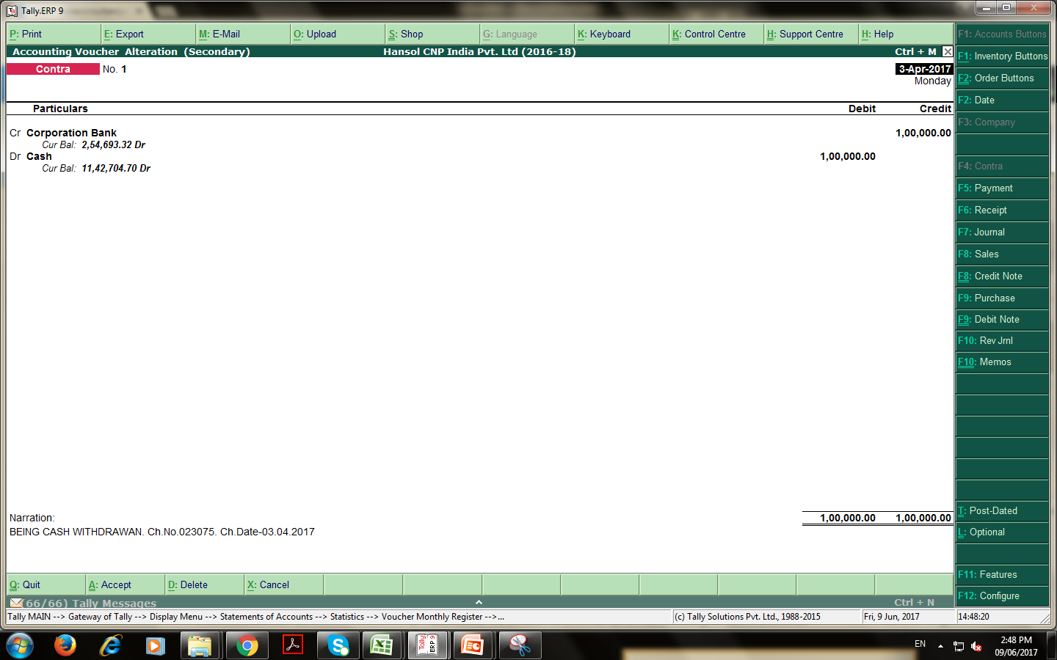
CONTRA ENTRY

Slide 15
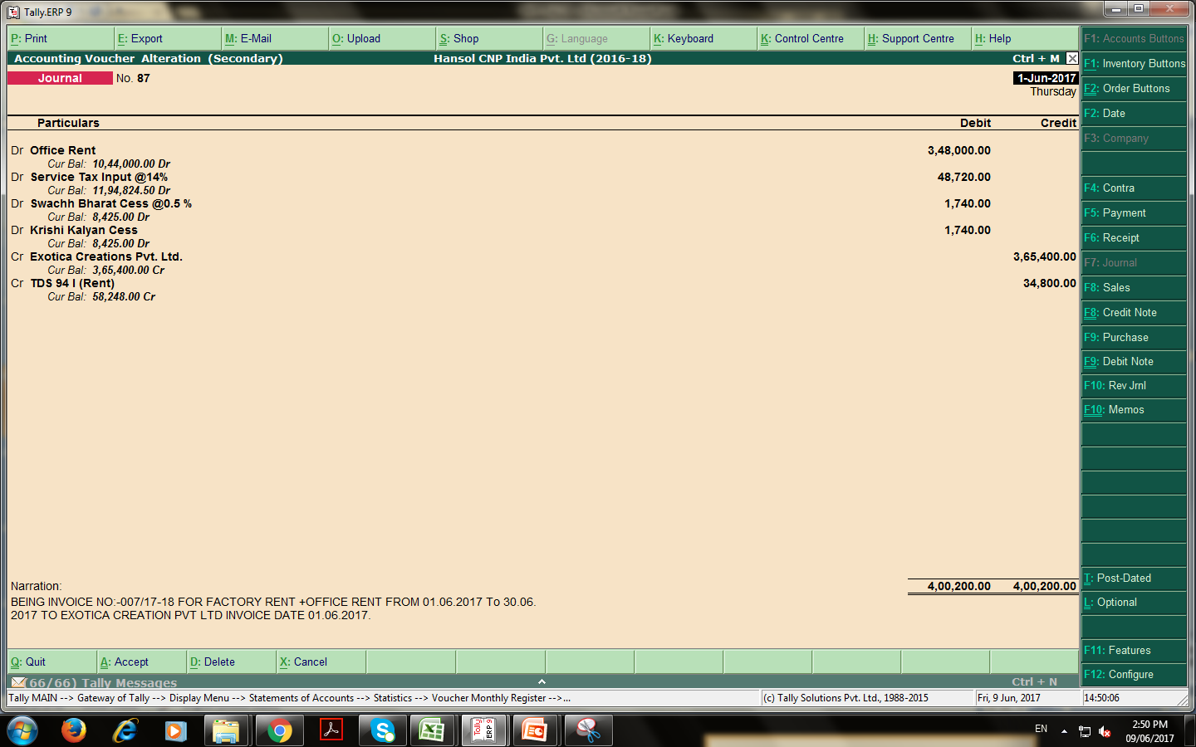
JOURNAL ENTRY

Slide 16
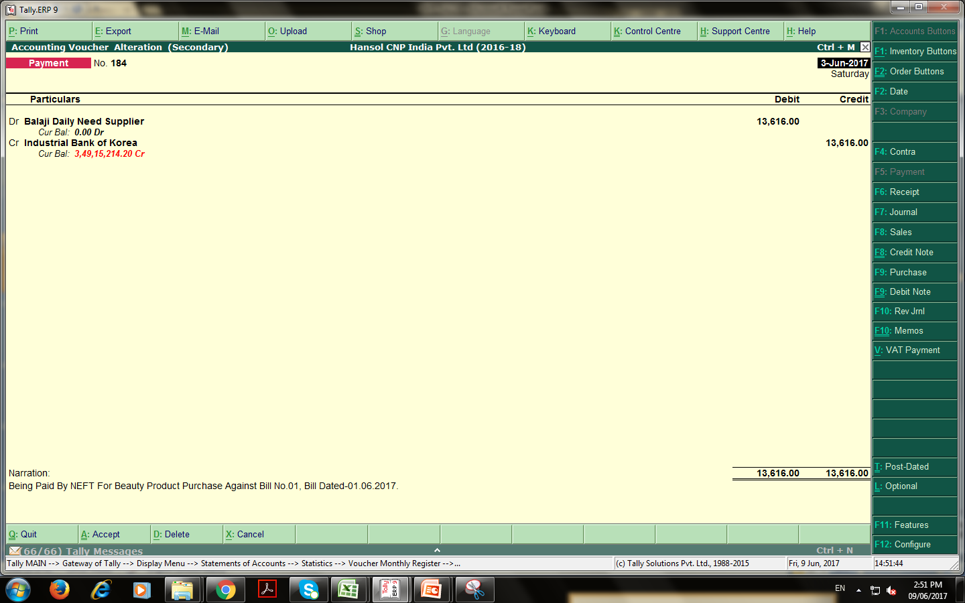
PAYMENT ENTRY

Slide 17
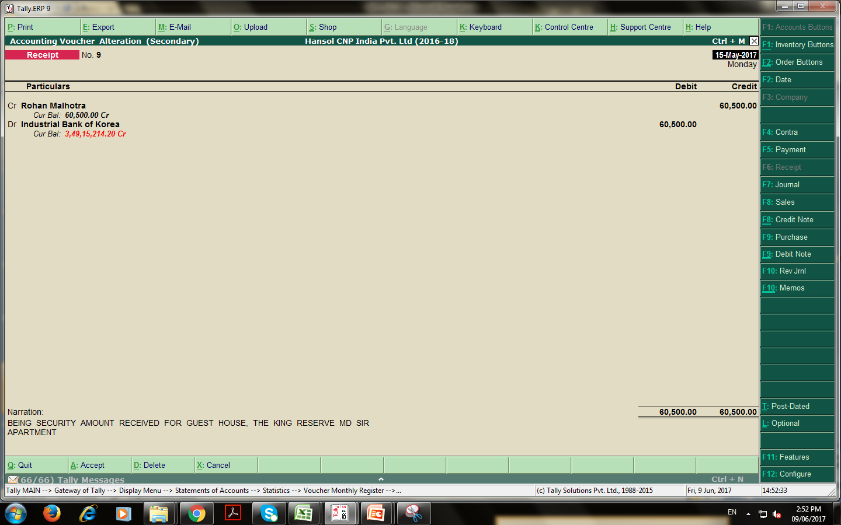
RECEIPT ENTRY

Slide 18
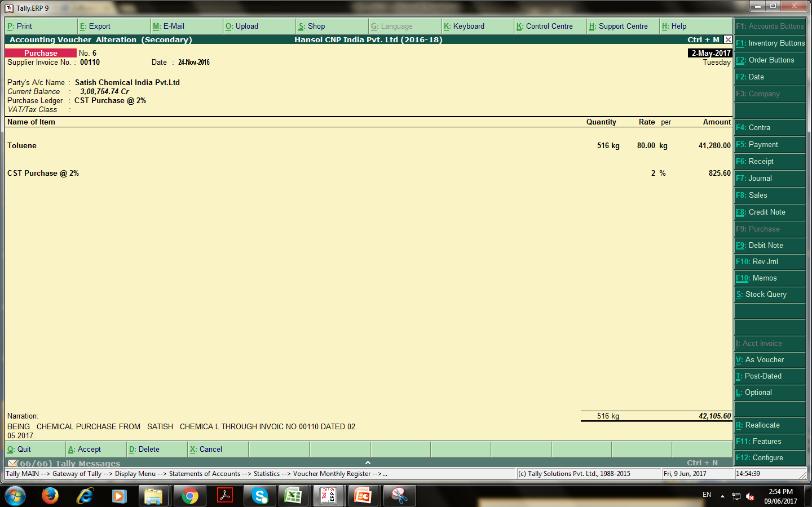
PURCHASE ENTRY

Slide 19
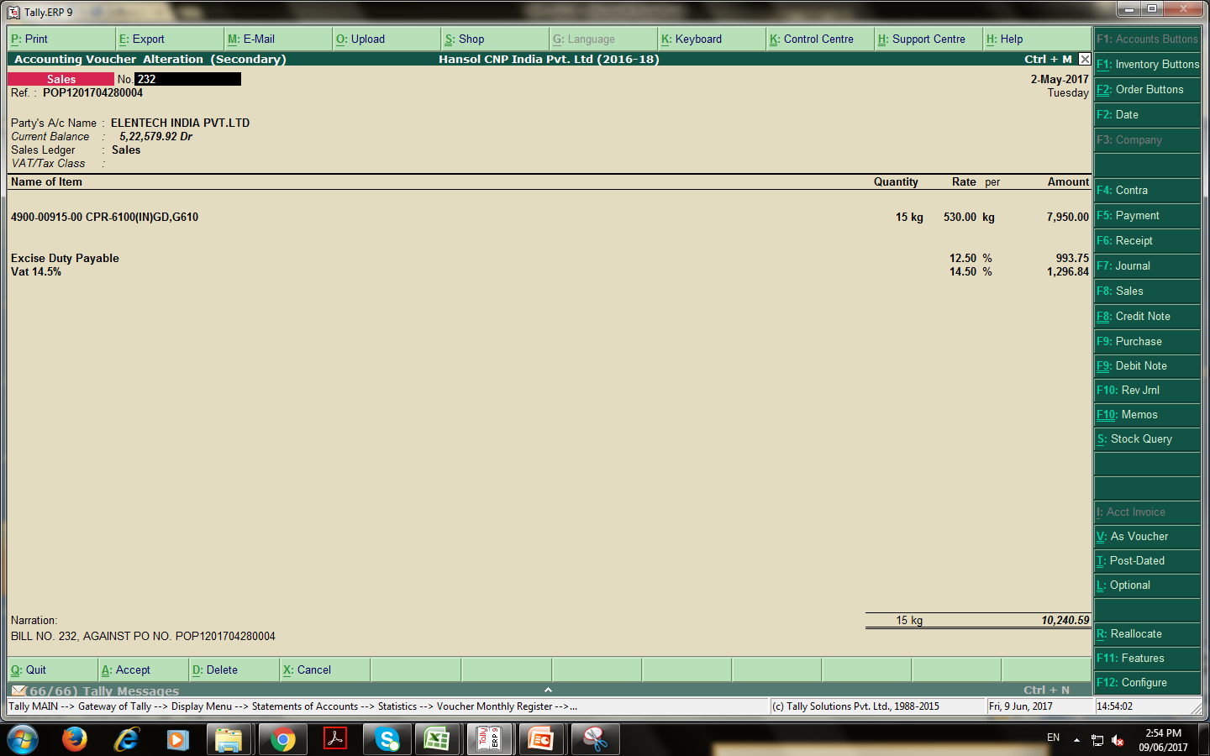
SALES BILL

Slide 20
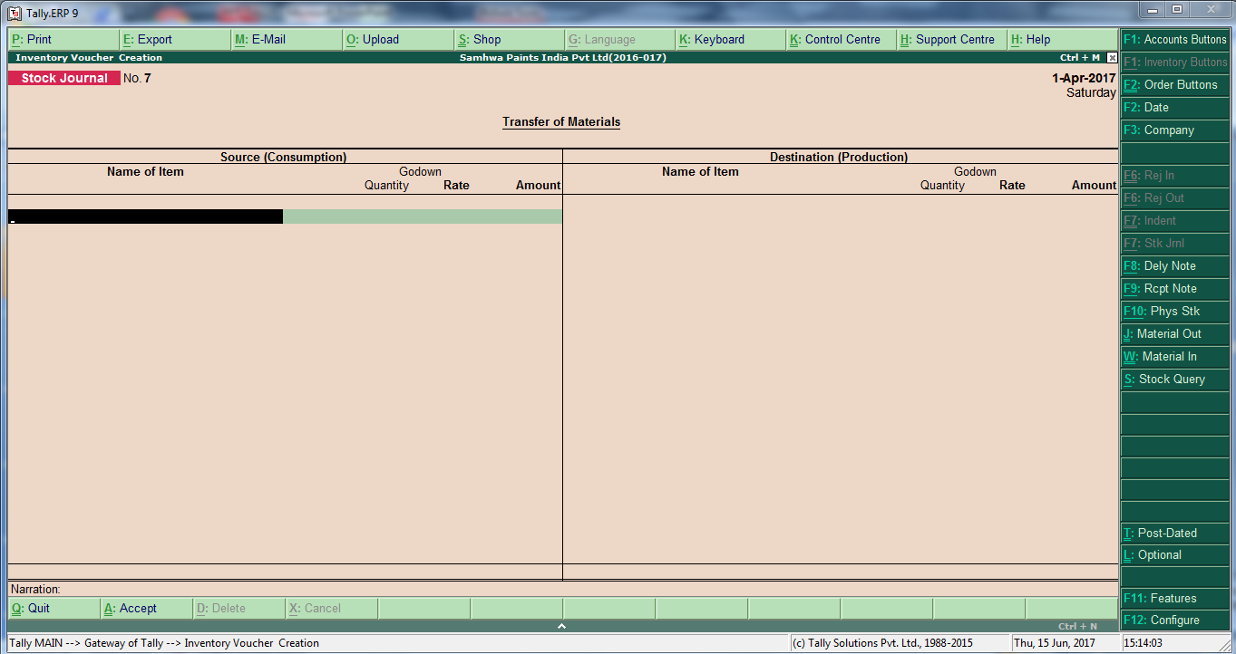
HOW TO PASS STOCK JOURNAL

Slide 21
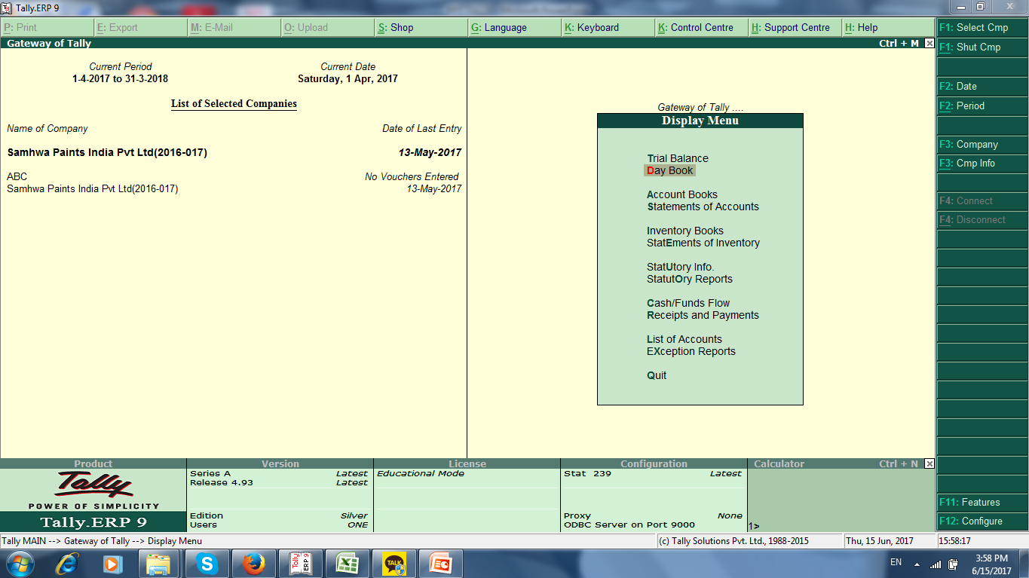
DISPLAY MENU

Slide 22
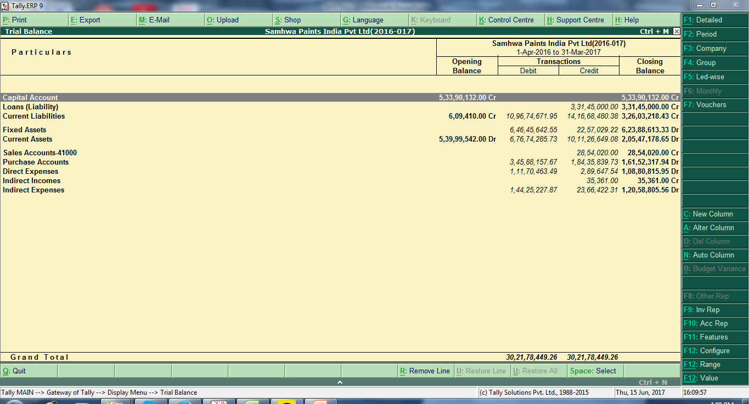
TRIAL BALANCE

Slide 23
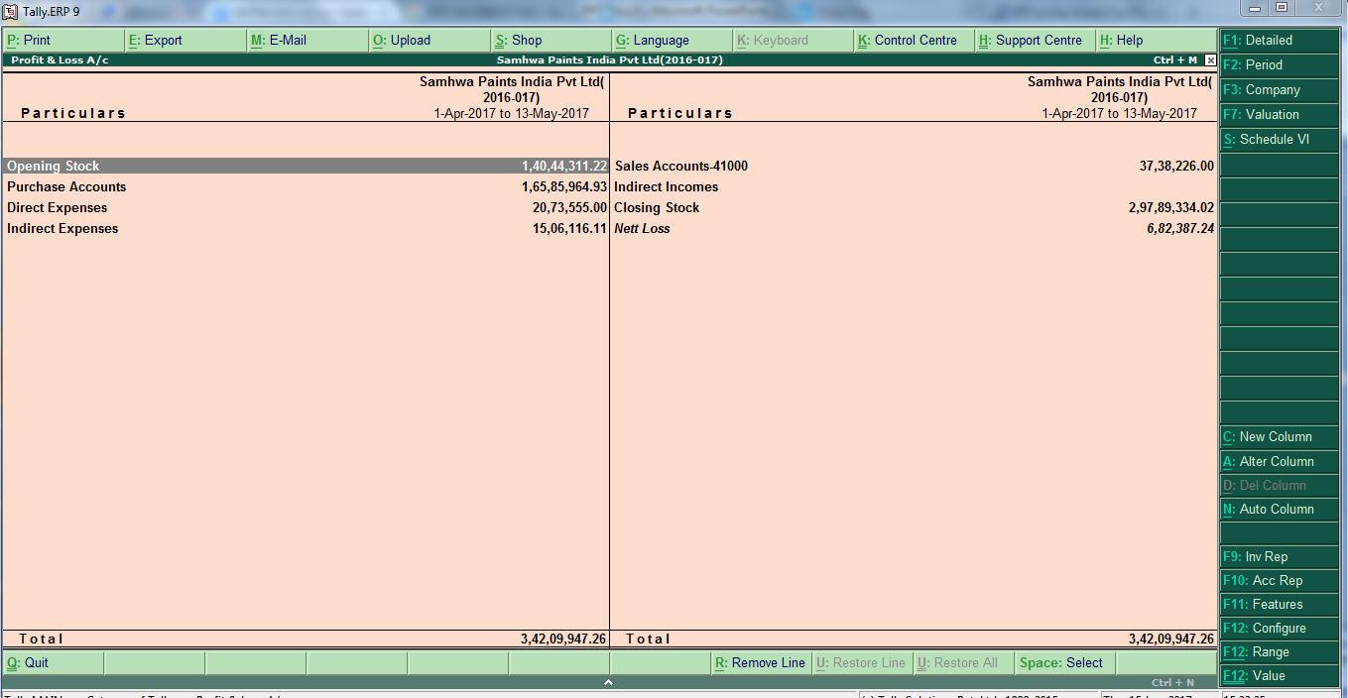
PROFIT & LOSS A/C

Slide 24
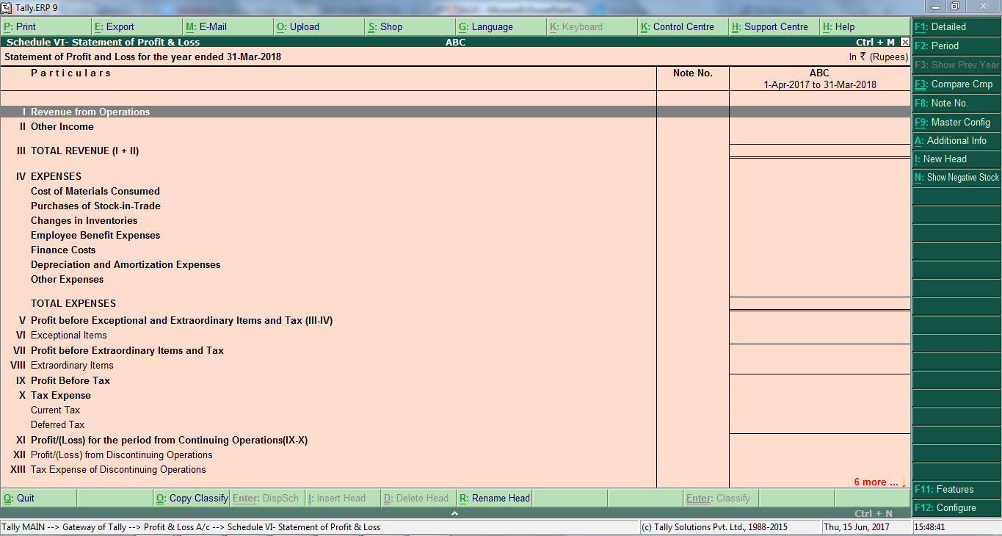
PROFIT & LOSS A/C AS PER SCH VI

Slide 25
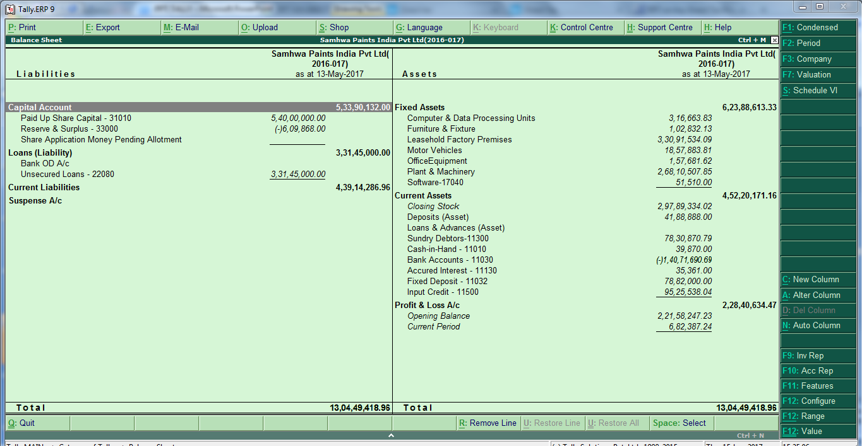
BALANCE SHEET

Slide 26
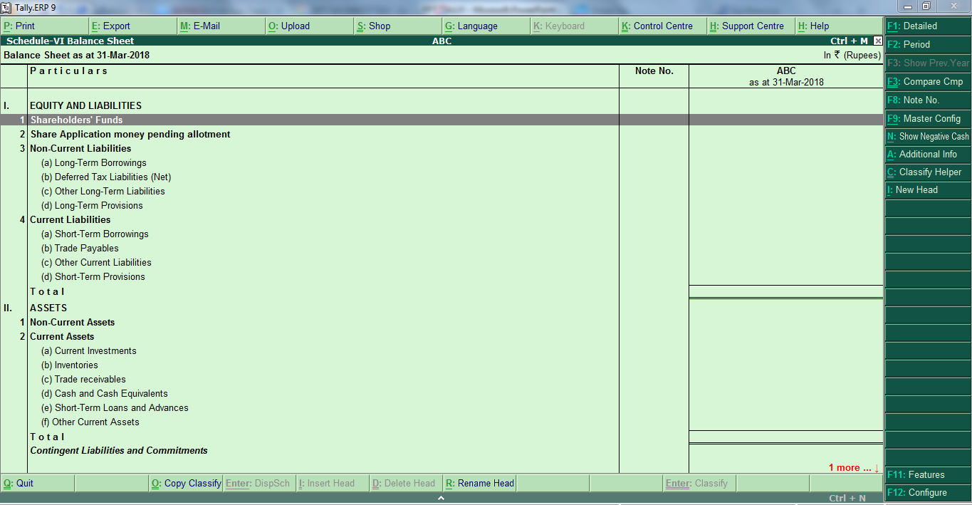
BALANCE SHEET AS PER SCH VI

Slide 27
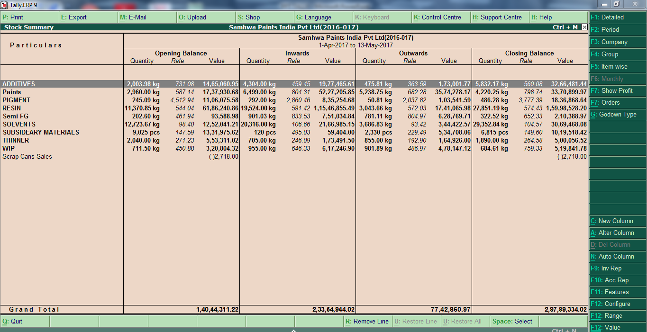
STOCK SUMMARY

Slide 28
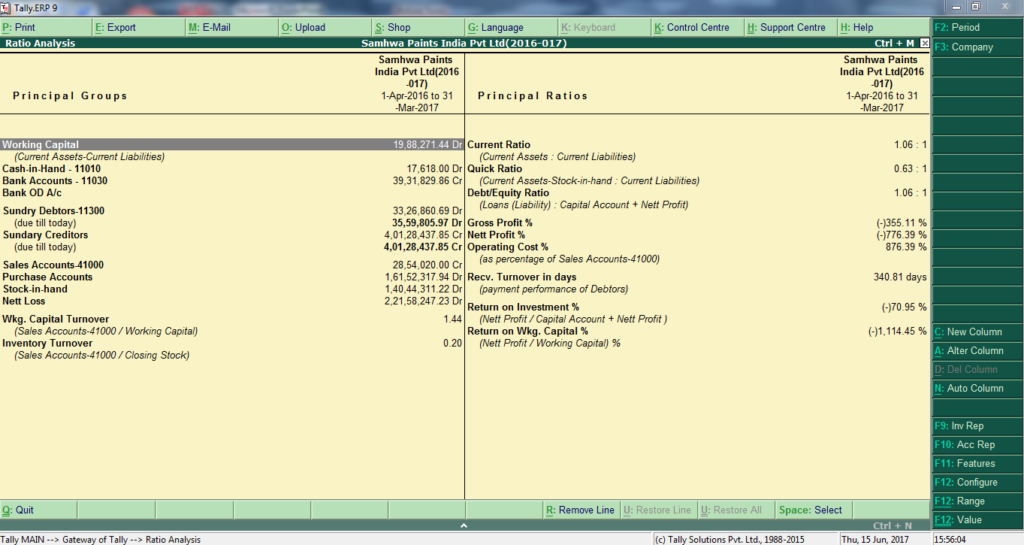
RATIO ANNLYSIS

Slide 29
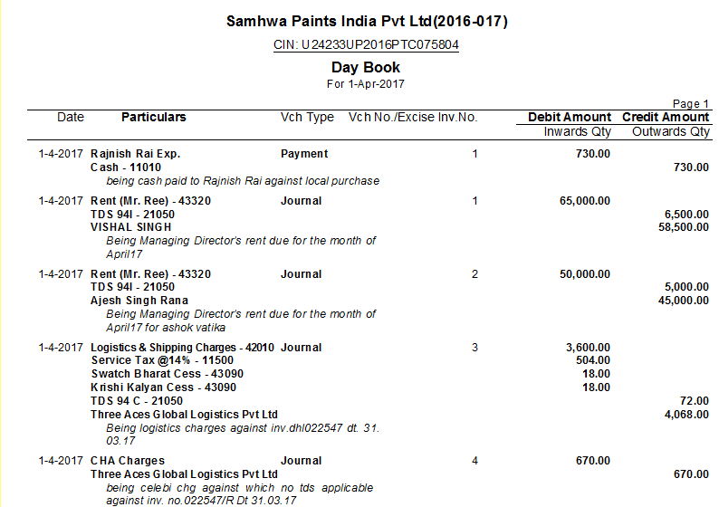
DAY BOOK

Slide 30
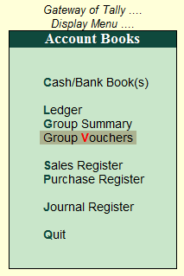
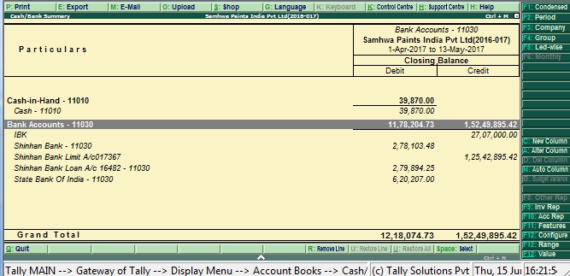
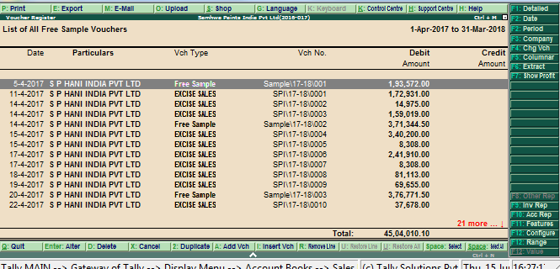
ACCOUNT BOOKS, CASH /BANK BOOKS, & SALES REGISTER
ACCOUNT BOOKS
CASH /BANK BOOKS
SALES REGISTER

Slide 31
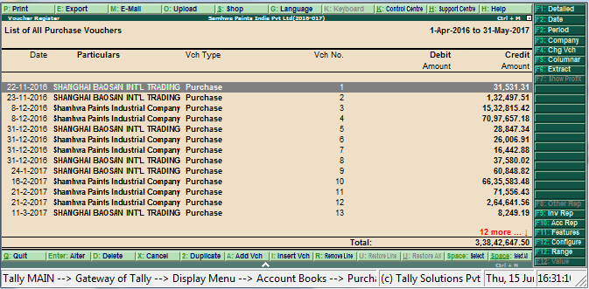
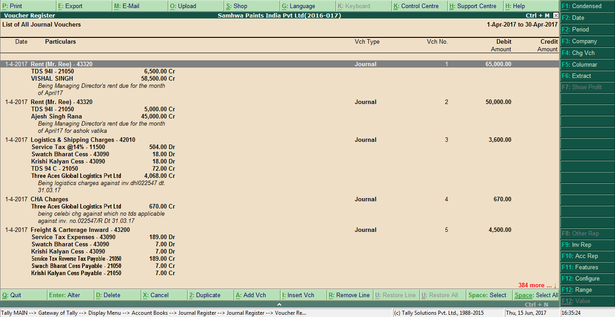
PURCNASE&JOURNAL REGISTER
PURCHASE REGISTER
JOURNAL REGISTER

Slide 32
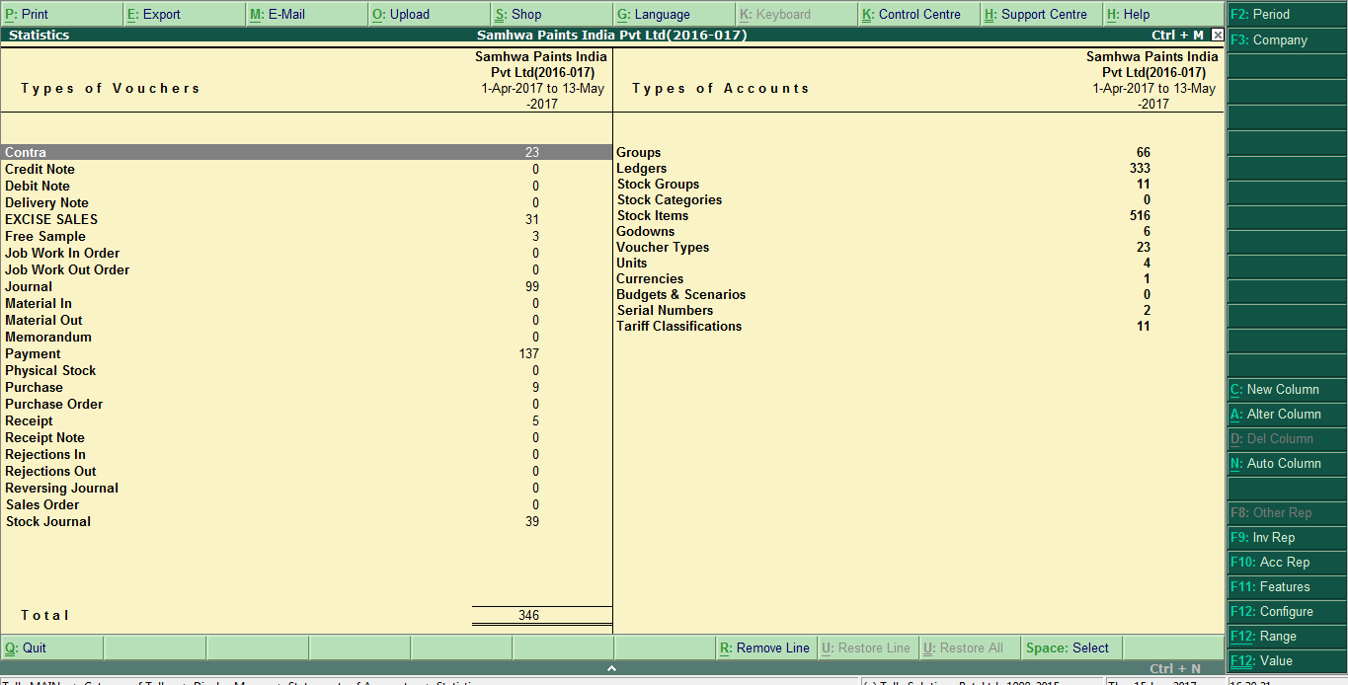
STATISTICS

Slide 33
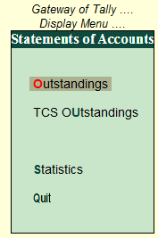
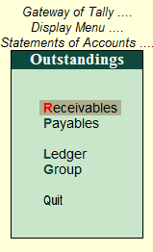
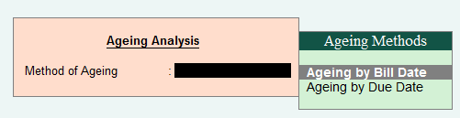
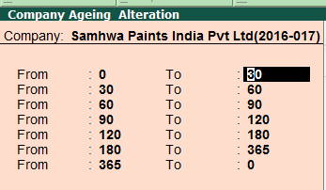
AGING REPORT
Step-1 Statement of A/C
Step-2 Outstandings
Step-3 Method of Ageing report
Step-4 dues in days

Slide 34
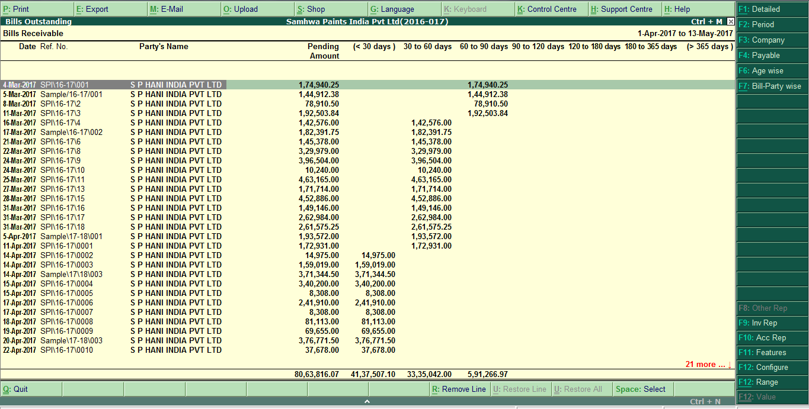
AGING REPORT OF RECEIVABLE

Slide 35
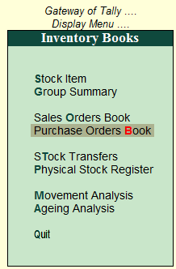
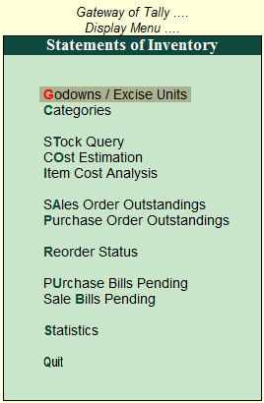
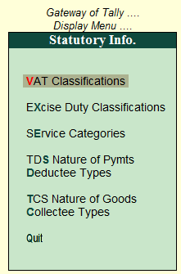
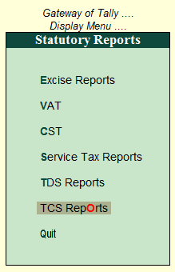
INVENTORY BOOKS & STATUORYINFO
INVENTORY BOOKS
STATEMENTS OF INVENTORY
STATUTORY INFO
STATUTORY REPORT

Slide 36
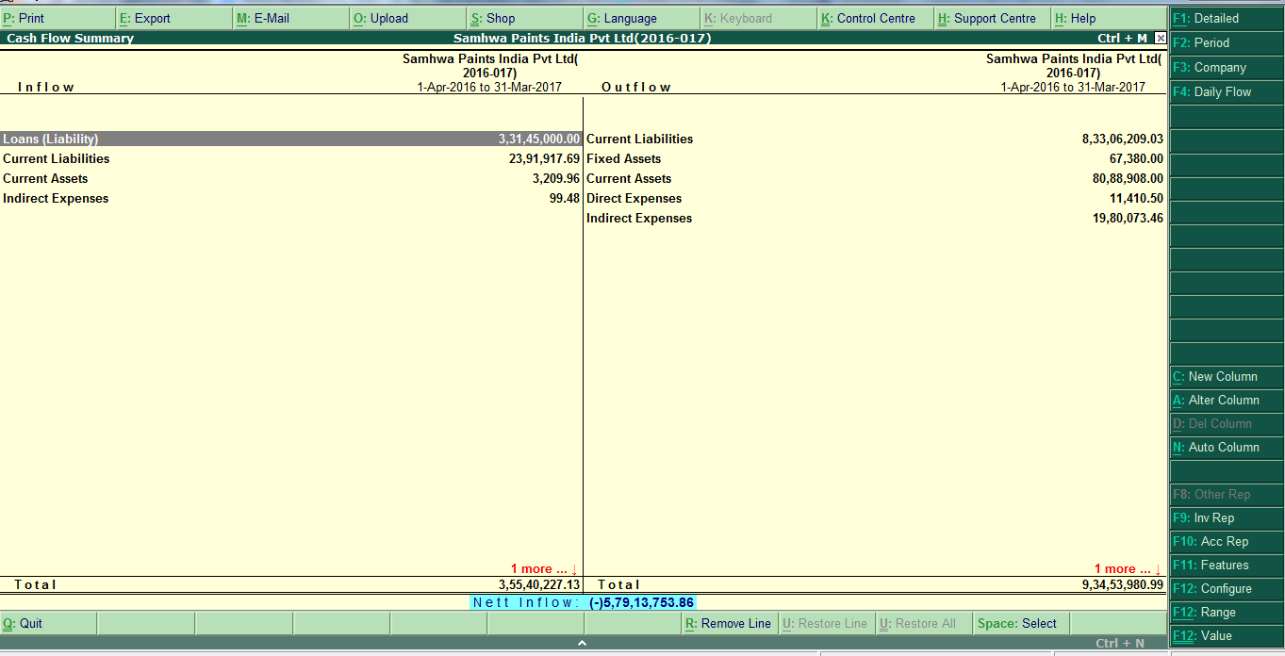
CASH FLOW

Slide 37
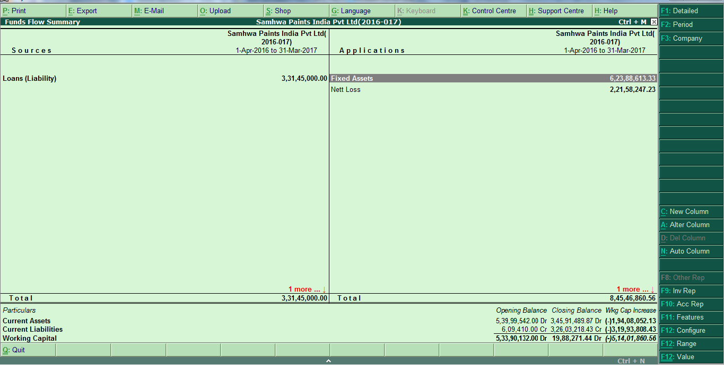
FUND FLOW

Slide 38
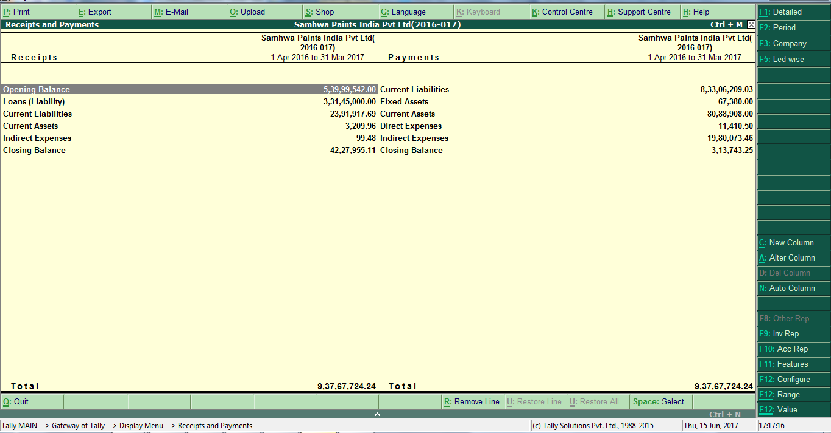
RECEIPTS & PAYMENTS

Slide 39
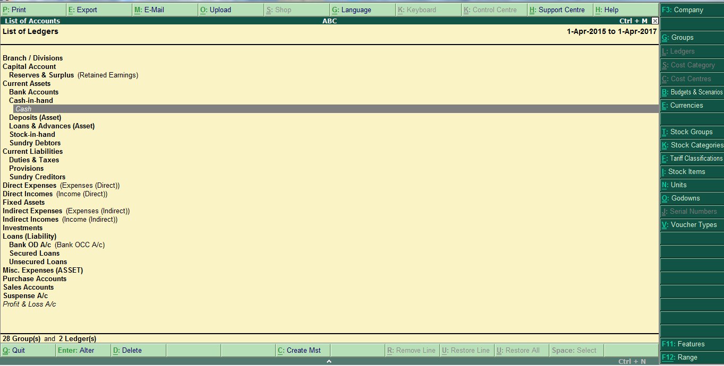
LIST OF LEDGERS

Slide 40
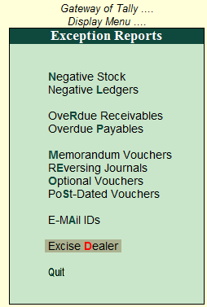
EXCEPTION REPORTS

Slide 41


Slide 42


Slide 43


Slide 44


Slide 45


Slide 46


Slide 47


Slide 48
Thank You

Slide 49
KAMAINDIA PVT. LTD.
까마인디아
대표자: 노 영 진
국내연결: 070-4067-9911, 070-7518-9435
본사: 546A, 3rd Floor, Hanuman Mandir Road, Chirag Delhi, New Delhi-110017, India
지점: G-45, 1st Floor, Green Park, opp. Main market, New Delhi-110016, India
휴대폰: +91-9810760090
홈페이지: www.kamaindia.net

