Slide 1


Slide 2


Direct tax proposal - highlights
Prepare by: Ankur Singhal
Spl. In: Income Tax Cases & Transfer Pricing

Slide 3
Personal Taxation
Corporate Taxation
Penal Provisions
Capital Gain Taxation
Cash Proposal to reduce Cash Transactions and promote Digital Economy
Tax Deduction At Source (TDS)
Business Taxation
Prepare by: Ankur Singhal
Spl. In: Income Tax Cases & Transfer Pricing

Slide 4
Personal Taxation
Prepare by: Ankur Singhal
Spl. In: Income Tax Cases & Transfer Pricing

Slide 5
Income Tax Slab
Individual resident aged below 60 years
Income Slab |  | Tax Rates
i. | Upto Rs. 2.5 Lakhs | Nil
ii. | Rs. 2.5 Lakhs to Rs. 5 Lakhs | 5%
iii. | Rs. 5 Lakhs to Rs. 10 Lakhs | 20%
iv. | More than Rs. 10 Lakhs | 30%
Senior Citizens
Income Slab |  | Tax Rates
i. | Upto Rs. 3 Lakhs | Nil
ii. | Rs. 3 Lakhs to Rs. 5 Lakhs | 5%
 | (Remaining Same as above)
Super Senior Citizens
Income Slab |  | Tax Rates
i. | Upto Rs. 5 Lakhs | Nil
 | (Remaining Same as above)
Prepare by: Ankur Singhal
Spl. In: Income Tax Cases & Transfer Pricing

Slide 6
Rebate in Income Tax (Sec. 87A)
The rebate of Rs. 5,000 currently available under section 87A in case of an individual resident in India whose total income does not exceed Rs. 5,00,000,
is proposed to be reduced to Rs. 2,500, where the total income does not exceed Rs. 3,50,000 from A.Y. 2018-19.
Prepare by: Ankur Singhal
Spl. In: Income Tax Cases & Transfer Pricing

Slide 7

Surcharge on Income Tax
Surcharge @ 10% of tax payable is proposed to be levied on individuals/HUFs or AOPs or BOIs whose total income exceeds Rs. 50 lakhs but does not exceeds Rs. 1 crore.
Thereafter, surcharge @15% would continue to be applicable on total income exceeding Rs. 1 crore.
Prepare by: Ankur Singhal
Spl. In: Income Tax Cases & Transfer Pricing

Slide 8
No Change in Tax Rates
Firm/Local Authority:
Tax Rate – 30%
Plus:
Surcharge - 12% of the Income Tax if taxable income exceeds ₹ 1 crore.
Education Cess - 3% of the total of Income Tax and Surcharge.
Demestic Company:
Tax Rate – 30%*
Plus:
Surcharge - 7% of the Income-tax if taxable income exceeds ₹ 1 crore and 12% of the income-tax if taxable income exceeds ₹ 10 crores.
Education Cess - 3% of the total of Income Tax and Surcharge.
Foreign Company:
Tax Rate – 40%
Plus:
Surchage - 2% of the Income-tax if taxable income exceeds ` 1 crore and 5% of the income-tax if taxable income exceeds ` 10 crores.
Education Cess - 3% of the total of Income Tax and Surcharge.
Prepare by: Ankur Singhal
Spl. In: Income Tax Cases & Transfer Pricing

Slide 9
Corporate Taxation
Prepare by: Ankur Singhal
Spl. In: Income Tax Cases & Transfer Pricing

Slide 10

Corporate Income Tax Rate
In order to make Medium and Small Enterprises more viable and to encourage firms to migrate to company format, the corporate tax rate is proposed to reduce to 25% from 30% from A.Y. 2018-19 for Medium and Small Enterprises companies with annual turnover upto Rs. 50 crore.
Prepare by: Ankur Singhal
Spl. In: Income Tax Cases & Transfer Pricing

Slide 11
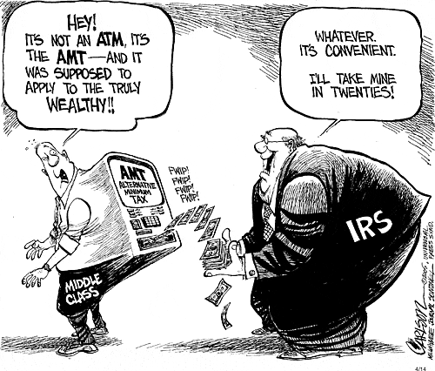
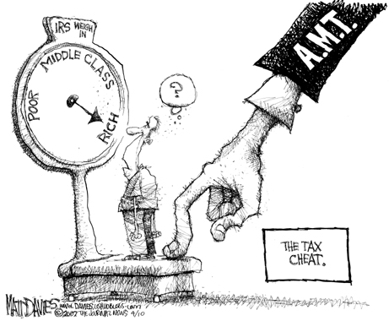
MAT & AMT (Sec. 115JAA, 115JD & 115JB)
The period for carry forward of MAT & AMT credit proposed to be increased – From 10 Years to 15 Years.
Book Profit is calculated as per notified Ind-AS if applicable.*
Prepare by: Ankur Singhal
Spl. In: Income Tax Cases & Transfer Pricing

Slide 12
*Applicability of Ind AS
The Indian Accounting Standards (Ind AS) shall be applicable to the companies as follows:
On voluntary basis for financial statements for accounting periods beginning on or after April 1, 2015, with the comparatives for the periods ending 31st March, 2015 or thereafter;
On mandatory basis for the accounting periods beginning on or after April 1, 2016, with comparatives for the periods ending 31st March, 2016, or thereafter, for the companies specified below:
Companies whose equity and/or debt securities are listed or are in the process of listing on any stock exchange in India or outside India and having net worth of Rs. 500 Crore or more.
Companies other than those covered in (ii) (a) above, having net worth of Rs. 500 Crore or more.
Holding, subsidiary, joint venture or associate companies of companies covered under (ii) (a) and (ii) (b) above.
On mandatory basis for the accounting periods beginning on or after April 1, 2017, with comparatives for the periods ending 31st March, 2017, or thereafter, for the companies specified below:
Companies whose equity and/or debt securities are listed or are in the process of being listed on any stock exchange in India or outside India and having net worth of less than rupees 500 Crore.
Companies other than those covered in paragraph (ii) and paragraph (iii)(a) above that is unlisted companies having net worth of rupee 250 crore or more but less than rupees 500 Crore
Holding, subsidiary, joint venture or associate companies of companies covered under paragraph (iii) (a) and (iii) (b) above.
Prepare by: Ankur Singhal
Spl. In: Income Tax Cases & Transfer Pricing

Slide 13
Penal Provisions
Prepare by: Ankur Singhal
Spl. In: Income Tax Cases & Transfer Pricing

Slide 14
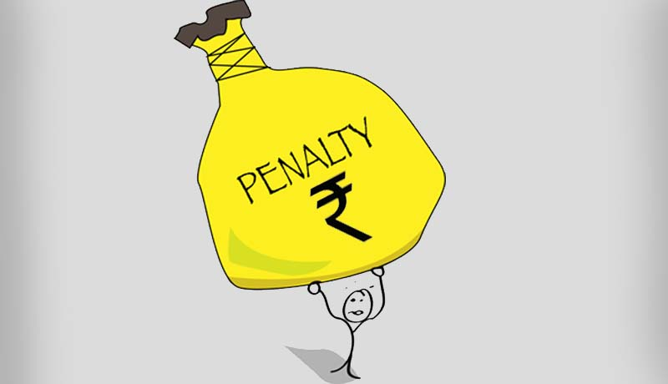


Furnishing Incorrect Information (New Sec. 271J)
Late Filing of ITR (New Sec. 234F)
Rs. 5,000 would be levied for return filed after the due date but on or before the 31st day of December of the assessment year and Rs. 10,000, in any other case.
However, where the total income does not exceed Rs. 5 lakh, the fee amount shall not exceed Rs. 1,000.
Penalty of Rs. 10,000 would be levied, if an accountant or a merchant banker or a registered valuer furnishes incorrect information in a report or certificate under any provisions of the Act or the rules made thereunder.
Prepare by: Ankur Singhal
Spl. In: Income Tax Cases & Transfer Pricing

Slide 15
Capital Gain Taxation
Prepare by: Ankur Singhal
Spl. In: Income Tax Cases & Transfer Pricing

Slide 16

Period of Holding of Immovable Property
The period of holding for considering gain from immovable property, being land or building or both to be long term is proposed to be reduced – From 3 Years to 2 Years
Prepare by: Ankur Singhal
Spl. In: Income Tax Cases & Transfer Pricing

Slide 17
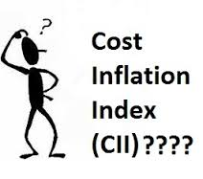
Indexation of LTCA
The base year for indexation proposed to be shifted for all classes of assets including immovable property – From 1.4.1981 to 1.4.2001.
Prepare by: Ankur Singhal
Spl. In: Income Tax Cases & Transfer Pricing

Slide 18


No Exemption of Sec. 10(38) if no STT on acquisition
It is proposed to amend section 10(38) to provide that exemption under this section for income arising on transfer of equity share acquired or on after 1st day of October, 2004 shall be available only if the acquisition of share is chargeable to Securities Transactions Tax.
This amendment will take effect from 1st April, 2018 and will, accordingly, apply in relation to the assessment year 2018-19 and subsequent assessment years.
Prepare by: Ankur Singhal
Spl. In: Income Tax Cases & Transfer Pricing

Slide 19
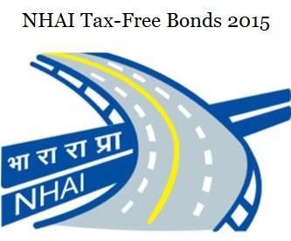


Investment in Bonds (Sec. 54EC)
Presently, investment in bond issued by the National Highways Authority of India or by the Rural Electrification Corporation Limited is eligible for exemption under section 54EC to the extent of Rs. 50 Lakhs. In order to widen the scope of the section for sectors which may raise fund by issue of bonds eligible for exemption, the said section proposed to be amended so as to provide that investment in any notified bond redeemable after three years which has been notified by the Central Government in this behalf shall also be eligible for exemption.
Prepare by: Ankur Singhal
Spl. In: Income Tax Cases & Transfer Pricing

Slide 20
Unquoted shares taxable at FMV (New Sec. 50CA)
The Finance Bill, 2017 proposed insertion of a new Section 50CA, to provide that where the consideration declared for transfer of unquoted shares of a company is less than the Fair Market Value of such share, the FMV of such shares shall be deemed to be the Full Value of Consideration for the purpose of computing the capital gains.
Conversion of preference shares to equity shares
It is proposed to amend section 47 to provide that the conversion of preference share of a company into its equity share shall not be regarded as transfer.
These amendments will take effect from 1st April, 2018 and will, accordingly, apply in relation to the assessment year 2018-19 and subsequent years.
Prepare by: Ankur Singhal
Spl. In: Income Tax Cases & Transfer Pricing

Slide 21
Clarification on the rate of tax under section 112
Section 112(1)(c) as amended by the Finance Act, 2012 provided concessional rate of tax at the rate of 10% for long-term capital gains arising from the transfer of unlisted securities. The ambiguity as to applicability of this provision to share of a private company was clarified by the Finance Act, 2016, w.e.f. 01-04-2017.
As the concessional rate in section 112(1)(c) was provided w.e.f. 1st April, 2013, there was uncertainty about the applicability of the amendment to the intervening period. With a view to resolve the above uncertainty, it is proposed that the effective date of amendment made to section 112(1)(c)(iii) vide Finance Act, 2016 shall be w.r.e.f. 01-04-2013 instead of w.e.f. 01-04-2017.
Prepare by: Ankur Singhal
Spl. In: Income Tax Cases & Transfer Pricing

Slide 22
Cash Proposal to reduce Cash Transactions and Promote Digital Economy
Prepare by: Ankur Singhal
Spl. In: Income Tax Cases & Transfer Pricing

Slide 23

Deduction of Donation (Sec. 80G)
No deduction to be allowed under section 80G in respect of donation by any mode other than cash, if such amount of donation exceeds Rs. 2,000. The present limit is Rs. 10,000.
Prepare by: Ankur Singhal
Spl. In: Income Tax Cases & Transfer Pricing

Slide 24
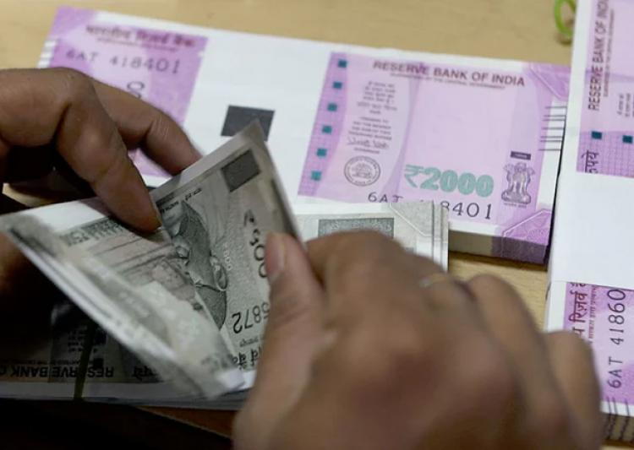
Allowability of Cash Expenditures
The threshold limit under section 40A(3) for allowability of revenue expenditure incurred in cash is proposed to be reduced - From Rs. 20,000 to Rs. 10,000.
In order to discourage cash transactions even for capital expenditure, limit of Rs. 10,000 is proposed. Accordingly, capital expenditure incurred in cash shall be ignored for the purposes of determination of actual cost under section 43, if such amount of expenditure exceeds Rs. 10,000. Further, no deduction would be allowable under section 35AD, in respect of such capital expenditure incurred in cash for an amount exceeding Rs. 10,000.
Prepare by: Ankur Singhal
Spl. In: Income Tax Cases & Transfer Pricing

Slide 25

Cash Receipt (New Sec. 269ST & 271DA)
Section 269ST to be inserted, to provide that no person shall receive an amount of Rs. 3 lakh or more, in aggregate from a person in a day; in respect of a single transaction; or in respect of transactions relating to one event or occasion from a person, otherwise than by an account payee cheque or account payee bank draft or use of electronic clearing system through a bank account.
Simultaneously, new section 271DA has also proposed to levy penalty of sum equal to the amount of such receipt on a person who receives such sum in contravention of the provisions of the proposed section 269ST.
Prepare by: Ankur Singhal
Spl. In: Income Tax Cases & Transfer Pricing

Slide 26
Tax Deduction at Source
Prepare by: Ankur Singhal
Spl. In: Income Tax Cases & Transfer Pricing

Slide 27


TDS on Rent Paid (New Sec. 194-IB)
New section 194-IB, proposed to be inserted to provide for tax deduction at source @ 5% by an Individuals or a HUF (other than those covered under 44AB), while making payment of rent to a resident of an amount exceeding Rs. 50,000 per month or part of month.
To reduce compliance burden, the deductor shall not be required to obtain TAN or file any separate TDS return for this purpose.
Prepare by: Ankur Singhal
Spl. In: Income Tax Cases & Transfer Pricing

Slide 28
Strengthening of PAN quoting mechanism in the TCS regime (New Sec. 206CC)
Any person paying any sum or amount, on which tax is collectable at source shall furnish his PAN to the person responsible for collecting such tax, failing which tax shall be collected at the twice the rate or at the rate of five per cent. whichever is higher.
The declaration filed under sub section (1A) of section 206C shall not be valid unless the person filing the declaration furnishes his PAN in such declaration.
No certificate under sub section (9) of section 206C shall be granted unless it contains the Permanent Account Number of the applicant.
It is also proposed to provide for mandatory quoting of PAN of the collectee by both the collector and the collectee in all correspondence, bills and vouchers exchanged between them.
To exempt the non-resident who does not have permanent establishment in India from the provisions of this proposed section 206CC of the Act.
This amendment will take effect from 1st April, 2017.
Prepare by: Ankur Singhal
Spl. In: Income Tax Cases & Transfer Pricing

Slide 29


Interest on Refund due to Deductor (Sec. 244A)
It is proposed that, where refund is due to a deductor, he shall be entitled to receive simple interest on such refund, calculated at the rate of 0.5% per month or part of the month, for the period beginning from the date on which claim is made and ending on the date on which refund is granted.
In case of an appeal, the interest shall be payable for the period beginning from the date on which tax is paid and ending on the date on which refund is granted.
Prepare by: Ankur Singhal
Spl. In: Income Tax Cases & Transfer Pricing

Slide 30
Sec. 40(a)(ia) apply to Income from Other Sources also
For computing income under the head “Profits and gains of business or profession”, a disallowance is made for non-deduction of tax from payment to resident.
With a view to improve compliance of provision relating to tax deduction at source (TDS), it is proposed to amend the said section so as to provide that provisions of section 40(a)(ia) shall, so far as they may be, apply in computing income chargeable under the head “Income from Other Sourches” as they apply in computing income chargeable under the head “Profit and gains of business or Profession”.
Prepare by: Ankur Singhal
Spl. In: Income Tax Cases & Transfer Pricing

Slide 31
TDS on Professional & Tech. Fees (Sec. 194J)
In order to promote ease of doing business, section 194J proposed to be amended to provide for lower the rate of deduction of tax from 10 % to 2% in case of payments made or credited to a person engaged only in the business of operation of call centre.
Prepare by: Ankur Singhal
Spl. In: Income Tax Cases & Transfer Pricing

Slide 32
Business Taxation
Prepare by: Ankur Singhal
Spl. In: Income Tax Cases & Transfer Pricing

Slide 33

Revision of Income Tax Return [Sec. 139(5))]
The time period for revising a tax return:
From “before the expiry of 1 year from the end of relevant ASSESSMENT YEAR
To “12 months from completion of FINANCIAL YEAR
Prepare by: Ankur Singhal
Spl. In: Income Tax Cases & Transfer Pricing

Slide 34


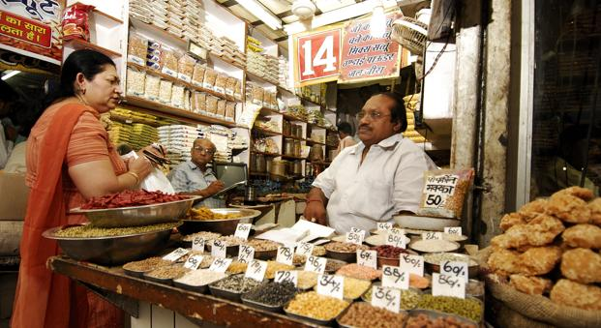
Presumptive Income Scheme (Sec. 44AD)
Threshold limit for audit who opt for presumptive Income Scheme –
1 Cr. To 2 Cr.
Presumptive Tax Rate (in respect of those turnover or gross receipt for which digital payment accepted) – 8% to 6%
Prepare by: Ankur Singhal
Spl. In: Income Tax Cases & Transfer Pricing

Slide 35

Maintenance of Books of Accounts (Sec. 44AA)
The threshold limit for maintenance of books for individuals and HUF carrying business or profession (except specified profession):
Limit of total Income – Rs. 1.20 Lacs to Rs. 2.50 Lacs
Limit of Turnover/Gross Receipt – Rs. 10 Lacs to Rs. 25 Lacs
Prepare by: Ankur Singhal
Spl. In: Income Tax Cases & Transfer Pricing

Slide 36

Domestic Transfer Pricing (Sec. 92BA)
The scope of domestic transfer pricing to be restricted to cases where atleast one of the entities involved in related party transaction enjoys specified profit-linked deduction.
It is proposed to omit clause (i) to section 92BA to provide that expenditure in respect of which payment has been made by the assessee to a person referred to in under section 40A(2)(b) are to be excluded from the scope of section 92BA of the Act. This amendments will take effect from 1st April, 2017 and will, accordingly, apply in relation to the assessment year 2017- 18 and subsequent years.
Prepare by: Ankur Singhal
Spl. In: Income Tax Cases & Transfer Pricing

Slide 37

Scrutiny Assessment [Sec. 143(3)]
The time for completion of scrutiny assessments is also proposed to be compressed further:
For A.Y. 2018-19 – From 21 months to 18 months
For A.Y. 2019-20 and thereafter – to 12 months
W.e.f. AY 2017-18, processing of return under section 143(1) is mandatory before passing of assessment order for Scrutiny Assessment.
AO not disclose reason to believe to conduct a Search (New Expl. to Sec. 132(1), (1A) & 132A(1)
AO do not need to disclose the ‘reason to believe’ or ‘reason to suspect’, as the case may be, to any person or any authority or the Appellate Tribunal. Applicable retrospectively from 01-10-1975.
Prepare by: Ankur Singhal
Spl. In: Income Tax Cases & Transfer Pricing

Slide 38
FMV as full value of consideration in case of unquoted shares (New Sec. 50CA)
Where consideration for transfer of share of a company (other than quoted share) is less than the Fair Market Value (FMV) of such share determined in accordance with the prescribed manner, the FMV shall be deemed to be the full value of consideration for the purposes of computing income under the head “Capital gains”.
This amendment will take effect from 1st April, 2018 and will, accordingly, apply in relation to the assessment year 2018-19 and subsequent assessment years.
Prepare by: Ankur Singhal
Spl. In: Income Tax Cases & Transfer Pricing

Slide 39

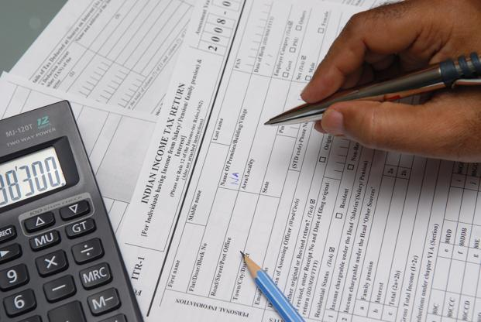
Mandatory Filing of ITR for Trust (Sec. 12A & 12AA)
Return filing is proposed to be made mandatory for the trust registered under sections 12AA. Earlier, return filing was mandatory only when income of a trust before availing exemption under section 11 exceeds the basic exemption limit.
Section 12A is proposed to be amended to provide that any trust or institution availing benefit of tax exemption under section 11 should inform the CIT within 30 days if there is any change in the object clause which do not conform to the conditions of the registration.
Applicable from Assessment Year 2018-19
Prepare by: Ankur Singhal
Spl. In: Income Tax Cases & Transfer Pricing

Slide 40
Widening scope of Income from other sources [Sec. with new clause 56(2)(x)]
It is proposed to insert a new clause (x) so as to provide that receipt of the sum of money or the property by ANY PERSON (earlier only Individual/HUF) without consideration or for inadequate consideration in excess of Rs. 50,000 shall be chargeable to tax in the hands of the recipient under the head “Income from other sources”.
These amendments will take effect from 1st April, 2017 and the said receipt of sum of money or property on or after 1st April, 2017 shall be chargeable to tax in accordance with the provisions of proposed clause (x) of sub-section (2) of section 56.
Prepare by: Ankur Singhal
Spl. In: Income Tax Cases & Transfer Pricing

Slide 41
Extend applicability of Sec. 115BBDA
It is proposed to amend section 115BBDA so as to provide that the provisions of said section shall be applicable to all resident assessees except domestic company and certain funds, trusts, institutions, etc.
This amendment will take effect from 1st April, 2018 and will, accordingly apply in relation to the assessment year 2018-19 and subsequent years.
Restriction on set-off of loss from House property [New sub sec. 71(3A)]
Set-off of loss under the head ”Income from House Property” against any other head of income shall be restricted to two lakh rupees for any assessment year.
However, the unabsorbed loss shall be allowed to be carried forward for set-off in subsequent years in accordance with the existing provisions of the Act.
This amendment will take effect from 1st April, 2018 and will, accordingly apply in relation to assessment year 2018-19 and subsequent years.
Prepare by: Ankur Singhal
Spl. In: Income Tax Cases & Transfer Pricing

Slide 42
Common Authority for Advance Ruling (Sec.155)
The Authority for Advance Ruling (AAR) for income-tax, central excise, customs duty and service tax shall be merged.
As a result, qualifications criteria for members and chairman have been revised.
Prepare by: Ankur Singhal
Spl. In: Income Tax Cases & Transfer Pricing

Slide 43
Donations
Prepare by: Ankur Singhal
Spl. In: Income Tax Cases & Transfer Pricing

Slide 44
Discontinue of 80CCG Deduction
No deduction under section 80CCG shall be allowed from assessment year 2018-19 for investment made in listed equity shares or listed units of Equity oriented fund.
However, an assessee who has claimed deduction under this section for assessment year 2017-18 and earlier assessment years shall be allowed deduction under this section till the assessment year 2019-20 if he is otherwise eligible to claim the deduction as per the provisions of this section.
Self-employed individuals to get 20% deduction under NPS Scheme (Sec. 80CCG)
In order to provide parity, it is proposed to amend Section 80CCD(1) so as to increase the upper limit of 10% to 20% of gross total income in case of other individuals.
Prepare by: Ankur Singhal
Spl. In: Income Tax Cases & Transfer Pricing

Slide 45
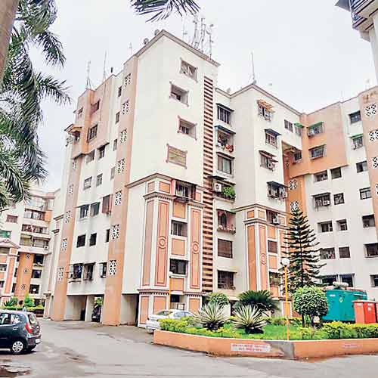
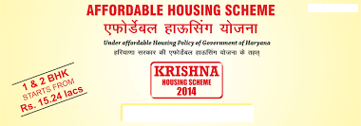
Affordable Housing Scheme (Sec. 80 IBA)
Restrict CARPET AREA to 30 and 60 sq.mtr. in the place of restriction of BUILT UP AREA to 30 and 60 sq.mtr.
The project can now be completed in 5 years after commencement (in the place of 3 years).
Prepare by: Ankur Singhal
Spl. In: Income Tax Cases & Transfer Pricing

Slide 46
THANK YOU
ANKUR SINGHAL
SPL. IN: INCOME TAX CASES & TRANSFER PRICING
FOR ANY QUERIES –
CALL: 8010325881
E-MAIL: connect.ankursinghal@gmail.com

