Slide 1
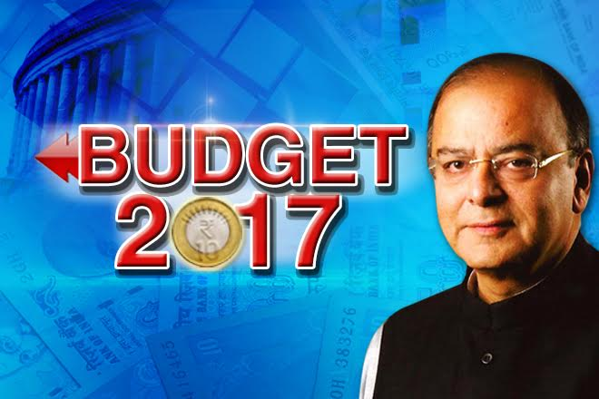

Slide 2
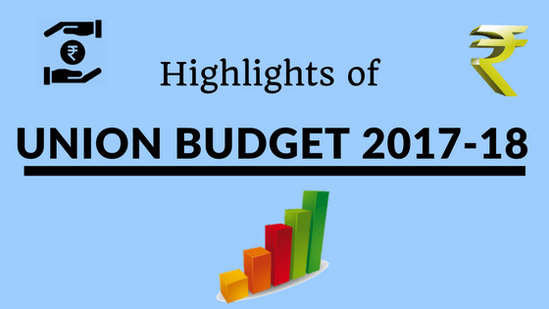

Slide 3
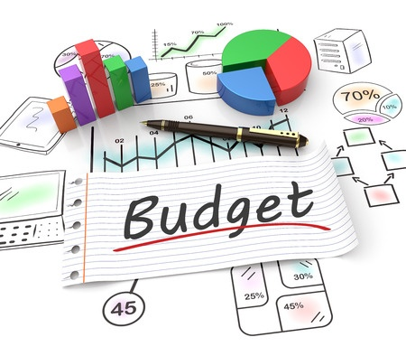
Union Budget: Important Facts that you should know
Budget is the statement of the estimated receipts and expenditure of the Government of India in a financial year.
On November 26, 1947 R.K. Shanmukham Chetty had presented the first union budget of Independent India. But actually it was a review of the economy and no new taxes were proposed as the union budget day for 1948-49 was just 95 days away.
Morarji Desai was the only FM who presented two union budget on his birthday – in 1964 and 1968. He was born on February 29.

Slide 4
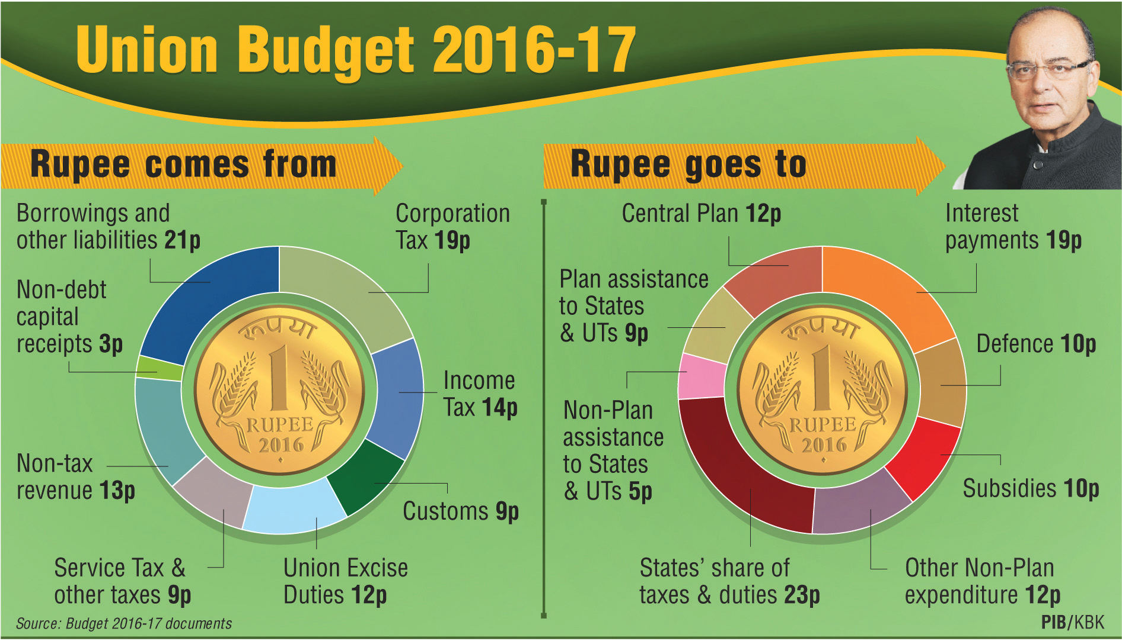
Union Budget: Allocation of Revenue and Expenses
Revenue Sources
Allocation of Expenditure

Slide 5
Union Budget 2017: Introduction
Agenda for 2017-18 in Union budget is : “Transform, Energise and Clean India” – TEC India.
TEC India seeks to
  Transform the quality of governance and quality of life of our people;
  Energise various sections of society, especially the youth and the vulnerable, and enable them to unleash their true potential; and
  Clean the country from the evils of corruption, black money and non-transparent political funding.
Budget 2017-18
Focus on Quality of Governance and Life
Energise various sections of society
Eradication of Black Money and corruption*
*Already our honorable PM Narendra Modi take an initiative on 8th Nov 2016 by way of “Demonetization”

Slide 6

Union Budget 2017: Focus on Agriculture
Target for agricultural credit in 2017-18 has been fixed at a record level of Rs. 10 lakh crores.
New mini labs in Krishi Vigyan Kendras (KVKs) and ensure 100% coverage of all 648 KVKs in the country for soil sample testing.
Dedicated Micro Irrigation Fund in NABARD to achieve ‘per drop more crop’ with an initial corpus of Rs. 5,000 crores.
Aim to bring one crore households out of poverty and to make 50,000 Gram Panchayats poverty free by 2019.
MGNREGA allocation to be the highest ever at Rs. 48,000 crores in 2017-18.
Allocation for Pradhan Mantri Awaas Yojana – Gramin increased from Rs. 15,000 crores in BE 2016-17 to Rs. 23,000 crores in 2017-18 with a target to complete 1 crore houses by 2019 for the houseless and those living in kutcha houses.
A programme of “human resource reforms for results” will be launched during 2017 18 for human resources development in Panchayati Raj Institutions.
Total allocation for Rural, Agriculture and Allied sectors is Rs. 1,87,223 crores.

Slide 7

Union Budget 2017: Various Programmes & Services
Skill Acquisition and Knowledge Awareness for Livelihood Promotion programme (SANKALP) to be launched at a cost of Rs. 4,000 crores.
Next phase of Skill Strengthening for Industrial Value Enhancement (STRIVE) will also be launched in 2017-18 at a cost of Rs. 2,200 crores.
Mahila Shakti Kendra will be set up with an allocation of Rs. 500 crores in 14 lakh ICDS Anganwadi Centres. This will provide one stop convergent support services for empowering rural women with opportunities for skill development, employment, digital literacy, health and nutrition.
Two new All India Institutes of Medical Sciences to be set up in Jharkhand and Gujarat.
For senior citizens, Aadhar based Smart Cards containing their health details will be introduced.

Slide 8
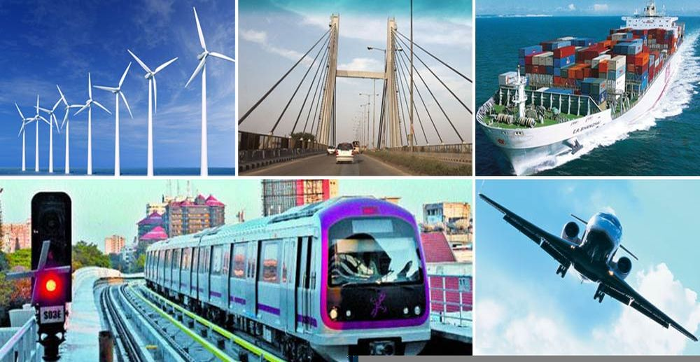
Union Budget 2017: Transport Sector
For transportation sector as a whole, including rail, roads, shipping, provision of Rs. 2,41,387 crores has been made in 2017-18.
In Railways, for passenger safety, a Rashtriya Rail Sanraksha Kosh will be created with a corpus of Rs. 1 lakh crores over a period of 5 years.
By 2019, all coaches of Indian Railways will be fitted with bio toilets.
Tariffs of Railways would be fixed, taking into consideration costs, quality of service and competition from other forms of transport.
In the road sector, Budget allocation for highways increased from Rs. 57,976 crores in BE 2016-17 to Rs. 64,900 crores in 2017-18.

Slide 9

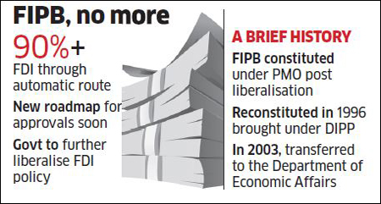
Union Budget 2017: Technology and FIPB*
*Foreign Investment Promotion Board
By the end of 2017-18, high speed broadband connectivity on optical fiber will be available in more than 1,50,000 gram panchayats, under Bharat Net.
A Digi Gaon initiative will be launched to provide tele-medicine, education and skills through digital technology.
Foreign Investment Promotion Board to be abolished in 2017-18 and further liberalization of FDI policy is under consideration.
A Computer Emergency Response Team for our Financial Sector (CERT-Fin) will be established.

Slide 10

Union Budget 2017: Banking/Financial Sector
A new ETF with diversified CPSE stocks and other Government holdings will be launched in 2017-18.
Lending target under Pradhan Mantri Mudra Yojana to be set at Rs. 2.44 lakh crores. Priority will be given to Dalits, Tribals, Backward Classes and Women.
Aadhar Pay, a merchant version of Aadhar Enabled Payment System, will be launched shortly.
Proposed to create a Payments Regulatory Board in the Reserve Bank of India by replacing the existing Board for Regulation and Supervision of Payment and Settlement Systems.

Slide 11
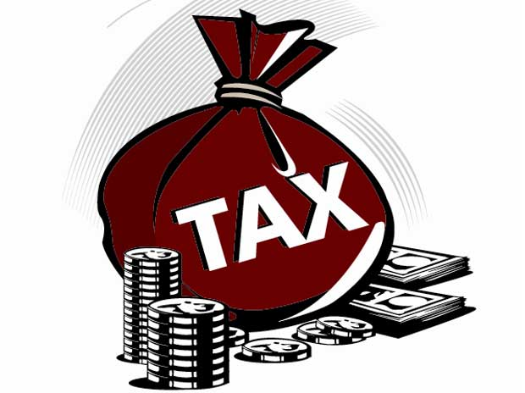
Union Budget 2017: Taxation and Others important points
MAT credit is allowed to be carried forward up to a period of 15 years instead of 10 years at present.
Income tax for companies with annual turnover up to Rs. 50 crore is reduced to 25%.
No transaction above Rs. 3 lakh would be permitted in cash subject to certain exceptions.
Maximum amount of cash donation, a political party can receive, will be Rs. 2,000/- from one person. This is one of the best points under the current union budget.
Existing rate of taxation for individual assesses between income of Rs. 2.5 lakhs to 5 lakhs reduced to 5% from the present rate of 10%. Surcharge of 10% for those whose annual income is Rs. 50 lakh to 1 crore.
Fiscal deficit for 2017-18 pegged at 3.2% of GDP and Fiscal deficit target for next three years pegged at 3%.
Revenue Deficit of 2.3% in BE 2016-17 stands reduced to 2.1% in the Revised Estimates. The Revenue Deficit for next year is pegged at 1.9%, against 2% mandated by the FRBM Act.

Slide 12

Thank You!!!
Do you have
Please drop a mail at : manishpandey177@gmail.com
91+9047763584

