Slide 1
By: CA Abhishek Aggarwal ( YNR)
MUTUAL FUNDS

Slide 2
What is a Mutual Fund?
A mutual fund is a pool of money collected from investors and is invested according to stated investment objectives.
A Mutual Fund is a trust that pools together the savings of a number of investors who share a common financial goal.
The money thus collected is then invested in capital market instruments such as shares, debentures and other securities

Slide 3
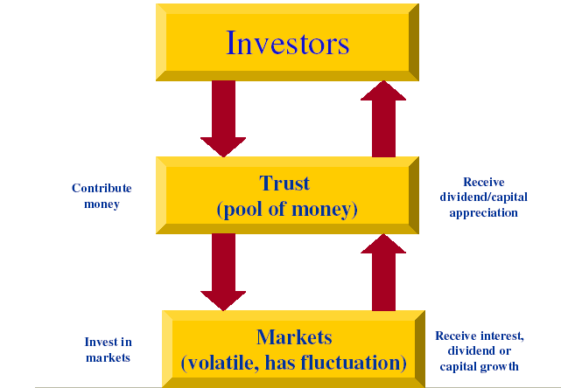

Slide 4
Concept
What is a mutual fund?
Common pool of money
  Joint or “mutual” ownership
  Similarity with shares of a joint stock company
  Units are the representation of ownership
  Mutual fund is not a company which manages individual portfolios

Slide 5
Advantages of Mutual Funds
  Portfolio diversification
  Professional management
  Reduction / diversification of risk
  Reduction of transaction cost
  Liquidity
  Convenience and flexibility
  Well Regulated
  Transparency
  Attractive Returns

Slide 6
Not really disadvantages
SEBI regulation caps the cost involved. Competition pushes them further lower
Multiplicity of portfolio largely satisfies the needs of most of the investor
Availability of multiple portfolio increases choice by comparison

Slide 7
TYPES OF MUTUAL FUNDs
Mutual Funds
By Maturity Period
By Investment Objective
Open ended
Close ended
Equity
Balance fund
Gilt fund
Income
Money market
Index fund

Slide 8
Schemes according to Maturity Period
A mutual fund scheme can be classified into open-ended scheme or close-ended scheme depending on its maturity period.
Open-ended Fund
An open-ended Mutual fund is one that is available for subscription and repurchase on a continuous basis. These Funds do not have a fixed maturity period.
close-ended Fund
A close-ended Mutual fund has a stipulated maturity period e.g. 5-7 years. The fund is open for subscription only during a specified period at the time of launch of the scheme.

Slide 9
Fund according to Investment Objective
A scheme can also be classified as growth fund, income fund, or balanced fund considering its investment objective.
Growth / Equity Oriented Scheme
The aim of growth funds is to provide capital appreciation over the medium to long- term.
Such funds have comparatively high risks.
These schemes provide different options to the investors like dividend option, capital appreciation, etc.

Slide 10
Balanced Fund
The aim of balanced funds is to provide both growth and regular income as such schemes invest both in equities and fixed income securities in the proportion indicated in their offer documents.
These are appropriate for investors looking for moderate growth.

Slide 11
Money Market
These funds are also income funds and their aim is to provide easy liquidity, preservation of capital and moderate income.
These schemes invest exclusively in safer short-term instruments such as treasury bills, commercial paper and government securities, etc.
These funds are appropriate for corporate and individual investors as a means to park their surplus funds for short periods.

Slide 12
Gilt Funds
These funds invest exclusively in government securities.
Government securities have no default risk.
Index Funds
This schemes invest in the securities in the same weightage comprising of an index.
This schemes would rise or fall in accordance with the rise or fall in the index

Slide 13

Various Mutual Funds in India
State Bank of India mutual fund
ICICI prudential mutual fund
TATA mutual fund
HDFC mutual fund
Birla sun life mutual fund
Reliance mutual fund
Kotak Mahindra mutual fund etc..

Slide 14

ASSOCIATION OF MUTUAL FUNDS IN INDIA
Association of Mutual Funds in India (AMFI) was incorporated on 22nd August, 1995.
(AMFI) modeled on the lines of a Self Regulating Organization (SRO) with a view to 'promoting and protecting the interest of mutual funds and their unit-holders, increasing public awareness of mutual funds, and serving the investor’s interest by defining and maintaining high ethical and professional standards in the mutual funds industry'
Association of Mutual Funds India has brought down the Indian mutual fund industry to a professional and healthy market with ethical lines enhancing and maintaining standards.
It follows the principle of both protecting and promoting the interests of mutual funds as well as their unit holders.

Slide 15
MUTUAL FUND
Structural Framework

Slide 16
Summary
The Mutual Fund Industry is a growth industry
Mutual Funds cover a spectrum of Investment Options
Start Investing Early & Systematically
We invest directly or through a Professional Money Manager

Slide 17
THANK YOU….

