Slide 1

Introduction & Overview of FTP 2015-20
- CA Madhukar N. Hiregange

Slide 2
Coverage
Introduction - FTP 2015-20
Vision and Goal of FTP
Objective of FTP
Key Features of FTP
Transitional Provision
Exports prior to 31.3.2015 -Old Scheme Validity

Slide 3
Introduction
April 1, 2015
Road map for India’s global trade engagement in the coming years
Framework for increasing exports of goods and services
Focus of the new policy is to support both the manufacturing and services sectors,
Special emphasis on improving the ‘ease of doing business’.

Slide 4
Vision and Goal
Vision –
  to make India a significant participant in world trade by the year 2020 and
  to enable the country to assume a position of leadership in the international trade discourse.
Goal –
  increase India’s exports of merchandise and services from USD 465.9 billion in 2013-14 to apprx USD 900 billion by 2019-20 and
  to raise India’s share in world exports from 2 percent to 3.5 percent.

Slide 5
Objective
    To provide a stable and sustainable policy environment;
    To link rules, procedures and incentives for exports and imports with other initiatives (such as Make in India, Digital India and Skills India )
    To create an Export Promotion Mission for India;
    To promote the diversification of India’s export basket by helping various sectors of the Indian economy;

Slide 6
Objective
    To create an architecture for India’s global trade engagement with a view to expanding its markets and better integrating with major regions, thereby increasing the demand for India’s products and contributing to the government’s flagship ‘Make in India’ initiative;
To provide a mechanism for regular appraisal in order to rationalise imports and reduce the trade imbalance.

Slide 7
Key Features
Introduction of 2 schemes –
  Merchandise Exports from India Scheme (MEIS)
  Services Exports from India Scheme (SEIS)
Procurement of CGs from indigenous manufacturers - EO reduced to 75% of normal EO
MEIS benefit extended to e-Commerce exports of handloom products, books/periodicals, leather footwear, toys and customized fashion garments through courier or foreign post office [(for values upto 25,000 INR)]

Slide 8
Key Features
MEIS and SEIS benefits extended to SEZ units also
Paperless working in 24x7 environment
Trade facilitation and enhancing the ease of doing business
Reduction of the number of mandatory documents - Notification 114/ (RE-2013)/2009-2014

Slide 9
Key Features
Online facility to upload documents
Approved Exporter Scheme yet to be notified
MSME clusters 108 have been identified for focused interventions to boost exports.
Niryat Bandhu Scheme’ - galvanized and repositioned to achieve the objectives of ‘Skill India’
Outreach activities - to be organized by knowledge partners & industry partners.

Slide 10
Transition Provision
License/ scrip issued before 1.04.2015
  Such scrips shall be valid.
  Only for the purpose and duration for which it was issued
  subject to the conditions stipulated in the erstwhile FTP

Slide 11
Transition Provision
License/ scrip issued on or after 1.04.2015
  Goods already exported or services already rendered before 1.04.2015
  exporter can apply/ may be issued the scrip on or after 1.04.2015
  Shall be governed by the then prevailing policy and procedure (under erstwhile FTP and HBP)

Slide 12
Transition Provision
New Restrictions imposed on import/ export
  export or import will ordinarily be permitted, notwithstanding such restriction or regulation
  However, export or import is made within the original validity period of an irrevocable commercial LOC, established before the date of imposition of such restriction and it shall be restricted to the balance value and quantity available and time period of such irrevocable LOC

Slide 13
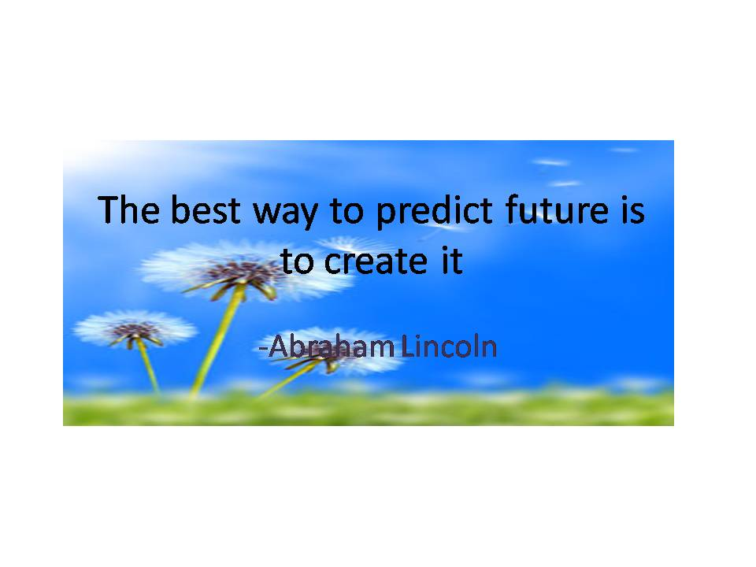

Slide 14

- madhukar@hiregange.com

