Slide 1
CASH MANAGEMENT IN MNC
NEHA ABHISHEK, BANGALORE
Batch: 22, (5th July to 30th August, 2014)

Slide 2
OVERVIEW
Motives For Holding Cash
Objectives of Cash Management
Effective Cash Management: Key Factor
Cash Flow Analysis: Subsidiary Perspective
Technique to Optimize Cash Flow
Complication in Optimizing Cash Flow
Transfer Pricing And Related Issues

Slide 3
Motives For Holding Cash
Transaction Motive
Cash to meet anticipated obligations whose time is not perfectly synchronized with cash receipts
Precaution Motive
Precautionary cash balance serves to provide a cushion to meet unexpected contingencies
Speculative Motive
Compensating Motive
Cash to quickly take advantage of opportunities typically outside the normal course of business.
Cash to compensate banks for providing certain services or loans.

Slide 4
Objectives of Cash Management
The objectives of cash management are to:
  Minimize the time involved in converting receipts into usable bank funds
  Concentrate those funds into a central account where they can be most effectively managed
  Control and minimize the cost of payments
  Reduce or eliminate borrowings

Slide 5
Effective Cash Management: Key Factor
Cash budget that project expected cash inflow and outflow.
Systematic Cash receipt and disbursement of cash.
Fund Mobilization
  Borrowing at most favorable rates
  Surplus fund invested in advantageous rates
In MNC cost of foreign exchange transactions is to be managed.

Slide 6
Cash Flow Analysis: Subsidiary Perspective
Working capital management and management of cash flow are integrated.
Subsidiary Expense: Risk involved on International purchase of raw materials or supplies.
  Difficult to forecast cash outflow due to exchange rate fluctuation
  Payment may be substantially higher due to appreciation in invoice currency
  If the sales volume is highly volatile, larger cash balances may need to be maintained in order to cover unexpected inventory demands.
  Firm may maintain large inventory of supplies and raw materials
    -Cut down its purchases when invoice currency appreciates
    -Imported goods from another country could be restricted by the host government

Slide 7
Cash Flow Analysis: Subsidiary Perspective
Subsidiary Revenue: Risk involved if subsidiary export their products.
Sale volumes may be more volatile due to fluctuation in exchange rate of invoice currency.
Demand for these products most likely to decrease if invoice currency appreciates.
Looser credit standards may increase sales (accounts receivable), but often it slowdown cash inflows from sales.

Slide 8
Cash Flow Analysis: Subsidiary Perspective
Subsidiary Dividend Payment:
Forecasting cash flow is easier for subsidiary if payment of dividend and fees paid by subsidiary to parent are known in advance and denominated in subsidiary currency.
Level of dividend and fees paid by subsidiary to parents depend on
  Liquidity needs of each subsidiary
  Potential uses of fund at various subsidiary locations
  Expected movement in currencies of subsidiary
  Regulation of host country government

Slide 9
Cash Flow Analysis: Subsidiary Perspective
Subsidiary Liquidity Management:
  Cash deficiency: Short term financing
  Excess Cash: If invested in foreign currency then effective yield may be uncertain due to fluctuation in foreign currency.
  If the subsidiary has access to lines of credit and overdraft facilities, it may maintain adequate liquidity without substantial cash balances.
Centralized Cash Management: Need to monitor and manage the parent subsidiary and inter subsidiary cash flow.

Slide 10
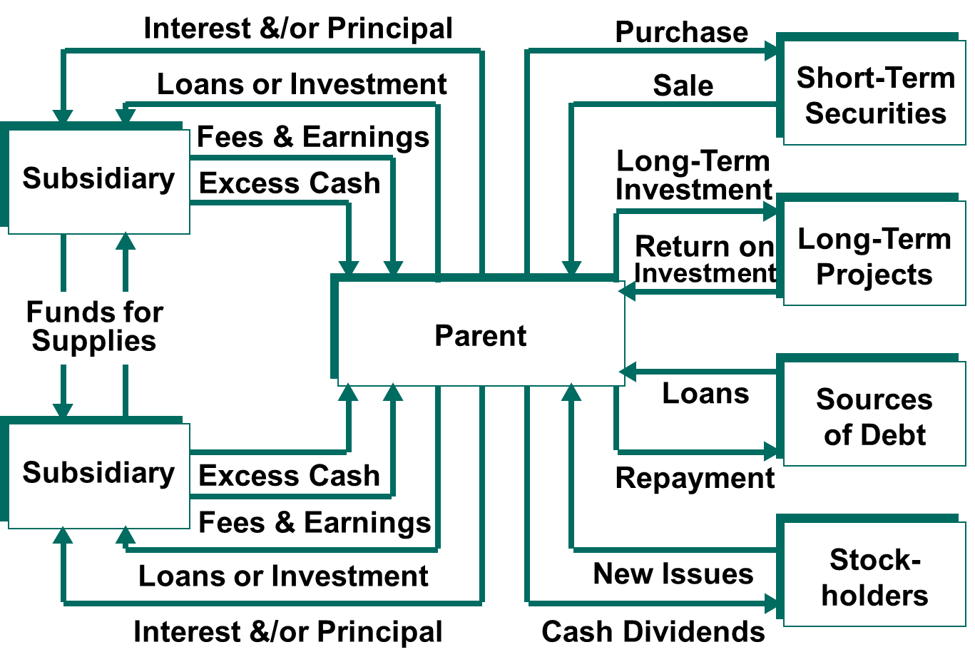
Cash Flow of Overall MNC

Slide 11
Technique to Optimize Cash Flow
Accelerating Cash Inflow
Lockboxes reduce Mailing Time. Bank usually processes incoming cheques at lockbox on daily basis.
Preauthorized Payment allows corporation to charge costumer bank account up to some limit.
Minimizing Currency Conversion Cost
Netting reduce the administrative and transaction cost that result from currency conversion.
Managing Blocked Fund
Setup R&D division, which incur cost and possibility generate fund for other subsidiary.
Transfer Pricing that will increase the expense incurred by the subsidiary.
Managing Inter Subsidiary Cash Transfer
Bilateral Netting System involve transaction between two units, between parent and subsidiary or between inter subsidiaries.
Multilateral Netting System involve more complex interchange among the parent and several subsidiary.
Borrowing from local intermediary, so that earning can be distributed to payoff previous financing.
A subsidiary with excess funds can provide financing by paying for its supplies earlier than is necessary. This technique is called leading.
Alternatively, a subsidiary in need of funds can be allowed to lag its payments. This technique is called lagging.

Slide 12
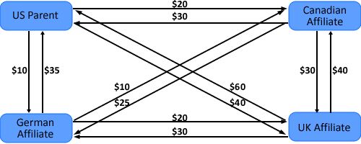
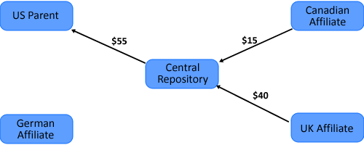
Inter-subsidiary Payments Matrix
Receipt | Disbursements
 | U.S. | Canada | Germany | U.K. | Total Receipt | Net
U.S. | - | 30 | 35 | 60 | 125 | 55
Canada | 20 | - | 10 | 40 | 70 | (15)
Germany | 10 | 25 | - | 30 | 65 | 0
U.K. | 40 | 30 | 20 | - | 90 | (40)
Total disbursement | 70 | 85 | 65 | 130 | 350 | 0
Inter affiliated foreign transaction without Netting
Multilateral Netting with Central Depository

Slide 13
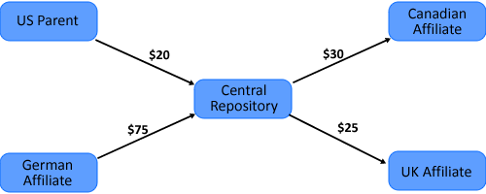
External Payments Matrix
Affiliate | Receipt | Disbursement | Net
U.S. | $140,000 | $120,000 | $20,000
Canada | $135,000 | $165,000 | ($30,000)
Germany | $125,000 | $50,000 | $75,000
U.K. | $130,000 | $155,000 | ($25,000)
 |  |  | $40,000
Flow of net cash receipt with External Parties with a Central Depository ($000)

Slide 14
Investing Excess Cash
Separate Investment for all subsidiary
Centralized Approach
More efficient uses of fund and possibly higher return.
Multiple currencies
Subsidiary use same currency
Cash can be pooled together so that there is separate pool for each currency.
Invest fund in securities denominated in the foreign currencies that will be needed by the subsidiaries in the future.
Local bank relationships are better developed since the affiliate conducts more of its cash management functions at the local level.
Facilitates the transfer of funds from subsidiary with excess funds to those that need fund, thereby reducing financial cost.

Slide 15
Important term
Determining the effective yield: The effective rate for foreign investment is
r_{f} = ( 1 + i_{f} ) ( 1 + e_{f} ) – 1
  where i_{f} = the quoted interest rate on the investment
  e_{f} = the % change in the spot rate
Interest Rate Parity(IRP): the interest rate differential between two countries is equal to the differential between the forward exchange rate and the spot exchange rate.
If IRP exists, the forward rate can be used as a break-even point to assess the short-term investment decision
Diversifying Cash Across Currencies: If an MNC is not sure of how exchange rates will change over time, it may prefer to diversify its cash among securities that are denominated in different currencies. The degree to which such a portfolio will reduce risk depends on the correlations among the currencies.

Slide 16
Key Implication of IRP and Forward rate
Scenario | Implication for Investing in Foreign Money Market
IRP exist | Covered interest arbitrage is not worthwhile.
IRP exist, and the forward rate is an accurate forecast of future spot rate | Uncovered investment in foreign security is not worth worthwhile.
IRP exist and forward rate is unbiased forecast of future spot rate | Uncovered investment in foreign security will on average earn an effective yield similar to an investment in a domestic security.
IRP exist and forward rate is expected to over estimate the future spot rate | Uncovered investment in foreign security is expected to earn a lower effective yield than investment in a domestic security.
IRP exist and forward rate is expected to under estimate the future spot rate | Uncovered investment in foreign security is expected to earn a higher effective yield than investment in a domestic security.
IRP does not exist, the forward premium (discount) exceed (is less than) the interest rate differential | Covered interest arbitrage is feasible for investor residing in the home country.
IRP does not exist, the forward premium (discount) is less than (exceed) the interest rate differential | Covered interest arbitrage is feasible for foreign investors but not for investor residing in home country.

Slide 17
Complication in Optimizing Cash Flow
Company Related Characteristic
When a subsidiary delays its payments to the other subsidiaries, the other subsidiaries may be forced to borrow until the payments arrive.
Centralized approach that monitor all inter subsidiary payment should be able to minimize such problem.
Government Restriction
Prohibit the use of a netting system.
Periodically prevent cash from leaving the country.
Characteristic of Banking System
The abilities of banks to facilitate cash transfers for MNCs may vary among countries.
Without full use of banking recourses and information, the effectiveness of international cash management.

Slide 18
Transfer Pricing And Related Issues
The Transfer Price is the price that for accounting purposes, is assigned to goods and services flowing from one division of a firm to another division.
For MNC, there exists the added complications of:
  Difference in tax rate.
  Import duties and quotas.
  Exchange rate restrictions on part of host country.
Most countries have regulations controlling transfer pricing. In the U.S., the tax code requires transfer prices to be arms length prices.

Slide 19
Arms Length Price
A price a selling affiliate would charge an unrelated customers for the goods and services.
The provisions relating to determination of arm’s length price are contained in section 92C which provides as follows:
  Comparable uncontrolled price.
  Resale price: the price at which the good is resold by the affiliate is reduced by overhead and profit.
  Cost-plus approach: an appropriate profit is added to the cost of the manufacturing affiliate.
  Profit split method.
  Transactional net margin method.
  Such other method as may be prescribe by the board.

Slide 20

Thank You

