Slide 1

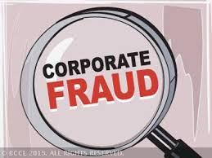
How can we do secure Business Transaction

Slide 2



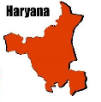
If I ship goods,
will you pay?
If I pay, will you ship the goods?
Buyer
(Inox Ltd.)
Seller
( Busch)
Great!
Ok, I’ll ask my bank (Axis) to open LC

Slide 3
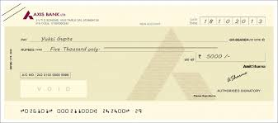
LETTER OF CREDIT ( LC )
LC is another banking instrument which is used in the Modern Banking.

Slide 4
Definition
“Letter of Credit” or “L/C” is the most preferred form of payment for goods in international trade as it solves issues of mutual mistrust by using banks as arbiters.
In a simple explanation a letter of credit is a promise to pay. Banks issue letters of credit as a way to ensure sellers that they will get paid as long as they do what they've agreed to do.

Slide 5
Involvement of Parties
Buyer
(Inox Ltd.)
Buyer’s Bank/ Applicant bank
Axis Bank
Seller
( Busch)
Seller’s Bank/ Benificiary Bank
IDBI Bank

Slide 6
Customer Enquiry
Performa Invoice
with Bank Details (IDBI Bank)
              Bank Name
              Brach Address
              Account No.
              IFSC Code for Swift Message
Receive Purchase Order with INCO Terms e.g. DDP, FOB, CIF, Ex-Works etc.

Slide 7

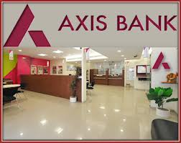

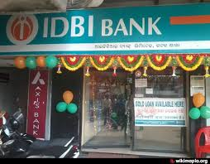
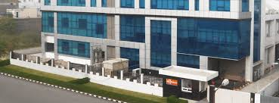

What Buyer (Inox) will do
SWIFT MESSAGE

Slide 8

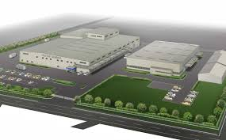
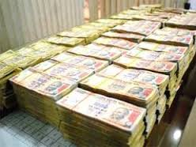
After receiving LC confirmation what seller will do:
Recd. Material as per PO
Thanks, Applicant ( INOX) recd. Material .

Slide 9

Advantages of LC:
Bank ensures us that he will make payment on time i.e. very low risk.
No need to check the customer’s net worth.
Less/ No follow up for payment.
LC can be discounted ( Negotiated)with bank.
Acceptable worldwide.
In case of dispute- Arbitrage Facility.
More credit period can be allowed by seller
USANCE/Interest option.

Slide 10
THANK YOU

