Slide 1
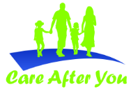

Care After You
“Your today’s decision can change your family future”

Slide 2
Insurance Regulatory and Development Authority (IRDA)
Dependant of Insured are not aware about the insurance policy taken by the insured. Therefore in the event of untimely death of the insured, the family members are not in a position to claim the amount“
IRDA Circular No.IRDA/F&A/CIR/GLD/056/02/2014 dated 18th Feb 2014

Slide 3
Reserve Bank of India/Others
More than 3600 crores is stagnant in unclaimed account in banks
Thousands of crores are pending unclaimed in PPF, Post Office Scheme and other investments

Slide 4
Only One Test
Ask one of your family member, whether they are aware about your documents / investments, if the Answer is NO then this service is for you.
PS : 96 % Family members are not fully aware about these documents as per survey made by Care After You Team in Delhi NCR

Slide 5
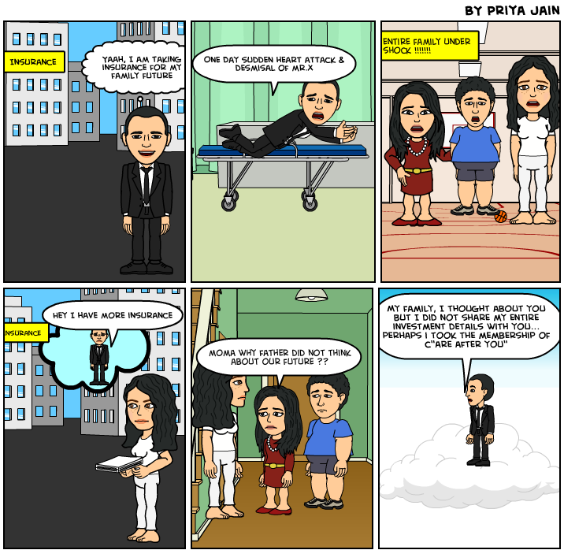
Are We not like Mr. X ?
We are Just like Mr. X, who is investing and thinking that my family’s future is safe. However we are not thinking that unless we’ll share the details of these investments / documents, till then our family will not get full benefits of our Investments.

Slide 6
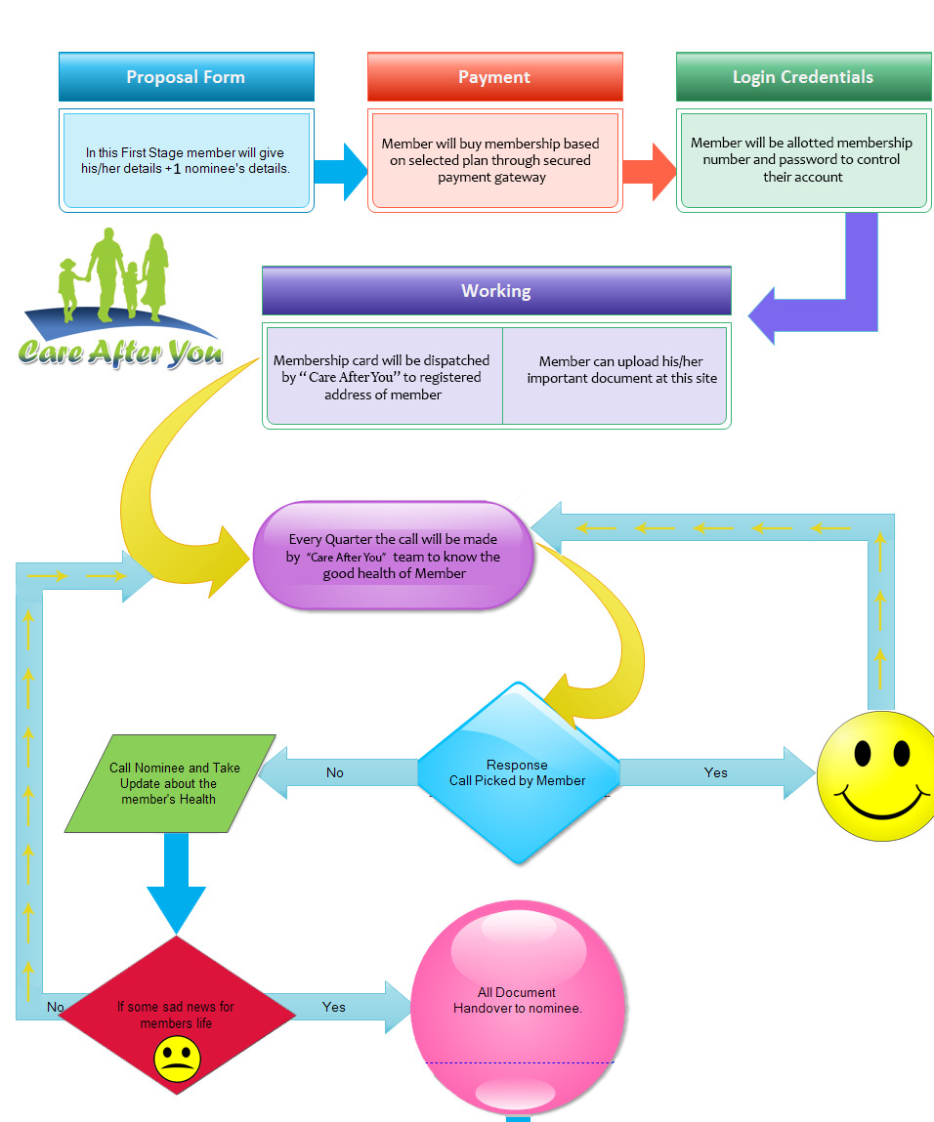
How it works

Slide 7
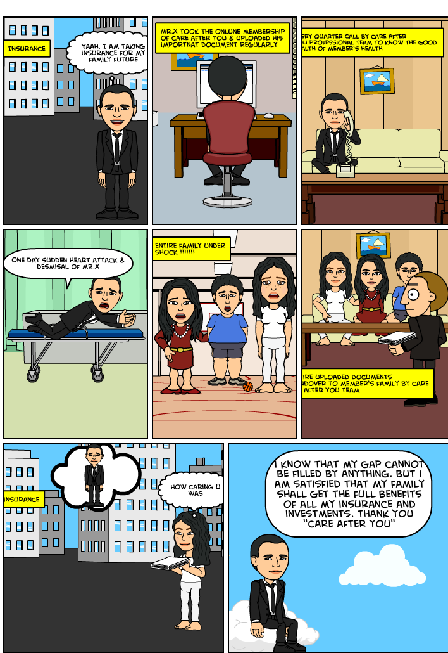
Can’t we take decision like Mr. X ?
As Life is like a coin, only 1 side is visible at a time. But remember other side is waiting for its turn.
Don’t think that Bad things happens only to others..
Secure your family NOW

Slide 8
What is our Benefits ?
In our family, we have seen such cases, where sudden death of earning members, leads financial death of family too
For this we are working @ zero Profit.
We feel that with this, if we can help even one person then our objective to start this will achieve.

Slide 9
What we need from You
Awareness….Ask your friends, relatives to share details of documents/investments with family…
Though being a professional company we could make it much Simpler for You…
Take this membership Now and upload all your documents immediately…
Don’t wait.. Bad time does not come after knocking the door..

Slide 10
Cost of the Membership
The Cost of this Membership is INR 1000 Per Annum only. Once we’ll achieve more numbers, then we’ll reduce this cost further…
Don't worry If you do not have money for this
As this a social cause, we want your association in this. Just write a small mail to us @ info@careafteryou.com. We will give this membership at Rs.1 only

Slide 11
Login Today
www.careafteryou.com
A secured site having SSL certificate
Secured Payment Gateway of CC Avenue
Regular back-up

Slide 12
Contact Us
Care After You
04th Floor , Statesman House Building
Barakhamba Road, Connaught Place,
New Delhi-110001
e mail- info@careafteryou.com
Website : www.careafteryou.com
Telephone Number : +91 7042255055
Toll Free : 1800 3000 1185

