Slide 1
100 HOURS ITT Programme
PROJECT REPORT
Submitted By:
Name :-
Roll No. :-
Regn. No. :-
Batch :-
Timings :-
Section :-
Submitted To:

Slide 2

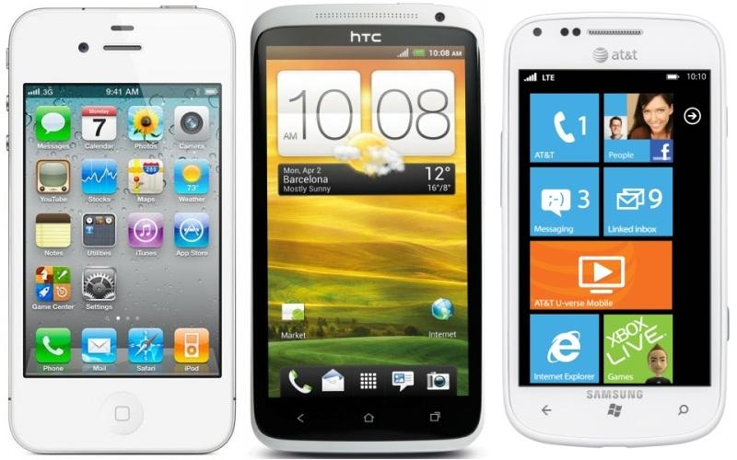
Mobile Operating Systems

Slide 3
ACKNOWLEDGEMENT
We would like to express our gratitude towards our teacher ____________ for their support and guidance while making this project.
Their constant guidance and willingness to share their vast knowledge made us understand this project and its manifestations in great depths and helped us to complete the assigned tasks.

Slide 4
INDEX
Introduction
Different types of OS’s
Comparison Of Operating System
User Interface
Maps
Camera
Browser
Mobile Payment
In-car Integration
Market Share
Apps
Handsets and affordability
Memory and storage
Video Chat
Call Features
Advantages
Disadvantages
Conclusion
Bibliography

Slide 5
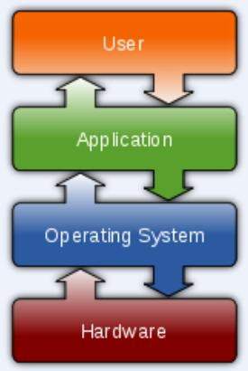
Introduction
An Operating System (OS) is an interface between hardware and user. It manages hardware and software resources of the system.
An Operating System which controls mobile devices is called Mobile OS. They are simple and deal with the wireless versions of broadband and local connectivity.

Slide 6
Different types of OS’s
Mobile OS
iPhone OS
Windows Mobile
Android
Symbian OS
Palm OS

Slide 7
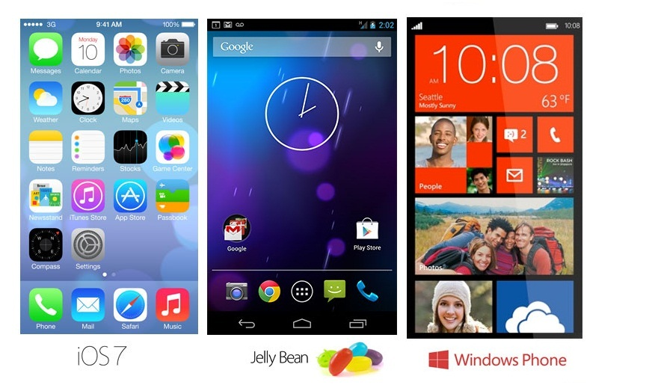
_{Overview}
iOS 7 | Android Jelly Bean | Windows OS 8
Apple’s current operating system is completely user friendly and provides a quality Smartphone experience with perhaps the best ecosystem. Apple itself has the control over its hardware, software and apps, therefore there is a strict quality check. | Android is an operating system based on the Linux kernel, and designed primarily for touch screen mobile devices such as Smartphone and tablet computers. Android has major market share. | Users are going to find that Windows Phone 8 offers an elegant and playful user experience. The same outlook as that on Windows laptops is definitely an advantage when it comes to functionality and handling.

Slide 8
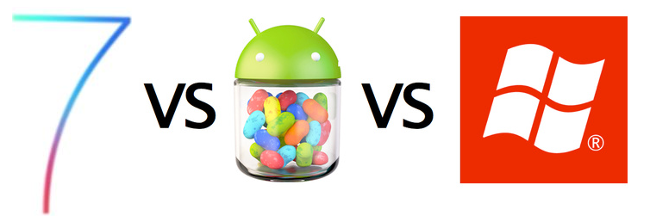
IOS 7 vs. Android Jelly Bean vs. Windows OS 8
Now, lets take a look at the Three Operating Systems and see how well they perform in the Various key Areas

Slide 9
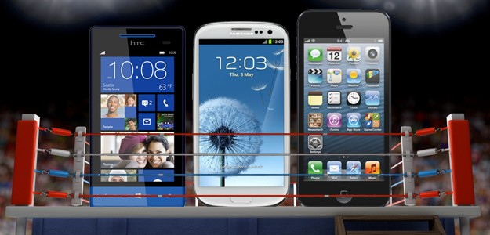
Comparison Of Operating System
Basis | iOS 7 | Android Jelly Bean | Windows Phone 8
Control Center | Control Centre to Apple devices, giving users quick access to toggles | It does have a central Control Centre, but it varies as per the phone manufacturer | Windows Phone 8 does not have provision for a Control Centre
Notification Center | Divided into three tabs | Detailed notifications | Live tile badges
Multitasking preview | Flat design for multitasking preview | Recents list | It allows users to move between active apps
Photos Grouping | Photo grouping features called Moments | Grouped by albums, dates and other tags | Photos are segregated as per albums and date

Slide 10
Real Battle Started - Apple vs. Google vs. Microsoft

Slide 11
How user friendly the interface is ?
User Interface
Mobile Payment
Camera
OS
Maps
Browser

Slide 12
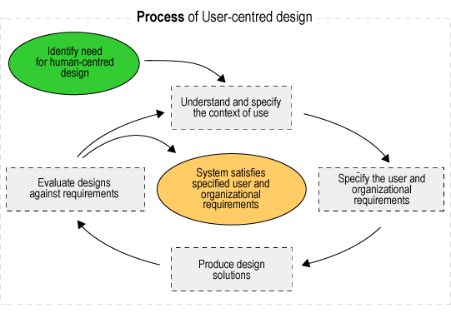
User Interface
iOS 7 | Android Jelly Bean | Windows OS 8
Apple iOS 7 is bound to follow it tried and tested formula of keeping things simple. Every new iOS version has added better functionality to the user interface, making the UI intuitive and easy to operate. | The most recent version of Android Jelly Bean offers something different and enticing in the form of highly customizable home screens – a feature that iPhones never support. | Windows 8 has the most innovative mobile UI – it has taken the concept of live tiles to a different level by adding interactivity.

Slide 13
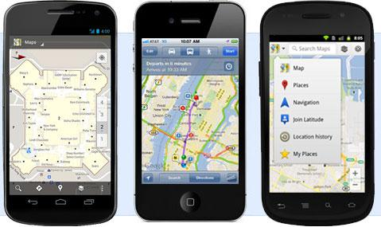
Maps
iOS 7 | Android Jelly Bean | Windows OS 8
Apple iOS 7 has ditched Google Maps and created its own mapping system. It takes an integrated approach to maps – maps are integrated with Yelp and Siri. | Android OS has, perhaps, the simples and the best mapping system. It is based on Google Maps, and it provides popular features like indoor mapping, 3D and street view. | The new Windows 8 OS doesn't use Bing Maps anymore. It has adopted Nokia's mapping system. This is a lot better than its previous map app. Not only does it allow users to access 3D street view, but it also comes with Nokia's Navtek Traffic service.

Slide 14
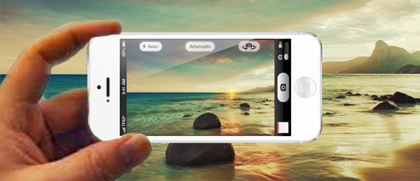
Camera
iOS 7 | Android Jelly Bean | Windows OS 8
Apple iOS 7 has the best camera software for people who do not want to bother will all sorts of settings. It is simple, all setting are automatically set, and it has automatic focus. It's the perfect camera for the average user. | Android Jelly Bean has made a lot of changes to the way the camera is used. As is the case with most Android innovations, the camera is highly customizable. It also has a new review system which makes the task of editing and deleting images simpler and faster. | The biggest surprise is Windows 8 camera app. There are lots of positive changes, and the new camera app has a simple, sleek and easy-to-use feel. When combined with Nokia PureView technology, this app is extremely powerful and effective.

Slide 15
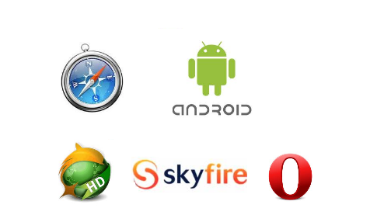
Browser
iOS 7 | Android Jelly Bean | Windows OS 8
Safari is one of the best mobile browsers, and it gets better with iOS 7. In addition to providing a great browsing experience, it also offers innovative features like cloud integration and offline reading. | As one would expect, Android Jelly bean comes with great browser support. Its basic browser works on all devices, and it is loaded with several innovative browsing and security features. It also offers several syncing facilities, and Google Chrome is available for select devices. | Windows 8 comes equipped with a smart and highly secure IE 10 browser. The latest version of the Explorer has phishing protection, and it provides an amazing mobile browsing experience.

Slide 16
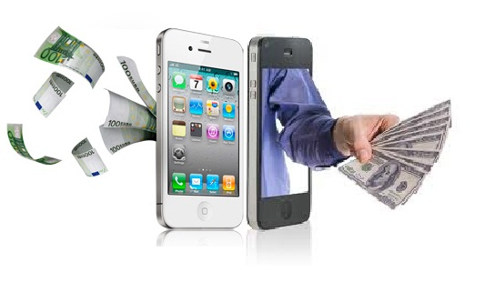
Mobile Payment
iOS 7 | Android Jelly Bean | Windows OS 8
Apple iOS 7 doesn't use the NFC technology, but it simplifies mobile payment through its Passbook services. | Android Jelly Bean comes with Google Wallet, an app that can handle mobile payment, discounts, rewards and other mCommerce services | Using NFC Windows 8 has made it a lot easier for users to make online purchases through their mobiles. Microsoft Wallet is expected to integrate with different apps and enable users to make payment through services like PayPal.

Slide 17
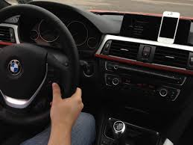
In-car Integration
iOS 7 | Android Jelly Bean | Windows Phone 8
Apple has unveiled iOS in the Car feature with the latest software update, so that they can access calls, messages, maps etc hands-free | Driving Mode in Android Jelly Bean allows in-car integration for smartphones and tablets | Nokia Drive is available on Windows Phone 8 for in-dash integration

Slide 18
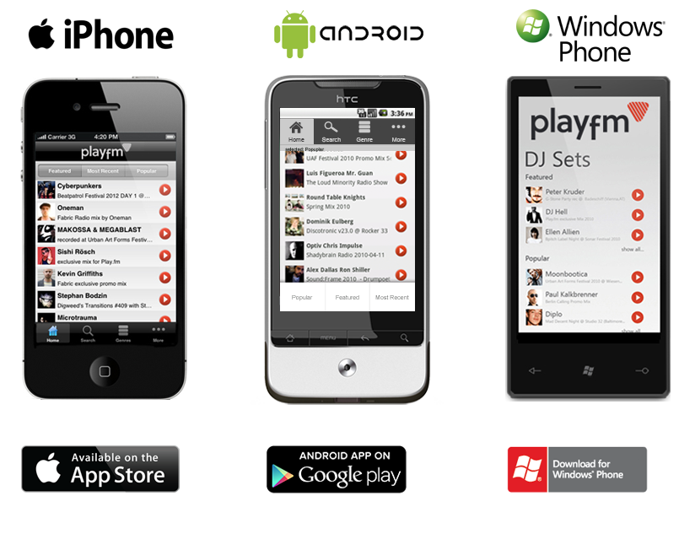
Official Application store

Slide 19

Market Share
iOS 7 | Android Jelly Bean | Windows OS 8
13.4% | 81.3% | 4.1%

Slide 20
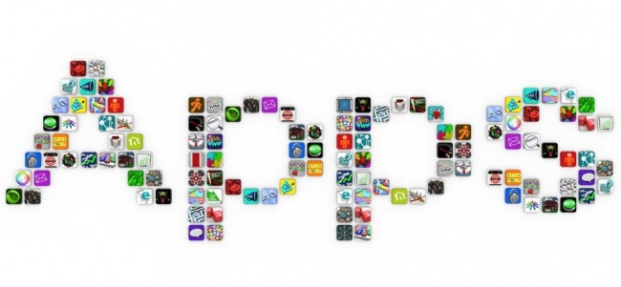
Apps
iOS 7 | Android Jelly Bean | Windows OS 8
There are over 750,000 apps. Therefore a wide variety with good quality | Android also has a large selection of apps and most of them are free but with poor quality control | Because of less market share it has very less apps to offer and these tend to be expensive when compared with others

Slide 21
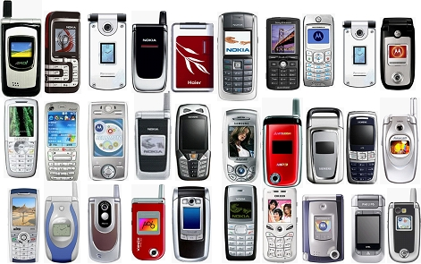
Handsets and affordability
iOS 7 | Android Jelly Bean | Windows OS 8
Good quality handsets with not so good affordability ratings. They still have high resale value | Android system is available in cheaper phones as well, the prices depend upon build quality | Android system is available in cheaper phones as well, the prices depend upon build quality

Slide 22
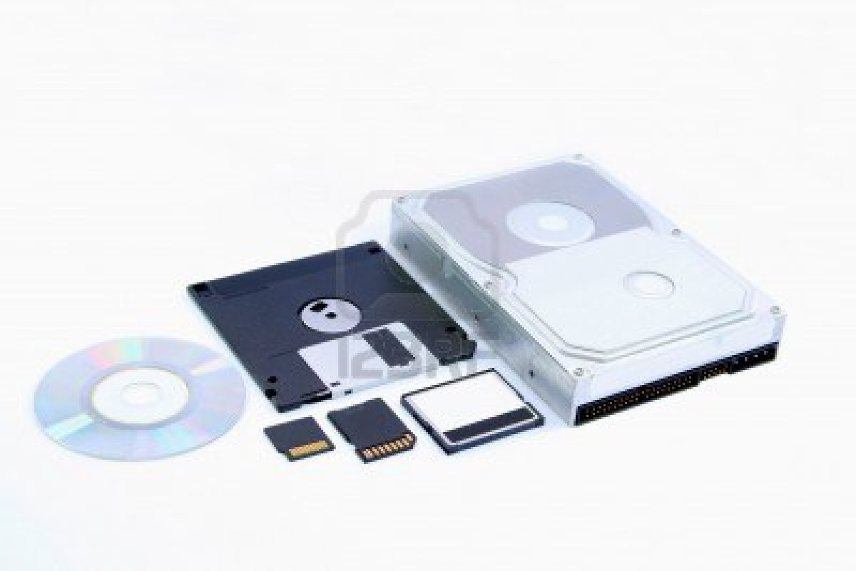
Memory and storage
iOS 7 | Android Jelly Bean | Windows OS 8
No expandable memory | Memory can be expanded | Memory can be expanded on most cells

Slide 23
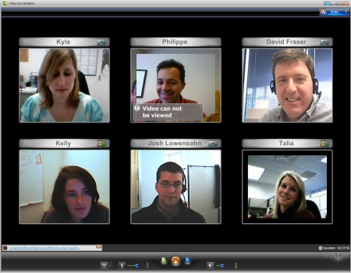
Video chat
iOS 7 | Android Jelly Bean | Windows OS 8
Apple has FaceTime, which can place calls over 3G or Wi-Fi, and works fairly well. But its also a pretty insular app that only works with other Apple devices. | Android's Gmail/Google Talk-based video chat system is a bit more universal, considering you can video chat with anybody who has Gmail on a Mac, PC, or Android phone. And yes, you can chat over 3G or Wi-Fi. | Microsoft's secret voice chat weapon is Skype, which is arguably the most universal standard of them all. There are already proper Skype apps for Macs, PCs, iOS, and Android—and Microsoft owns all of them.

Slide 24
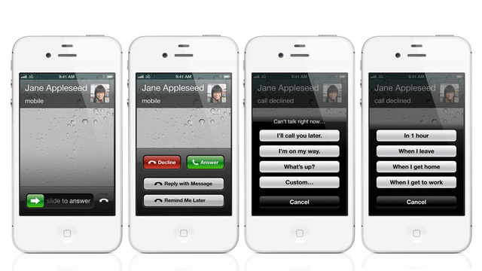
Call Features
iOS 7 | Android Jelly Bean | Windows OS 8
iOS 6 lets you decline a call with a canned SMS response, filter out calls annoying contacts, and includes a Do Not Disturb toggle, all of which will prove useful for power users | Android lets you compose a series of texts you can use as quick auto-replies when declining a call, and also lets you filter out calls from specific people, but it lacks the ability to enter into a Do Not Disturb mode. | This is another weak point in Windows Phone, as there are no pre-composed texts you can fire off to people you don't want to talk to, nor is there any sort of Do Not Disturb functionality. But there are advanced filtering and call block options for those people you're trying to avoid.

Slide 25
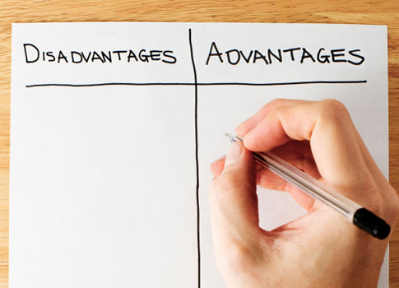
Advantages
iOS 7 | Android Jelly Bean | Windows OS 8
Large ecosystem allows syncing, sharing and remote control over secret and personal data. | Different security options e.g. unlocking the phone with eye identification. | There is a kid’s corner that allows the kids to play without disturbing other settings. Availability of Hubs that lets you group similar features like photos from different galleries and social medias

Slide 26
Disadvantages
iOS 7 | Android Jelly Bean | Windows OS 8
Very expensive phones and requires a good technical knowledge to jail break it | Free market share has no quality control, therefore quality of phone and apps suffers | Free market share has no quality control, therefore quality of phone and apps suffers

Slide 27
Conclusion
For developers the operating system is an ultimate platform to develop apps innovatively and publish in market very easily. Not only in mobile phones, the OS is diverging in various fields like Tabs, Smart TVs and Cameras etc.
A mobile OS should be a result of factors like user experience, battery life, cloud readiness, security and openness. A successful mobile OS is a result of a design between software and hardware together.

Slide 28
  Consumers are provided with a great deal of choice when it comes to selecting smart phones based on different operating systems.
  This advancement in technology can surely cause a lot of confusion.
  With so many operating systems already existing and still more to come, it can be mind boggling for a consumer to finally set his hands on a particular handset.

Slide 29
Bibliography
All the material have been gathered from the following sources:-
http://gizmodo.com/5921789/android-jelly-bean-vs-ios-6-vs-windows-phone-8-the-ultimate-ultimate-comparison
http://www.diffen.com/difference/Android_vs_iOS
http://www.imore.com/iphone-vs-android-vs-blackberry-vs-windows-phone-which-phone-should-you-get
http://pocketnow.com/2013/10/31/kitkat-vs-ios-7-wp8

Slide 30
THANK
YOU

