Slide 1
Central Depository Services (India) Limited
e-Voting Presentation

Slide 2
Introduction to CDSL
CDSL promoters:
  BSE and leading banks SBI, BOI, BOB, HDFC, Stan Chart, Canara Bank, Union Bank, Bank of Maharashtra, etc.
CDSL Today
  7.6 million depository account
  Over 8500 Security ISINs
  557 Depository Participants
  10000+ locations
ISO 27001 certified for all systems & processes.
100% subsidiary engaged in Common KYC for Mutual Funds.
2

Slide 3
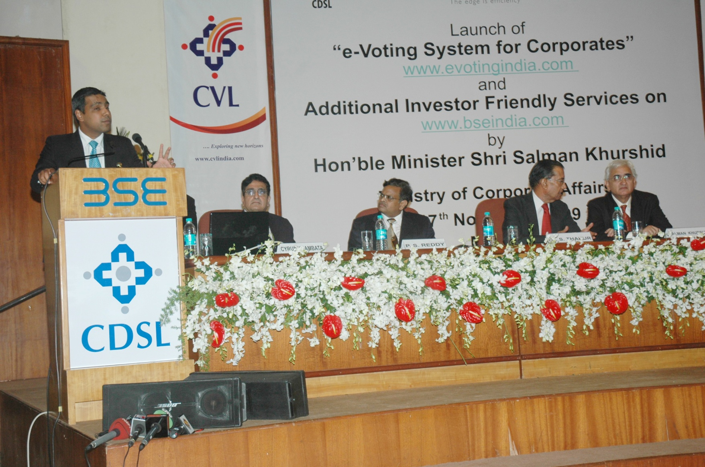
e-Voting System For Corporates
3

Slide 4
Scope of presentation
What is eVoting?
Why eVoting?
Scope
The Process
Who can Vote?
Controls in the system
Benefits - Company
Benefits - Shareholder

Slide 5

What is e-Voting?
Internet Based Facility
Enables investors to cast their votes any time any where
Automated system which records votes and gives results instantaneously.

Slide 6
Why e-Voting ?
Enhance Security Holder Participation
Ease of Administration
Big boost to Corporate Governance

Slide 7
The Companies (Passing of the Resolution by Postal Ballot) Rules, 2001
Rule 2(b):“Postal Ballot” includes voting by share holders by postal or electronic mode instead of voting personally by presenting for transacting businesses in a general meeting of the company,
MCA vide its Gazette notification dated May 30, 2011 under the Companies (Passing of Resolution by Postal Ballot) Rules, 2011 permits:
Sending of notices through electronic mail
Companies to permit voting by postal ballot or electronic mode
Follow procedure for voting by electronic mode as recommended by agency
MCA has approved CDSL for providing and supervising electronic platform for electronic voting.
MCA vide its circular dated April 21, 2011 clarified that service of documents through electronic mode should be considered as compliance with Sec. 53 of The Companies Act, provided that the companies have obtained email address of its members.

Slide 8

Scope
Postal Ballot
AGM
EGM
Other Meetings

Slide 9
The Process
Joining
Signing of Agreement
Setting up
Set-up e-Voting schedule
Upload Register of Members & password generation
Voting Process
Security holders login for voting
Dispatch of Notices along with passwords electronically and through post.
Counting of Votes & Declaration of Results
Data Storage
Creation of Corporate Login-ids
Upload of votes received through physical mode

Slide 10
Who can vote?
Physical Security Holders (Individual)
All Demat Security Holders (Individual)
All Individual Security Holders

Slide 11
Modes of voting
Internet
Postal Ballot
Terminals at Venue
Phase II
Telephone (IVR)
Mobile

Slide 12

Controls in the system
Secured Site- VeriSign Certified
BCP & DRS Compliant
Secured Access to investors using
  Key information known to the investor
  Password
No Modification of votes
Blocking/ unblocking of votes
Integrity of Data/Audit Trail Maintained

Slide 13
Benefits to Shareholder
Participate in the decision making process from anywhere
Can vote easily On any number of resolutions for any number of companies
No scope for invalid votes
Ease of voting – No pasting and posting
Ample time to vote – Till the last day
13

Slide 14
Benefits to Company
Results of Voting available immediately at the end of voting period.
Time saved
  Compilation of voting data
  Scrutinizing votes
Erroneous compilation eliminated
Cost saved

Slide 15
Cost - Benefit
Regular Mode | Cost (in Rs.) | eVoting | Cost
Dispatch of Notices by post @ Rs. 12 per post. (40500 * 12) | 4,86,000 | Dispatch of notices by e-mail @ Rs. 0.50 (0.50 * 40500) | 20,250
Receipt of Postal Ballot @ Rs. 5 per ballot assuming 10% shareholders vote (4050 * 5) | 20,250 | Receipt of Postal Ballot @ Rs. 5 per ballot assuming 10% shareholders vote (4050 * 2) | 8,100
The administrative cost for counting of votes and preparation of reports would also be saved.

Slide 16
Thank You
Moloy Biswas – Regional Manager – Kolkata – moloyb@cdslindia.com

