Slide 1
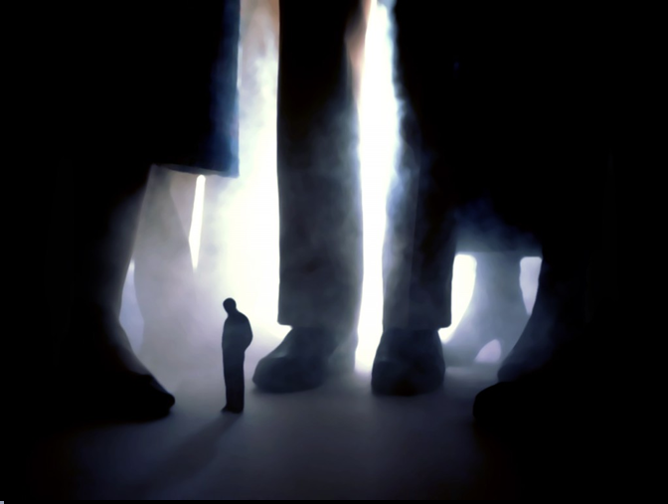
Don't compare yourself with any one in this world.
If you compare, you are insulting yourself.

Slide 2

No one will manufacture a lock without a key.
Similarly God won't give problems without solutions.

Slide 3

Life laughs at you when you are unhappy...
Life smiles at you when
you are happy...
Life salutes you when
you make others happy...

Slide 4

Every successful person has a painful story.
Every painful story has a successful ending.
Accept the pain and get ready for success.

Slide 5

Easy is to judge the mistakes of others.
Difficult is to recognize our own mistakes.
It is easier to protect your feet with slippers than to cover the earth with carpet.

Slide 6

No one can go back and change a bad beginning;
But anyone can start now and create a successful ending.

Slide 7

If a problem can be solved, no need to worry about it.
If a problem cannot be solved what is the use of worrying?

Slide 8

If you miss an opportunity don't fill the eyes with tears.
It will hide another better opportunity in front of you

Slide 9

"Changing the Face" can change nothing.
But "Facing the Change" can change everything.
Don't complain about others;
Change yourself if you want peace.

Slide 10

Mistakes are painful when they happen.
But year's later collection of mistakes is called experience, which leads to success.

Slide 11

Be bold when you loose
and be calm when you win.
Heated gold becomes ornament. Beaten copper becomes wires. Depleted
stone becomes statue. So the more pain you get in life you become more valuable.
JADA ‘08

