Slide 1



Slide 2

COMMUNICATION

Slide 3
What is Communication?
  Communication: The sharing of information ideas, experience, knowledge and feelings between two or more individuals or groups to reach a common understanding.

Slide 4
Importance of Communication
For connecting with others
Giving advice
Learning
Sharing values
For expressing our creativity
For expressing our life philosophy
Writing rules and laws
Selling goods and services

Slide 5
Means of communication
Devices used to send or receive messages is usually referred as means of communication
For examples
Letters
Telephone
News Papers
Internet

Slide 6
The Process of communication
Involving both receiving and giving messages ; and
Two-way method utilizing both spoken words and nonverbal messages
Communication
is a two-way
process

Slide 7
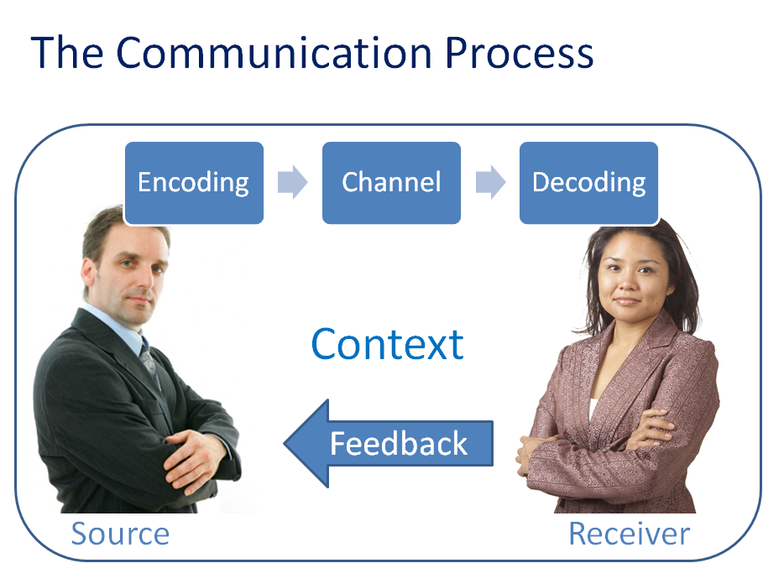
The Process of communication

Slide 8
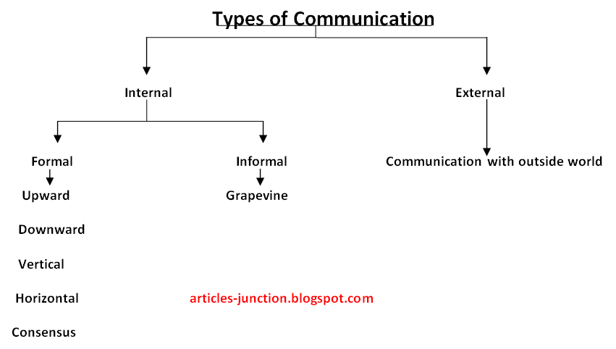
Forms of communication

Slide 9
Forms of communication
Formal:
Informal:
Established and agreed procedures – Memos, Letters , Circulars notices etc.
Channels not a formal recognised–‘the grapevine', gossip, Chitchat

Slide 10
Communication media
Media of communication
Verbal
Oral
Written
Non-verbal
Visual signs
Body Language
Sign Language
Audio signs

Slide 11
Verbal communication
Oral
One-On-One Conversion
Written
Memorandums
Meetings
Phone calls
Presentations
Video Conferences
Letters
E-Mails
Reports
Orders

Slide 12
Verbal communication

Slide 13

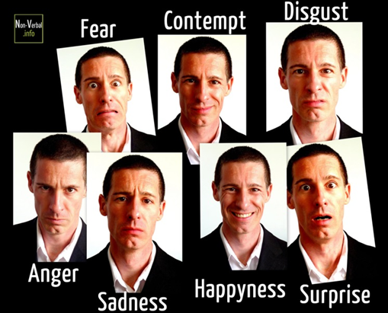
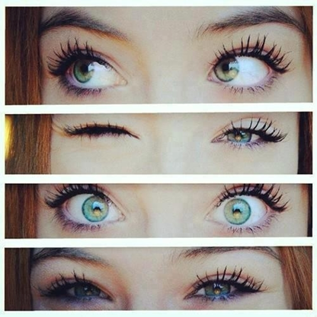
Non-Verbal communication
Effective communication is the combined harmony of verbal and non-verbal actions.
Non-verbal communication consists of body movement, facial expressions and eye movement.

Slide 14
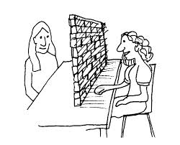
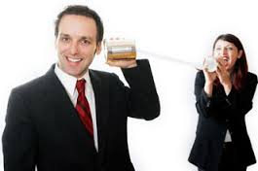
Barriers of communication
A communication of the message is successful only when both the sender and receiver perceive it in the same manner
It is very important to under stand the causes of communication breakdown

Slide 15



Slide 16


