Slide 1



Slide 2

My Views

Slide 3
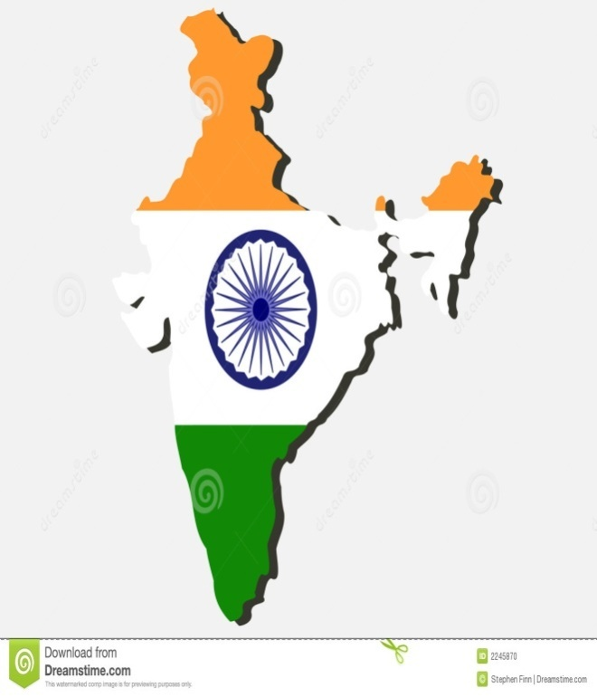
Democracy
Whistle Blowers
Emerging Leaders
Change in people thinking
SCAMS
Defence
Our Dignity
Smaller States
Nelson Mandela
NEW LAWS
(CSR)

Slide 4

Days have been passing ,yet an another year passed away with beautiful memories ,wonderful experiences , joyful moments.& Mind blowing facts
So
I decided to share my Thoughts as an Indian along with others……

Slide 5

During the year , I have observed a revolutionary change in people thinking in India and world as well
People started to revise their ideas once more during this year.
I agree I don’t have much experience or knowledge but I believe am a common man who can understand by reading a Three rupees news paper.

Slide 6
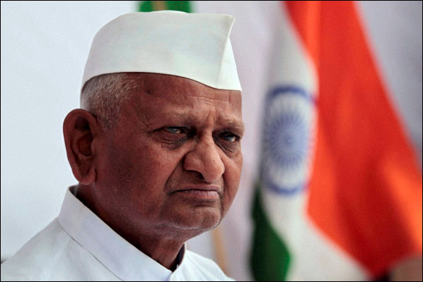
I have seen Anna hazare , the revolutionist fighting against Govt of India on various issues
A retired army person has attracted entire India attention with his ideas.
And did tremendous work for passing a 46 years making Loakpal bill

Slide 7
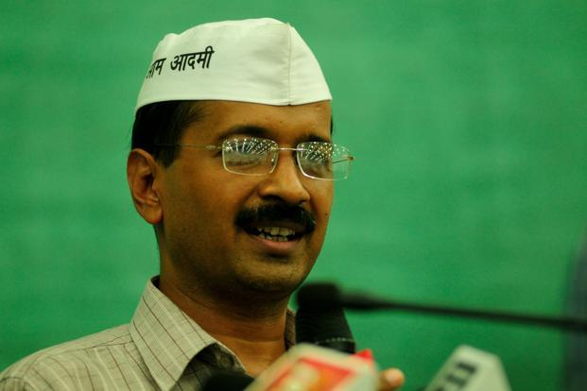
It was once again proved the true democracy meaning in India , a common man form Delhi without any political experience or rich wealth started a new party ,and won a major seats in Delhi ruling out Two national parties and gave a hope to Indians that there are some whom they can believe .
My sincere congrats to him.

Slide 8
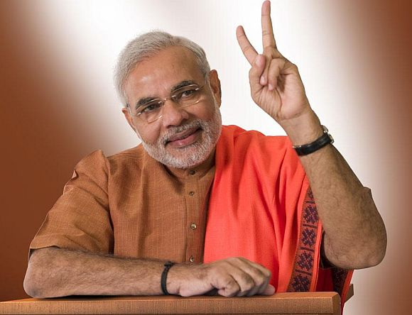
I have seen an emerging leader from Gujarat who created hope among all Indians that he can lead the country in a good manner i.e Modi
Salute to his idea of constructing a worlds tallest Sardar statue as a symbol of unity
My sincere all the best to him
I think he is the man of time

Slide 9
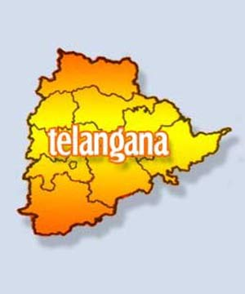
Hoping a better day , I observed people fighting for smaller states for better Governance .
A lot of Discussions , Difference in opinions ,at lost political parties created mess than benefits to common man
At last all the industries had a negative impact of this issue.

Slide 10
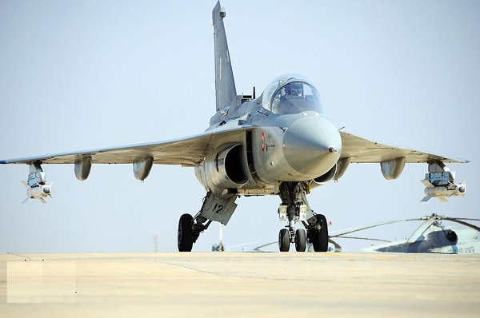
Indian Govt spending huge exp on defense related matters as threat form our neighboring countries .
I have seen India army saying bye bye to foreign built MIG war craft to welcoming self built Teja craft
Hope it will help us in the times of mot need

Slide 11
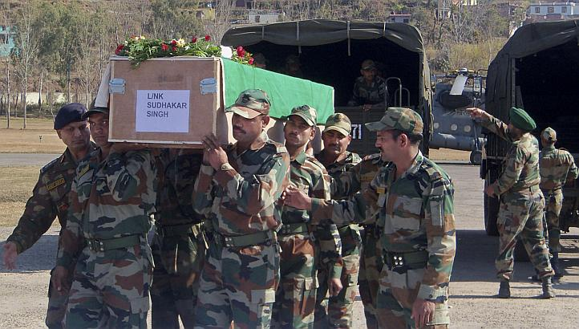
People to whom entire India owes are at difficult times. They wakes up at night to protect us . They stays in Rough weather sacrificing every thing .
But I can say only sorry to their families ,Pakistani terrorists cutting their heads but un fortunately my elected representatives have taken no action,
At least this time I elect a better leader to safe guard them

Slide 12
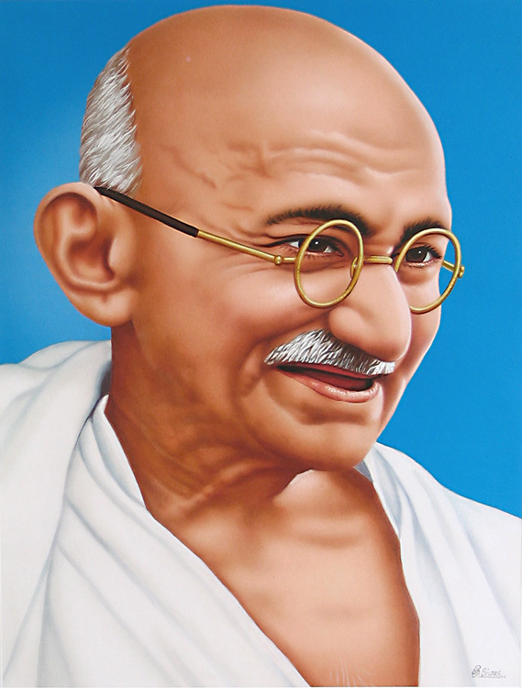
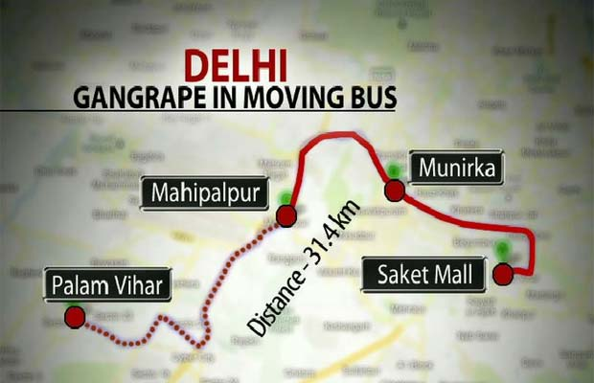
Once Nation father Gandhi said :The real independence comes only when a women walks in streets with out any fear in the mid night.
Thanks to Godsay who killed him, other wise Gandhi might not have the capability to digest all these things.
Women has lost faith , People who meant to protect them it self taking undue advantage
As an Indian ,I will take responsibility of not to tease any girl.
Lets respect them.

Slide 13
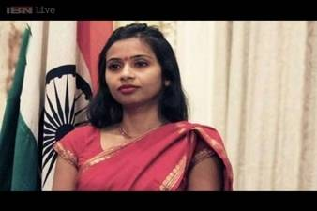
Our dignity
We belive in sentence from epics
Athidhi dhevo Bhava
We believed in this from histories & we are giving utmost respect other nations Representatives in our country.
but what happened to our Representatives working in Other countries.
Who is US to ill Treat my nation Representative ???
What is my external affairs ministry is doing ???
I believe “Country pride does not depends on nations GDP , or HDI, it truly depends on Respect it gets from other nations “

Slide 14
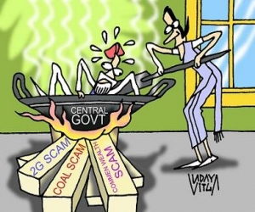
I have seen Indians not knowing about PM name ,but I have never seen any India not knowing about 4 letter word.(SCAM)
Every month one new SCAM & every scam involves Lakhs of crores.
Every employee who is working day & Night for his salary was attracted by TDS , every good he purchases he is paying Indirect taxes , For every service he is paying Service Tax
What is happening to all this money…
Don’t worry my friends they are safe in SWISS Banks
At least this time I hope my representatives wont waste the money

Slide 15

New companies act 2013 brought a new concept of spending 2% of net profit for the society. Popularly known as CSR.
It also brought a better governance features
Thanks to GOVT of INDIA for making this happen.

Slide 16
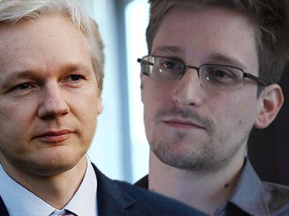
Here comes the hero's of the world who clearly depicted the original character of so called most coward powerful nation which traps all the emails around the world without any …………
Thanks to Edward snowden and Julian Assange for opening the eye of many nations
My heartful thanks to both of them

Slide 17
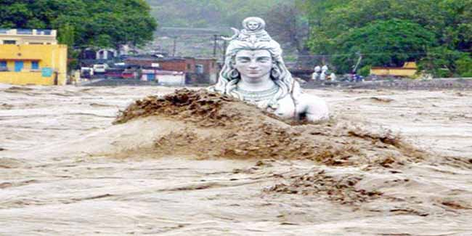
Kedarnath –A historical religious place in India had seen a worst night mare .
Floods washed away every thing many peoples lives are at risk.
Thanks to Indian army for saving their lives and my sincere tributes to those who lost their lives in saving them.

Slide 18
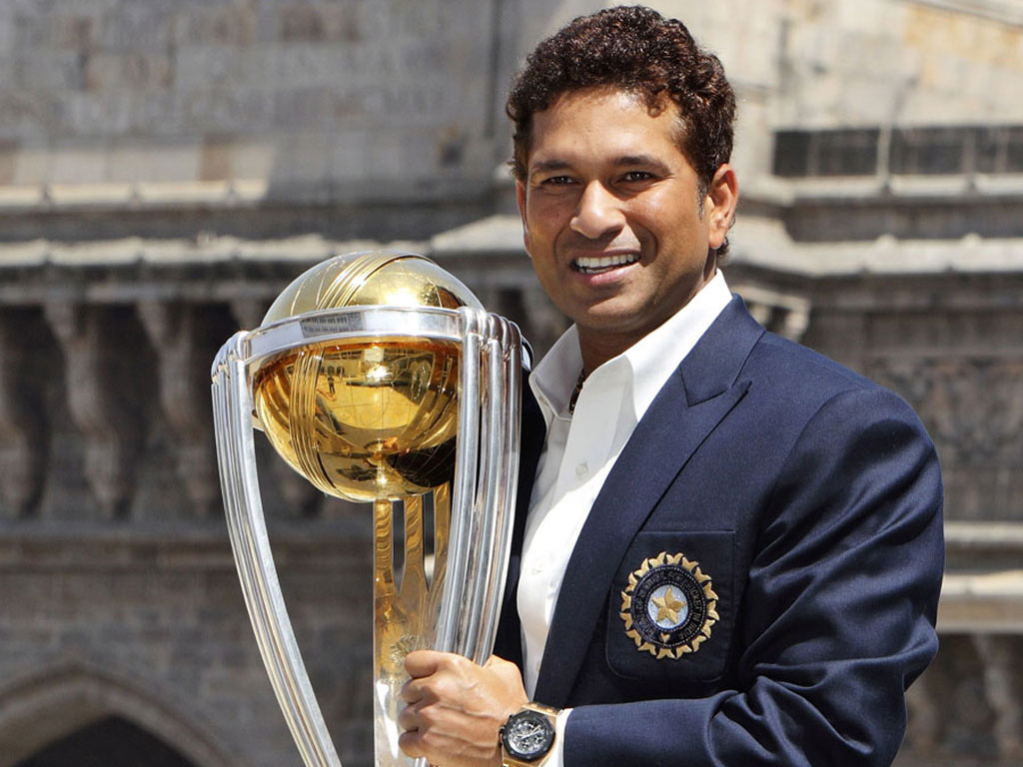
“He might have taken retirement from game but not from our hearts ”
is the most popular dialogue of 2013.
Hats off to the person who brought glory to India cricket

Slide 19
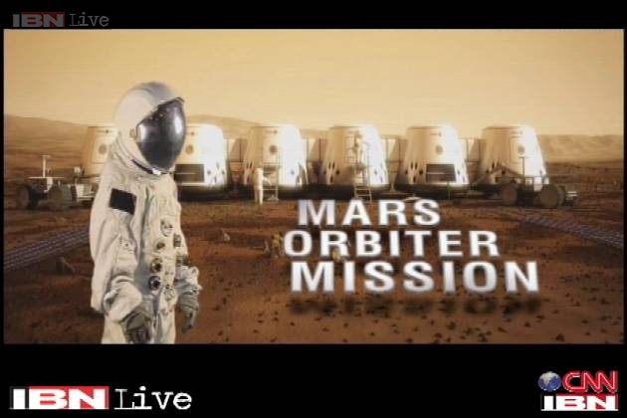
ISRO-Indian Space research organization
ISRO has launched first Mars orbiter mission on 2013 in space .
As per ISRO , The funds allocate by Govt of India are Not sufficient
Hope Govt of India transfers the money from SCAM Head to ISRO Head.

Slide 20

FDI-in Retail Trade
Once white people came to India for trade ,then slowly they entered in to political matters later they conquered India.
I hope we didn’t learn much from history. FDI In retail trade –a disaster.
What will happen to Street vendors and weekend market sellers.

Slide 21
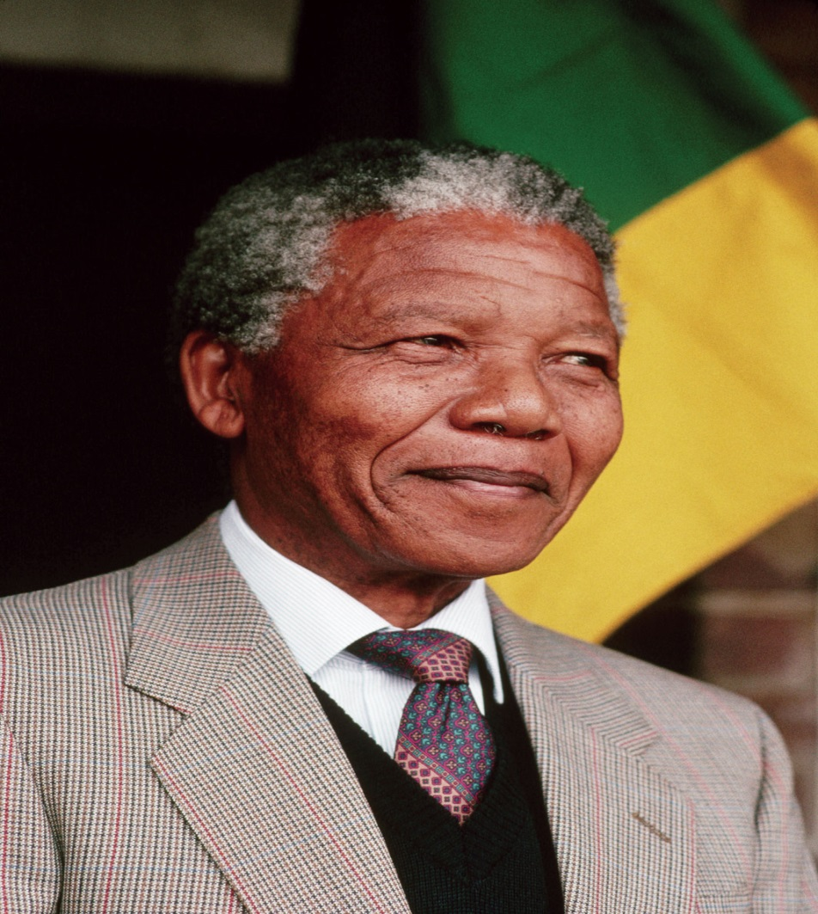
A noble literate who fought against white for the rights of black in south Africa is no more ..Nelson Mandela
But his ideas will be with us for ever
Lets pray for his soul for one second

Slide 22
Till now we have discussed about India
Lets see the opinions of few young Indians who gonna vote for 2014 Elections for the first time

Slide 23
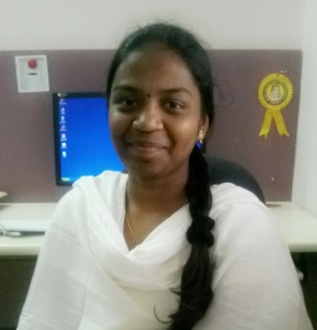
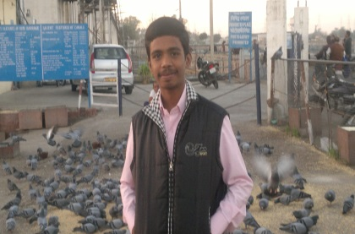
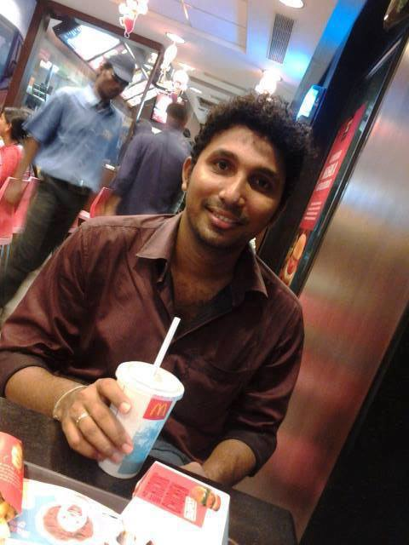
“ India should develop strict law for those who commits crimes against women ”-Moulika
“India has been a developing economy for Years ,at least before 2020 we should call it as developed economy” -Sai Rajendhra
“As Indians after studies lets stay in india & lets develop our country .Dont run to foreign countries” - Jaya praksh

Slide 24
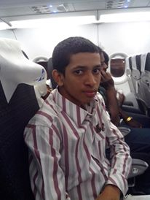
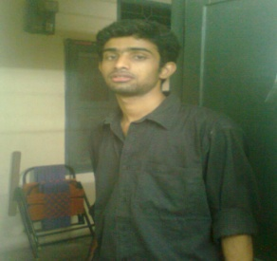

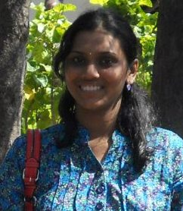
“India should have been aggressive with neighboring countries like Border dispute with china ” - Abhilash
“Educated people should come out & help the poor people ” -John
“Infrastructure woith reagrds to Communication should be given priority” -Nandini
“ Intelligent tracking devises should be installed in all kinds of pvt Transport to safeguard women” - Sindhu

Slide 25
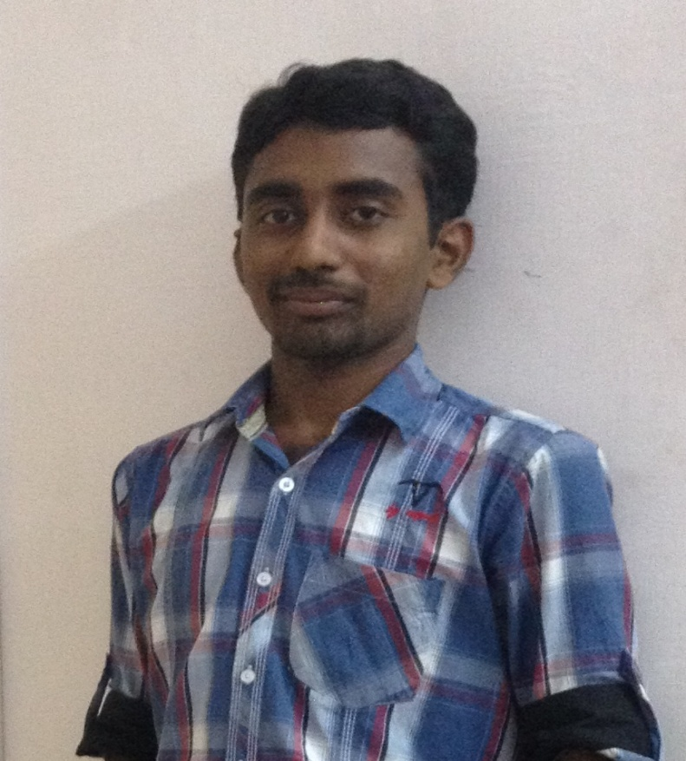
Thanks for Reading this Presentation patiently
Hope it will be useful to you.
JAI HINDH
Please give me your feedback
Regards
Chilukuri Raghavendhra Reddy
Currently pursing CA Articleship-2ND Year
Mail :raghu.royals@gmail.com
Face book :https://www.facebook.com/raghavendhra.reddy.7

