Slide 1
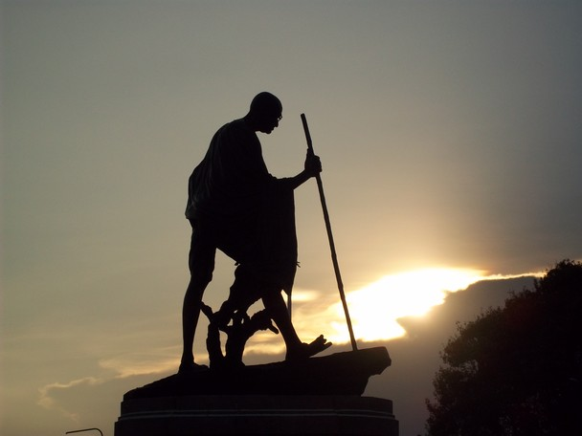
Leaders are real architect of success

Slide 2

Overview
Introduction
Leadership
Types
Qualities
Traits
Attributes
Lack of Leadership
Conclusion

Slide 3

Whom do you think is a Leader ?
Leader is one who leads or commands a country, organization or a group of people towards the achievement of goals.
Basic Requirements to be a Leader :
one who goes first and leads, so that others are motivated to follow him.

Slide 4
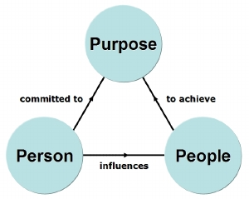
How the Goal is Achieved ?

Slide 5
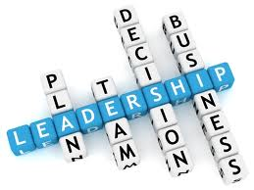
Leadership ?
Leadership means activity or ability of leading a group of people or organization for achievement of goals.
Leadership Involves :
1. Establishing a clear vision.
2. Sharing that vision so that others should follow.
3. Providing the information and methods to realize that
vision.
4. Coordinating and balancing the interests of all members
and stakeholders.

Slide 6

Types of Leadership
Autocratic
Participative
Laissez Faire

Slide 7
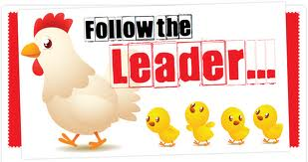
Qualities of Leaders
Integrity
Ability to truly listen
Ability to communicate
Initiative
Enthusiasm

Slide 8
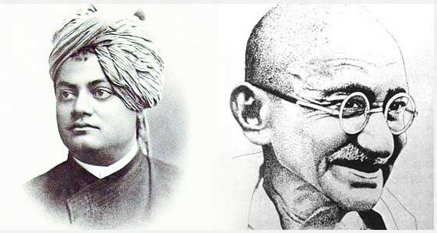
Traits of a Good Leader
Honest
Competent
Forward looking
Inspiring
Intelligent
Fair minded
Courageous
Imaginative

Slide 9

Attributes of a Leader
Be in touch.
Hone your communication skill.
Lead people where they want to go.
Inspire teams.
Sharpen your decision-making skills.

Slide 10
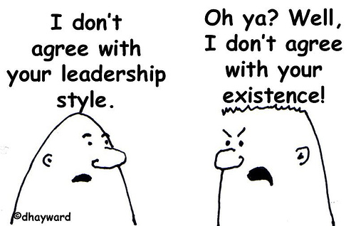
Lack of Leadership
Misunderstanding Your Role
Lack of Feedback
Being Too Friendly
Failing to Define Goals
Not Making time for your Team

Slide 11
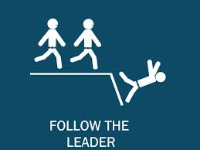

Slide 12
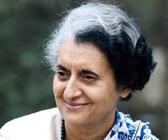
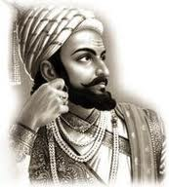
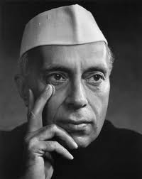
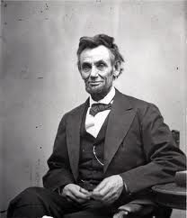
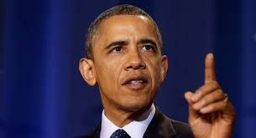
Some of the great leaders

Slide 13
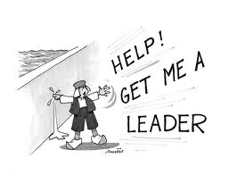

Slide 14
Some of the Famous Quotes
“As a Leader, it’s a major responsibility on your shoulders to practice the behavior you want others to follow”
“If the blind lead the blind, both shall fall in the ditch”
“You cannot be a leader, and ask other people to follow you, unless you know how to follow, too”

Slide 15


